Slide 1
Auto-qPCR
A R-Shinny App
By Mitchell Kendzel

Slide 2
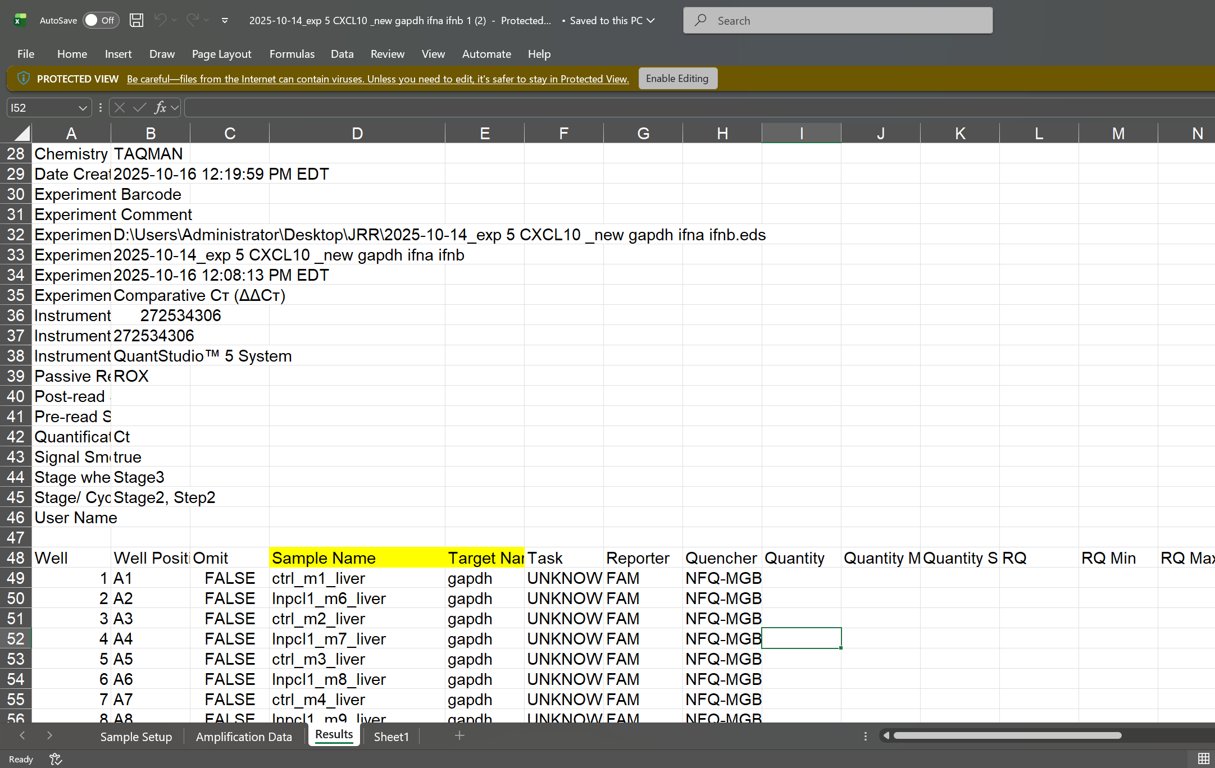
Raw PCR machine readings
<- Meta Data information
<- Sample information
(what we need for analysis)

Slide 3

Sample Name & Target Name Variables
Sample Name format:
#_x_y_z
Where:
#, is a unique number to identify a single sample, Sample ID
x, y, z, are potential grouping variables, ranging from treatment, tissue, timepoints

Slide 4

Naming Example 1
Example 1: Experiment with 3 treatments, 1 sample per dish
Mock
Treatment 1
Treatment 2
#1
#3
#5
#2
#4
#6
Example 1 (#_x_y_z naming convention)
6 unique samples
3 individual treatments
Names: 1_mock, 2_mock, 3_treatment1, 4_treatment1, 5_treatment2, 6_treatment2

Slide 5

Naming Example 2
Example 2: Experiment with 2 treatments, 2 sample per animal
Example 2 (#_x_y_z naming convention)
4 unique individuals
2 individual treatments
2 samples per individual (based on tissue for this example)
Names: 1_mock_lung, 1_mock_spleen, 2_mock_lung, 2_mock_spleen, 3_treatment_lung, 3_treatment_spleen… etc.
Mock
Treatment
Lung
Lung
#1
spleen
#3
spleen
#2
Lung
Lung
#4
spleen
spleen

Slide 6
Most important considerations for naming
The unique number, Sample ID, should equal the number of plates, mouse, or other sampled “individuals”.
It identifies each individual and only applies to that individual

Slide 7
Setting up the App

Slide 8
Install R and Rstudio
https://posit.co/download/rstudio-desktop/
Works on R version 4.5.x

Slide 9
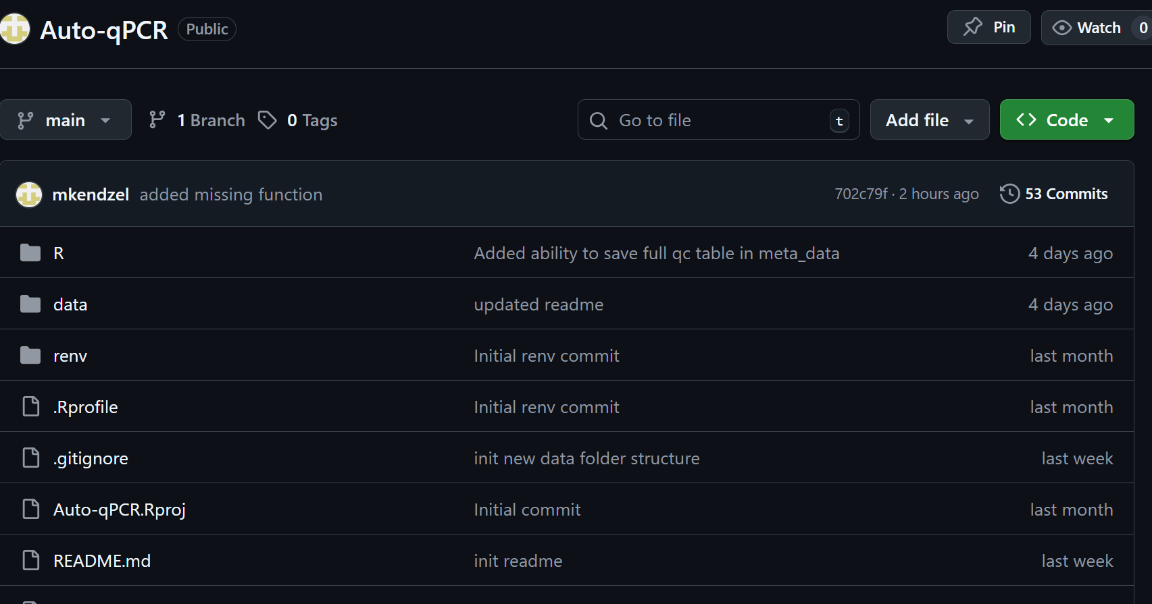
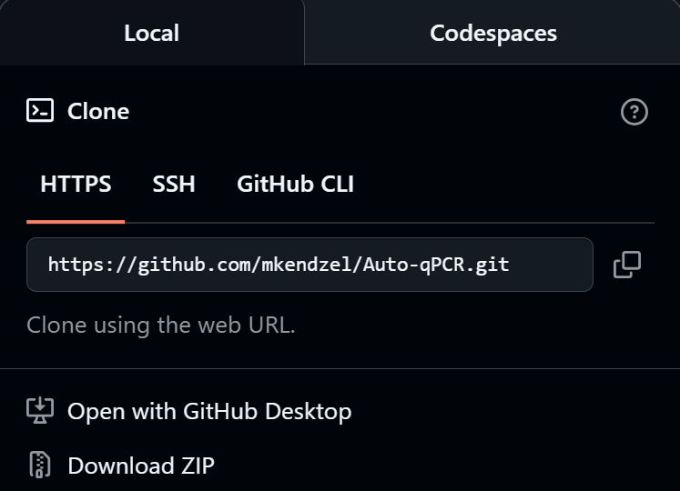

https://github.com/mkendzel/Auto-qPCR
Go to GitHub and download the app

Slide 10
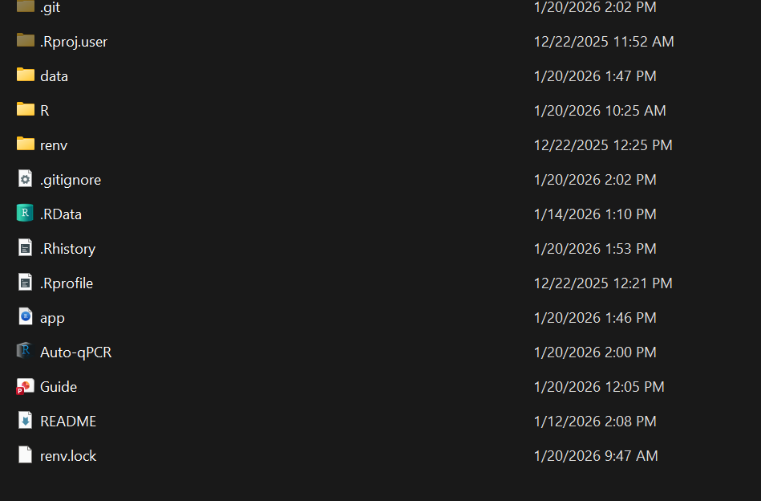
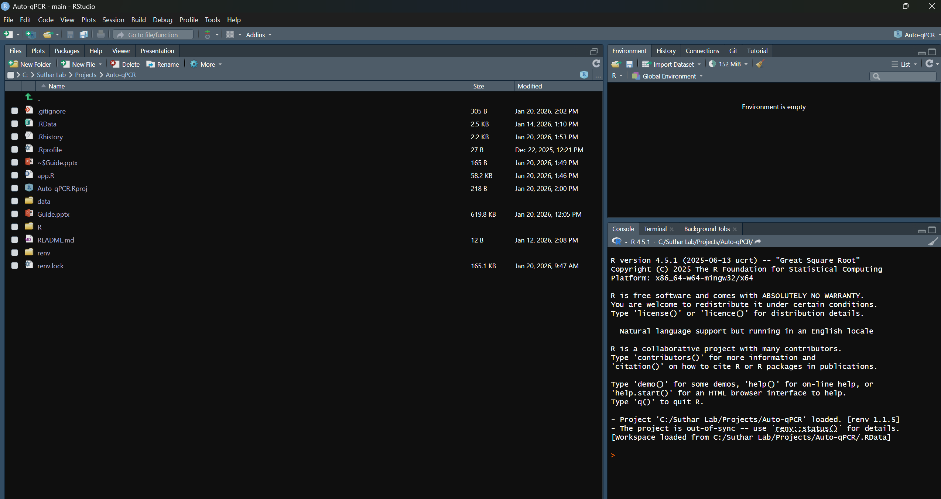
Launch the app from the folder
Extract the downloaded folder
Then open and click “Auto-qPCR”
A new Rstudio window will open up.
Click “app.R” in RStudio

Slide 11
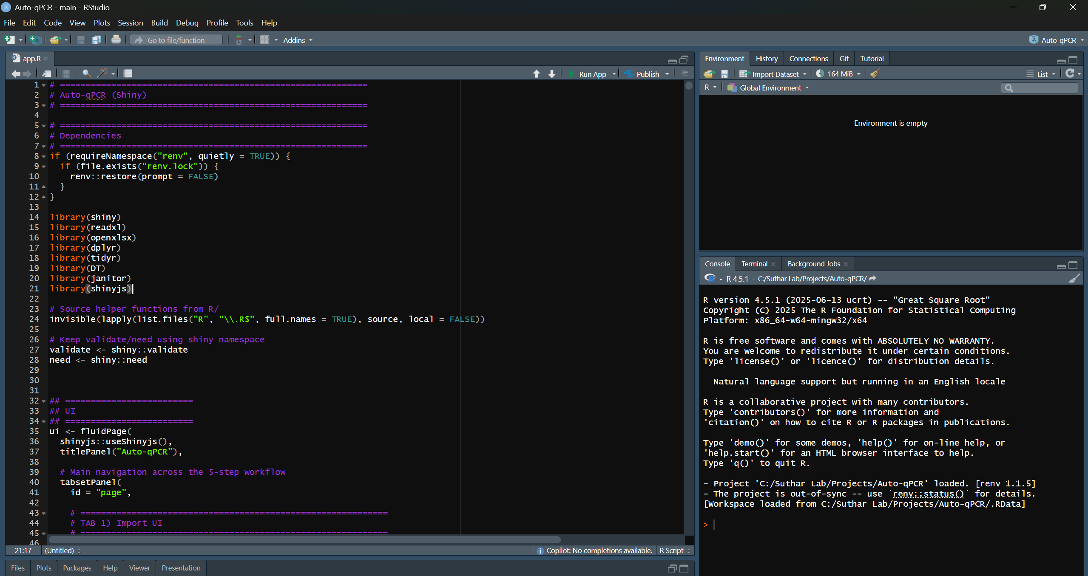
Your Rstudio will look similar. Now click Run app

Slide 12
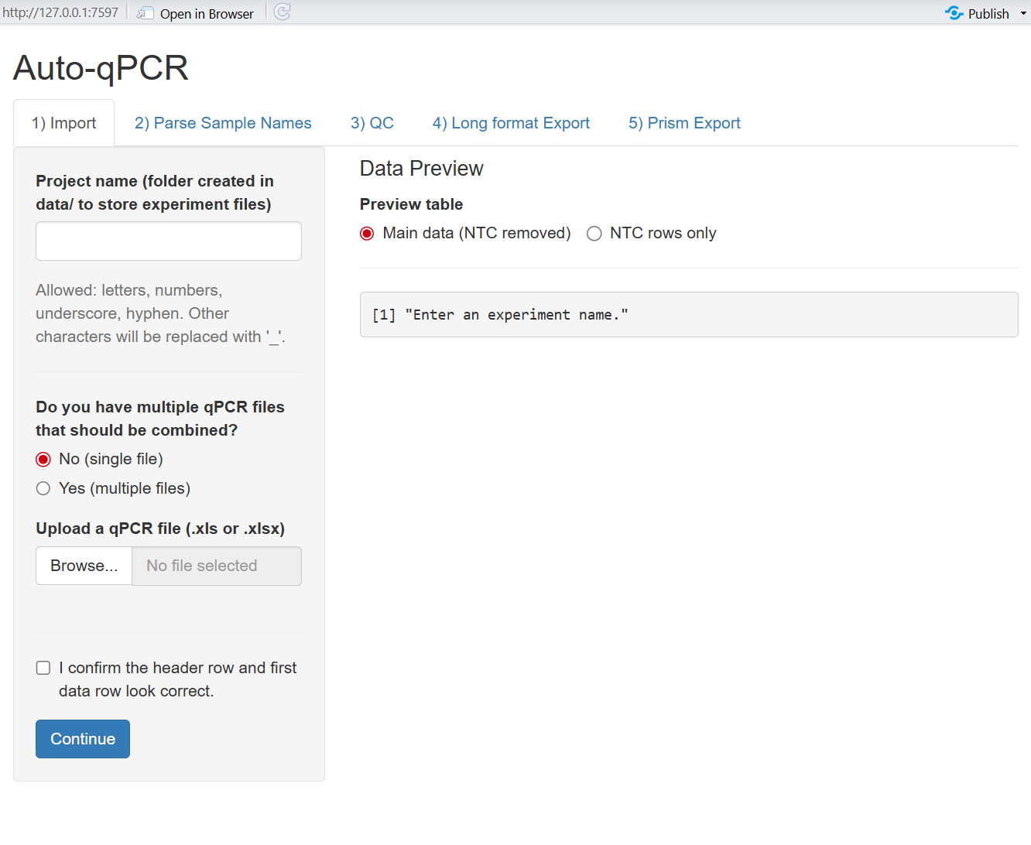
Congratulations! You opened the app
Launching the app for the first time may take some time. It is installing important packages for it to work. This should only happen the first time the app is opened.

