Slide 1
TMATH390B Autumn 2019
Wednesday Sep 25
Introductions, Canvas, Syllabus
Lecture 1: Intro to Stats
Important upcoming deadlines:
First day survey: Friday Sep 27
HW0 Friday Sep 27
Quiz 1 Wednesday Oct 2 (in class, Lectures 1-2)
HW1, R Lab 1 Friday Oct 4 (Canvas)

Slide 2
Quick Bio (Maureen Kennedy)
Quantitative Ecology and Resource Management (QERM!) UW Seattle interdisciplinary graduate program
Started at UWT in Autumn 2015
Conduct research with the Fire and Environmental Research Applications at the Pacific Wildland Fire Sciences Laboratory (US Forest Service Science Lab, Seattle), and with an interdisciplinary environmental science research group out of UCSB
Focus on fire modeling, and analysis of wildfire data sets including fuel treatment effectiveness during wildfire and remotely sensed burn severity

Slide 3
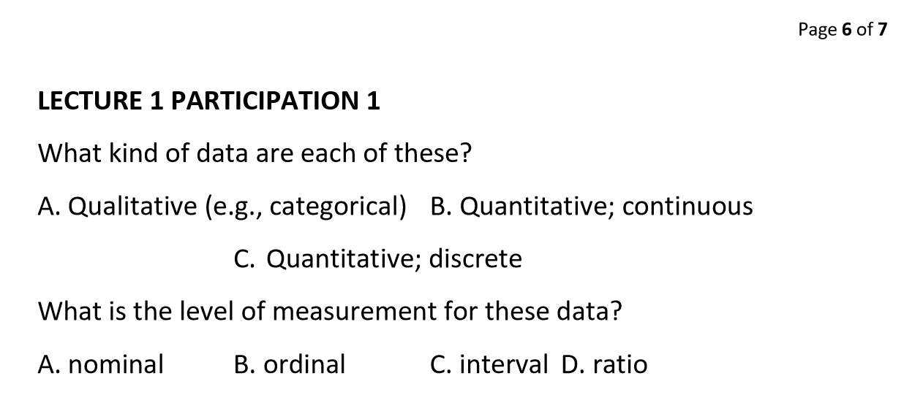
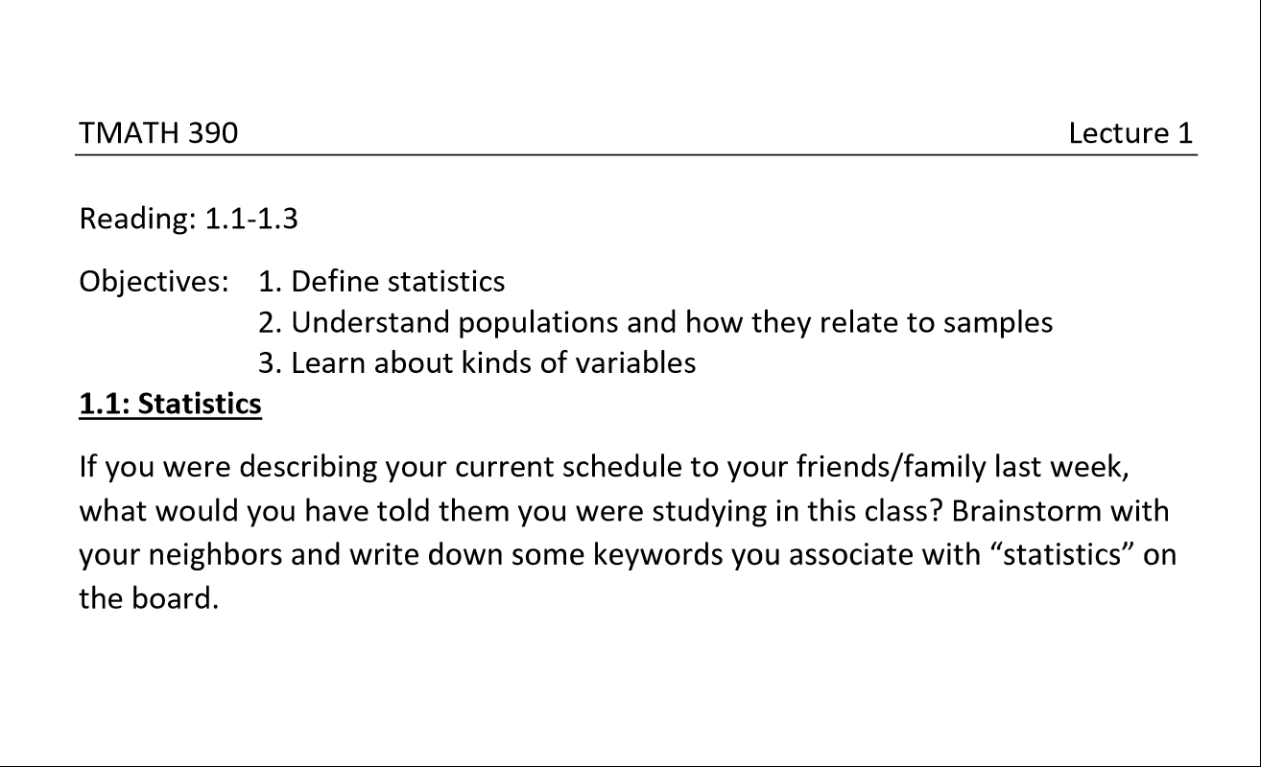
Class structure
Lecture outlines posted on Canvas
In-lecture participation exercises (5%)
Solutions posted to Canvas
Participation assignment—upload proof of completion for participation credit, or certify completion on spreadhseet
NO LATE PENALTY for participation! Final date for submission is day of final exam
Random call
Online lectures
Drop1
Canvas homework “Quizzes” (15%)
3 tries
Drop 1
Weekly in-class quizzes (Wednesdays) (10%)
No notes
Drop 1
R computer labs (15%)
On your own (home computer or TLC)
Drop 1
3 exams (55%)
1 page of notes handwritten, front and back, calculator

Slide 4
TMATH390B Autumn 2019
Monday Sep 30
Lecture 1 Poll EV
Lecture 2: Probability
Important upcoming deadlines:
Quiz 1 Wednesday Oct 2 (in class, Lectures 1-2)
HW1, R Lab 1 Friday Oct 4 (Canvas)
Next time:
Lecture 3 (distributions, density and mass functions)

Slide 5
TMATH390B Autumn 2019
Wednesday Oct 2
Finish Lecture 2 (5.1-5.4)
Lecture 3: Distributions, density and mass functions (1.3)
Important upcoming deadlines:
Quiz 1 TODAY (in class, Lectures 1-2)
HW1, R Lab 1 Friday Oct 4 (Canvas) *Move to Sunday?
Watch lecture 4 on your own! Empirical distributions and summaries
Next time:
Finish Lecture 3 (1.3)
Lecture 4 (2.1-2.2) activities, Lecture 5 (2.3)(boxplots)

Slide 6
TMATH390B Autumn 2019
Monday October 7
Finish lecture 3
Lecture 4 (2.1-2.2) activities
Important upcoming deadlines:
Quiz 2 Wednesday Oct 9 (in class, Lectures 2-4)
HW2, R Lab 2 Friday Oct 11 Sunday Oct 13 (Canvas)
Coming up:
Lecture 5 (2.3) (boxplots)
Lecture 6 (2.1, 2.2) (expected value and variance)
Climate survey launch party!
Tuesday, October 8, 12:30 - 1:30 on the Ground Floor of TPS
Tuesday, October 8, 12:30 -1:30 in the Dawg House on the First Floor of Mattress Factory
Tuesday, October 8, 4:00 - 5:30 in the Dawg House on the First Floor of Mattress Factory

Slide 7
TMATH390B Autumn 2019
Wednesday October 9
Lecture 4 activities
Lecture 5 (2.3) (boxplots)
Important upcoming deadlines:
Quiz 2 Today! (in class, Lectures 2-3)
HW2, R Lab 2 Sunday Oct 13 (Canvas)
Coming up:
Lecture 6 (2.1, 2.2) (expected value and variance)
Lecture 7 (1.4) (normal probability distribution)

Slide 8
TMATH390B Autumn 2019
Monday October 14
Lecture 6: Expected value and variance
Important upcoming deadlines:
Quiz 3 Wednesday! (in class, Lectures 5-6)
HW3, R Lab 3 Sunday Oct 20 (Canvas)
Coming up:
Finish Lecture 6
Lecture 7 (normal probability distribution)
Exam 1 Monday Oct 21. Covers lectures 1-6

Slide 9
TMATH390B Autumn 2019
Wednesday October 16
Lecture 7: Normal Distribution
Important upcoming deadlines:
Quiz 3 TODAY! (in class, Lectures 5-6)
HW3, R Lab 3 Sunday Oct 20 (Canvas)
Coming up:
Exam 1 Monday Oct 21. Covers lectures 1-6
One 8.5x11” page of notes, handwritten, front and back. Calculator. Full class time
Lecture 7, 8 next Wednesday Quiz 4 next Wednesday covers lecture 7

Slide 10
TMATH390B Autumn 2019
Wednesday October 23
Lecture 7 (1.4): Normal Distribution
Lecture 8 (1.5,1.6): Other distributions
Important upcoming deadlines:
HW4, R Lab 4 Sunday Oct 27 (Canvas)
Coming up:
Lecture 8 (1.5,1.6)
Lecture 9 (1.5): χ², F distributions (watch video on your own!)
Lecture 10 (5.5,5.6): Sampling distributions

Slide 11
TMATH390B Autumn 2019
Monday October 28
Lecture 8 (1.5,1.6): Other distributions
Important upcoming deadlines:
HW5, R Lab 5 Sunday Nov 3 (Canvas)
Docs up on Canvas, quiz forthcoming
Quiz Wednesday will be on Lectues 7-8 (normal and other theoretical distributions)
Coming up:
Lecture 9 (1.5): χ², F distributions (watch video on your own!)
Lecture 10 (5.5,5.6): Sampling distributions

Slide 12
TMATH390B Autumn 2019
Wednesday October 30
Lecture 9 (1.5): χ², F distributions (watch video on your own!)
Lecture 10 (5.5,5.6): Sampling distributions
Quiz 4 (important probability distributions)
Important upcoming deadlines:
HW5, R Lab 5 Sunday Nov 3 (Canvas)
Coming up:
Lecture 11 (2.4) Video on your own
Lecture 12 (7.1, 7.2): Estimation

Slide 13
TMATH390B Autumn 2019
Monday November 4
Finish Lecture 10 (sampling distributions)
Lecture 11 Video on your own (need it for R lab 6)
Lecture 12: Estimation
Important upcoming deadlines:
HW6, R Lab 6 Sunday Nov 10 (Canvas)
Quiz 5. Covers Lecture 10
Coming up:
Exam 2. Wednesday November 13 (through this Wednesday’s material, likely Lecture 12 (confidence intervals)
Finish lecture 12
Lecture 13: t-distribution
Lecture 14: 2-sample estimation

Slide 14
TMATH390B Autumn 2019
Wednesday November 6
Lecture 11 Video on your own (need it for R lab 6)
Lecture 12: Estimation
Quiz 5. Covers Lecture 10
Important upcoming deadlines:
HW6, R Lab 6 Sunday Nov 10 (Canvas)
Coming up:
Exam 2. Wednesday November 13 (through Lecture 11)
Monday after Exam 2:
Finish lecture 12
Lecture 13: t-distribution
Lecture 14: 2-sample estimation

Slide 15
TMATH390B Autumn 2019
Monday November 18
Lecture 12: Estimation
Lecture 13: t-distribution
Quiz 6. Lectures 12 & 13
Important upcoming deadlines:
HW7, R Lab 8 Sunday Nov 24 (Canvas)
Coming up:
Julie Eaton substitute: Exercise on CI’s, quiz covering lectures 12 and 13
Lecture 14: 2-sample estimation

Slide 16
TMATH390B Autumn 2019
Wednesday November 20
Exercise on CI’s
Quiz 6. Covers Lectures 12-13
Important upcoming deadlines:
HW7, R Lab 8 Sunday Nov 24 (Canvas)
Coming up:
Lecture 14: 2-sample estimation
Lecture 15: Inference and hypothesis testing

Slide 17
TMATH390B Autumn 2019
Monday November 25
Lecture 14 2 sample estimation
Important upcoming deadlines:
Quiz 7. Lectures 13 & 14
HW8, R Lab 9 Tuesday Dec 3 (Canvas)
Coming up:
Lecture 15: Hypothesis testing
Lecture 16: Correlation and Regression

Slide 18
TMATH390B Autumn 2019
Wednesday November 27
Lecture 15 Hypothesis testing
Quiz 7. Lectures 13 & 14
Important upcoming deadlines:
HW8, R Lab 9 Tuesday Dec 3 (Canvas)
Coming up:
Lecture 15: Hypothesis testing
Lecture 16: Correlation and Regression

Slide 19
TMATH390B Autumn 2019
Monday Dec 2
Finish Lecture 15 Hypothesis testing
Start Lecture 16: Regression
Important upcoming deadlines:
HW8, R Lab 9 Tuesday Dec 3 (Canvas)
HW9, R Lab 10 Sunday Dec 8 (Canvas)
Participation!
Final exam Monday Dec 9—through lecture 16
NO quiz Wednesday! Voluntary quiz Friday
Coming up:
Lecture 16: Correlation and Regression
Final topics list

Slide 20
TMATH390B Autumn 2019
Wednesday Dec 4
Lecture 16: Regression
Course Evaluations
Important upcoming deadlines:
HW9, R Lab 10 Sunday Dec 8 (Canvas)
Voluntary Quiz 9
Friday Dec 6, 10:30-10:50am, 2:40-3pm
Office hours Friday (11-12, in my office), usual time Monday (in TLC). Or make an appointment for Friday
Final Exam Monday Dec 9.
Through Lecture 16, emphasizing lectures 12-16
1 page of notes, handwritten, front and back and calculator
Participation! You can still take pictures of completed lecture participation exercises and get credit!

