Slide 1
TMATH390B Autumn 2019
Wednesday Sep 25
Introductions, Canvas, Syllabus
Lecture 1: Intro to Stats
Important upcoming deadlines:
First day survey: Friday Sep 27
HW0 Friday Sep 27
Quiz 1 Wednesday Oct 2 (in class, Lectures 1-2)
HW1, R Lab 1 Friday Oct 4 (Canvas)

Slide 2
Quick Bio (Maureen Kennedy)
Quantitative Ecology and Resource Management (QERM!) UW Seattle interdisciplinary graduate program
Started at UWT in Autumn 2015
Conduct research with the Fire and Environmental Research Applications at the Pacific Wildland Fire Sciences Laboratory (US Forest Service Science Lab, Seattle), and with an interdisciplinary environmental science research group out of UCSB
Focus on fire modeling, and analysis of wildfire data sets including fuel treatment effectiveness during wildfire and remotely sensed burn severity

Slide 3
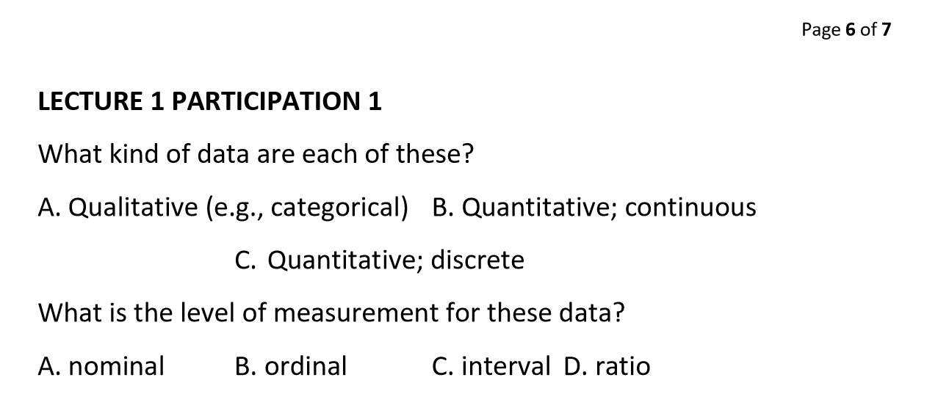
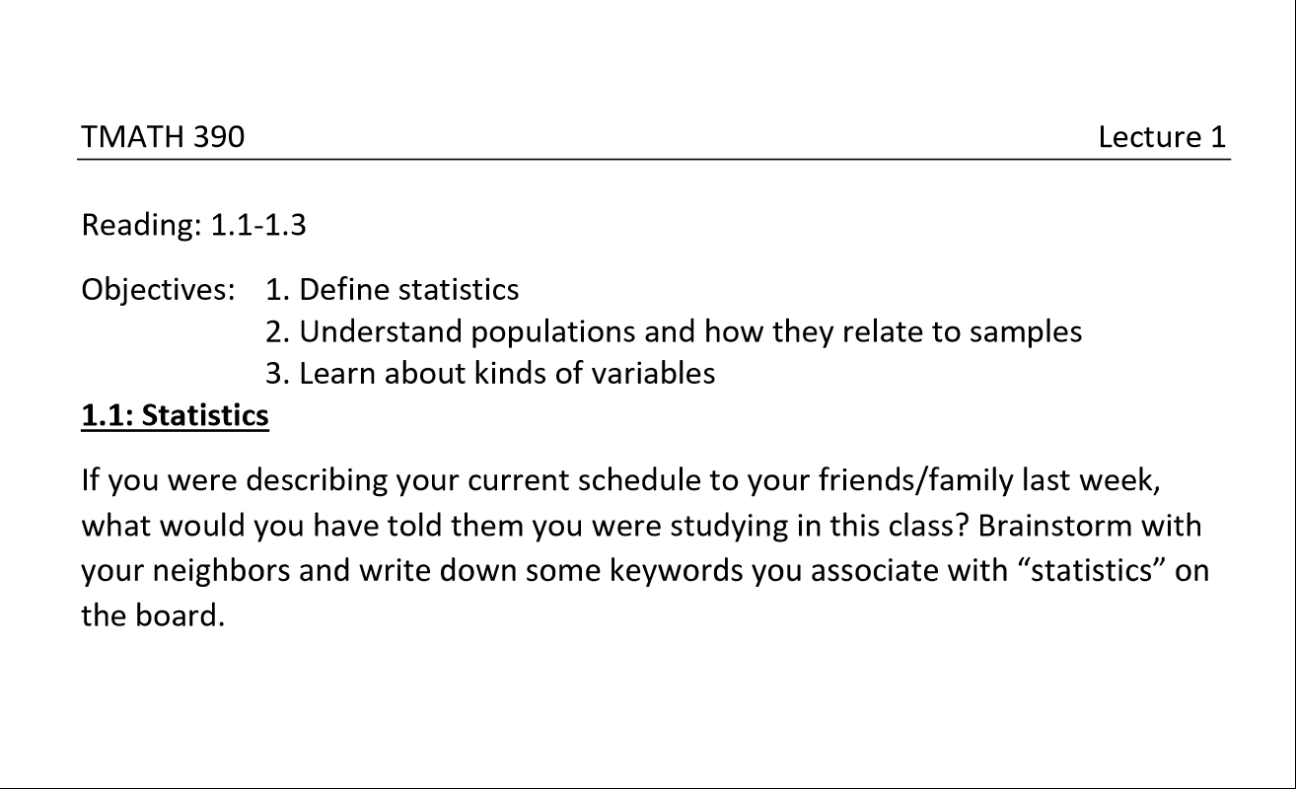
Class structure
Lecture outlines posted on Canvas
In-lecture participation exercises (5%)
Solutions posted to Canvas
Participation assignment—upload proof of completion for participation credit, or certify completion on spreadhseet
NO LATE PENALTY for participation! Final date for submission is day of final exam
Random call
Online lectures
Drop1
Canvas homework “Quizzes” (15%)
3 tries
Drop 1
Weekly in-class quizzes (Wednesdays) (10%)
No notes
Drop 1
R computer labs (15%)
On your own (home computer or TLC)
Drop 1
3 exams (55%)
1 page of notes handwritten, front and back, calculator

Slide 4
TMATH390B Autumn 2019
Monday Sep 30
Lecture 1 Poll EV
Lecture 2: Probability
Important upcoming deadlines:
Quiz 1 Wednesday Oct 2 (in class, Lectures 1-2)
HW1, R Lab 1 Friday Oct 4 (Canvas)
Next time:
Lecture 3 (distributions, density and mass functions)

Slide 5
TMATH390B Autumn 2019
Wednesday Oct 2
Finish Lecture 2 (5.1-5.4)
Lecture 3: Distributions, density and mass functions (1.3)
Important upcoming deadlines:
Quiz 1 TODAY (in class, Lectures 1-2)
HW1, R Lab 1 Friday Oct 4 (Canvas) *Move to Sunday?
Watch lecture 4 on your own! Empirical distributions and summaries
Next time:
Finish Lecture 3 (1.3)
Lecture 4 (2.1-2.2) activities, Lecture 5 (2.3)(boxplots)

Slide 6
TMATH390B Autumn 2019
Monday October 7
Finish lecture 3
Lecture 4 (2.1-2.2) activities
Important upcoming deadlines:
Quiz 2 Wednesday Oct 9 (in class, Lectures 2-4)
HW2, R Lab 2 Friday Oct 11 Sunday Oct 13 (Canvas)
Coming up:
Lecture 5 (2.3) (boxplots)
Lecture 6 (2.1, 2.2) (expected value and variance)
Climate survey launch party!
Tuesday, October 8, 12:30 - 1:30 on the Ground Floor of TPS
Tuesday, October 8, 12:30 -1:30 in the Dawg House on the First Floor of Mattress Factory
Tuesday, October 8, 4:00 - 5:30 in the Dawg House on the First Floor of Mattress Factory

Slide 7
TMATH390B Autumn 2019
Wednesday October 9
Lecture 4 activities
Lecture 5 (2.3) (boxplots)
Important upcoming deadlines:
Quiz 2 Today! (in class, Lectures 2-3)
HW2, R Lab 2 Sunday Oct 13 (Canvas)
Coming up:
Lecture 6 (2.1, 2.2) (expected value and variance)
Lecture 7 (1.4) (normal probability distribution)

Slide 8
TMATH390B Autumn 2019
Monday October 14
Lecture 6: Expected value and variance
Important upcoming deadlines:
Quiz 3 Wednesday! (in class, Lectures 5-6)
HW3, R Lab 3 Sunday Oct 20 (Canvas)
Coming up:
Finish Lecture 6
Lecture 7 (normal probability distribution)
Exam 1 Monday Oct 21. Covers lectures 1-6

