Slide 1


Social Media & Travel and Tourism Marketing Association
August 8, 2012
Sportsmen’s Lodge
Amani Roberts
Fifty & Five
VP, Sales

Slide 2





Why Social Media?
Social Media is a $17 Billion dollar business.
Facebook is the leading source of referred social media traffic to websites, at 26%.
Twitter now has 200 million users, including 8% of the U.S. population
Google+ will reach 400 million users by the end of 2012. We have case studies that prove that the more active you are on Google+, the better your search rankings are on Google.
Pinterest is the fastest growing website in history. 83% of Pinterest users are women and it has grown by 4000% in the past six months.
4.8 billion people now own mobile phones. Just 4.2 billion own a toothbrush.
Social media sites and blogs reach 80% of all U.S. internet users.
Social networks and blogs account for 23% of all time spent online — twice as much as gaming.

Slide 3
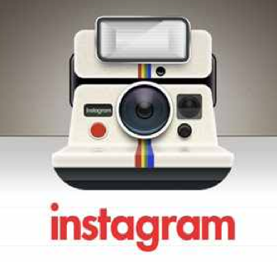

What’s new in Social Media?
Brands using Instagram to communicate their story.
”visual storytelling”
Starbucks (780K+ followers), American Airlines, Ford, Nike Red Bull and Tiffany’s are known as Instagram industry leaders.
Sheraton Bratislava has an Instagram Moments book they share with certain guests upon checkin.
Use of #Hashtags allows for creativity with campaigns.
Pinterest – “A picture is worth more than a 1,000 words”
fastest growing website in history. (11.7 million unique visitors per month).
combination of mood boards, vision boards and pin board.
a valuable source for providing leads with the sharing of photos and videos that show characteristics of your product.
Users spend an average of 89 minutes per month on the site. (2nd to Facebook & Tumblr)

Slide 4

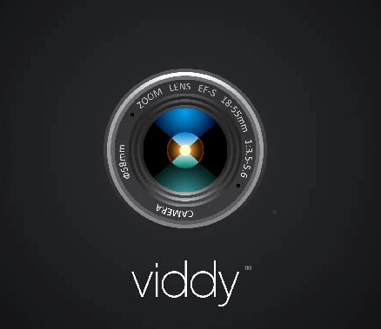

What’s new in Social Media? (cont’d)
Mobile Video sharing could be the next big thing
Apps such as Social Cam and Viddy are the biggest players at the current time.
Your content has a much higher chance of being seen on these platforms due to the “young” age of the platform.
The platforms are focused on creating “bite-sized” videos for consumption and sharing.
Contest and promotions are great ways to use Viddy. Southwest Airlines had a very successful contest on Viddy for users to win two free tickets by creating a Southwest “themed” video.
User generated content is gold!
The emergence of Google+ Hangouts
The ability to converse over video (for free) is here to stay.
Video conferencing is now more personal and more effective.
Many brands are now using Google+ Hangouts to announce breaking news and new products. Dell makes a practice of this.

Slide 5
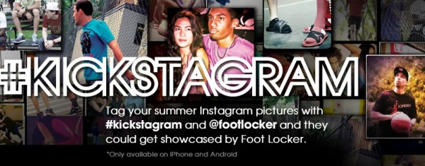
Action Steps:
Create a Facebook Fan Page and a Twitter account for your location.
Make sure your Linkedin page is up to date and profile is 100% complete.
Try using Skype/Google Hangouts with a client or a potential client.
Leave me your business card so you can receive our weekly newsletter and begin your social media educational journey.
Try Instagram. I recommend looking at their Levi’s campaign or the Ford campaign.
Review the social media profiles for all of your VIP guests. This inside and real-time information will be invaluable to providing personalized service.
BONUS: Look at the platform known as Quora. One of the best Q&A sites out right now that has CEO’s of companies (Mark Cuban, CEO of Instagram, etc.) participating actively
Have fun. Social media is fun and once you get involved be wary of “addiction”.

Slide 6
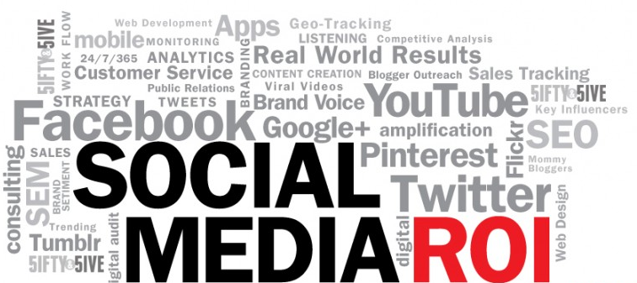
Thank you!! Don’t forget to call or email me with any questions.
Amani Roberts
(424)244-1443
Twitter.com/ahr19
Amani@fiftyandfive.com

