Slide 1
Software Evolution Problem Detection Report
Max Kesselbacher
Stefan Pasterk
02.05.2017

Slide 2
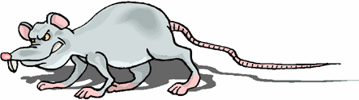
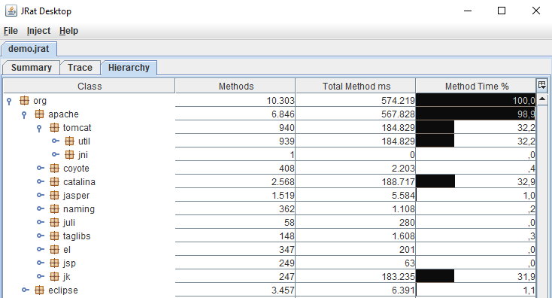
JRat – Java Runtime Analysis Toolkit
Open source performance profiler, written for Java 5
Gathers dynamic performance metrics of Java applications
Results are displayed in Swing application
Size of JRat: 11kloc

Slide 3
JRat – Main Features
Injection of bytecode
ASM framework for bytecode manipulation
Runtime instrumentation through javaagent
Installing class transformers through CLI agent
Swing desktop application
Loading and displaying of resulting profiling files

Slide 4
Understanding the Application
First Contact
Initial Understanding

Slide 5
Understanding the Application
Detailed Model Capture

Slide 6
Problem Detection
Used tools
inCode
X-Ray
SonarQube

Slide 7
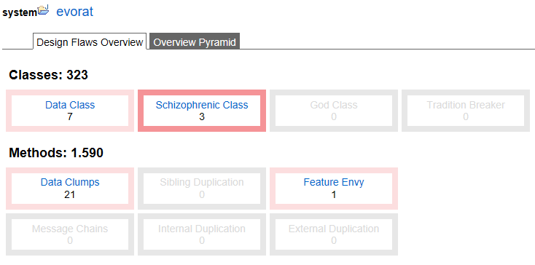
Problem Detection – inCode

Slide 8
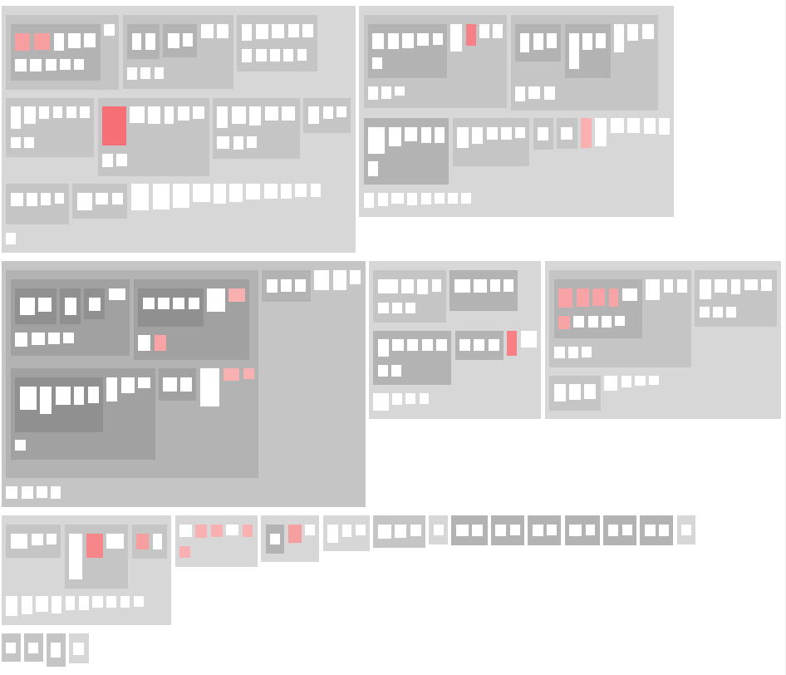
Problem Detection – inCode
Data Classes: Request, Response
Data Class: Settings

Slide 9
Problem Detection – inCode
Schizophrenic Class: LoggerFactory
Schizophrenic Class: StringUtil
Schizophrenic Class: LoggerFactory

Slide 10
Problem Detection – inCode
Feature Envy
Data Clumps

Slide 11
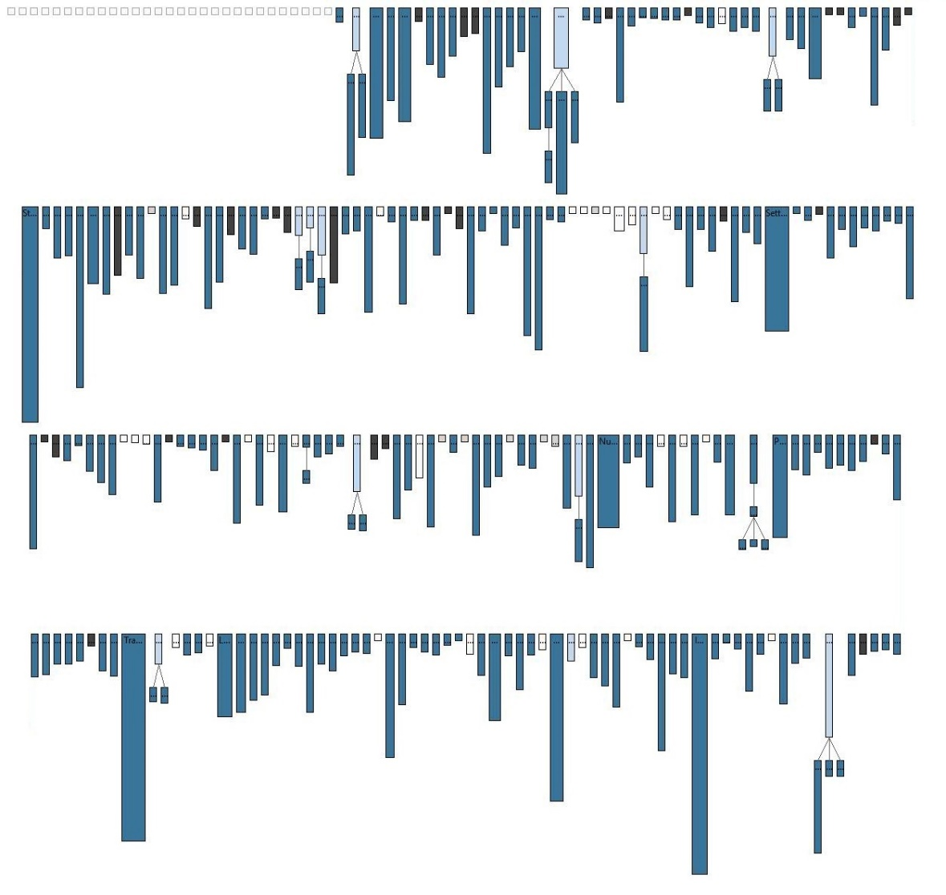
Problem Detection – X-Ray

Slide 12
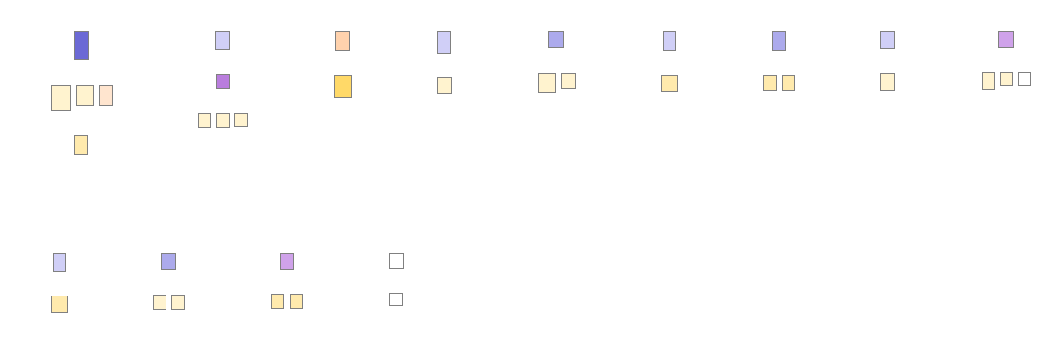
Problem Detection – inCode

Slide 13
Violations - SRP
Schizophrenic classes (inCode severity 6)
Cohesion of methods very low
Accessed by many different callers
Affected classes
DesktopPreferences
LoggerFactory

Slide 14
Violations - OCP
Analysis of class and method flagged for feature envy
Set of three dependent classes found
Dependent through many method calls
Dependent through access of inner classes
Affected classes:
SummaryTableModel, Table (inner class Column), MethodSummaryModel

Slide 15
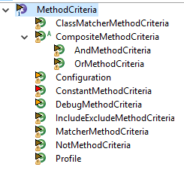
Violations - DIP
Analysis of inheritance, interfaces and call structures
Anomaly in interface implementation Interface MethodCriteria to configure profiling
Class Configuration used to configure runtime
Configuration implements MethodCriteria
-> Break of abstraction level

Slide 16
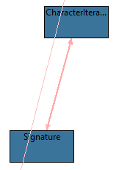
Violations - ADP
Analysis of class dependencies with X-Ray
Cyclic dependency between class and private inner class
Affected classes
Signature and CharacterIterator

Slide 17
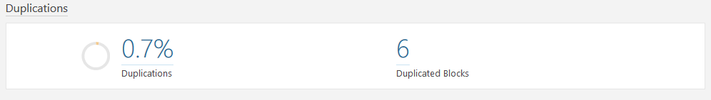
Violations - DRY
Analysis of duplicated code with SonarQube
Affected blocks:
1. core.proxy.ProxyCommand = integration.aop.proxy.ProxyCommand
2. core.output.FileOutputWriter ~ core.output.FileOutputOutputStream
3. inject.ant.InjectTask ~ inject.ant.InjectCopyTask

Slide 18
Summary
JRat – open source profiling tool for Java 5
Applied object-oriented reengineering patterns
Found violations against many of the SOLID principles
Starting points for refactoring identified

