Slide 1
Oil price and federal funds rate
Student NAME: Kevin min
Colorado State University Global
Course Code: MIS581-1
Instructor: professor steve chung
Due Date; 5/14/2023
Notes:
Hello, My name is Kevin Min and I will present to you my finding on the oil prices and federal funds rates. Today is May 14, 2023 and this presentation is for Colorado State University Global Course MI581-1.

Slide 2
Agenda
Purpose
Thesis
Overview
Business Problem/Hypothesis
Descriptive Results
Historical Trends
Relationship
Models
Impact
Conclusion
Notes:
Agenda of the presentation. Preview over the main points.

Slide 3

Purpose
Understand historical trends
Descriptive understanding of data
Relationship between oil prices and Federal Funds Rate (FFR)
Regression Analysis
Notes:
The primary goals are to provide a comprehensive analysis of the connection between FFR and oil prices. It is specially imported crude oil prices in real terms (normalized to account for inflation) but I will refer it to oil prices in this presentation. I will also refer the federal funds rate to ffr throughout the presentation. It is also to analyze the impact of changes in FFR on oil prices. To do that I will go over the descriptive findings. The results can provide insights into how policymakers, investors, and businesses can use the findings of this research to make informed decisions. The research will also identify the factors that influence the relationship between these two economic indicators, such as inflation, GDP growth, and geopolitical events Interest rates are always part of a country’s management of money, whether it's in the public or private sector. If central banks also use interest rates to combat recession and inflation, then it could be a further discussion to see if countries should stray away from oil usage as they need interest rates in their economies. This situation is a possible topic of discussion if there is a linkage between FFR and oil prices. I will do a regression analysis between the two variables.

Slide 4
thesis
The relationship between oil prices and the Federal Funds Rate is complex, with the Federal Reserve Bank’s monetary policy of changing the federal funds rate having an influence on oil prices
Notes:
My thesis is The relationship between oil prices and the Federal Funds Rate is complex, with the Federal Reserve Bank’s monetary policy of changing the federal funds rate having an influence on oil prices
To support my thesis I will study if There is a correlation between oil prices and FFR. FFR can predict oil prices. There is a regression relationship between FFR and oil prices

Slide 5
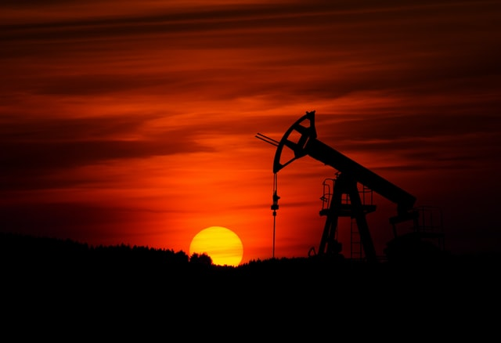
overview
Figure 1
Crude oil mining at sunset
Data from January 2000 to January 2023
Real imported Crude Oil Prices
U.S Energy Information Administration (EIA)
Impact on fuel costs
Global Demand and Supply
FFR
Federal Reserve Economic Data (FRED)
Impact on borrowing cost
Monetary Tool
Note: Adapted from Pump-jack mining crude oil with the sunset, by Z. Burival, 2018, Unsplash (https://unsplash.com/photos/GrmwVnVSSdU). In the public domain.
Notes:
The research design for studying the correlation between oil prices and FFR typically involves quantitative research using time-series data. Data on oil prices were collected from 1972 to 2023. The crude oil price was obtained from the U.S. Energy Information Administration's (EIA) website (EIA, 2023). The data contains 612 observations from 1972 to 2024. It is specially imported crude oil prices in real terms (normalized to account for inflation). The FFR data was obtained from the Federal Reserve Economic Data (FRED) database. The Federal Reserve Bank of St. Louis maintains the FRED

Slide 6
Business problem/hypothesis
What is the direction and strength of the relationship between oil prices and FFR?
Ho: No significant relationship exists between oil prices and the FFR
Ha: There is a significant relationship between oil prices and the FFR.
What is the FFR regression influence on oil prices?
Ho:β1=0
Ha: β1≠0
Notes:
The key point is to see if an increase in the increase rate will increase or decrease the oil point and how much of a change it will make. It is also an opportunity to examine the relationship across periods. So, some of the questions to ask to examine this relationship are:
• What is the direction and strength of the relationship between oil prices and FFR?
• What is the FFR influence on oil prices?
The null hypothesis is zero correlation or relationship between oil prices and interest rates. The alternative hypothesis would be that there is no correlation or relationship between these variables. The null hypothesis in this context would be that the slope is 0 or that FFR is not useful for making predictions of oil prices. The alternative hypothesis would be that the slope is not 0 and the FFR is used for making predictions of oil prices.

Slide 7
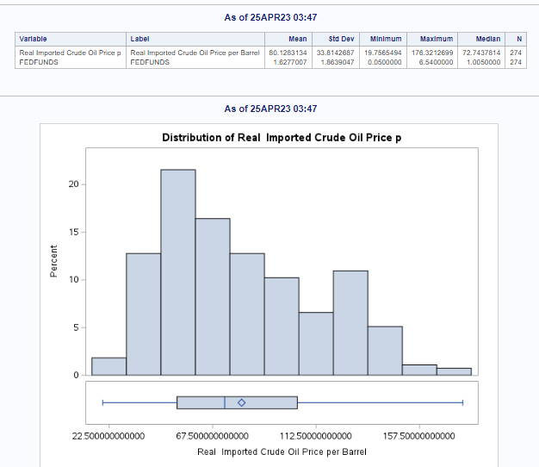
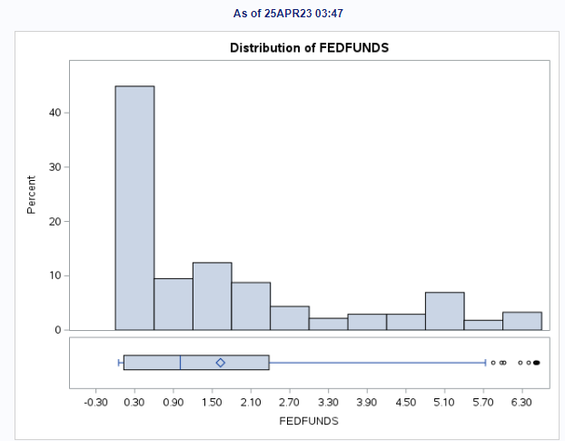
Descriptive results
Figure 2
Snapshot of descriptive results
Notes:
The mean of real imported crude oil price per barrel is 80.1, greater than the median of 72.74. The FFR’s mean is 1.62, greater than the median of 1. Both imply that they are a positively skewed distribution. The FFR also seemed to have a couple of outliers as noted by the box plot. The distribution of FFR is highly skewed

Slide 8
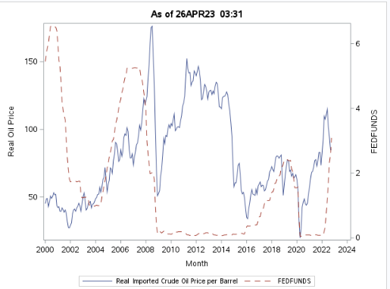
Historical trends
Figure 3
Historical trend snapshot
2000 to 2023
FFR in red
Oil Prices in blue
Notes:
2000 to 2023
FFR in red
Starts high
Drops in 2008
Goes Up in 2016
Drops in 2020
Oil Prices in blue
Goes up from 200 to 2008
Drops in 2008 then goes up
Drops in 2014 and 2020

Slide 9
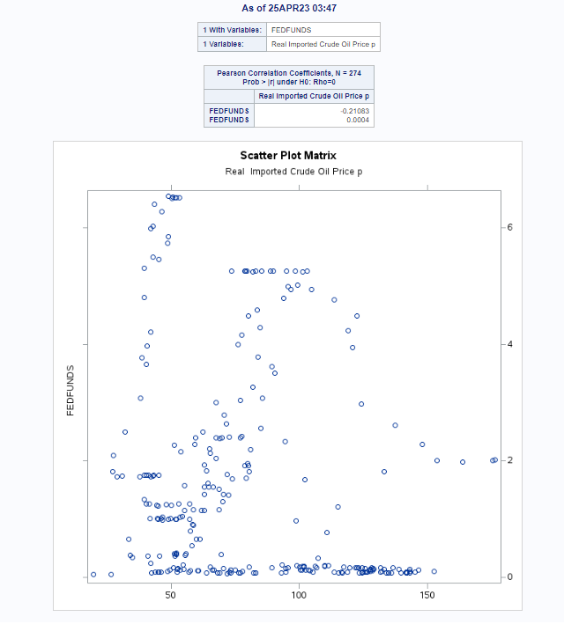
Relationship
Figure 4
Snapshot of correlation results
Correlation -.21083
P-value 0.0004
Notes:
The correlation between FFR and real imported oil price is -0.21, meaning there is an inverse relationship between the two variables. The p-value is less than 5% suggesting that it is statically significant. There is a negative correlation in which when the FFR goes up, then the oil prices go down or vice versa but it is a very weak correlation. The scatter plot matrix does not show a visual of a linear trend between the two variables, supporting the notion that it is a weak negative correlation.

Slide 10
models
Type | Models | R-squared | Akaike information criterion (AIC)
Simple Linear | Oilprices=86.35-3.82(FFR) | 4.09% | none
Linear with months and FFR as coefficients | Oilprices=67.42+0.00099(month)-3.15(FFR) | 4.08% | none
Lag month and month 2 for oil prices and FFR | Oilprice=3.02+1.4(oil1)-.51(oil2)-2.15(FFR1)+1.97(FFR2) | 97% | 1754.37
Multivariate time | Oilprices=1.95+0.14(FFR(t))+.088(oil(t-1) | none | 1335.1
Notes:
I created four models to see if there are different results and to see if one model is a better model than the other. Using AIC as a criterion, the fourth model where the month is used as a time series in Figure 6 or the time series analysis is the best model. If we were to use the lowest SSE, the model where I used two lags for FFR and oil prices is the best model.

Slide 11
impact
Inverse relationship creates economic uncertainty
Low oil prices stimulate consumer spending
High oil prices affect business investment
Fed rate hikes decrease oil demand
Notes:
The impact is that the inverse relationship between the ffr and oil prices can create economic uncertainty. Monetary policy does not have a significant impact on oil prices as the global demand and supply are more impactful than monetary policy. However monetary policy can have an impact on demand. Low oil prices can stimulate consumer spending and high oil prices can affect business investment. Rising federal funds rate can also decrease oil demand which can have an impact on oil prices.

Slide 12
conclusion
Negative Correlation between oil prices and FFR
Statistical Significant models for FFR predicting oil prices
Continued analysis and research required
Understanding relationship crucial for decision-making
Notes:
thesis is The relationship between oil prices and the Federal Funds Rate is complex, with the Federal Reserve Bank’s monetary policy of changing the federal funds rate having an influence on oil prices. There is a negative correlation and statistical significance on models for ffr to predict oil prices but both are weak or not strong influences. In sum, this study emphasizes how crucial it is to consider the link between federal funds rates and oil real prices to comprehend the global economy. Policymakers and investors can make better choices about energy policy and investments in the energy industry by looking at the variables that affect this relationship. More research can be done if there is a strong relationship between ffr and oil price.

Slide 13
References
Azad, N. F., & Serletis, A. (2022). Oil Price Shocks in Major Emerging Economies. Energy Journal, 43(4), 199–213. https://doi.org/10.5547/01956574.43.4.naza
Burival, Z. (2018). Pump-jack mining crude oil with the sunset [Stock image]. Unsplash. https://unsplash.com/photos/GrmwVnVSSdU
Board of Governors of the Federal Reserve System (US). (2023, March 31), Federal Funds Effective Rate [FEDFUNDS], retrieved from FRED, Federal Reserve Bank of St. Louis. Retrieved April 1, 2023 from https://fred.stlouisfed.org/series/FEDFUNDS/
Hong, T., Wang, J., & Zhang, H. (2017). The relationship between oil price and U.S. inflation. Energy Economics, 61, 41-48.
Mohammadi, H., & Su, L. (2017). Monetary policy and crude oil prices: Empirical evidence from the wavelet analysis. Energy Economics, 65, 98-110.
U.S. Energy Information Administration (EIA) (2023). Short-Term Energy Outlook. Retrieved April 1, 2023 from https://www.eia.gov/outlooks/steo/realprices/
Verbeek, M. (2017). Using linear regression to establish empirical relationships. IZA World of Labor.https://doi.org/10.15185/izawol.336

