Slide 1


110: Chess Checkmate
Kevin, Callum, Steven, Evan

Slide 2

Summary
This project aims to detect if our king is in checkmate. We are assuming that our king is our only friendly piece left, and if there are no safe squares for our king to move to then it is checkmate. For this project we will be ignoring pieces blocking each other’s path to achieve checkmate.
8
7
6
5
4
3
2
1
1 2 3 4 5 6 7 8

Slide 3
Propositions
S_{ij} - is considered true if the enemy can’t move into the space (i, j)
K_{ij} - is considered true if the friendly King is in that space
The logic for the friendly King applies for all enemies, for example:
b_{ij} is considered true if an enemy bishop occupies that square
This applies to enemy pawns (p), enemy queens (q), enemy kings (k), enemy knights (n), and enemy rooks (r)

Slide 4
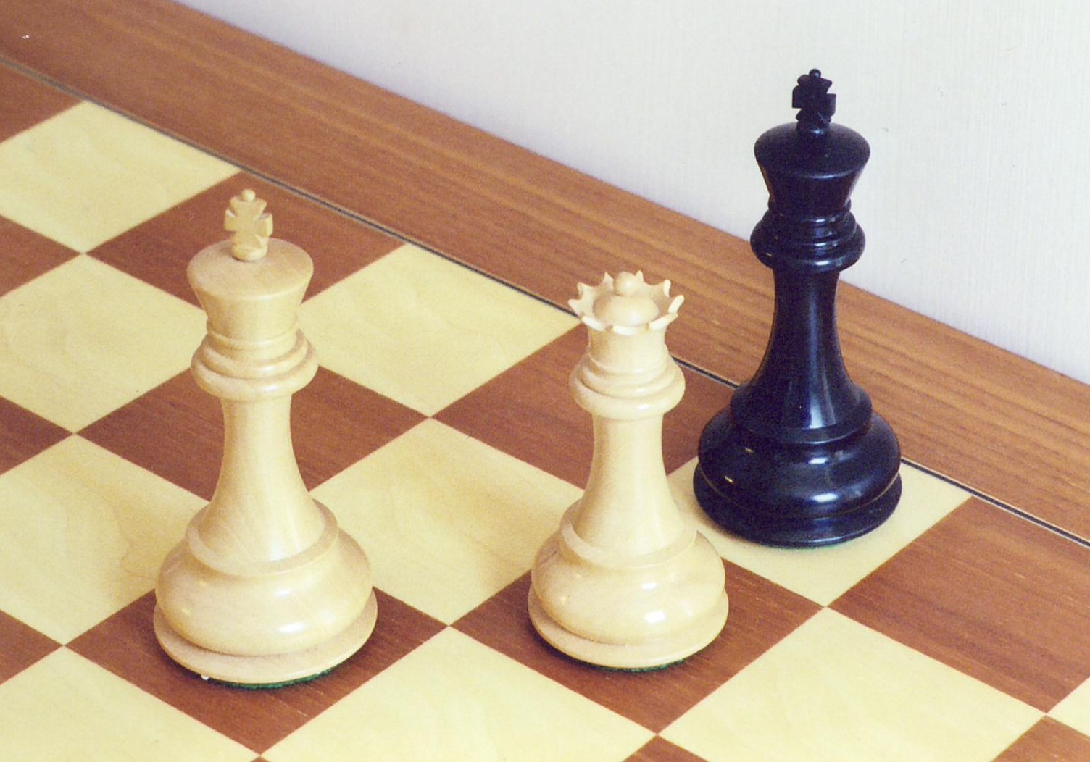
Constraints
i and j must be within 1 and 8 inclusive
The Friendly King does not has a safe space to move to: K_{i,j} →(S_{i+1,j-1} ∧ S_{i+1,j} ∧ S_{i+1,j+1} ∧ S_{i,j+1} ∧ S_{i,j-1} ∧ S_{i-1,j-1} ∧ S_{i-1,j} ∧ S_{i-1,j+1})
The pawns cover diagonals in front of them: p_{i,j} → (S_{i+1,j-1} ∧ S_{i+1,j+1})
rook covers up, down, left, right: r_{i,j} → (S_{i-1,j} ∧…∧S_{i-7,j} )∧(S_{i+1,j} ∧…∧S_{i+7,j} )∧(S_{i,j-1} ∧…∧S_{i,j-7})∧(S_{i,j+1} ∧…. ∧S_{i,j+7})
Enemy bishop is diagonals : b_{i,j} → (S_{i+1,j+1} ∧…∧S_{i+7,j+7}) ∧ (S_{i-1,j-1} ∧…∧S_{i-7,j-7}) ∧ (S_{i+1,j-1} ∧…∧S_{i+7,j-7}) ∧ (S_{i-1,+-1} ∧…∧S_{i-7,j+7})
Queen: q_{i,j} → combines the constraints of rook and bishop
The enemy king covers the spaces around them: k_{i,j} → (S_{i+1,j-1} ∧ S_{i+1,j} ∧ S_{i+1,j+1} ∧ S_{i,j+1} ∧ S_{i,j-1} ∧ S_{i-1,j-1} ∧ S_{i-1,j} ∧ S_{i-1,j+1})
The knight covers the other end of the L: n_{i,j} → (S_{i+1,j-2} ∧S_{i+2,j-1} ∧S_{i+2,j+1} ∧S_{i+1,j+2} ∧S_{i-1,j+2} ∧S_{i-2,j+1} ∧S_{i-2,j-1} ∧S_{i-11,j-2} )
Multiple pieces cannot occupy the same space:
q_{i,j} → ¬r_{i,j} ∧ ¬b_{i,j} ∧ ¬n_{i,j} ∧ ¬k_{i,j} ∧ ¬p_{i,j} ∧ ¬K_{i,j}
r_{i,j} → ¬q_{i,j} ∧ ¬b_{i,j} ∧ ¬n_{i,j} ∧ ¬k_{i,j} ∧ ¬p_{i,j} ∧ ¬K_{i,j}
… And so on for every enemy piece
There is only one friendly King:
K_{i,j} → (¬K_{i+1,j} ∧ ¬K_{i+2,j} ∧ ...) and so on for every position of the grid
We start with an initial configuration for all pieces, for example:
q_{7,5} ∧ k_{6,4} ∧ K_{8,5}

Slide 5
Model Exploration
We have explored our model by experimenting with different grid sizes from 3x3 to 6x6 and verified given correct s grids and we have given different piece starting positions and have confirmed the correct grid outputs

Slide 6
First-order extension
We can add quantifiers added for rows and columns for the rook not safe grid as rook will make the entire row and column it is on not safe
We can add similar quantifiers using this principal for the queen and bishop

Slide 7
Feedback Request
How can we make our constraints more efficient in the run.py file?
How can we create a checkmate situation given a limited number of each pieces and a partially complete board?
How can we specify grid positions in Jape for our not safe grid?
What can we conclude from our Jape premises?

Slide 8
End

