Slide 1
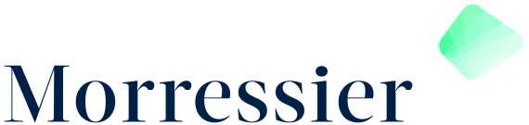
321Code!
Autonome Autos. Lächeln für Orwell. Ritter der Kokosnuss?!

Slide 2

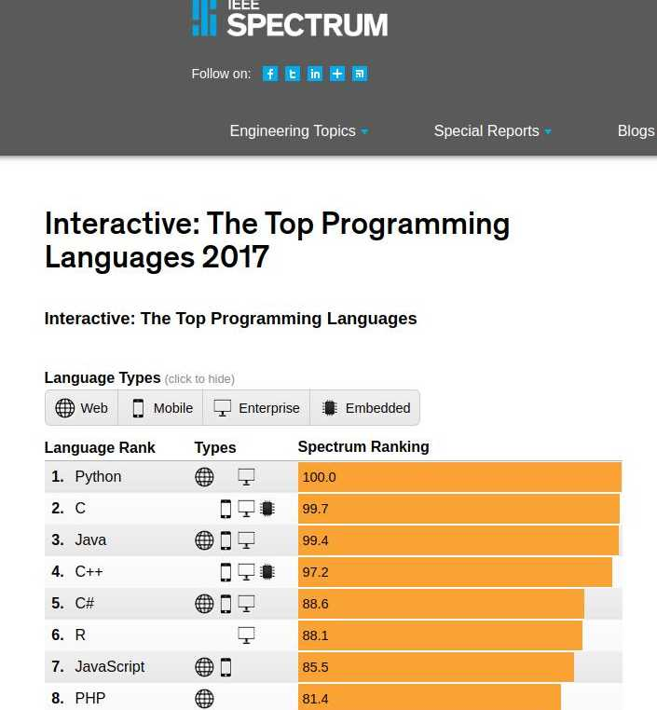
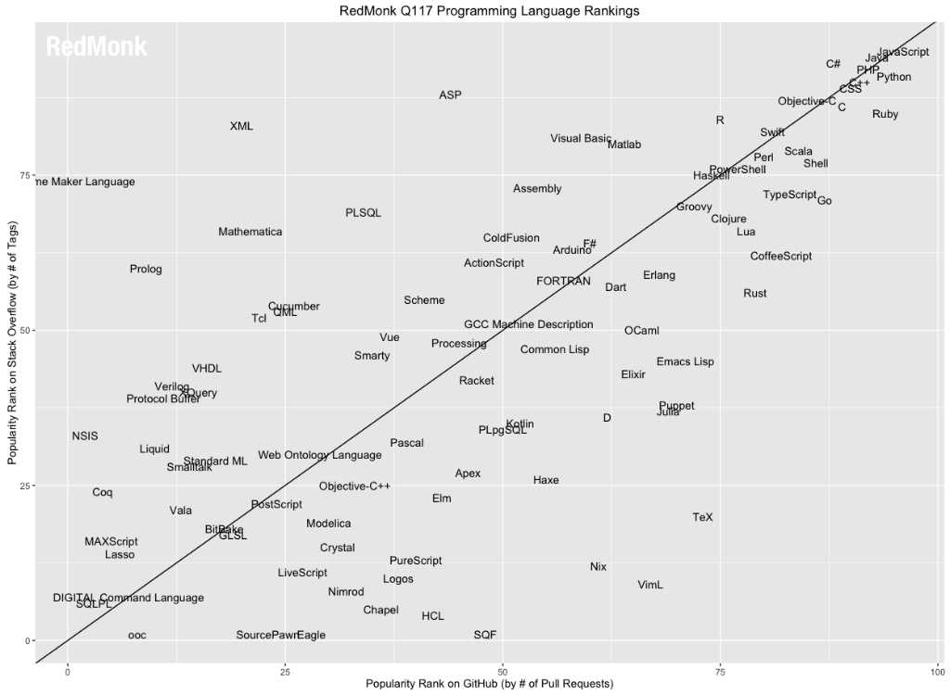
Programmiersprachen
https://spectrum.ieee.org/static/interactive-the-top-programming-languages-2017
https://redmonk.com/sogrady/2017/06/08/language-rankings-6-17/

Slide 3
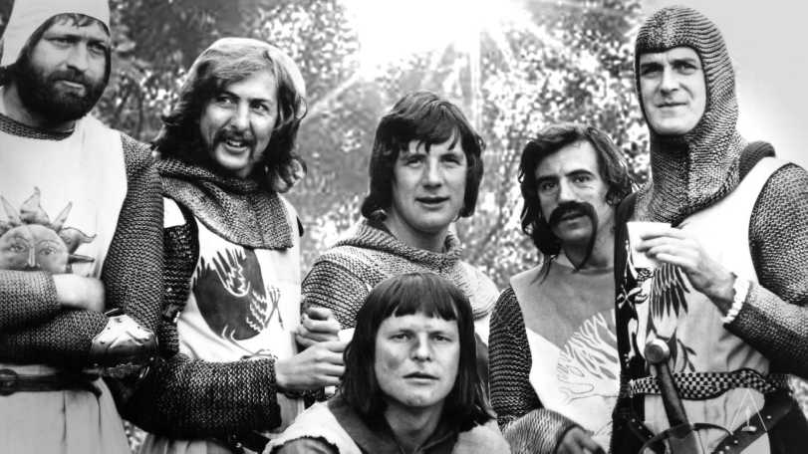
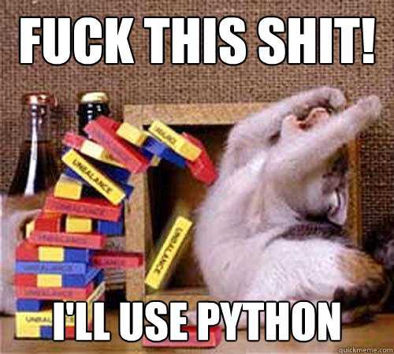

Programmiersprachen
https://docs.python.org/3.6/tutorial/appetite.html

Slide 4
3 Folien Python 0/3
$python3↲
Python 3.6.1 (default, Mar 27 2017, 00:27:06)
[GCC 6.3.1 20170306] on linux
Type "help", "copyright", "credits" or "license" for more information.
>>>
$python3 file.py↲

Slide 5
3 Folien Python 1/3
>>> # Funktionen
>>> def add(a, b):
... return a + b
...
>>> add(2, 3)
5
>>> # Zeichenketten (Strings)
>>> titel = '321Code!'
>>> print(titel)
321Code!
>>> titel.lower()
'321code!'
>>> titel.upper()
'321CODE!'
>>> titel.replace('321', '123')
'123Code!'
>>> titel * 2
'321Code!321Code!'
>>> len(titel)
8
>>> # Variablen
>>> fünf = add(2, 3)
>>> print(fünf)
5
>>> zwei, drei = 2, 3
>>> add(zwei, drei)
5

Slide 6
3 Folien Python 2/3
>>> # Listen
>>> liste = [3, 2, 1]
>>> liste[2]
1
>>> print(liste)
[3, 2, 1]
>>> len(liste)
3
>>> liste.append('Code!')
>>> len(liste)
4
>>> # Kontrollstrukturen
>>> if len(liste) > 3:
... print('Wahr')
... else:
... print('Falsch')
...
Wahr
>>> if '3' in tuple:
... print('Auch Wahr')
...
>>> if 3 in tuple:
... print('Jetzt aber.')
...
Jetzt aber.
>>> # Tuple
>>> tuple = (3, 2, 1, 'Code!')

Slide 7
3 Folien Python 3/3
>>> # Schleifen
>>> for i in liste:
... print(i)
...
3
2
1
Code!
>>> a = 5
>>> while a >= 0:
... print(a)
... a = a - 1
...
5
4
3
2
1
0

Slide 8
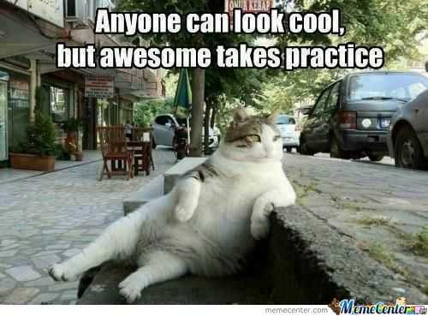
Coding Session

Slide 9
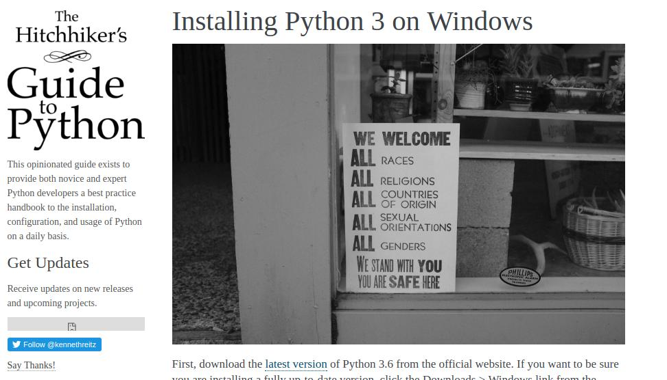
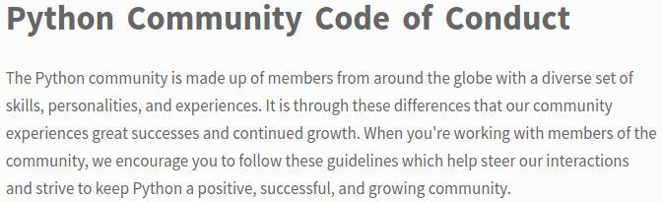
3 Folien Python 4/3
# Python
http://docs.python-guide.org/en/latest/starting/install3/win/ [EN]
https://py-tutorial-de.readthedocs.io/de/python-3.3/ [DE]
https://docs.python.org/3/tutorial/ [EN]
# OpenCV
http://docs.opencv.org/3.3.0/d6/d00/tutorial_py_root.html [EN]
http://docs.opencv.org/3.3.0/ [EN]
http://opencv-python-tutroals.readthedocs.io [EN]

Slide 10
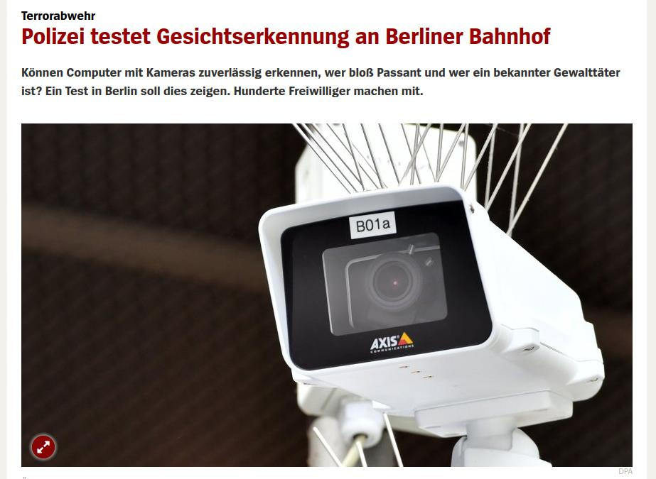
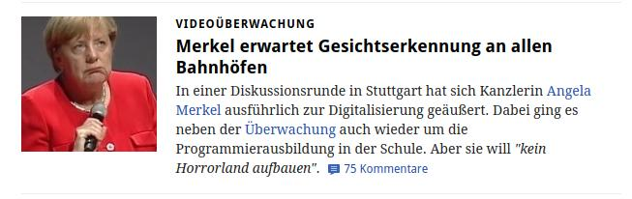
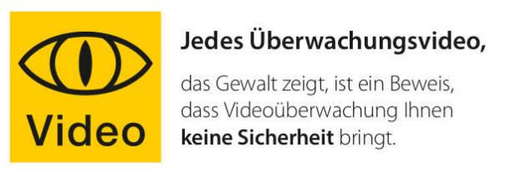
So Are We Living in 1984?
http://www.spiegel.de/netzwelt/netzpolitik/gesichtserkennung-test-am-berliner-suedkreuz-beginnt-am-1-august-a-1160079.html
https://www.golem.de/news/videoueberwachung-merkel-erwartet-gesichtserkennung-an-allen-bahnhoefen-1709-129942.html
https://digitalcourage.de/blog/2017/kamera-laeuft-bitte-laecheln

Slide 11
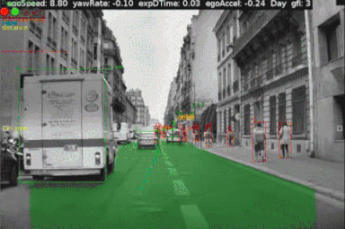
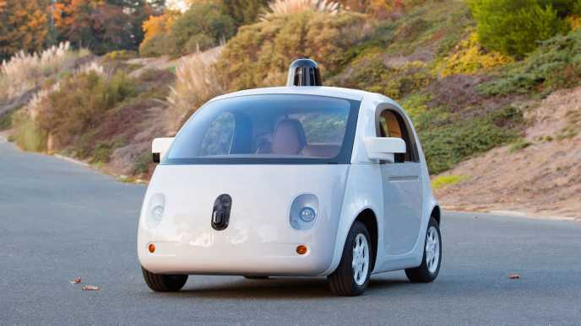
Autonome XXXX

Slide 12
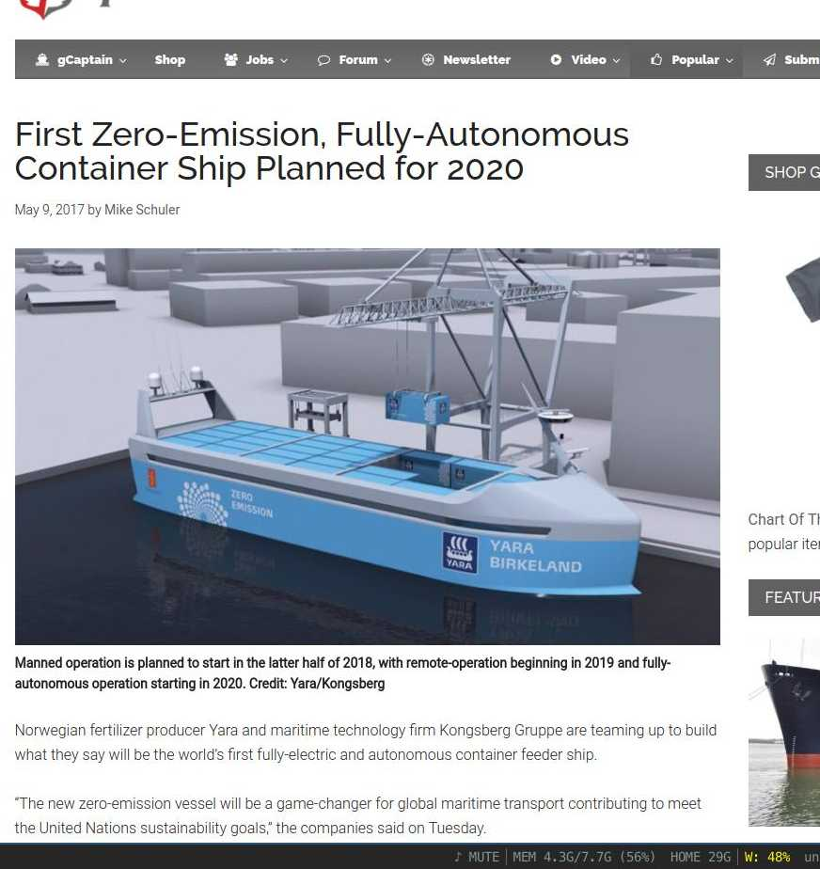
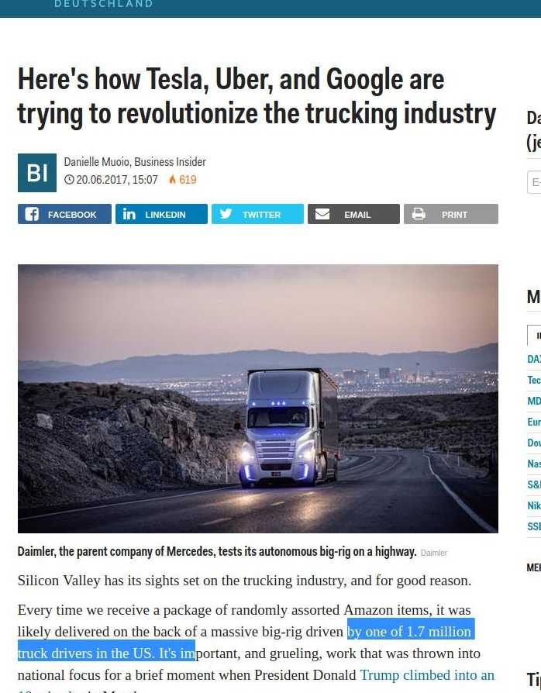
Autonome XXXX
http://www.businessinsider.de/autonomous-trucks-tesla-uber-google-2017-6?r=US&IR=T
http://gcaptain.com/worlds-first-zero-emission-fully-autonomous-ship-planned-for-2020/

Slide 13
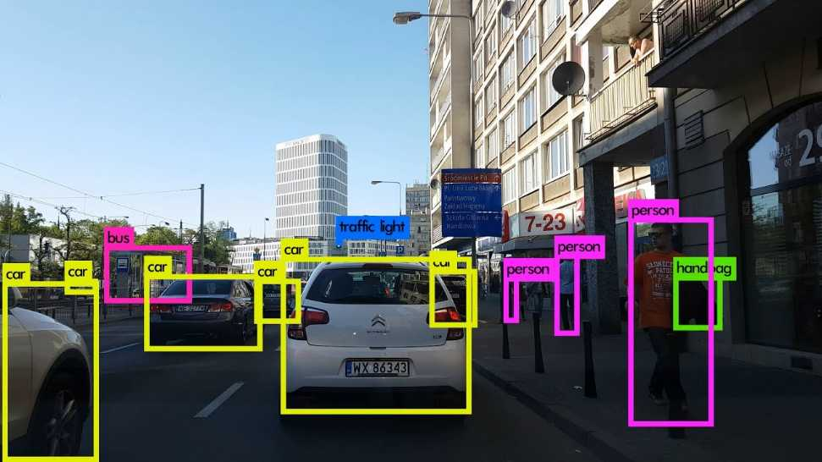
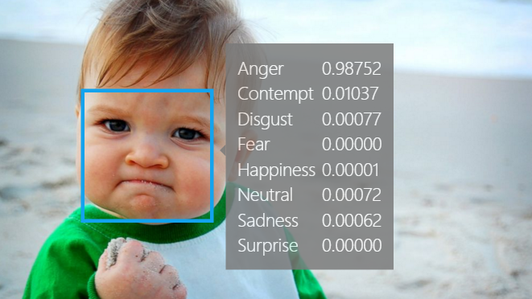
Artificial Intelligence

Slide 14
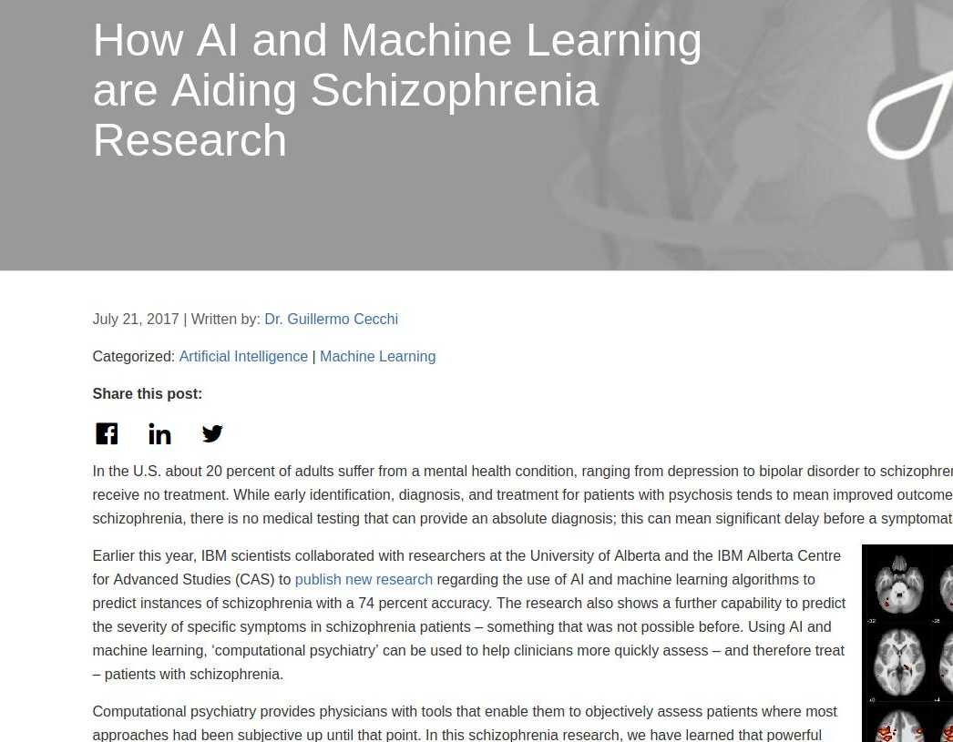
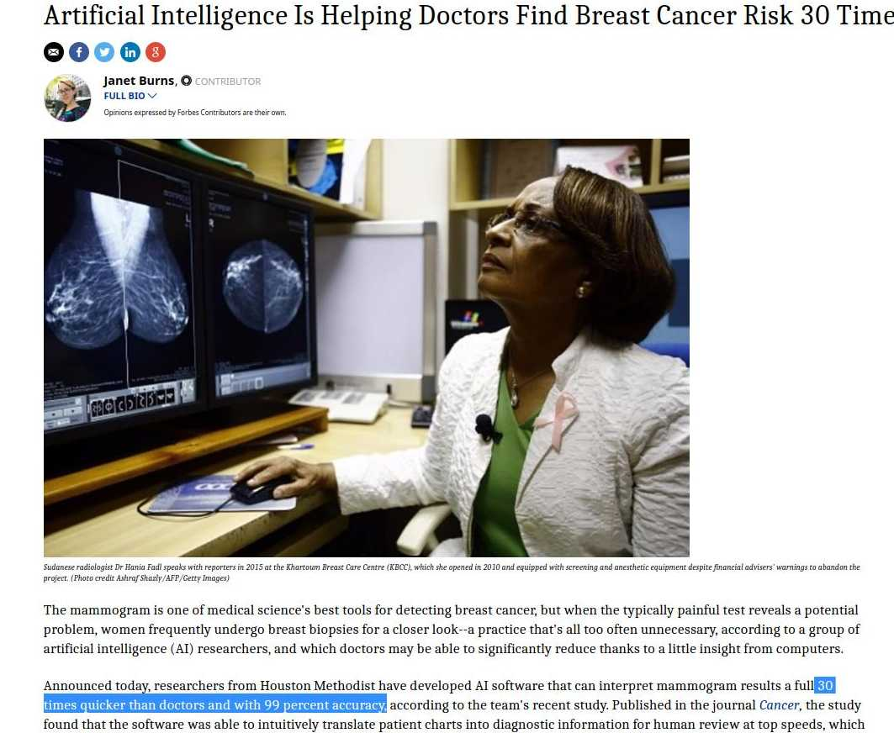
In Medizin?
In Medizin?
https://www.ibm.com/blogs/think/2017/07/ai-schizophrenia-research/
https://www.forbes.com/sites/janetwburns/2016/08/29/artificial-intelligence-can-help-doctors-assess-breast-cancer-risk-thirty-times-faster/#77b5638a5908

Slide 15
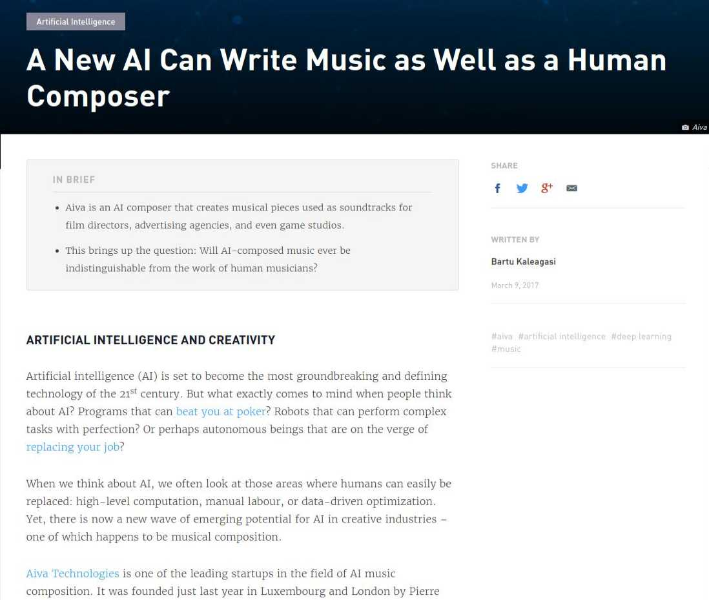
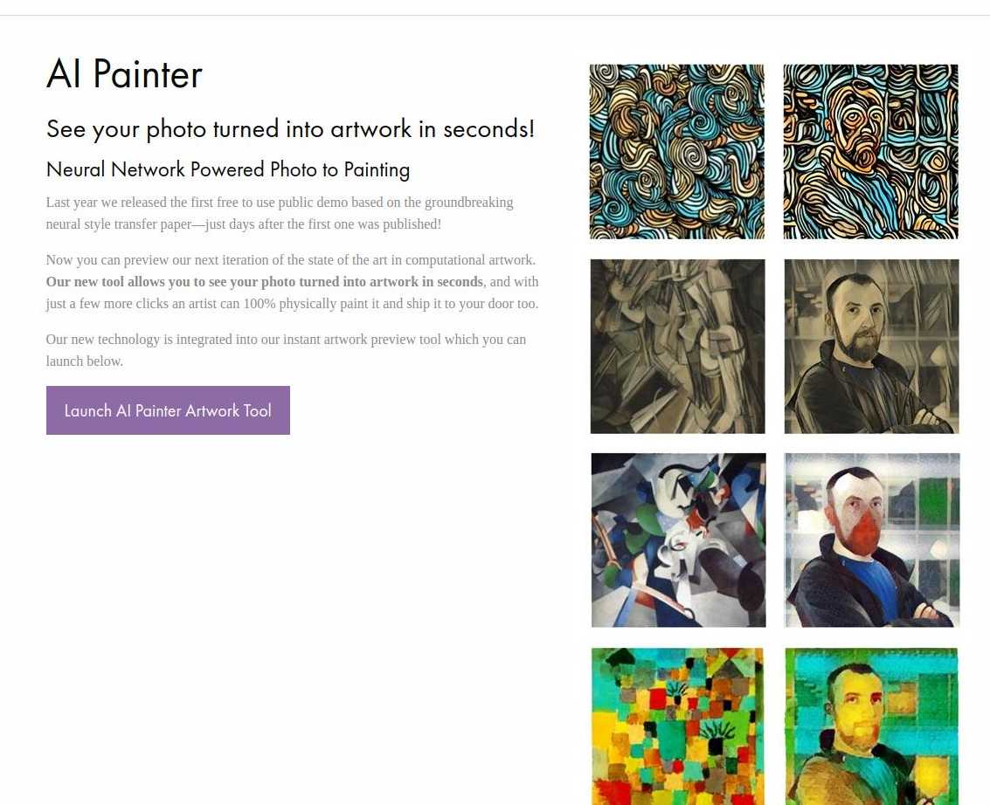
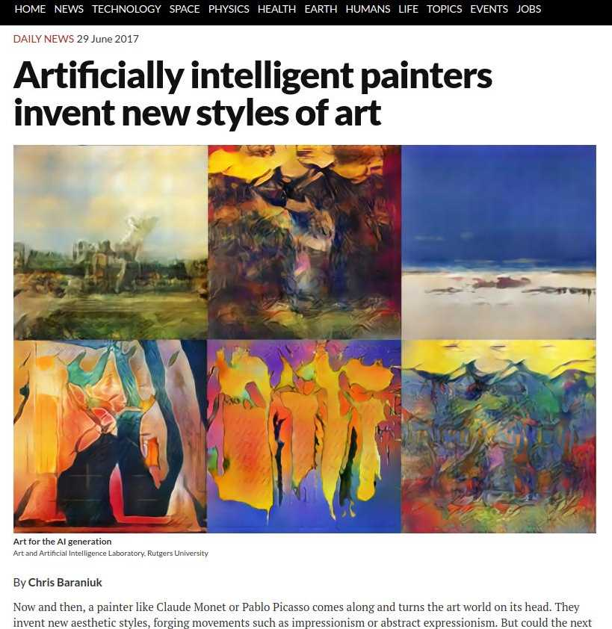
In Creativity?
https://www.newscientist.com/article/2139184-artificially-intelligent-painters-invent-new-styles-of-art/
https://www.instapainting.com/ai-painter
https://futurism.com/a-new-ai-can-write-music-as-well-as-a-human-composer/

Slide 16
git.io/v5zNL
für Code und Presentation

