Slide 1
Silicon-Gate CMOS Fabrication and GaAs Self-Aligned MESFET Technology
CMOS process flow | GaAs vs Si | Self-aligned gate | E/D MESFET process
Prof. Dr. Md. Tawabur Rahman
Dept. of Electrical and Electronic Engineering
Khulna University of Engineering & Technology

Slide 2
Silicon-gate CMOS (n-well) process: overview
1. Substrate
Start with lightly doped p-type wafer; clean, grow pad oxide.
2. n-well
Mask, implant phosphorus, drive-in to form well for pMOS.
3. Field oxide
Si₃N₄ mask defines active areas; LOCOS grows thick isolation oxide.
4. Gate stack
Grow thin gate oxide, deposit poly-Si, pattern the gates.
5. n+ implant
Arsenic implant for nMOS S/D; poly gate self-aligns it. pMOS masked.
6. p+ implant
Boron implant for pMOS S/D, also self-aligned. nMOS masked.
7. Contacts
Deposit ILD oxide, etch contact holes.
8. Metal
Deposit and pattern Al/Cu; passivation and bond-pad opening.
Key idea: the poly-Si gate is patterned before the S/D implants, so source and drain are automatically aligned to the gate edges.

Slide 3
Silicon-gate CMOS: cross-sections (steps 1–3)
pMOS
nMOS
n-well
n-well
n-well
p-substrate
p-substrate
p-substrate
A. n-well formation
B. Isolation + gate oxide
C. Poly-Si gate
Photoresist opens well region
Implant P, drive-in at high temperature
pMOS sits in n-well, nMOS in p-substrate
Nitride-masked LOCOS field oxide
Strip nitride, grow 5–20 nm gate oxide
Optional Vₜ adjust implant
LPCVD poly-Si deposited, doped
Lithography + anisotropic etch
Gates now act as implant masks
p-sub
n-well
Field oxide
Gate oxide
Poly-Si
n+
p+
ILD
Metal

Slide 4
Silicon-gate CMOS: cross-sections (steps 4–6)
pMOS
nMOS
pMOS
nMOS
pMOS
nMOS
n-well
n-well
n-well
p-substrate
p-substrate
p-substrate
p-sub
n-well
Field oxide
Gate oxide
Poly-Si
n+
p+
ILD
Metal
D. n+ source/drain
F. Contacts + metal
E. p+ source/drain
Resist covers pMOS region
As implant: S/D edges set by poly gate
Self-aligned, minimal overlap
Deposit oxide (ILD), open contacts
Al metallisation and patterning
Output node joins the two drains: CMOS inverter
Resist covers nMOS region
B implant into n-well, self-aligned
Anneal activates dopants

Slide 5
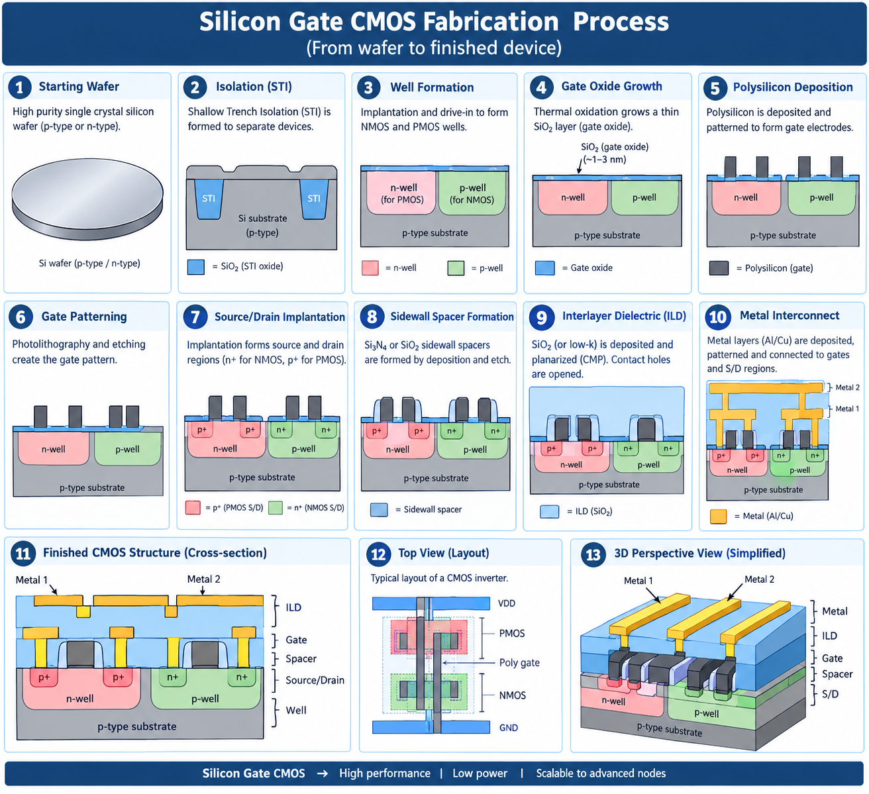

Slide 6
Self-aligned gate
The gate is formed first and used as the implant mask for the source/drain n+ regions.
S/D edges are defined by the gate edge, with no separate alignment step.
Gate must survive the activation anneal (~800 °C): refractory metal or silicide (WSiN, TiW) in GaAs, poly-Si in Si MOS.
Result: minimal gate–S/D overlap and spacing, low series resistance, low gate capacitance.
G
S
D
Semi-insulating GaAs
GaAs MESFET with self-aligned n+ regions
n+ implanted up to the gate edge

Slide 7
Advantages of self-aligned gate over metal gate
Parameter | Metal (Al) gate | Self-aligned gate
Gate–S/D overlap | Deliberate overlap to tolerate mask misalignment | Near zero; only lateral diffusion
Parasitic capacitance | Larger capacitance, slower switching | Much lower, so faster switching
Alignment | Critical gate-to-S/D mask alignment | Automatic, no critical alignment
Process order | S/D formed first; Al gate cannot take high temperature | Gate first, thermally stable, anneal afterwards (Polysilicon)
Density and yield | Larger area, Vₜ and speed spread from misalignment | Transistors can be made smaller, uniform Vₜ, better yield

Slide 8
Self-aligned process for GaAs E/D MESFET
Semi-insulating GaAs substrate, clean and cap with dielectric.
Selective Si channel implants with two masks: shallow for E-MESFET, deeper for D-MESFET.
Deposit refractory Schottky gate metal (WSiN or TiW) over the wafer, rapidly controls the depletion width of the channel
Pattern gates by RIE; gate stack now defines channel length.
Self-aligned n+ Si implant using the gate as mask, forming low-resistance S/D.
Cap with Si₃N₄ and anneal (~800 °C) to activate implants; gate remains stable.
Form AuGeNi ohmic contacts by lift-off and alloy, then interconnect and passivate.
G
S
D
Semi-insulating GaAs
E-MESFET: thin channel, Vₜ > 0
G
S
D
Semi-insulating GaAs
D-MESFET: thick channel, Vₜ < 0

Slide 9
Features of GaAs technology over Si technology
Feature | GaAs | Si
Electron mobility | ~8500 cm²/V·s (higher speed) | ~1400 cm²/V·s
Saturation velocity | Reached at lower field; higher peak velocity, 1.5×10⁷ cm/s | Lower ~ 1×10⁷ cm/s
Substrate | Semi-insulating: low parasitic capacitance, easy isolation | Conducting; needs junction isolation
Band gap | 1.42 eV, direct (light emission, lasers, LEDs) | 1.12 eV, indirect
Power / frequency | Low power at GHz speeds, suits microwave and RF | Slower at same power
Radiation and temperature | Better radiation hardness, wider temperature range | More sensitive
Limitations | No stable native oxide, low hole mobility, costly, brittle wafers | Excellent SiO₂, mature, cheap

Slide 10
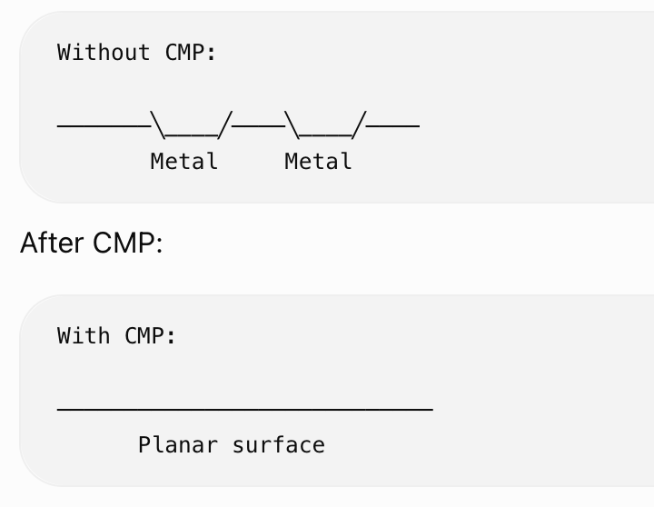
Chemical Mechanical Planarization/Polishing (CMP)
CMP combines:
Chemical action → chemically reacts with and softens/removes the surface material.
Mechanical action → abrasive particles and a polishing pad physically remove the reacted material.
CMP=Chemical removal + Mechanical removal​
Why is CMP particularly important in BEOL (Back-End-of-Line)?
It produces a planar surface
Enables multilayer interconnects
Removes excess metal
Enabling precise lithography and
reliable fabrication of multilayer Cu interconnects

Slide 11
Thank you

