Slide 1

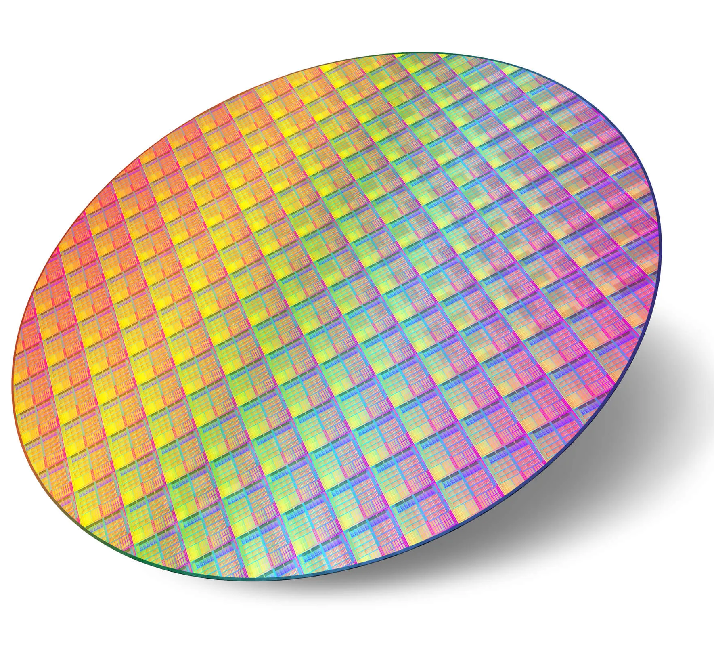
EE 4121
VLSI Design and Technology
Credit: 3.00
Dr. Md. Tawabur Rahman
Professor
Department of Electrical and Electronic Engineering
Khulna University of Engineering & Technology
Notes:
https://slideplayer.com/slide/4885269/

Slide 2
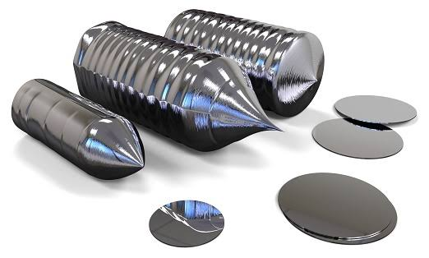
CZ growth of Si Crystal and Wafer Fabrication Process

Slide 3
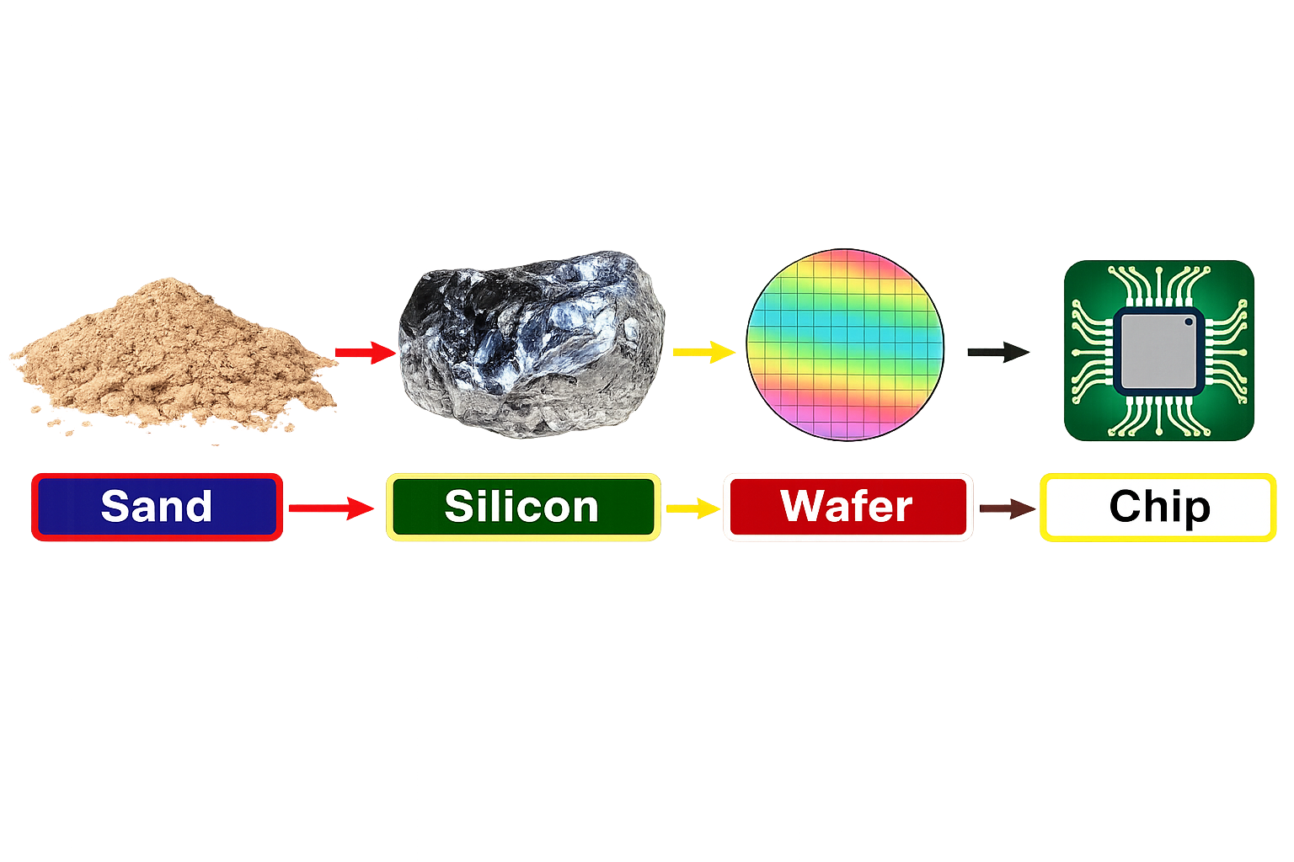
Chip Manufacturing Process

Slide 4
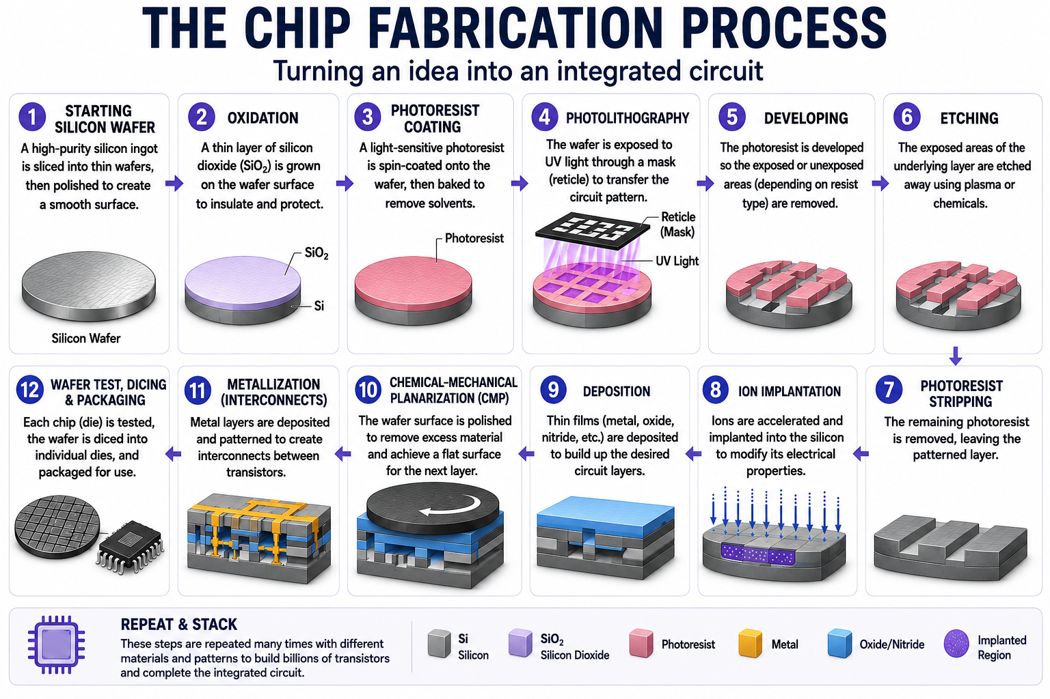

Slide 5
Why Silicon?
🌍
Abundant
Found in sand/quartz; low cost
🧪
High-Quality SiO₂
Excellent gate oxide & insulation
⚡
Ideal for MOSFETs
Low-defect Si/SiO₂ interface
🛡
Passivation
Protects circuitry; dopant masking
🏗
Si₃N₄
Hard mask & dielectric layer
⚙
1.12 eV Band Gap
Low leakage at room temperature
🎯
Easy Doping
Precise p- and n-type control
🏭
Mature Technology
Reliable, high-volume CMOS

Slide 6
Why not Germanium or GaAs?
Property | Silicon | Germanium | GaAs
Band gap | 1.12 eV | 0.66 eV | 1.42 eV
Native oxide | Excellent (SiO₂) | Poor | Poor
Leakage current | Low | High | Low
Cost | Low | Moderate | High
CMOS compatibility | Excellent | Poor | Limited

Slide 7

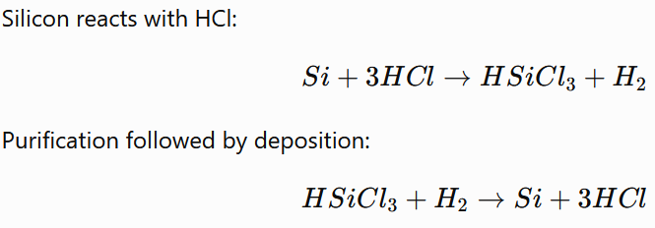
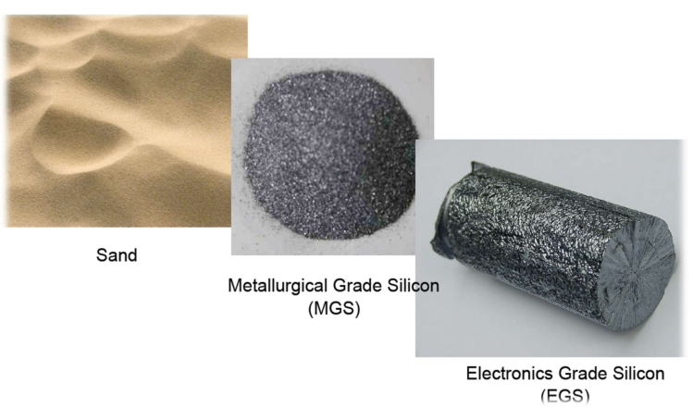
Silicon Wafer Manufacturing Techniques
Czochralski (CZ)
Float Zone (FZ)
Bridgman
Metallurgical Si (98–99% pure )
Electronics Grade Si (99.9999999%)

Slide 8
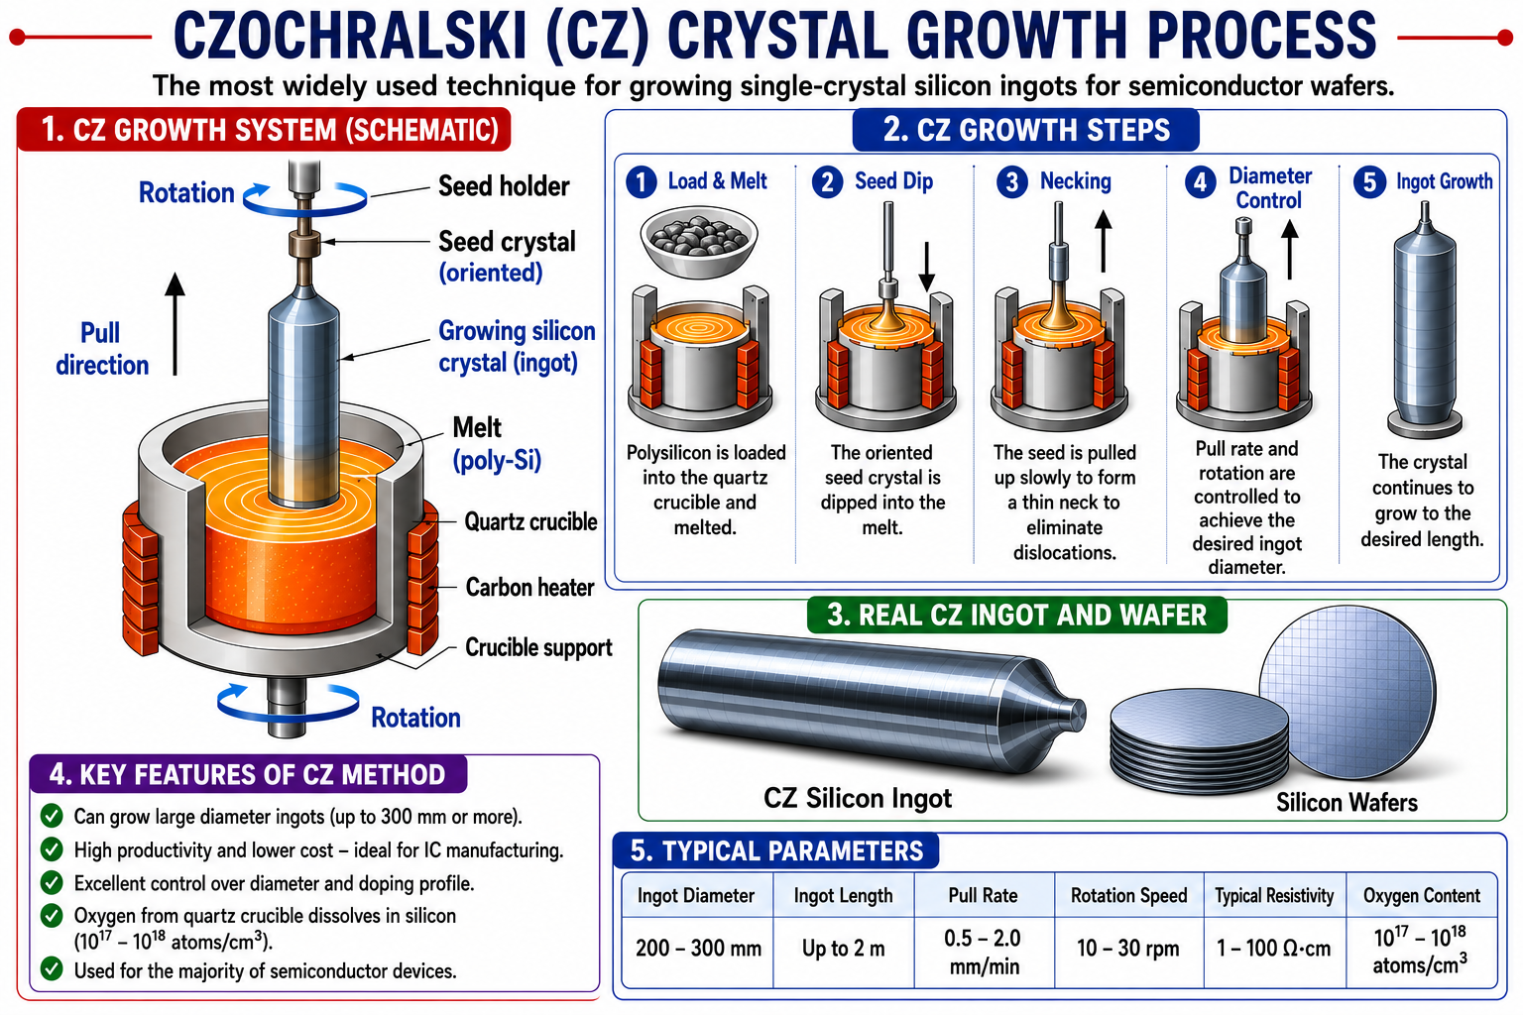

Slide 9
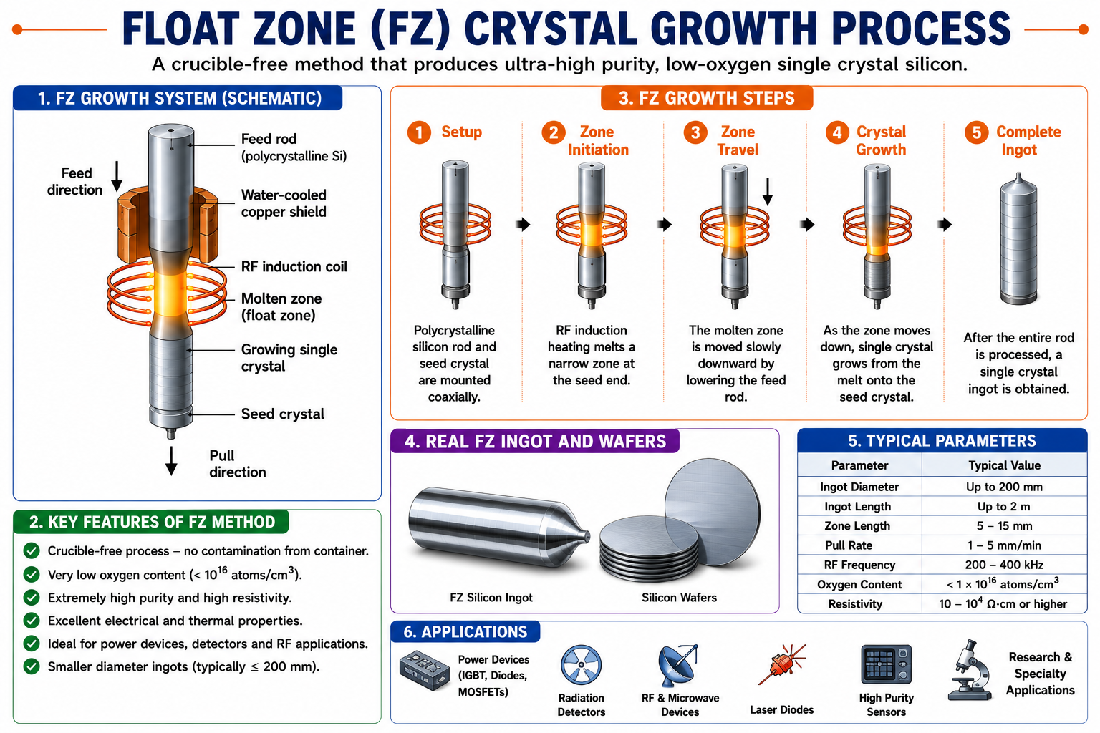

Slide 10
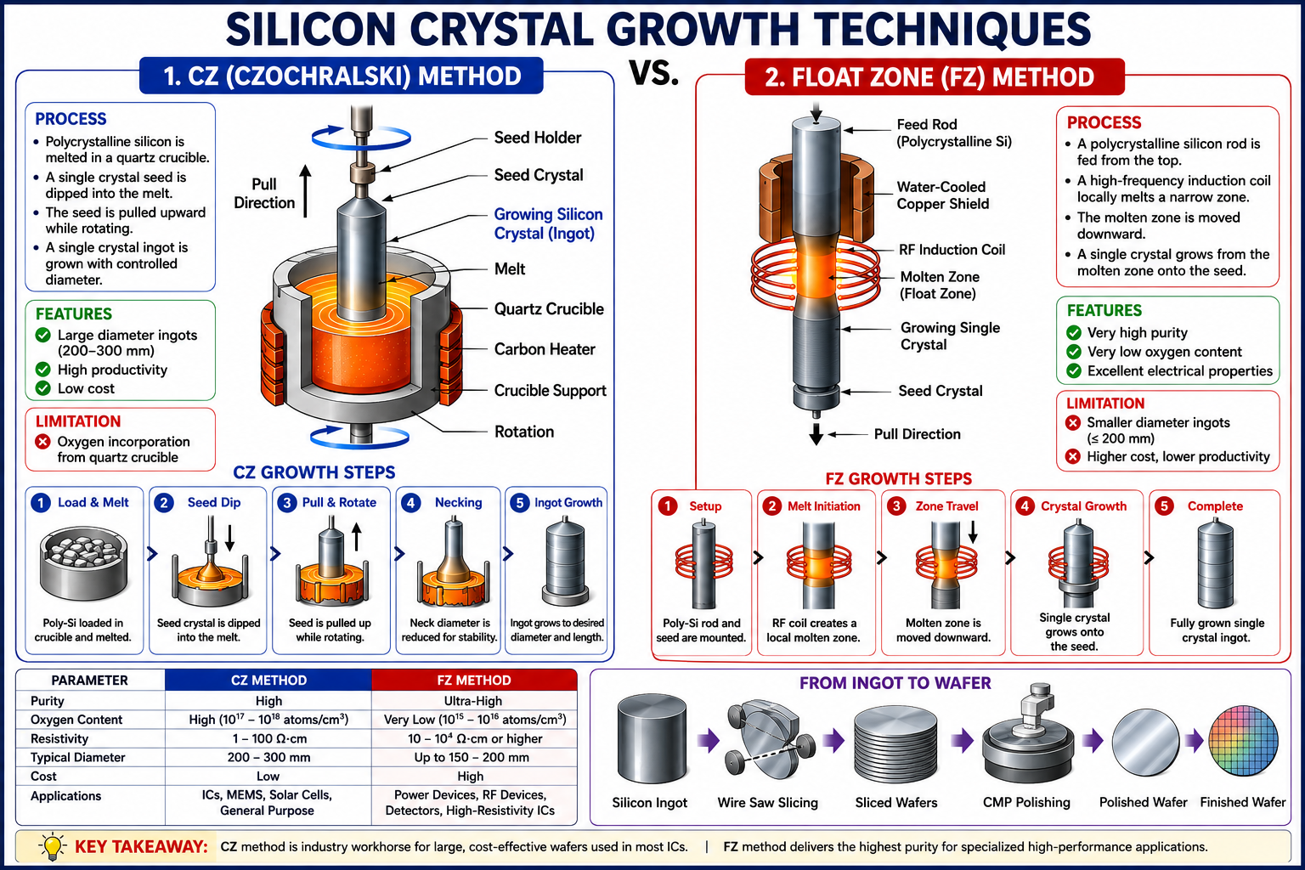

Slide 11
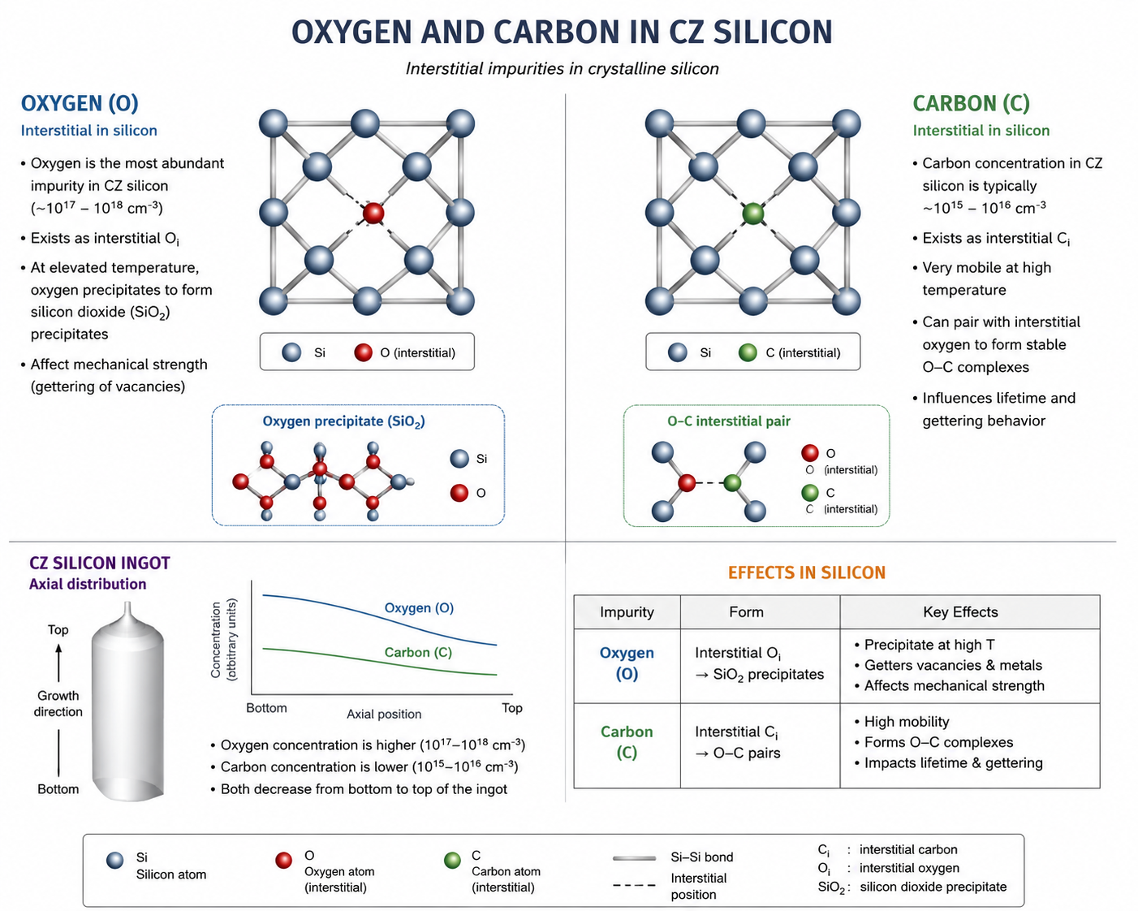

Slide 12
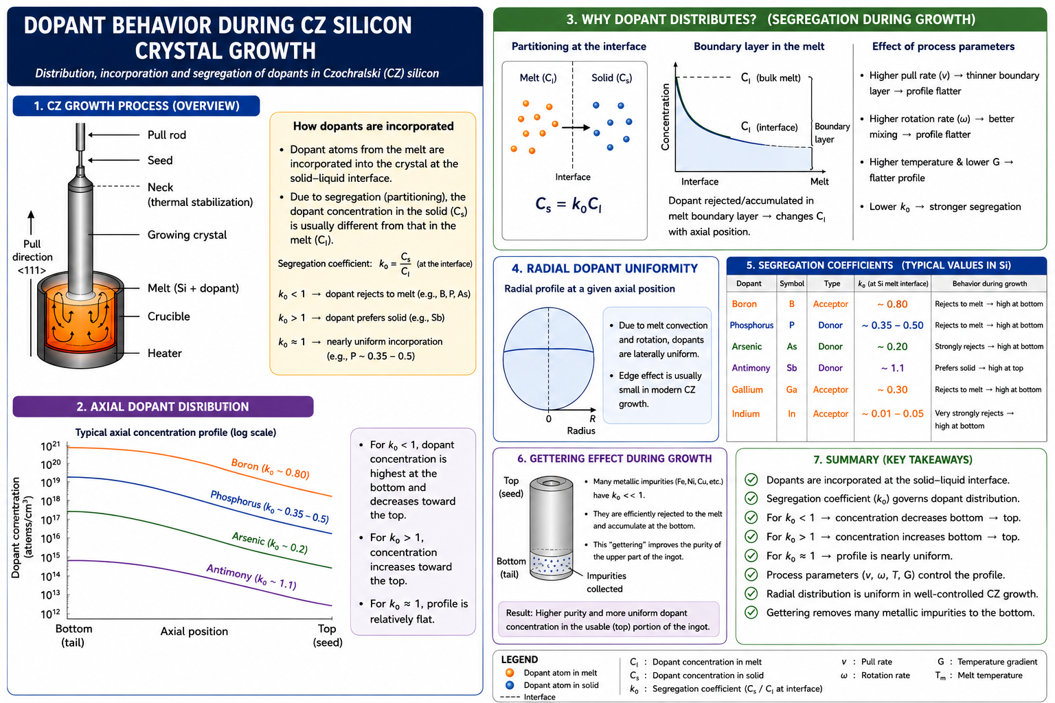

Slide 15
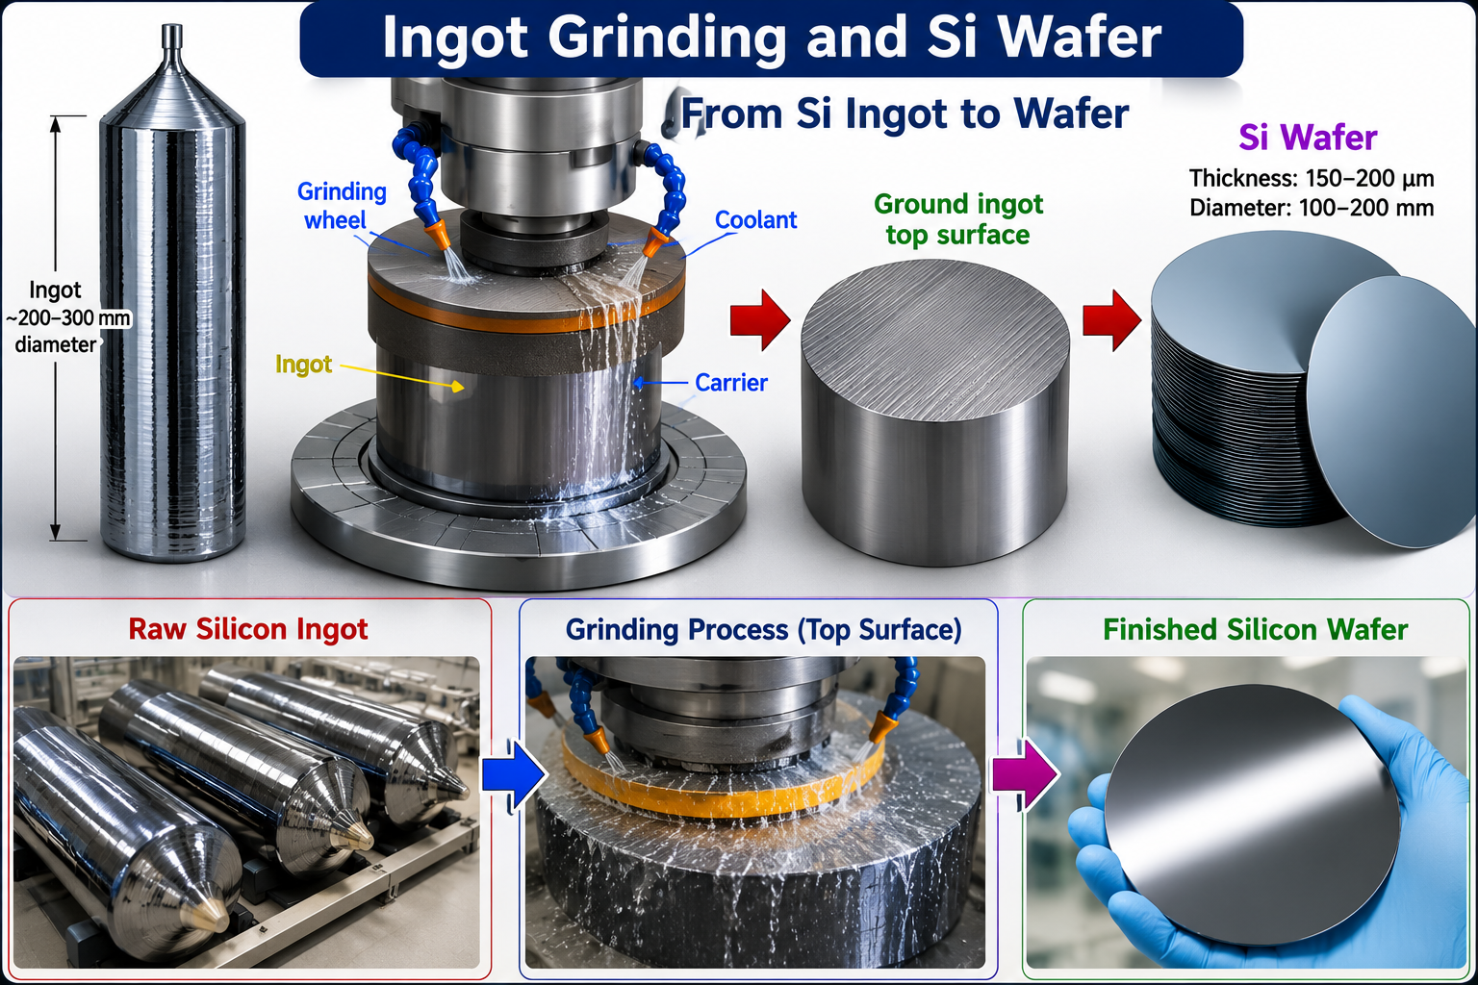

Slide 16
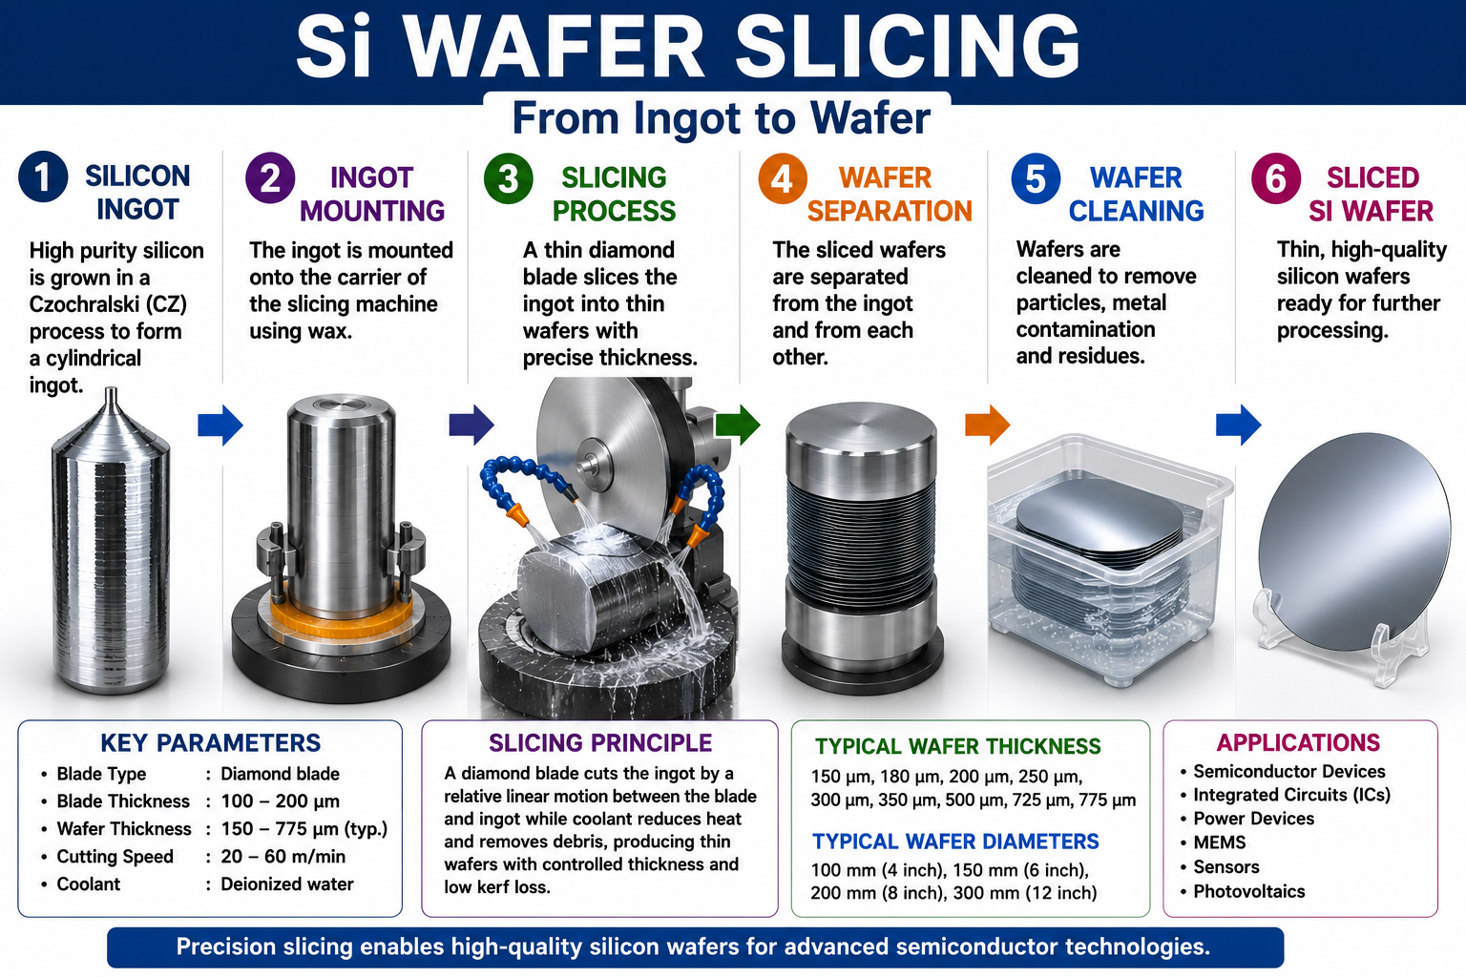

Slide 17
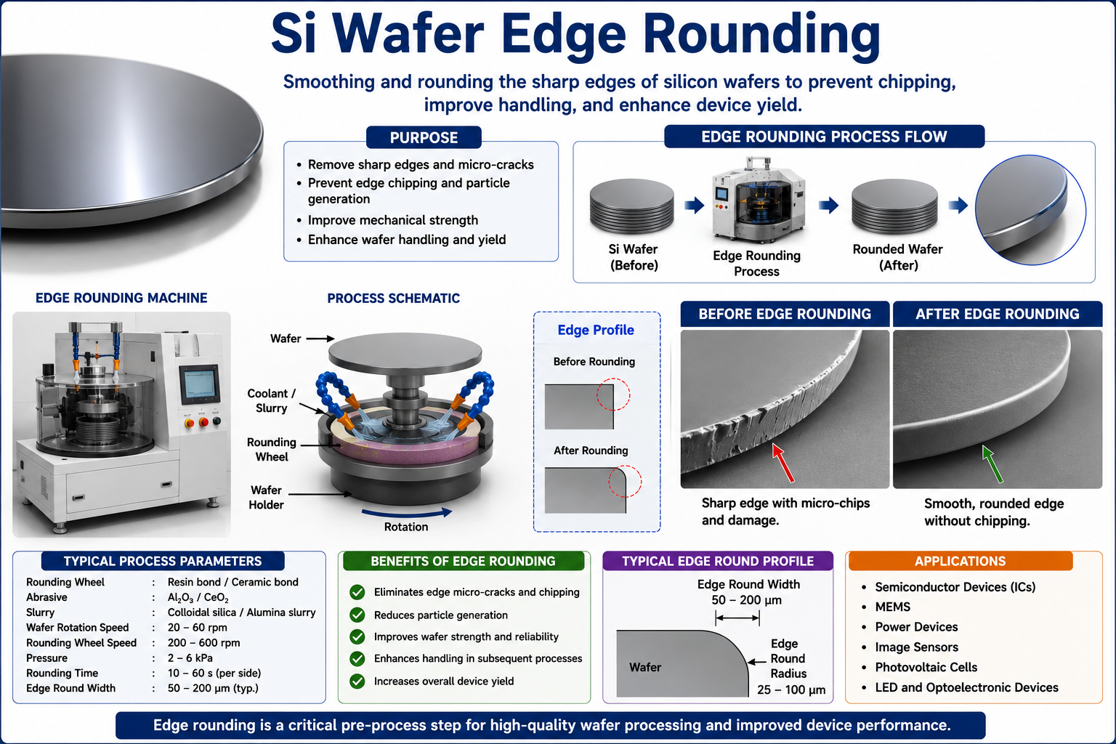

Slide 18
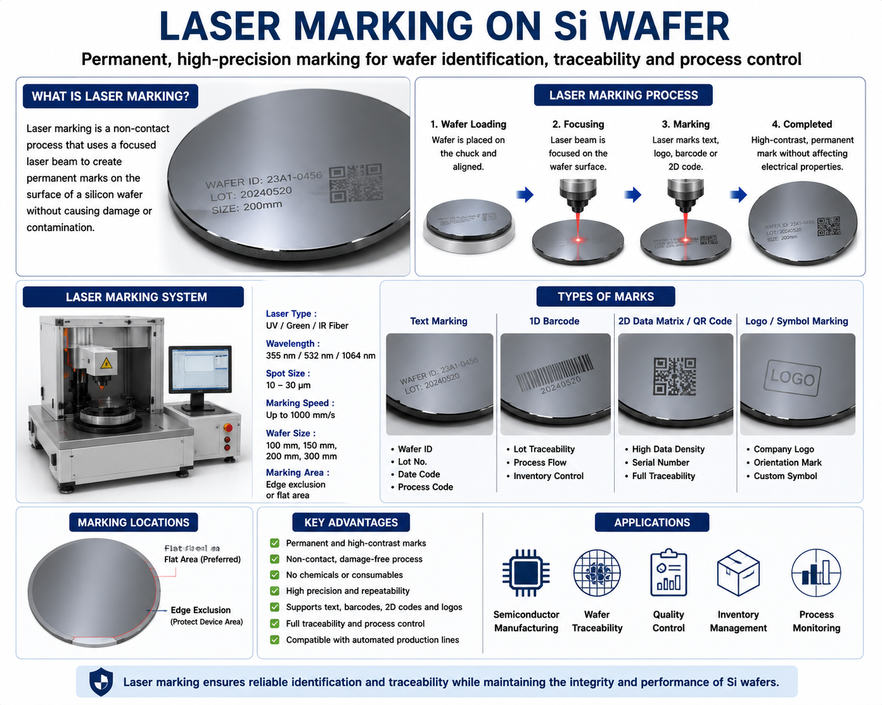

Slide 19
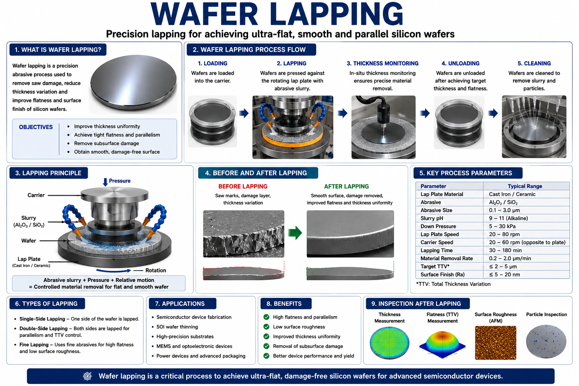

Slide 20
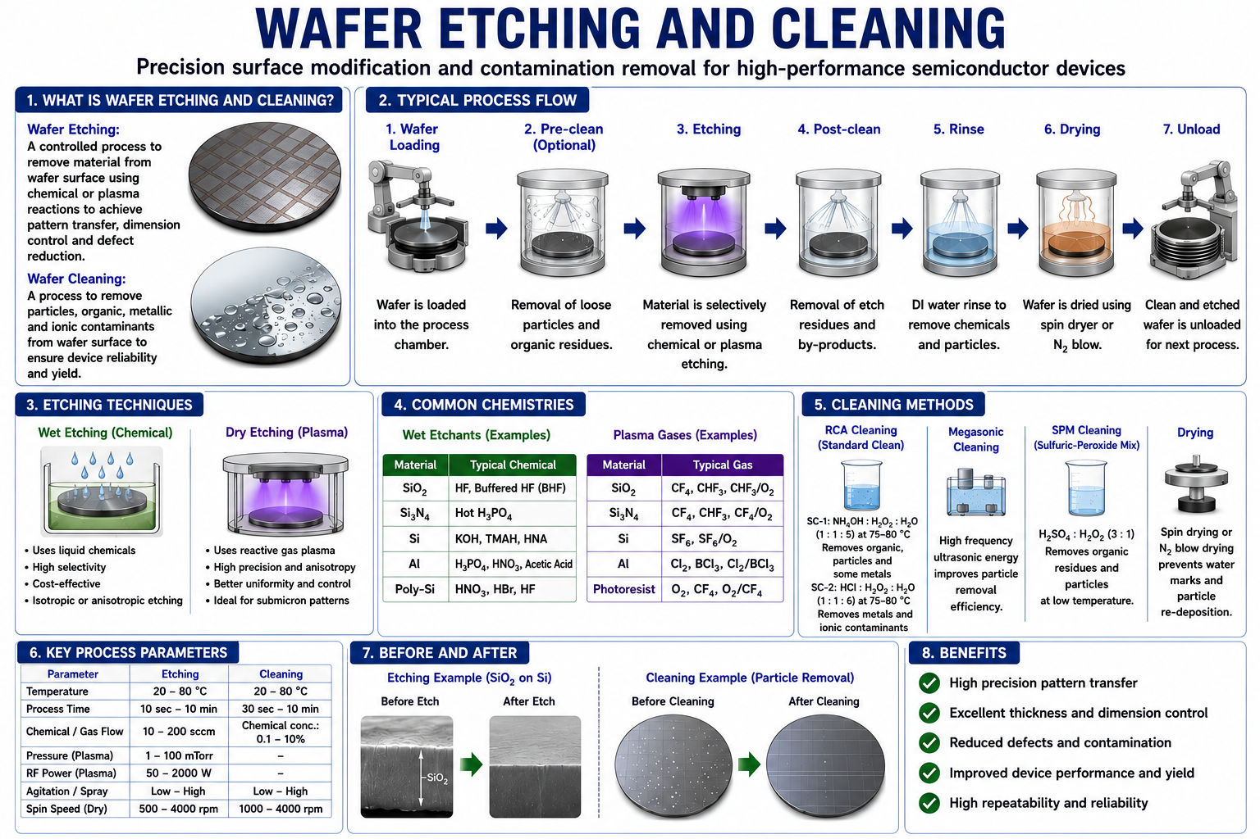

Slide 21
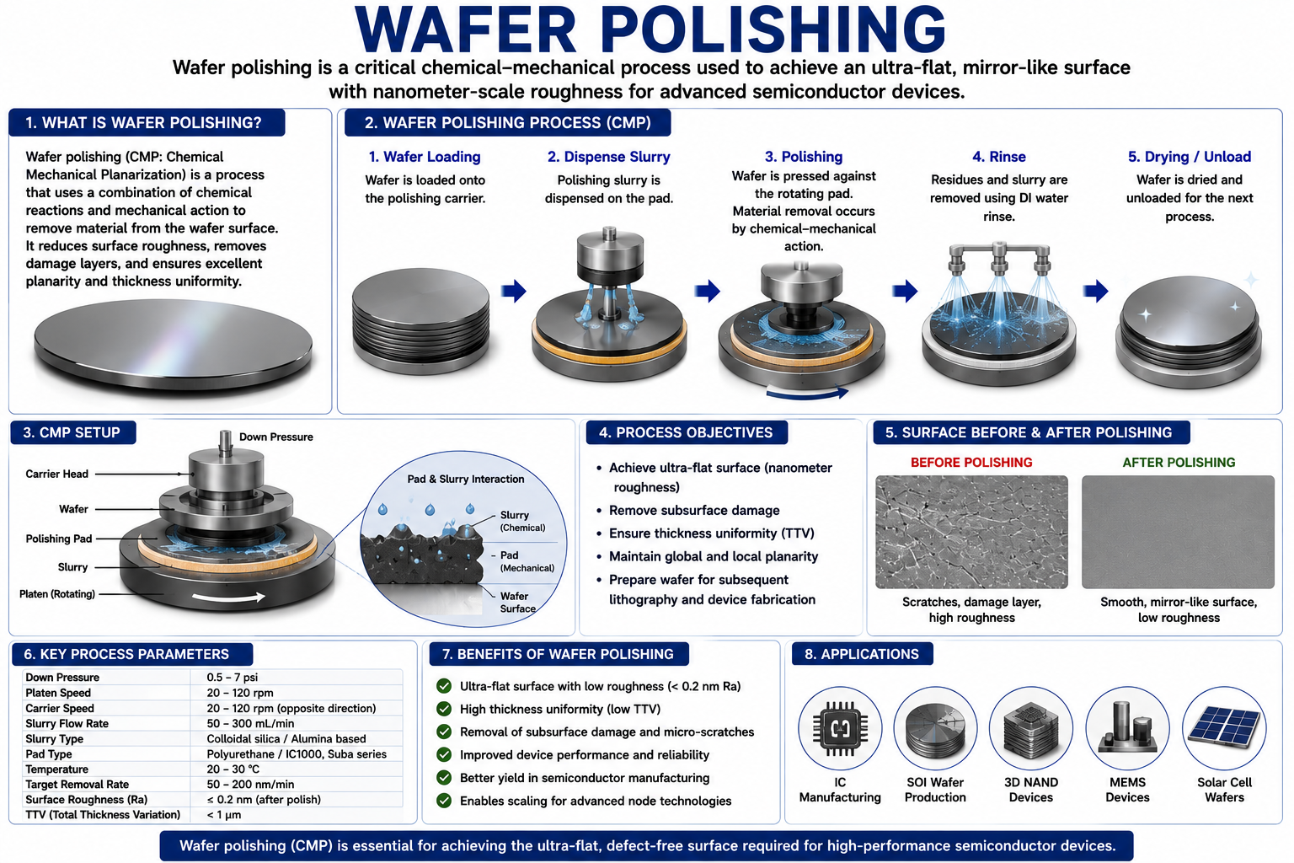

Slide 22
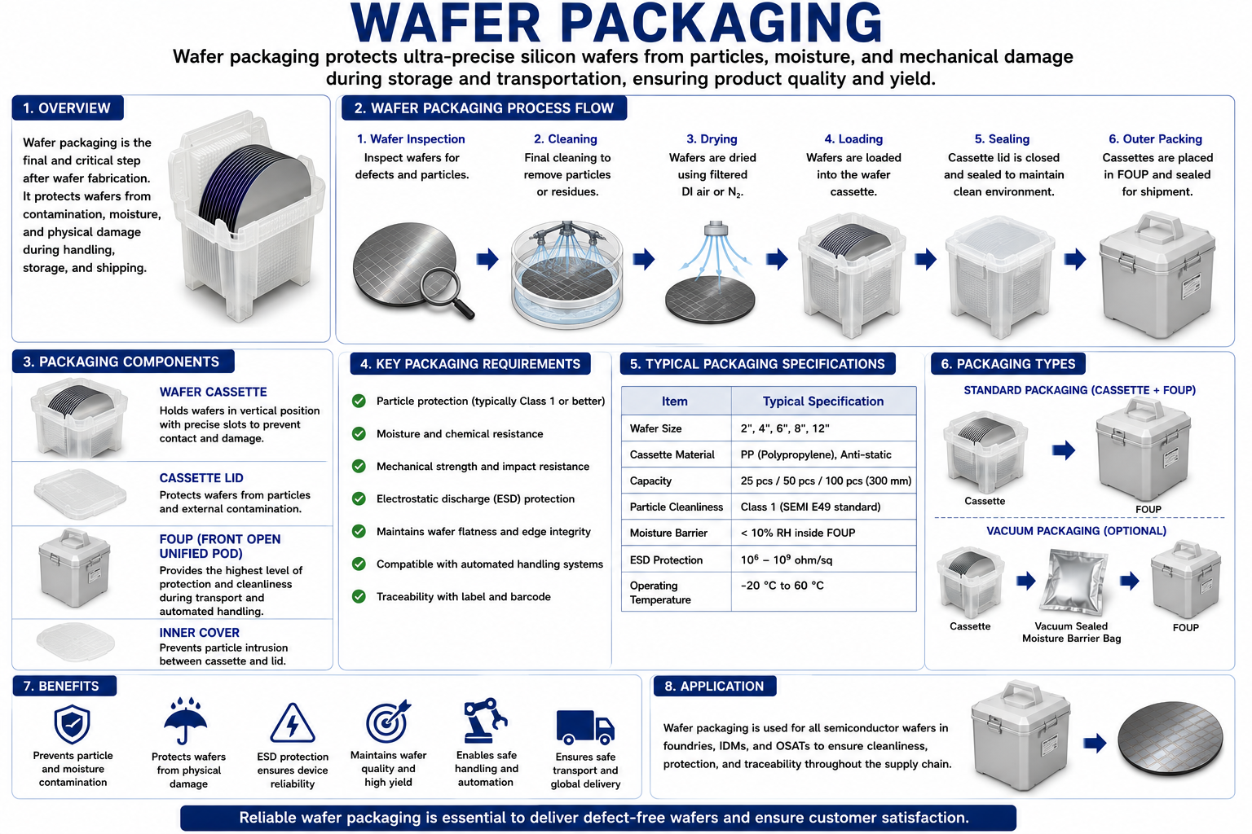

Slide 23
The End

