Slide 1
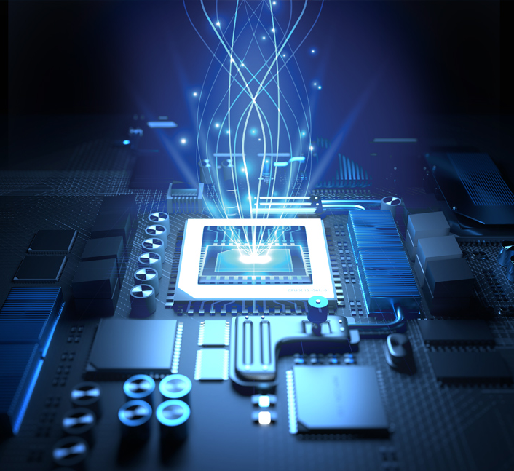
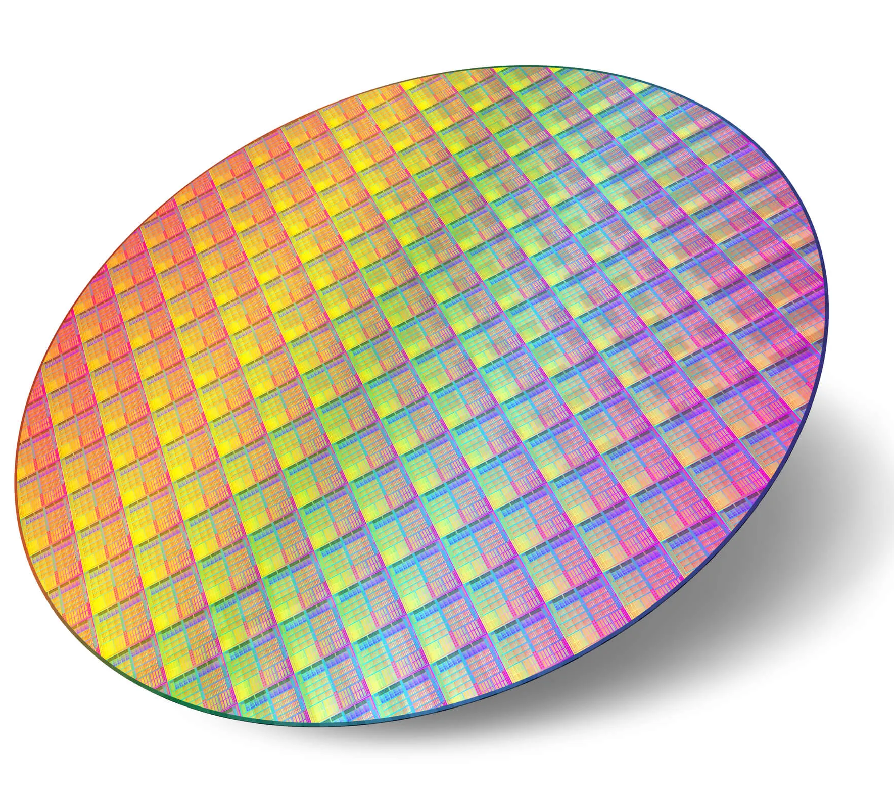
EE 4121
VLSI Design and Technology
Credit: 3.00
Dr. Md. Tawabur Rahman
Professor
Department of Electrical and Electronic Engineering
Khulna University of Engineering & Technology
Notes:
https://slideplayer.com/slide/4885269/

Slide 2
Course Contents
Introduction to microelectronics and MOS technology, basic electrical properties and circuit design processes of MOS and Bi-CMOS circuits, Layout design rules, and sub-system design processes.
Computational elements: design of CPU and ALU sub-system, data path, adder, multipliers, memory, registers, and aspects of system timing, practical aspects of design tools and testability
Device modeling: MOS, diode, bipolar and passive component; CMOS Design: Behavioral description, structural description, physical description, and design verification.
Fabrication and processing technology: Crystal growth, wafer preparation, photolithography, oxidation, diffusion, ion implantation, epitaxial metallization, etching, NMOS and CMOS fabrication technology.
Testing and packaging: Overview of silicon semiconductor technology, power dissipation, packaging, and silicon on insulator. Introduction to GaAs technology: Ultra-fast VLSI circuits and systems.

Slide 3
Course Objectives
Design MOS circuits using the principles of circuit design
Create models of MOS, diode, bipolar, and passive components
Run HDLs and simulate using FPGAs

Slide 4
Course Outcome (CO)
CO1 | Analyze mask layout, DRC, and LVS of VLSI circuits
CO2 | Design different logic gates and basic VLSI building blocks for complete system design
CO3 | Apply HDL to design, synthesize, and implement a digital system

Slide 5
Reference Books
VLSI Technology - S. M. SZE
Silicon VLSI Technology: James D. Plummer, Michael Deal, Peter B. Griffin
Semiconductor Device Physics and Technology - S. M. SZE
Basic VLSI Design: Pucknell
Principle of CMOS VLSI Design – Neil H. E. Weste, Kamran Eshraghian
Design of VLSI Systems: A Practical Introduction: Linda E. M. Brackenbury

Slide 6
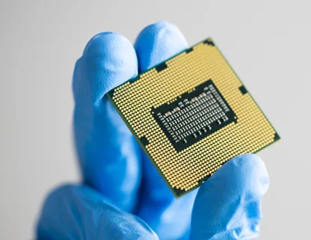
What is VLSI?
VLSI (Very Large Scale Integration) is the process of integrating millions or even billions of transistors onto a single integrated circuit (IC) chip
Key Features:
High transistor density
Compact chip design
High performance
Low power consumption
Cost-effective manufacturing

Slide 7
Evolution of VLSI
SSI (Small Scale Integration): 10–100 transistors
MSI (Medium Scale Integration): 100–1,000 transistors
LSI (Large Scale Integration): 1,000–10,000 transistors
VLSI (Very Large Scale Integration): Millions to billions of transistors
ULSI (Ultra Large Scale Integration): Advanced modern chips

Slide 8
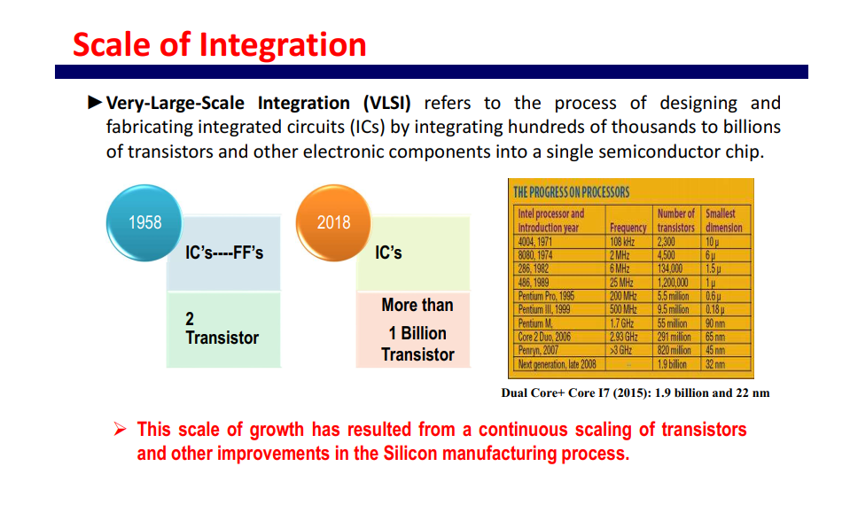

Slide 9
How many transistors are in the Intel Core i9 or Core Ultra 9 Processor?
Modern Core i9: about 20–25 billion transistors, depending on the model
Core Ultra 9 - Not Public

Slide 10
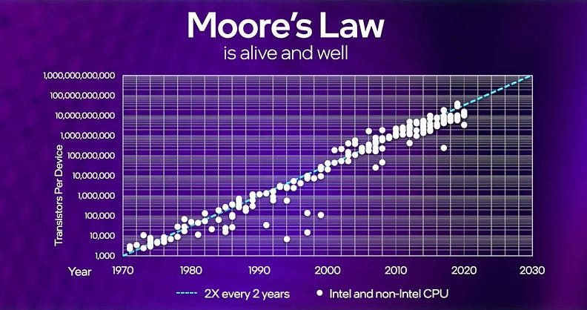
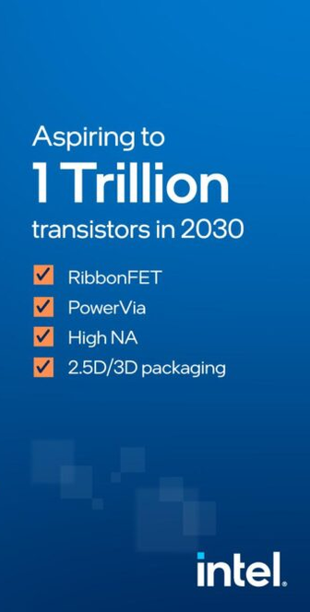
Moore’s Law
1965: Gordon Moore (Intel cofounder) plotted transistor on each chip
Moore's Law states that the number of transistors on a microchip approximately doubles every two years, leading to exponential growth in computing performance while reducing the cost per transistor

Slide 11
Importance/
Advantages of VLSI Technology
Enables miniaturization of electronic devices
Increases processing speed
Reduces power consumption
Improves system reliability
Lowers manufacturing costs
Supports advanced computing applications

Slide 12
Applications of VLSI
Smartphones and tablets
Computers and laptops
Artificial Intelligence (AI)
Internet of Things (IoT)
Automotive electronics
Medical devices
Communication systems
Consumer electronics

Slide 13
Challenges in VLSI
Heat dissipation
Design complexity
Manufacturing cost
Testing and verification
Signal integrity issues
Security concerns

Slide 14
Chip Manufacturing Companies
Company | Country | Specialty
TSMC | Taiwan | World's largest foundry
Samsung Electronics | South Korea | Memory & logic chips
Intel | USA | CPUs & AI chips
GlobalFoundries | USA | Specialty semiconductor manufacturing
SMIC | China | Semiconductor foundry

Slide 15
Chip Design Companies
Company | Main Products
NVIDIA | GPUs & AI chips
AMD | CPUs & GPUs
Qualcomm | Mobile processors
Apple | A-series & M-series chips
Broadcom | Networking chips

Slide 16
Bangladesh in the Global Semiconductor Market
Bangladesh targets chip design, testing, packaging; avoids costly fabrication initially
Government extends semiconductor tax incentives and duty cuts until 2031
Goal: grow semiconductor exports from $8 million to $1 billion
Bangladesh produces thousands of engineering graduates supporting semiconductor talent growth
Local firms already provide international chip design and engineering services
Skills training, infrastructure, and research investment remain major challenges
https://www.tbsnews.net/bangladesh/why-bangladesh-charts-design-first-path-semiconductors-ditching-wafer-fabrication-1469936

Slide 17
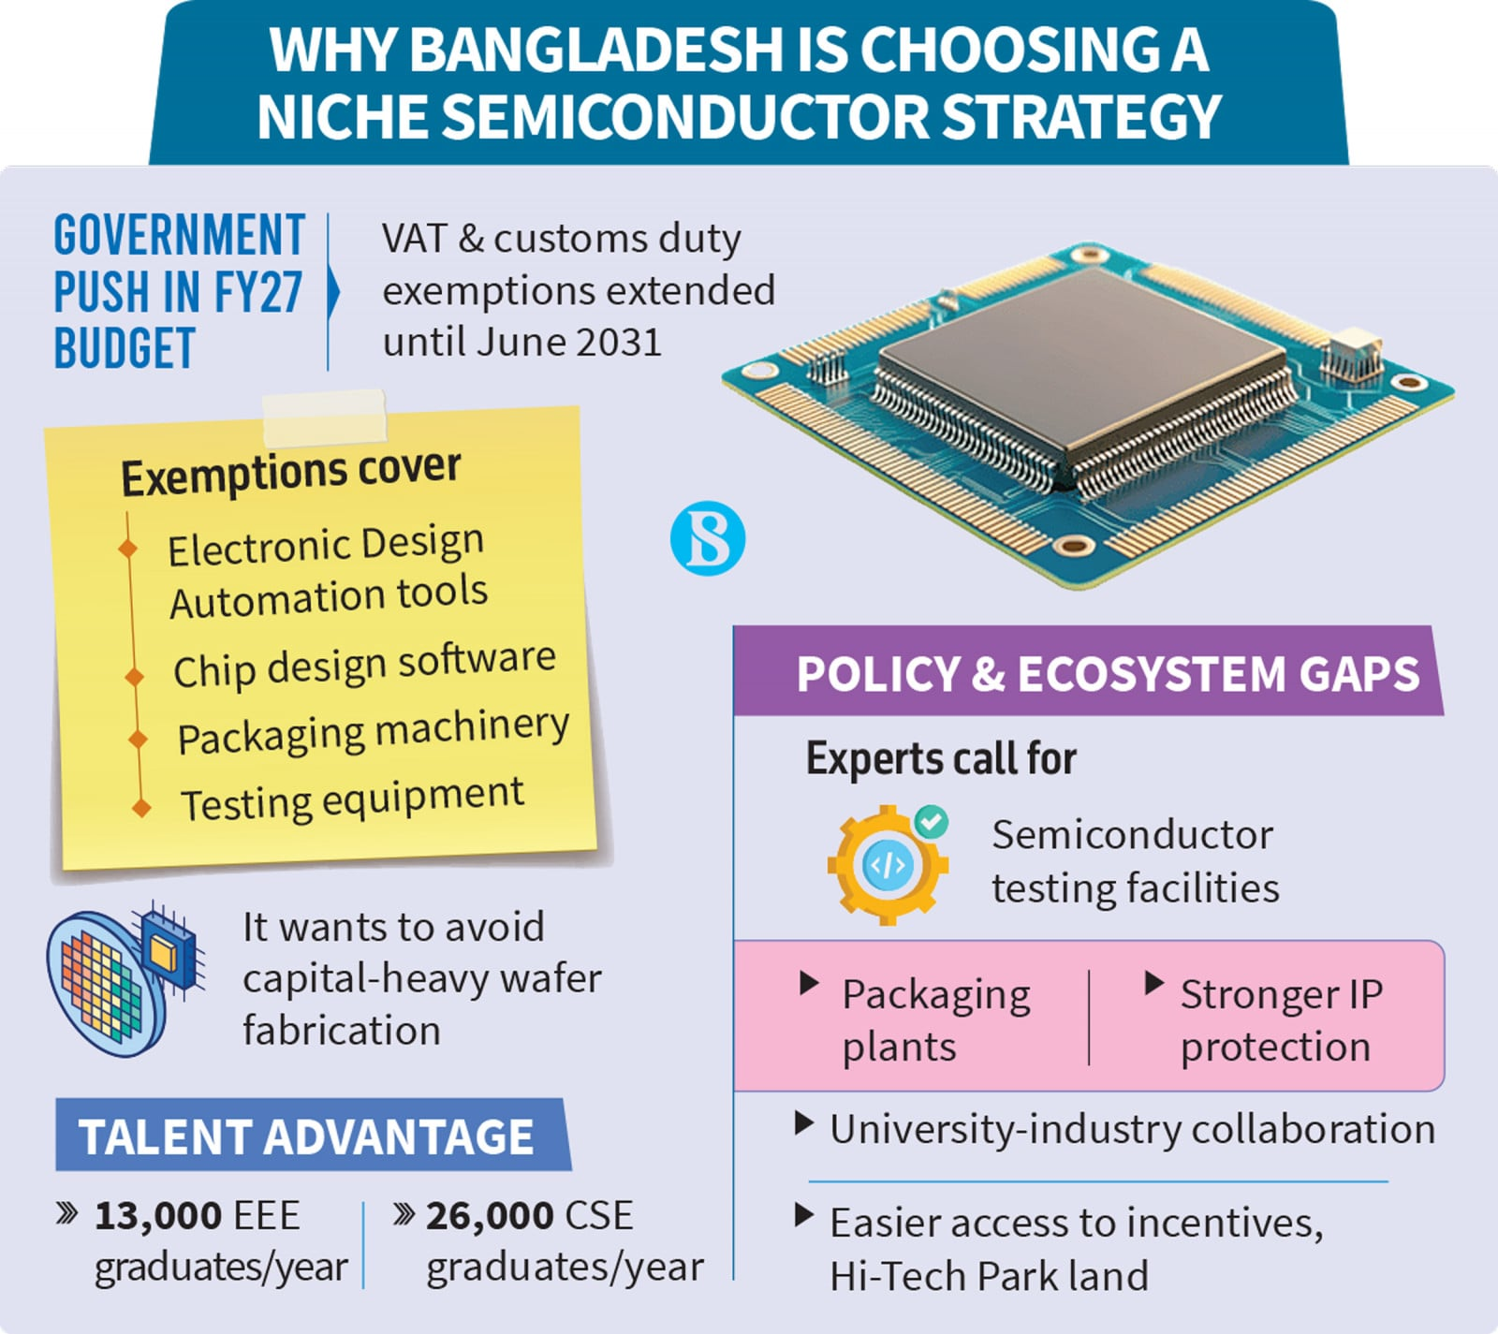

Slide 18
The End

