Slide 1
Lithography
The Art of the Small — patterning the geometry that makes a device
Dr. Md. Tawabur Rahman
Professor
Department of Electrical and Electronic Engineering
Khulna University of Engineering & Technology
Khulna-9203

Slide 2
WHY LITHOGRAPHY?
Simple Layers of Thin Films Do Not Make a Device
Thin-film deposition alone only stacks blanket layers — it cannot build a working transistor.
Building a MOSFET requires precisely shaped source, drain, gate, and interconnect regions.
Modern transistors and interconnects are patterned below 200 nm.
A chip contains 10⁷–10⁸+ devices — every single one must be printed correctly.
Intel demonstrated 30 nm gate transistors by December 2000 — a pace driven entirely by lithography.
n-type
(source)
Gate
n-type
(drain)
Gate Oxide
p-type substrate
A MOSFET device: every region — gate, source, drain — is defined by lithography
2

Slide 3
WHY LITHOGRAPHY?
How Small Is Small? Feature Size vs. Light Source
Submicroscopic patterns must be formed at scales far below what the eye — or even a simple microscope — can resolve.
Object | Approx. Size
Fly | 0.01 m
Hair | 0.0001 m
Erythrocyte (red blood cell) | 0.00001 m
Influenza virus | 0.0000002 m
Light Source | Wavelength
Hg i-line | 365 nm
KrF excimer laser | 248 nm
ArF excimer laser | 193 nm
F₂ laser | 157 nm
EUV | 13 nm
3

Slide 4
DEFINITION
What Is Lithography?
Lithography comes from the Greek “lithos” (stone) and “graphein” (to write) — “writing a pattern on stone.”
It is the transfer of geometric shapes on a mask to a smooth surface (the wafer).
It uses light — or other forms of radiant energy — to change the chemical properties of thin resist films coated on a substrate.
Typically 8–25 lithography steps, and several hundred total processing steps, are required to fabricate one packed integrated circuit.
5

Slide 5
IC FABRICATION
Lithography Within the Top-Down Fabrication Model
Lithography is one of the four major process families used to build an integrated circuit:
1
2
3
4
Lithography
Etching
Deposition
Doping
Define the pattern
Remove material selectively
Add new material layers
Change electrical properties locally
6

Slide 6
LANDSCAPE
Types of Lithography
1
Photolithography
Patterns using UV / deep-UV light through a photomask — the industry workhorse.
2
E-beam Lithography
Direct-write patterning with a focused electron beam; no mask needed.
3
X-ray Lithography
Uses very short-wavelength x-rays for high resolution with low diffraction.
4
Interference Lithography
Exposes resist with interfering coherent beams to create periodic patterns.
5
Scanning Probe Lithography
Uses a nanoscale probe tip to directly modify or pattern a surface.
7

Slide 7
10 KEY STEPS
Overview of the Photolithography Process
1
Surface preparation — remove H₂O, RCA clean, apply adhesion promoter
6
Development — remove soluble photoresist
2
Deposit photoresist by spin casting
7
Hard bake (100–180°C) to increase adhesion
3
Soft bake (90–120°C, 60–120 s) to remove solvent
8
Etching — remove exposed oxide
4
Photomask alignment
9
Stripping — photoresist removal
5
Exposure — pattern transfer via UV light
10
Post-processing / cleaning (ashing)
9

Slide 8
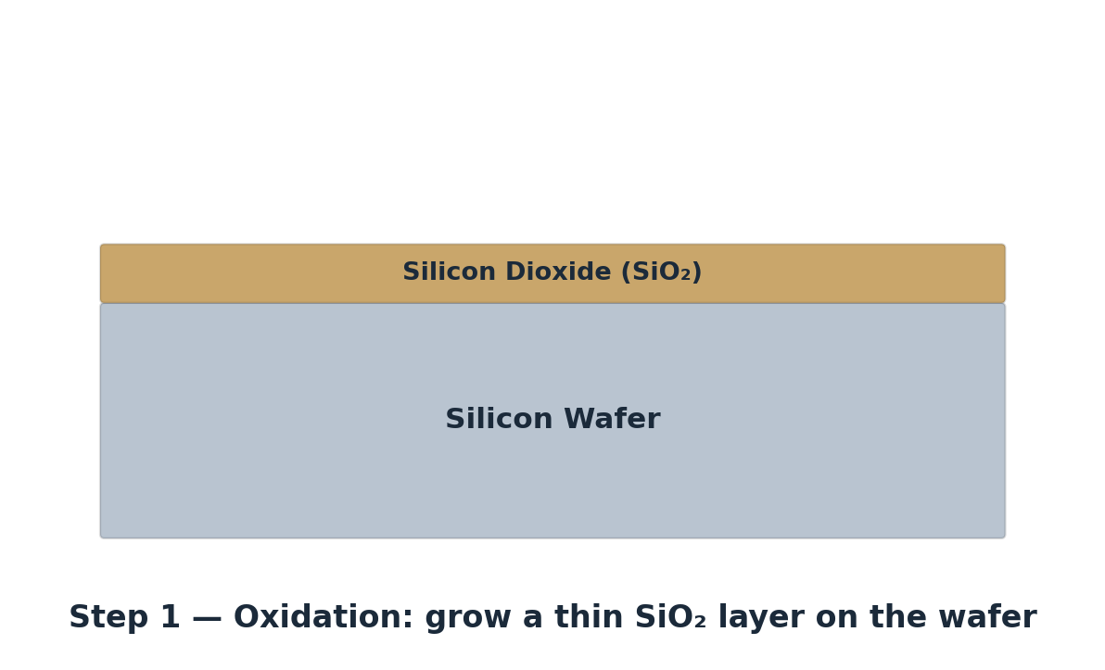
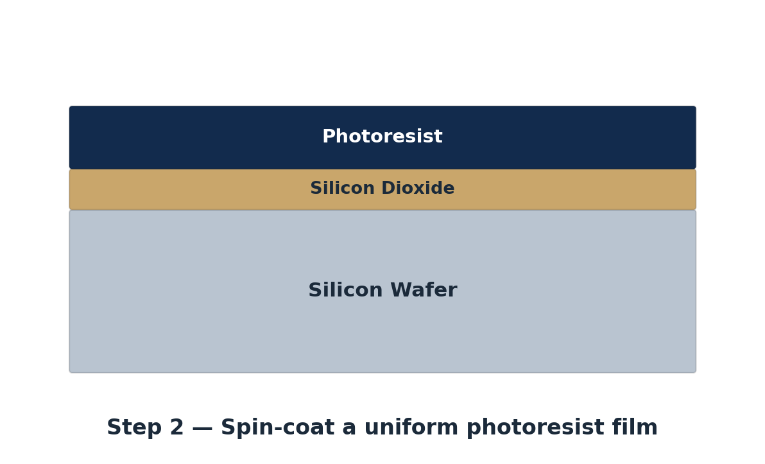
PHOTOLITHOGRAPHY, STEP BY STEP
Process Cross-Sections I — Oxidation & Resist Coating
Step 1 — Oxidation Layering
Step 2 — Photoresist Coating
A thin SiO₂ layer is grown on the wafer, then a photosensitive resist is spin-coated on top — the stack that every subsequent step will pattern.
10

Slide 9
PATTERN PREPARATION
The Photomask & Reticle
A photomask carries the master geometric pattern that will be transferred to every die on the wafer.
A reticle is built from a quartz substrate carrying a chrome pattern, protected by a pellicle membrane.
The pellicle keeps particles away from the focal plane so contamination doesn’t print onto the wafer.
One reticle can be stepped and repeated across an entire wafer to pattern all dies.
Reticle
Chrome Pattern
Quartz Substrate
Reticle cross-section
11

Slide 10
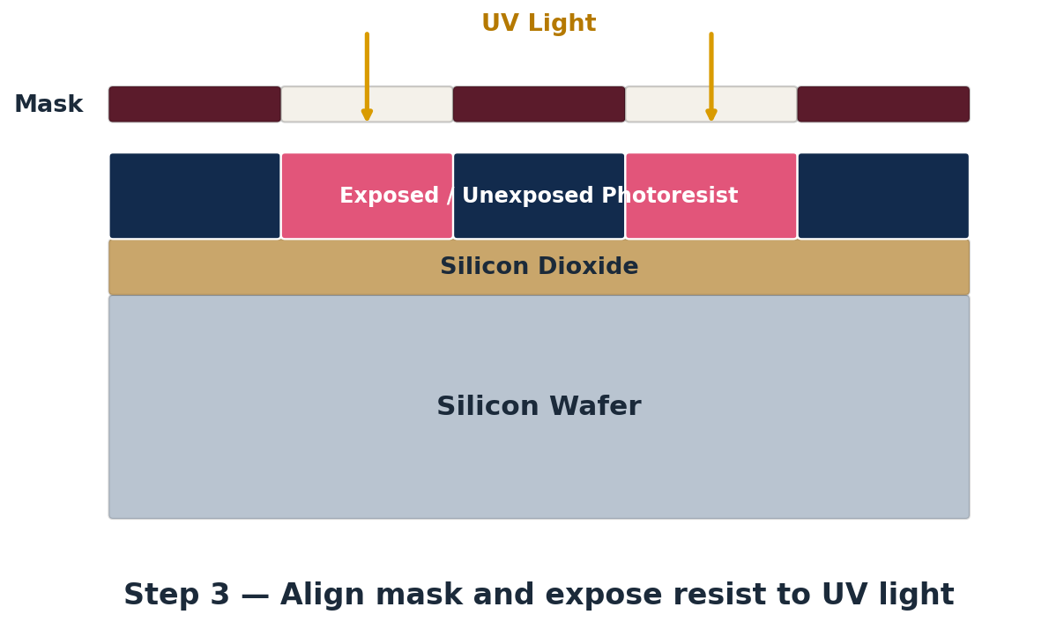
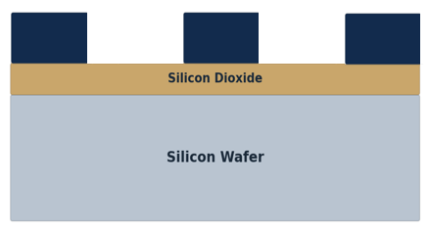
PHOTOLITHOGRAPHY, STEP BY STEP
Process Cross-Sections II — Exposure & Development
Step 4 — Developed Photoresist
Step 3 — UV Exposure Through the Mask
UV light passes through clear regions of the mask and exposes the resist beneath; the developer then dissolves the soluble (exposed, for positive resist) areas, leaving the pattern.
12

Slide 11
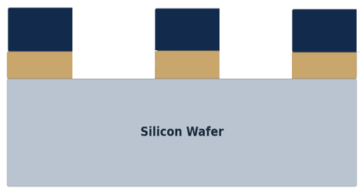
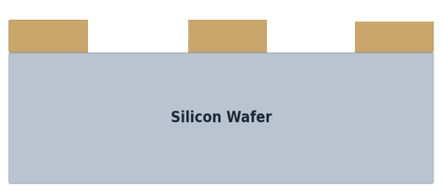
PHOTOLITHOGRAPHY, STEP BY STEP
Process Cross-Sections III — Etch & Strip
Step 5 — Dielectric Etching
Step 6 — Photoresist Ashing
Unprotected oxide is etched away; the remaining photoresist is then stripped by O₂ plasma ashing, leaving only the patterned SiO₂ on the wafer.
13

Slide 12
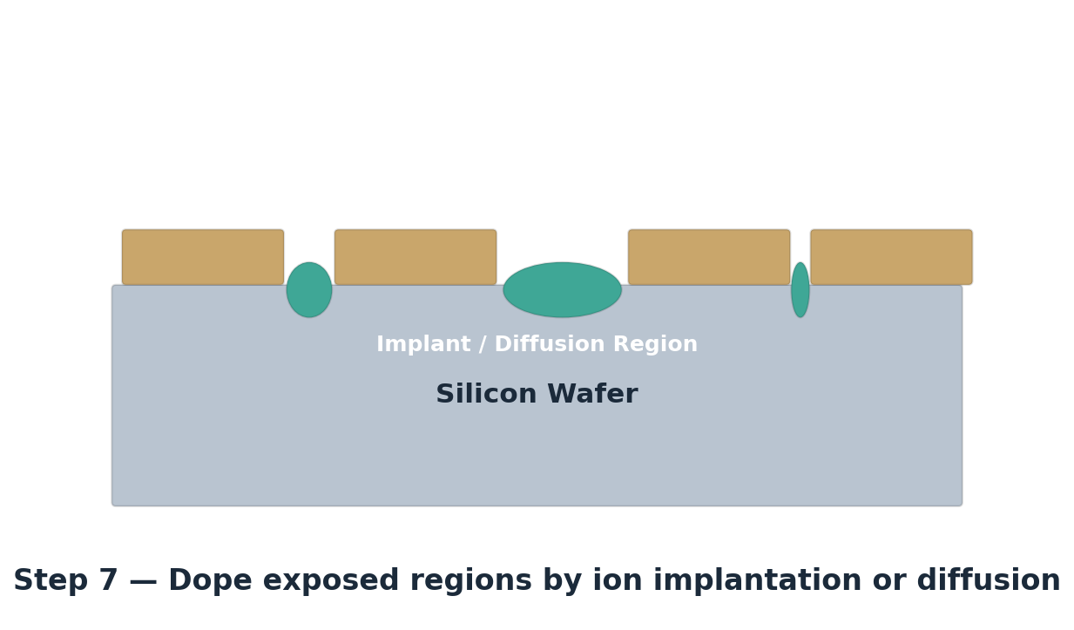
PHOTOLITHOGRAPHY, STEP BY STEP
Process Cross-Section IV — Doping the Pattern
Step 7 — Ion Implantation / Diffusion
With the SiO₂ pattern acting as a self-aligned mask, dopant atoms are introduced by ion implantation or diffusion only into the exposed silicon regions.
14

Slide 13
END-TO-END SEQUENCE
Photolithography Process Flow
Masking Film
(SiO₂ / Si₃N₄)
→
Coat + Soft Bake
Photoresist
→
Mask Alignment
→
Expose → Postbake
→ Develop
→
Etching
→
Stripping
A silicon substrate coated with a masking film is patterned through this repeated sequence — typically 8–25 times per chip — to build up every layer of the device.
Difference between positive and negative resist happens at the development step — see next slide.
15

Slide 14
TWO BRANCHES, ONE SEQUENCE
Positive vs. Negative Photoresist Flow
Spin-on Photoresist → Align & Expose → Development → Etch (wet or dry) → Photoresist Removal
Positive Photoresist
Negative Photoresist
Exposed areas become soluble
Exposed areas become insoluble
Removed in development → mask pattern duplicated
Unexposed areas dissolve in development
Selective etch of oxide/nitride/poly/metal
Selective etch of oxide/nitride/poly/metal
Photoresist stripped, permanent pattern remains
Photoresist stripped, permanent pattern remains
16

Slide 15
WHERE IT IS USED
Applications of Photolithography
1
2
3
4
Fabrication of Microcircuits
Semiconductor Industry
Sensors
Microprocessors
Printed circuit patterns for compact electronic assemblies.
The foundational patterning step for every IC fabrication process.
MEMS and imaging sensor structures rely on lithographic patterning.
Millions to billions of transistors defined layer by layer.
17

Slide 16
APPLYING THE RESIST
Photoresist Coating — Spin Casting
The wafer surface is coated with a photosensitive layer called photoresist, using a spin-on technique.
Spin-coater sequence:
  Apply — resist dispensed at 200–2,000 rpm
  Spin — wafer accelerated to 3,000–7,000 rpm to spread a uniform film
  Stop — spinning halted, film left to set
Apply
(200–2,000 rpm)
Spin
(3,000–7,000 rpm)
Stop
A drop of liquid photoresist is applied to the wafer center, then spun at high speed so centrifugal force spreads it into a thin, uniform film across the entire surface.
18

Slide 17
MATERIAL PROPERTIES
Photoresist Coating — Key Facts
Photoresist is a photosensitive liquid applied to the wafer in small quantities; spinning at roughly 3,000 rpm spreads the “puddle” into a uniform layer between 2 and 200 µm thick.
There are two main types of photoresist: negative and positive.
Negative resist: unexposed portions are removed, leaving a “negative” image; capable of features down to about 2.0 µm.
Positive resist: exposed portions are removed, leaving a “positive” image of the mask pattern; most semiconductor processes today use positive resist, resolving features typically below 1.0 µm and as small as 0.15 µm.
19

Slide 18
POSITIVE RESIST CHEMISTRY
Photoresist Composition — The Chemistry
The most common positive resist consists of diazonaphthoquinone (DQ), the photoactive compound (PAC), combined with novolac (N), the matrix resin.
Upon absorbing UV light, the PAC undergoes a structural transformation (Wolff rearrangement).
This is followed by reaction with water to form a base-soluble carboxylic acid.
The resulting acid is readily soluble in basic developers such as KOH, NaOH, or TMAH.
PAC (DQ)
+ UV light
↓
Wolff Rearrangement (Ketene)
+ Water
↓
Base-Soluble Carboxylic Acid
→ dissolves readily in KOH / NaOH / TMAH developer
20

Slide 19
POST-COATING THERMAL STEP
Soft Bake
Used to evaporate the coating solvent and densify the resist after spin coating.
Typical thermal cycles: 90–100°C for 20 min in a convection oven, or 75–85°C for 45 s on a hot plate.
Commercially, microwave heating or IR lamps are also used in production lines.
Improves adhesion
Improves uniformity
Improves etch resistance
Improves line-width control
Optimizes light absorbance characteristics of photoresist
22

Slide 20
MATERIALS
What Is a Photomask?
Photomasks are high-precision plates containing microscopic images of electronic circuits.
Four material types are used to make photomasks:
  Quartz — the most commonly used, and the most expensive
  LE (low expansion glass), e.g. Pyrex
  Soda lime — a mixture of NaOH and CaO chemicals
  White crown glass
23

Slide 21
BRIGHT FIELD VS. DARK FIELD
Types of Photomask
Bright Field Masks
Dark Field Masks
Opaque features defined by chrome
Background is transparent
Used e.g. for poly and metal layers
Transparent features defined in a chrome background
Background is opaque (chrome)
Used e.g. for contacts, and damascene metals
24

Slide 22
BUILDING UP THE CIRCUIT
Different Photomasks — Layer by Layer
A complete IC is built by successively laying multiple photomask images onto the wafer.
Each mask level adds, refines, or connects a new set of structures — from the first active layer through to the final metal interconnect.
15–20 different mask levels are typically required for a complete IC process.
1st Layer
2nd Layer Added
3rd Layer Added
4th Layer Added
15–20 masks
typically required for a complete IC process
25

Slide 23
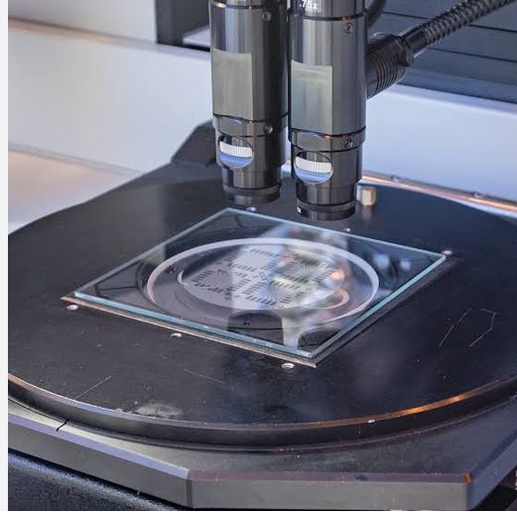
EQUIPMENT
The Photomask Aligner (Mask Aligner)
Aligns the mask precisely to previously defined patterns on the wafer before exposure.
The mask sits in a mask holder, secured by a mask retainer with a foam-rubber mask gasket.
The wafer rests on a vacuum chuck atop a wafer stage.
A height-adjustment ring and (x, y, θ) adjustment micrometers achieve precise registration.
A main chamber gasket seals the assembly for contact or proximity exposure.
27

Slide 24
EXPOSURE OPTICS
Light Sources & Wavelengths
Source | Wavelength | Approx. Resolution
Hg lamp (g-line) | 436 nm | 400 nm
Hg lamp (i-line) | 365 nm | 350 nm
KrF (krypton fluoride) | 248 nm | 150 nm
ArF (argon fluoride) | 193 nm | 80 nm
F₂ (molecular fluorine) | 157 nm | Research
Increasing Cost ↑
Shorter wavelengths give finer resolution but demand harder sources, optics, and mask materials.
EUV (13.4 nm) and X-ray push this further still — covered later in this lecture.
28

Slide 25
EQUIPMENT
Wafer Exposure Systems — The Stepper
UV light is used because modern semiconductor features are so small that the wavelength of the exposing light becomes a limiting factor.
Typical wavelengths: 436 nm (G-line), 405 nm (H-line), 365 nm (I-line), and 248 nm (Deep UV).
Manufacturers have also experimented with 193 nm UV, and with x-rays (shorter wavelength, but with personnel-safety hazards in production).
A stepper exposes one die (or a small field) at a time, then steps to the next position across the wafer, repeating the pattern precisely.
29

Slide 26
THREE TYPES OF EXPOSURE SYSTEMS
Exposure Systems I — Contact & Proximity Printing
Contact Printing
Proximity Printing
Mask
Mask
Photoresist / Wafer
gap
Photoresist / Wafer
Advantages
Advantages
Simple
Low cost
Mask damage is minimal
Good registration possible
Disadvantages
Disadvantages
Poor for small features
Mask damage from contact
Defects from contaminants on mask/wafer
Poorer resolution due to distance from surface
Diffraction errors
30

Slide 27
THE MODERN STANDARD
Exposure Systems II — Projection Printing using Lense
An optical system focuses the light source and reduces the mask image (usually 4x or 5x reduction) for exposure on the wafer surface.
Advantages
  Higher resolution
  Lens system reduces diffraction error
Disadvantages
  Errors due to lens-system focus may occur
  Resolution can be limited by the optical system itself
Light Source
Optical System
Mask
Photoresist
Wafer
4x / 5x reduction projection system
31

Slide 28
POST-EXPOSURE PROCESSING
Develop & Hard Bake
Develop
Hard Bake
Soluble areas of photoresist are dissolved by the developer chemical.
Visible patterns appear on the wafer: windows and islands.
Evaporates remaining solvent; stabilizes and hardens the developed resist before further processing.
Improves adhesion; eliminates solvent burst effects in vacuum processing.
Introduces some stress into the photoresist.
Needed prior to acid etching, e.g. buffered oxide etch (BOE).
32

Slide 29
PATTERN TRANSFER TO THE SUBSTRATE
Etching & Photoresist Removal
Etching
Stripping (Removal)
Oxide is etched with hydrofluoric acid (HF).
The etchant only attacks oxide where the resist has been exposed (removed).
Positive photoresists:
  Acetone
  Trichloroethylene (TCE)
  Phenol-based strippers
Negative photoresists:
  Methyl ethyl ketone (MEK)
  Methyl isobutyl ketone (MIBK)
  Plasma etching with O₂ (ashing) is also effective at removing organic polymer debris.
33

Slide 30
JUDGING A LITHOGRAPHY PROCESS
Performance Metrics & Limitations
Performance Metrics
Limitations of Optical Lithography
Resolution
  Minimum feature dimension that can be transferred with high fidelity to a resist film.
Registration
  How accurately patterns on successive masks can be aligned with previously defined patterns.
Throughput
  Number of wafers that can be exposed per unit time for a given mask level.
Resolution is becoming a challenge for deep-submicron IC process requirements.
Growing complexity of mask production and mask inspection.
High cost of masks.
34

Slide 31
BEYOND OPTICAL LIMITS
Electron Beam Lithography
Involves direct exposure of the resist by a focused electron beam, without a mask.
Resolution as low as 10–25 nm.
An electron gun generates the beam; condenser lenses focus it; beam-blanking plates turn the beam on and off.
Advantages
  Generates submicron resist geometries
  Highly automated and precisely controlled operation
  Greater depth of focus than optical lithography
  Direct patterning on the wafer, no mask required
Disadvantages
  Low throughput
  Expensive resists
  Proximity effect — backscattered electrons irradiate adjacent regions, limiting minimum feature spacing
35

Slide 32
PUSHING PAST DEEP-UV
Next-Generation Lithography — EUV & X-ray
Extreme Ultraviolet (EUV)
X-ray Lithography
Uses very short 13.4 nm light; requires vacuum operation and a laser-plasma source.
All-reflective optics — every material absorbs at this wavelength.
Step-and-scan printing with reduction optics (4x); a very expensive system.
Challenges
  EUV light is strongly absorbed in all materials.
  The whole process must run in vacuum.
  Mask blanks need multilayer coating to minimize reflection loss.
Advantages
  Low diffraction
  Shorter exposure time
  Minimum scattering; x-rays pass through mask openings
Problems
  Masks are the most difficult and critical element of an XRL system
  Lack of suitable photoresists
  Limited to 1:1 printing
  High-energy x-rays destroy conventional optics
36

Slide 33
Extreme Ultraviolet (EUV)
X-ray Lithography
The End
36

