Slide 1
Si
DOPING
Diffusion and Ion Implantation
Prof. Dr. Md Tawabur Rahman
Department of Electrical and Electronic Engineering
Khulna University of Engineering & Technology • Khulna-9203, Bangladesh

Slide 2
INTRODUCTION
What Is Impurity Doping?
SIMPLIFIED WAFER CROSS-SECTION
Impurity doping is the introduction of a controlled amount of impurity dopant into a semiconductor to change its electrical properties
dopant atoms
SiO₂
SiO₂
WHY DOPING MATTERS
doped
region
p-substrate (Si)
1
Forms p-n junctions during wafer fabrication and device processing
2
Alters the type and level of conductivity of semiconductor materials
3
Forms bases, emitters & resistors (bipolar) and drains/sources (MOS)
4
Used to dope poly-silicon layers
2

Slide 3
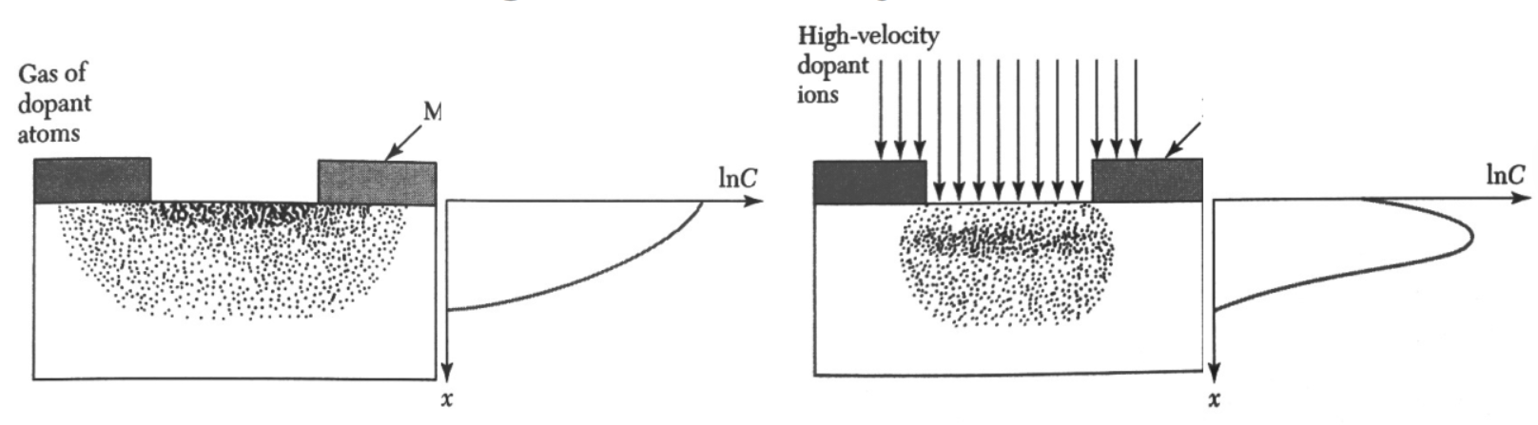
TWO KEY METHODS
Doping Techniques
Diffusion and ion implantation are the two key methods used to introduce impurities into a semiconductor
D
Diffusion
I
Ion Implantation
Dopant atoms move from the surface into silicon by thermal means, via substitutional or interstitial diffusion mechanisms
Carried out in “diffusion furnaces” — accurate, but relatively expensive.
Dopant atoms are forcefully added into silicon in the form of an energetic, high-velocity ion beam
Low-temperature, precisely controlled — but requires specialized equipment
3

Slide 4
TWO KEY METHODS
Doping Techniques
Diffusion and ion implantation are the two key methods used to introduce impurities into a semiconductor
D
Diffusion
I
Ion Implantation
Dopant atoms move from the surface into silicon by thermal means, via substitutional or interstitial diffusion mechanisms
Carried out in “diffusion furnaces” — accurate, but relatively expensive.
Dopant atoms are forcefully added into silicon in the form of an energetic, high-velocity ion beam
Low-temperature, precisely controlled — but requires specialized equipment
3

Slide 5
MATERIALS
Dopant Sources
Dopants are delivered into silicon from three types of source material.
G
S
O
Gas Source
Solid Source
Spin-on-Glass
Reliable, widely-used gaseous dopants delivered directly into the diffusion or implant chamber
A solid dopant wafer (e.g. boron nitride, BN) is placed next to the Si wafer; heating drives dopant oxide onto the silicon surface
A liquid dopant-oxide solution is spun onto the wafer to form a uniform coating before diffusion
AsH₃ · PH₃ · B₂H₆
BN + Si → B-oxide + SiO₂
SiO₂ + dopant oxide
Doping — Diffusion & Ion Implantation
4

Slide 6
DIFFUSION · FUNDAMENTALS
What is Diffusion?
Occurs as a result of a concentration gradient
CONCENTRATION-GRADIENT DIFFUSION
Carried out in systems called “diffusion furnaces”
Fairly expensive, but very accurate
time
Three main dopant sources: gaseous, liquid, and solid
Gaseous sources are most widely used — BF₃, PH₃, AsH₃
Dopant atoms (dark dots) spread from a region of high concentration across a semi-permeable boundary (amber) until more evenly distributed.
Source gas reacts with oxygen on the wafer, forming a dopant oxide that then diffuses into silicon
5

Slide 7
DIFFUSION · PROCESS
Diffusion Steps
Two main steps are used to create doped regions by diffusion.
1
Pre-deposition
2
Drive-in
(for dose control)
(for profile control)
Desired dopant atoms are controllably introduced onto the target using methods such as gas-phase diffusion and solid-phase diffusion.
Once dopant atoms have arrived at the wafer surface, they are redistributed deeper into the bulk — without introducing further dopant atoms.
dopant gas
dopant gas
SiO₂
SiO₂
SiO₂
SiO₂
SiO₂
doped Si region
Si
Si
6

Slide 8
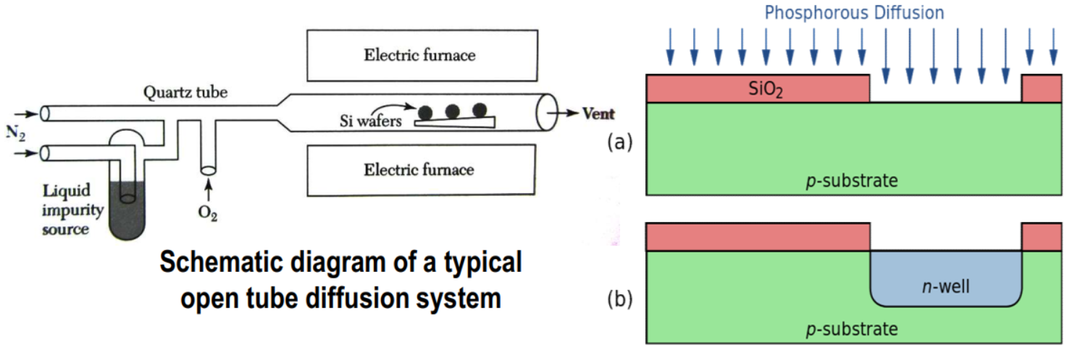
DIFFUSION · WORKED EXAMPLE
Phosphorus Diffusion
CHEMICAL REACTIONS (LIQUID SOURCE)
1. 4 POCl₃ + 3 O₂ → 2 P₂O₅ + 6 Cl₂ — forms a phosphosilicate glass (P₂O₅) on the wafer
2. 2 P₂O₅ + 5 Si → 4 P + 5 SiO₂ — phosphorus is reduced by silicon and released
The released phosphorus diffuses into the silicon, while by-product Cl₂ gas is vented away
OPEN-TUBE DIFFUSION SYSTEM
RESULT: n-WELL IN p-SUBSTRATE
SiO₂
7

Slide 9
ION IMPLANTATION · FUNDAMENTALS
Ion Implantation
A low-temperature process that accelerates ions of a chosen element toward a target wafer, changing its chemical and physical properties
Widely used in semiconductor device fabrication.
ADVANTAGES
1
2
3
4
Precise Control
Low Temperature
Flexible Masking
Lateral Uniformity
Exact control over both dose and depth (range) of the implanted profile
Operates close to room temperature — no need for heat-resistant equipment
Wide selection of masking materials compatible with the process
Excellent lateral dose uniformity across the wafer surface
8

Slide 10
ION IMPLANTATION · EQUIPMENT
Ion Implantation Process
Dopant atoms are ionized, isolated, accelerated, and made to impinge on the wafer surface.
1
2
3
4
Ion Source
Mass Analyzer
Acceleration
Scan & Implant
Gas (AsH₃, PH₃, BF₃) or solid (As, P) source material produces ions of the desired dopant element.
A 90° analyzing magnet bends ions according to mass, selecting only the desired species.
Selected ions are accelerated by a high-voltage field, which sets their final implant energy.
X/Y scanners raster the beam across the wafer; ions strike and embed into the target.
Each ion is either an atom or a molecule; penetration depth depends on ion energy (set by the accelerating field).
Dose = amount of ions implanted on the target. Implant current is small, so achievable dose per unit time is also small — well suited to smaller, precise chemical changes.
9

Slide 11
ION IMPLANTATION · PROFILE
Concentration Profile & Applications
Major application: doping of semiconductors
IMPURITY CONCENTRATION (C) vs. DEPTH (x)
Especially useful with device scaling
Can be used to dope very small regions
Used later in the process flow, when thermal budgets are tight and high-temperature diffusion isn't allowed
Range: the depth below the surface where implant concentration peaks — unlike diffusion, where the maximum is always at the surface.
Ion implantation peaks below the surface (range); diffusion peaks at the surface and falls off with depth.
10

Slide 12
ION IMPLANTATION · POST-PROCESSING
Effect of Ion Implantation
!
Damage: High-energy ions striking the wafer surface knock silicon atoms out of position, causing local structural (crystal lattice) damage.
REPAIR: POST-IMPLANT THERMAL ANNEALING
1
Tube Furnace Annealing
2
Rapid Thermal Annealing
Low-temperature anneal, roughly 600–1000°C, chosen to minimize unwanted lateral diffusion of the dopant while still repairing lattice damage.
Uses higher temperatures than a tube furnace, but for much shorter durations — repairing damage while further limiting dopant movement.
11

Slide 13
SUMMARY COMPARISON
Diffusion vs. Ion Implantation
Diffusion
Ion Implantation
Definition
Motion of impurities inside a substance via thermal means
Low-temperature process forcing ions into a material via an energetic beam
Directionality
Isotropic — includes significant lateral diffusion
Very directional — minimal lateral spread
Temperature
Done at high temperatures
Done at low temperatures (near room temp.)
Dose control
Amount of dopant cannot be precisely controlled
Amount of dopant can be precisely controlled
Surface damage
Does not damage the target surface
May damage the target surface (needs annealing)
Cost
Comparatively less expensive
More expensive — requires specialized equipment
12

Slide 14
Key Takeaways
1
Doping introduces controlled impurities to tailor a semiconductor's electrical behavior
2
Diffusion relies on thermal, concentration-driven movement of dopants — accurate but isotropic and costly
3
Ion implantation fires an energetic ion beam for precise, directional, low-temperature doping
4
Ion implantation requires post-anneal to repair lattice damage; diffusion does not
5
Both techniques remain essential, complementary tools in modern wafer fabrication
13

