Slide 1
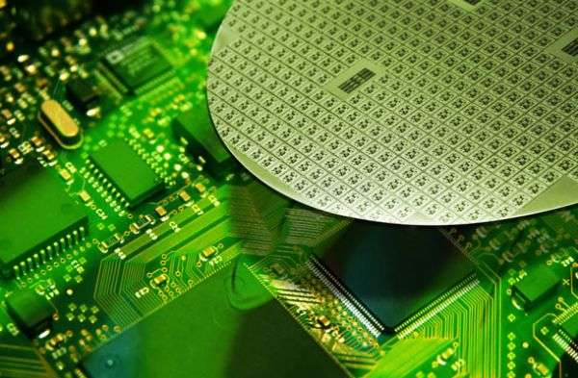

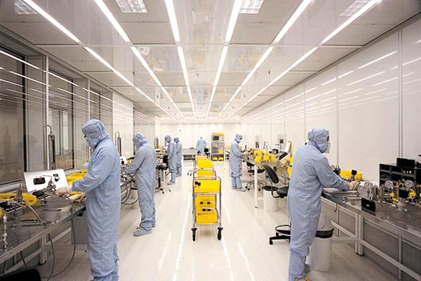
Etching
Department of Electrical and Electronic Engineering
Khulna University of Engineering & Technology
Khulna-9203

Slide 2
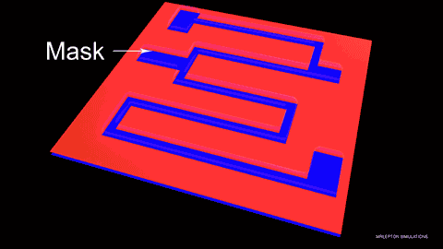
Etching
Etching is the process where unwanted areas of films are removed by either dissolving them in a wet chemical solution (Wet Etching) or by reacting them with gases in a plasma to form volatile products (Dry Etching).
Resist protects areas which are to remain. In some cases a hard mask, usually patterned layers of SiO₂ or Si₃N₄, are used when the etch selectivity to photo-resist is low or the etching environment causes resist to delaminate.
This is part of lithography - pattern transfer.

Slide 3
Necessity of Etching
To remove material from areas identified by the lithography process
To create structures for functional use
To remove oxide layers below features to allow for motion

Slide 4
Etching Methods
Etching is done either in “dry” or “wet” methods:
Wet etching uses liquid etchants with wafers immersed in etchant solution
Wet etch is cheap and simple, but hard to control (not reproducible), not popular for Nano for pattern transfer purpose
Dry etching uses gas phase etchants in a plasma, both chemical and physical (sputtering process)
Dry plasma etch can be used for many dielectric materials and some metals (Al, Ti, Cr, Ta, W…).
For other metals, ion milling (Ar⁺) can be used, but with low etching selectivity. (as a result, for metals that cannot be dry-etched, it is better to pattern them using liftoff)
Generally, chemical etching has high selectivity, physical etching (sputtering, milling) has low selectivity.

Slide 5
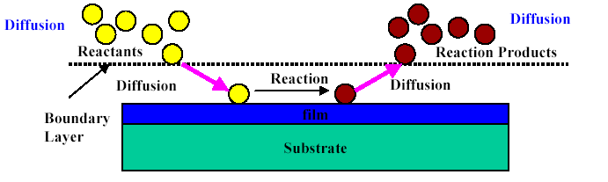
Etching Basic
Etching is consisted of 3 processes:
Mass transport of reactants (through a boundary layer) to the surface to be etched
Reaction between reactants and the film to be etched at the surface
Mass transport of reaction products from the surface through the surface boundary layer

Slide 6
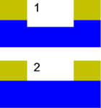
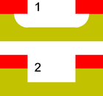
Figures of Merit
Selectivity
Blue: layer to remain
1. A poorly selective etch removes the top layer, but also attacks the underlying material.
2. A highly selective etch leaves the underlying material unharmed
Isotropy
Red: masking layer;
Yellow: layer to be removed
1. A perfectly isotropic etch produces round sidewalls.
2. A perfectly anisotropic etch produces vertical sidewalls

Slide 7
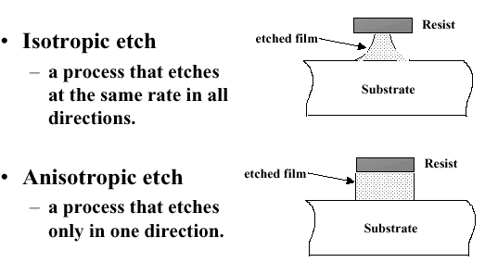
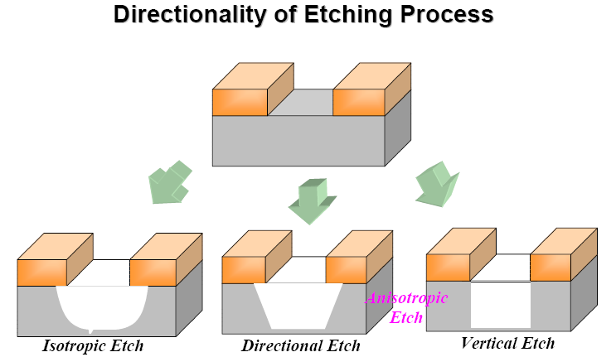
Figures of Merit

Slide 8
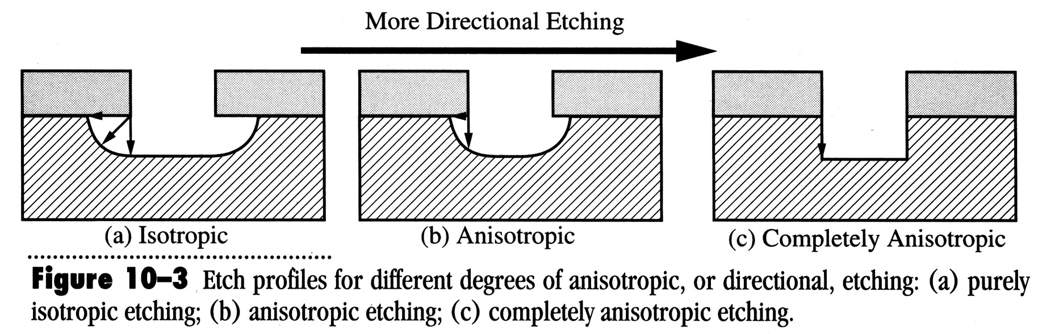
Isotropic vs. Anisotropic
Generally speaking, chemical process (wet etch, plasma etch) leads to isotropic etch; whereas physical process (directional energetic bombardment) leads to anisotropic etch.
Isotropic:
  Best to use with large features when sidewall slope does not matter, and to undercut the mask (for easy liftoff).
  Large critical dimension (CD, i.e. feature size) loss, generally not for nano-fabrication.
  Quick, easy, and cheap.
Anisotropic:
  Best for making small features with vertical sidewalls, preferred pattern transfer method for nano-fabrication and some micro-fabrication.
  Typically more costly.

Slide 9
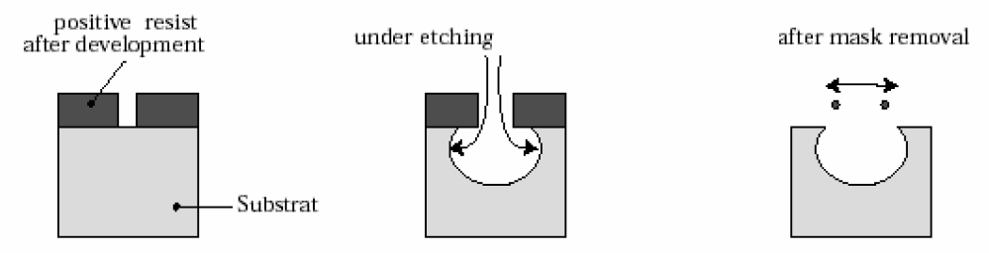
Wet Chemical Etching/Wet Etching
Wet Chemical Etching:
Regions in the wafer are “dissolved” away by chemical reactions.
Technique cannot produce sharp “sidewalls,” since etching is isotropic.
Wet chemical etching is used for products with feature sizes greater than 2 µm
Etching rate:
The etch rate can be controlled by any of the three serial processes (reactants transport to the surface, reaction, reaction products transport from the surface).
Preference is to have reaction rate controlled process because
    Etch rate can be increased by temperature
    Good control over reaction rate – temperature of a liquid is easy to control
Mass transport control will result in non-uniform etch rate: edge etches faster.

Slide 10
Wet Chemical Etching/Wet Etching
Advantages:
Damage-free finish to wafer surface where surface morphology is typically smooth and shiny
Fast etch rate especially for blanket etch (μm/min)
Etching is only chemical: great selectivity
Simple and direct etching process since simple resist can be used as etch mask
process occur at atmospheric environment
Cheaper cost
High etch selectivity easily available for etchants, resist and etched materials
good etch uniformity across wafer
Disadvantages:
Isotropic etching
No control for precision etching
Not well suited for nanostructures.
Poor process control,
Not well reproducible.

Slide 11

Application of Wet Process
Silicon etching:
For semiconductor materials, wet chemical etching usually proceed by oxidation followed by the dissolution of the oxide by a chemical reaction.
For silicon, the most commonly used etchants are mixture of nitric acid (HNO₃) and hydrofluoric acid (HF) in water or acetic acid (CH₃COOH)
Si + 4HNO₃ → SiO₂ + 2H₂O + 4NO₂
Hydrofluoric acid is used to dissolve the SiO₂ layer
SiO₂ +6HF → H₂SiF₆ + 2H₂O
Silicon dioxide etching:
Dilute solution of HF with or without the addition of ammonium fluoride (NH₄F) is used for wet etching.

Slide 12
Application of Wet Process
Silicon nitride and Poly-silicon Etching:
Silicon nitride films are etchable at room temperature in concentrated HF or buffered HF and in a boiling H₃PO₄ solution.
Selective etching of nitride to oxide is done with 85% H₃PO₄ at 180ºC because this solution attacks silicon dioxide very slowly. Silicon rate for silicon nitride is 10nm/min but less than 1nm/min for silicon dioxide
Gallium Arsenide Etching:
The most commonly used etchants are the H₂SO₄-H₂O₂-H₂O and H₃PO₄-H₂O₂-H₂O.
For an etchant with an 8:1:1 volume ration of H₂SO₄:H₂O₂-H₂O, the etch rate is 0.8 µm/min for <111> Ga face and 1.5 µm/min for all other faces.

Slide 13
Dry Etching
In dry Etching, material removal reactions occur in the gas phase. It can be plasma or non-plasma based.
Advantages
Eliminates handling of dangerous acids and solvents
Uses small amounts of chemicals
Isotropic or anisotropic etch profiles
Faithful pattern transfer into underlying layers (little feature size loss)
Directional etching without using the crystal orientation of Si
High resolution and cleanliness
Less undercutting
No unintentional prolongation of etching
Better process control
Ease of automation
Disadvantages:
Some gases are quite toxic and corrosive
Re-deposition of no volatile compounds
Need for specialized expensive equipment

Slide 14
Types of Dry Etching
Non-plasma based - uses spontaneous reaction of appropriate reactive gas mixture.
Plasma based - uses radio frequency (RF) power to drive chemical reaction.

Slide 15
Non-Plasma based Dry Etching
Isotropic etching of Si
Typically F-containing gases(fluorides or interhalogens) that readily etch Si
High selectivity to masking layers
No need for plasma processing equipment
Highly controllable via temperature and partial pressure of reactants
Xenon di-fluoride (XeF₂) etching of Si:
2XeF₂ + Si → 2Xe (g) + SiF₄ (g)
XeF₂ is a white powder, with vapor pressure ∼3.8 Torr at 25ºC.
Typical etch rate ∼1μm/min
Heat is generated during exothermic reaction
Popular for MEMS application
MEMS: micro electro mechanical systems
15

Slide 16
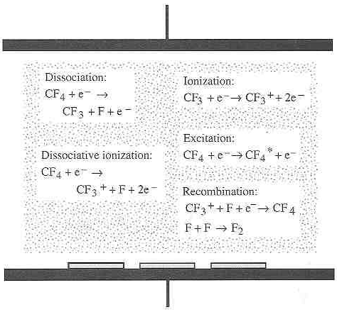
What is a Plasma?
A plasma is a partially ionized gas made up of equal parts positively and negatively charged particles.
Plasmas are generated by flowing gases through an electric or magnetic field.
Plasma consists of: ionized atoms/molecules + free electrons, free radicals (neutral)
Various reactions and species
present in a plasma

Slide 17
Plasma Etching
Two components existed in plasma
Ionic species results in directional etching.
Chemical reactive species results in high etch selectivity.
Control of the ratio of ionic/reactive components in plasma can modulate the dry etching rate and etching profile.

Slide 18
Plasma Etching Types
Chemical etching: free radicals react with material to be removed. E.g. plasma etching at high pressure close to 1Torr.
Physical etching or sputtering: ionic species, accelerated by the built-in electric field (self-bias), bombard the materials to be removed. E.g. sputter cleaning using Ar gas in sputter deposition system.
Ion enhanced etching: combined chemical and physical process, higher material removal rate than each process alone. E.g. reactive ion etching (RIE), which is the most widely used dry etching technique.
High density plasma etching
Physical Process
Chemical Process
Reactive Ion etching
Ion milling & Sputter etching
Wet etching
Plasma etching
Pressure
Energy (power)
Selectivity
Anisotropicity

Slide 19
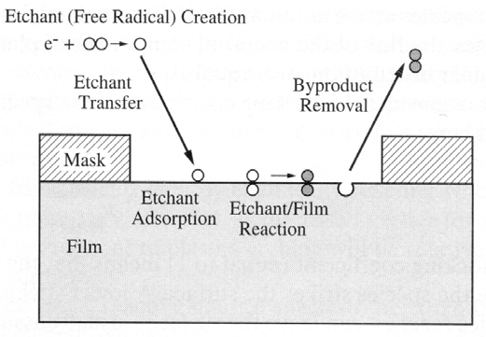
Plasma Etching (Chemical)
In a plasma, reactive neutral chemical species (free radicals, e.g. F atoms or molecular species CF₃) are mainly responsible for the chemical reaction due to their much greater numbers compared to ions.
Those free radicals are more abundant than ions because:
1) they are generated at lower threshold energy (e.g. < 8eV; in comparison, Ar is ionized at 15.7eV); and
2) they (uncharged radicals) have longer lifetime in the plasma.
The neutral radicals arrive at cathode surface by diffusion (thus non-directional).
Chemical etching
Due to their incomplete bonding,
free radicals are highly reactive
chemical species.

Slide 20


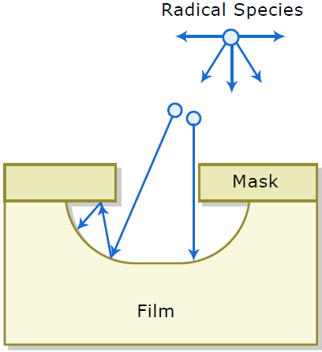
Plasma Etching (Chemical)
Due to their incomplete bonding (incomplete outer shells), free radicals (neutral, e.g. CF₃ and F from CF₄ plasma) are highly reactive chemical species.
Free radicals react with film to be etched and form volatile by-products.
Pure chemical etch is isotropic or nearly isotropic, and the etching profile depends on arrival angle and sticking coefficients of free radicals.

Slide 21
Plasma Etching (Chemical)
Advantages:
Lower chemical costs
Reduced environmental impact
Greater cleanliness
Greater potential for production-line automation.
Disadvantages:
Plasma etch has lower selectivity than wet etching
Pure chemical etch is isotropic or nearly isotropic
High RF levels can cause damage to the wafer

Slide 22
Plasma Etching (Physical)
Physically bombard the films to be etched with energized chemically inert ions or atoms
Material is removed by ion bombardment of the substrate. This process is most often used to pre-clean substrates prior to deposition.
Gas discharge is used to energize chemically inert ions or atoms(e.g. Ar)
Highly anisotropic etching
Damage to underlying material—may change device properties
Rarely used in VLSI

Slide 23
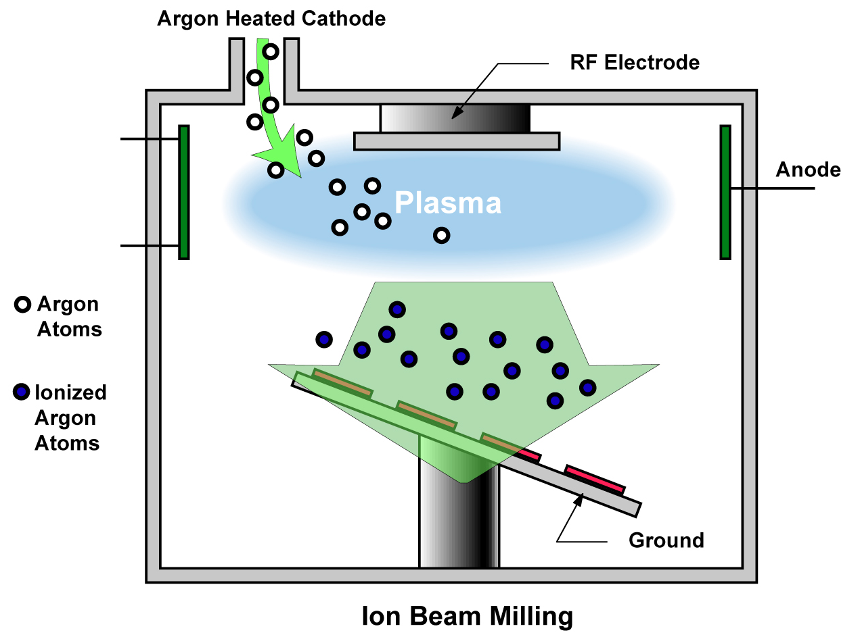
Sputtering Etching/Ion Milling
Physical milling when using heavy inert gases (Ar).
Plasma is used to generate ion beam (Ar⁺), which is extracted and accelerated to etch the sample. (i.e. sample outside of plasma)
Thus the ion density (determined by plasma source) and ion energy (determined by DC acceleration voltage – bias by applied DC voltage, not by RF bias as in high density plasma etching system), can be controlled independently.
High acceleration voltage (>1kV), leading to mill rate ∼10-30nm/min.
Used whenever RIE is not possible (due to the lack of volatile species formation). Usually employed to etch Cu, Ni, Au, superconducting materials containing metals…
Low pressure ∼10⁻⁴Torr (>1 order lower than RIE), so large mean free path and less energy loss due to collision. (such low pressure cannot sustain a plasma, so ion milling is not plasma etching)

Slide 24
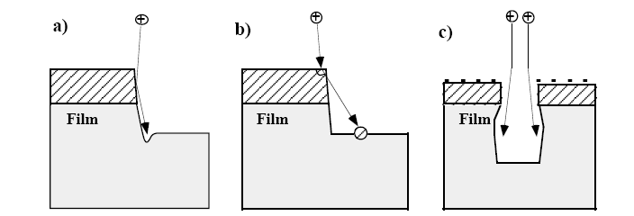
Sputtering Etching/Ion Milling
Poor selectivity (2:1 or 1:1), very anisotropic.
Sputtering rate depends on sputter yields which can be a function of incident angle.
Problems include faceting (sputter yield is a function of incident angle), trenching, re-deposition, charging and ion path distortion, radiation damage.
Not popular, etches too slow, though reactive gas (CF₄, CCl₄, O₂) can be added to slightly improve selectivity and etching rate.
Problems associated with sputter etching (or any etching that has a high degree of physical/ionic etching): a) trenching at bottom of sidewalls; b) redeposition of photoresist and other materials; c) charging and ion path distortion.
Notes:
Ion Beam Milling :
Ions beam is used to “chisel”off material from a wafer. The process is physical rather than chemical. Feature sizes < 0.1 µm can be produced
Sputtering (Ion Milling or Ion Beam Etch)
Reduced pressure environment (<50 mTorr)
Increases mean free path between molecules
Fewer collisions between molecules
Inert gas injected at low pressure is used as “milling” tool

Slide 25
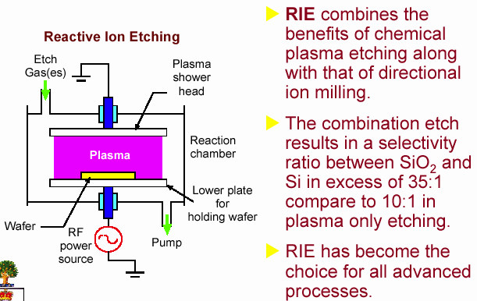
Plasma Etching (Chemical+Physical)
Reactive Ion Etching (RIE)------Combination of chemical and physical etching
Directional etching due to ion assistance.

Slide 26
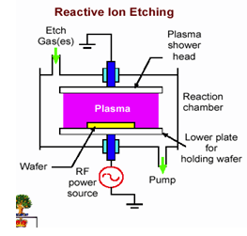
Reactive Ion Etcing (RIE)
In RIE processes, the wafers sit on the powered electrode substrates in a low pressure halogen-rich environment.
This placement sets up a negative bias on the wafer which accelerates positively charge ions(chemically inert ions) toward the surface.
Moreover, glow discharge is used to produce chemically reactive species (atoms, radicals, or ions)
Therefore, the material can be removed by both chemical means and ion bombardment of the substrate surface.

Slide 27
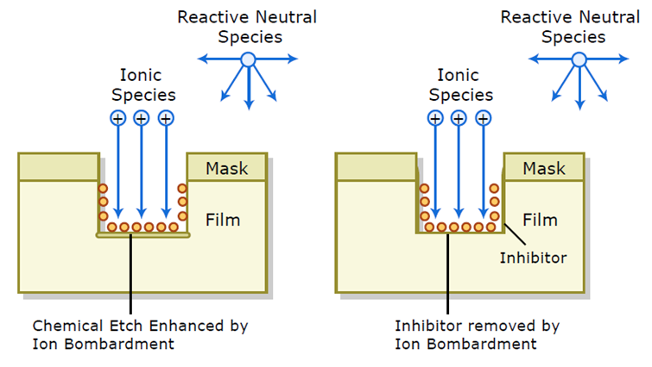
Reactive Ion Etcing (RIE)
RIE is an anisotropic (due to directional ion bombardment) and highly selective (due to chemical reaction) etching process.
  Anisotropic Profile
  Higher Etch Rate than either process
  Higher selectivity ratio than physical etch
  Smaller feature sizes possible
  To Greater control over line widths and edge profiles is possible with oxides, nitrides, poly-silicon and aluminum.
  Widely used in VLSI fabrication

Slide 28
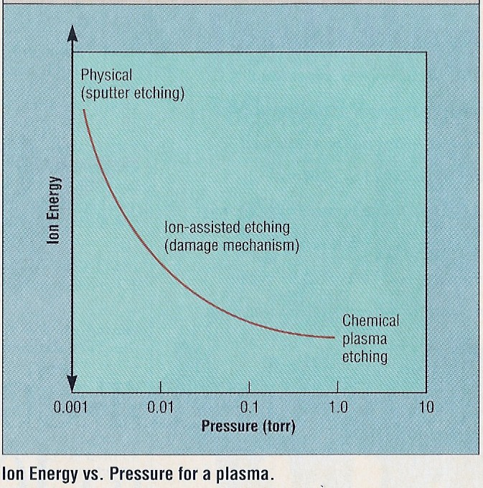
Ion Energy vs. Pressure for a Plasma

Slide 29
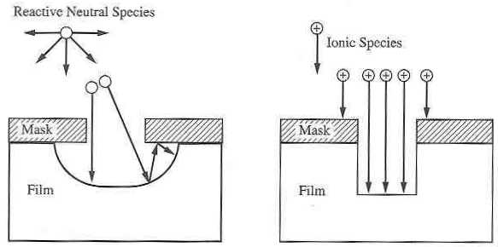
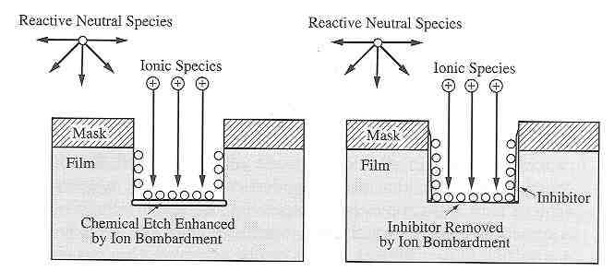
Chemical—Physical---Chem.+Phys.
Physical etching
(using ionic species)
Chemical + physical etching
(using reactive neutral species
and ionic species)
Anisotropic etching
Purely chemical etching
(using only reactive
neutral species)
Isotropic etching

