Slide 1

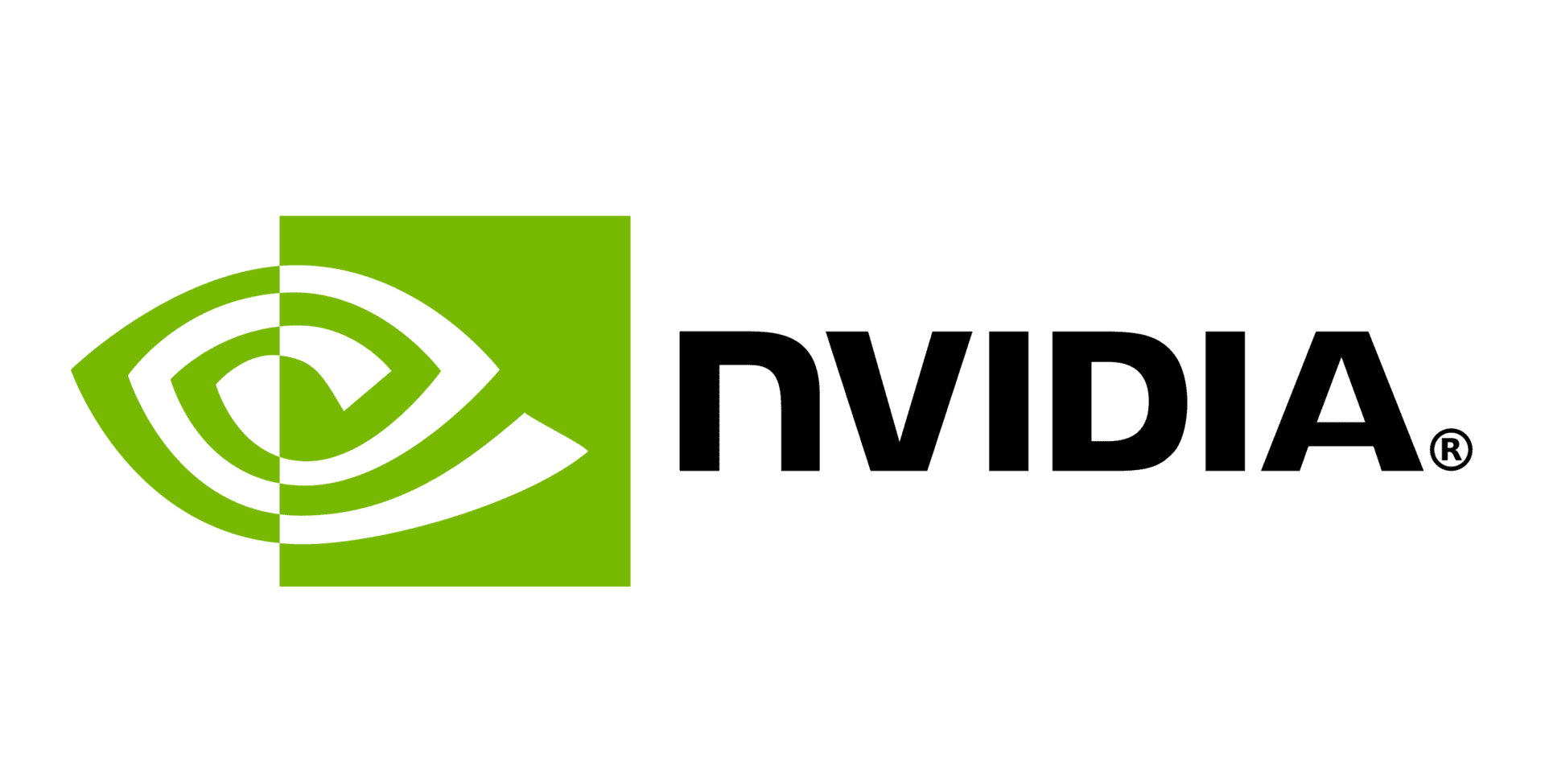
Locality-Centric Data and Threadblock Management for Massive GPUs
Mahmoud Khairy, Vadim Nikiforov, David Nellans, Timothy G. Rogers
MICRO 2020 – 9/19/2020
MICRO 2020 – 9/19/2020
Notes:
Hello everyone, my name is Mahmoud. In this talk, I will briefly discuss our work, Locality-Centric Data and Threadblock Management for Massive GPUs

Slide 2
GPU Performance Scalability is at Risk!
??
@7-3nm
Low Yield
Very Expensive
Transparent Scaling
Volta GPU
21B Tr @12nm
Pascal GPU
15B Tr @16nm
Normalized Performance
Maxwell GPU
8B Tr @28nm
Number of SMs
Scaling all the GPU resources: Increasing SMs, memory bandwidth and interconnection bandwidth.
Notes:
Thanks to high levels of inherent parallelism, many GPU workloads will be able to strongly scale performance, if large enough GPUs can be built.
However, recent work has shown that building GPUs with hundreds of SMs in a single monolithic chip will not be practical due to slowing growth in transistor density and low chip yield at small technology node.

Slide 3
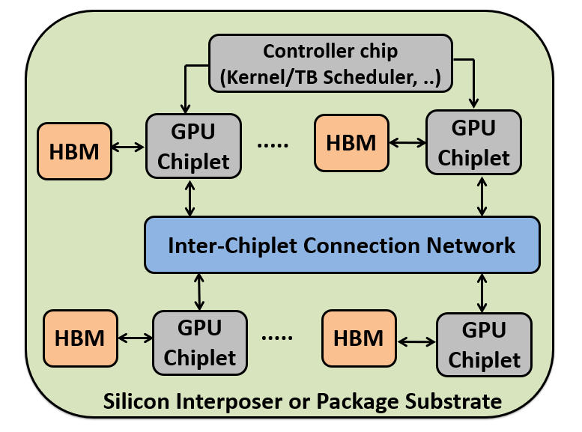
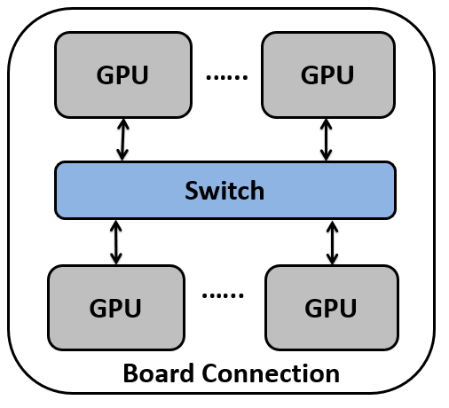
Hierarchical Multi-GPU Multi-Chiplet
Non-Uniform Memory Access (NUMA)
Single Logical GPU
Notes:
To maintain performance scalability, proposals exist to aggregate discrete GPUs into a larger virtual GPU as well as decomposing a single GPU into multiple chiplets with increased aggregate die area.
These approaches introduce non-uniform memory access (NUMA) effects and lead to decreased performance and energy-efficiency if not managed appropriately

Slide 4
Locality-Aware Data Management (LADM)
Static Index Analysis
Runtime
GPU Node 0
GPU Node 1
DB0 | DB1 | DB2 | DB3
TB0 | TB1
DB0
DB2
DB1
DB3
Data Blocks
Threadblock Grid
TB 0
TB 1
LADM exploits a threadblock-centric index analysis to optimize runtime threadblock scheduling, data placement and cache policy.
4x less memory traffic
Improving system performance by 1.8x
Notes:
To this end, we propose LADM, Locality-Aware Data Management for Multi-GPU system.
LADM exploits a threadblock-centric index analysis to optimize runtime threadblock scheduling, data placement and cache policy.
LADM decreases inter-GPU memory traffic by 4X improving system performance by 1.8x

Slide 5
Thanks! If you are interested in this work, please see the full talk.
Notes:
Thanks for your listening. If you are interested in this work, please see the full talk.

