Slide 1
Efficient Utilization of GPGPU Cache Hierarchy
Mahmoud Khairy, Cairo University, Egypt
Mohamed Zahran, New York University, US
Amr G. Wassal, Cairo University, Egypt

Slide 2
Outline
Motivation
Problem Definition
Experimental Setup
Workload Characterization
Proposed Methods
Experimental Results
Conclusion and Future Work

Slide 3
Outline
Motivation
Problem Definition
Experimental Setup
Workload Characterization
Proposed Methods
Experimental Results
Conclusion and Future Work

Slide 4
GPGPU is a Hot Topic of Research
Research focuses on:
1- High performance GPGPUs (memory, caches, control divergence, ..)
2- GPGPU programmability (Coherence, Consistency, Transactional Memory,…)
3- Power-Efficiency
4- Improving CPU-GPU integration
5- Fault-Tolerance
15 % of papers
# papers
Number of research papers related to GPGPU published in the last 7 years at the
top-tier computer architecture conferences (MICRO, ISCA, ASPLOS, HPCA)

Slide 5
Why GPU caches?
Modern GPUs are equipped with general purpose on-chip cache hierarchy in order to:
Reduce on-chip memory bandwidth demand
Increase memory system throughput
Improve the performance of some irregular GPGPU applications
Enhance the GPGPU programmability
However, due to the massive multithreading, GPGPU caches suffer from severe resource contention and low data-sharing which may degrade the performance instead.

Slide 6
Outline
Motivation
Problem Definition
Experimental Setup
Workload Characterization
Proposed Methods
Experimental Results
Conclusion and Future Work

Slide 7
Cache Thrashing
GPU caches are not designed to keep the per-thread working set.
GPU caches were designed to exploit some access patterns that exhibit small cache footprint per warp and can fit in the cache (e.g. Coalesced accesses).
In case, GPGPU applications rely on caches to exploit data locality and they contain a large cache footprint per-thread, the active threads will compete on the few available cache lines and the L1 cache will be vulnerable to thrashing.
 | Intel Core I7 | IBM Power7 | NVIDIA Fermi | NVIDIA Kepler
L1 cache size | 32 KB | 32 KB | 16-48 KB | 48 KB
Threads/core | 2 | 4 | 1536 | 2048
L1 / thread | 16 KB /thread | 8 KB /thread | 10-32 B / thread | 24 B /thread
Source: Minsoo Rhu, “A Locality-Aware Memory Hierarchy for Energy-Efficient GPU Architectures “, MICRO 2013

Slide 8
Conflict Contention
L1 Cache
Set0
Set1
Set2
Warp Threads’ memory loads
Memory-coalescing
Indexer
Set3
Set4
Set5
Set6
Set7

Slide 9
Conflict Contention
L1 Cache
Set0
causing severe stalls and conflict misses
Set1
Set2
Memory-coalescing
Indexer
Set3
Set4
Set5
Set6
Set7
Two Types of Conflicts:
1- Intra-Warp Conflict Contention: Threads within the same warp
2- Inter-Warp Conflict Contention: A group of coalesced warps

Slide 10
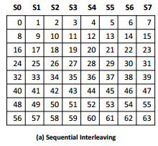
Sequential Interleaving Indexer
Conflict Degree n=M/gcd(M,S)
M number of cache sets
S is the stride of sequence
For example, assume a reference stream with an access stride of 2 (i.e. 0,2,4,6,8,10,12,14) has a 4-way conflict degree (i.e. mapped to only 4 cache sets out of 8)
Even strides will cause a high level of conflict degree, while odd strides don’t cause any conflicts (recall that M is a power-of-2 number).
The worst case scenario occurs when the reference sequence has a stride which is a multiple of M, thus causing a 1-way conflict.

Slide 11
1-way Conflict Contention Example
K * cache line
//from SYRK
//element c(i,j) = row i*row j
int j = blockIdx.x * blockDim.x + threadIdx.x;
int i = blockIdx.y * blockDim.y + threadIdx.y;
int k;
for(k=0; k< M; k++)
{
c[i * N + j] += alpha * a[i * M + k] * a[j * M + k];
}
When K is multiple of the number cache sets, all 32 threads will map to the same cache set.
Thread 0
Thread 1
Thread 2
.
.
.
Thread 31
A Matrix

Slide 12
Outline
Motivation
Problem Definition
Experimental Setup
Workload Characterization
Proposed Methods
Experimental Results
Conclusion and Future Work

Slide 13
Experimental Setup
GPGPU-sim 3.1.2
Nvidia GTX 480 (15 Fermi cores)
Main Benchmarks :
Rodinia (8 Apps)
CUDA SDK (6 Apps)
PolyBench (4 Apps)
Notes:
Add the L1/L2 write policy

Slide 14
Outline
Motivation
Problem Definition
Experimental Setup
Workload Characterization
Proposed Methods
Experimental Results
Conclusion and Future Work

Slide 15
Cache Sensitivity
Unbounded is better by an order of magnitude
Unbounded and Bypassing better than Bounded
Bypassing better than Bounded
and Unbounded
Bounded is better than bypassing
Notes:
Bypassing means totally bypassing L1/L2 caches (i.e. no caches)
Unbounded was emulated by 256 sets 64-way L1 cache (2 MB) (almost only cold misses occur)

Slide 16
L1/L2 Data Locality Analysis (Read only)
L1 Cache
Cache
Friendly
Applications
L1/L2 Streaming Applications
Inter-warp conflict
contention
Inter-warp Thrashing
Intra-warp
Conflict Contention
+Thrashing
Per Kilo Cycles
Bounded L1
L1 Streaming
Unbounded L1
L2 Cache
Bound L2
Unbou L2
Per Kilo Cycles
Left bar Unbounded Cache, Right bar Bounded Cache
Notes:
L1 16KB +LRU + GTO scheduler
L2 786 KB + LRU
L1: Write back local, Write-evict Global, no-write allocate
L2 Write back with write allocate
Unbounded L2 is measured while L1 is bounded (=16 KB GTO)
Notes:
1- Global Read after Read locality is only exploited in L1
2- Read after Write, Write after Write, Write after Read, Read after Write after Read are all exploited in L2

Slide 17
Outline
Motivation
Problem Definition
Experimental Setup
Workload Characterization
Proposed Methods
Experimental Results
Conclusion and Future Work

Slide 18
Idea#1: Dynamically Bypassing Streaming Applications
Every N cycles
If Miss rate of L1 cache sets > Threshold
Disable L1 Cache (i.e. bypassing all the memory accesses)
Else
Enable L1 Cache
The same for L2 cache.
During bypassing, the cache controller is enabled and tags are updated to compute the new miss rate.

Slide 19
Static Warp Throttling Effect on BFS
Maximum IPC
Maximum TLP
Lowest MPKI
IPC
MPKI
#Active Warps

Slide 20
Idea#2: Dynamic Warp Throttling Via Cores Sampling (DWT-CS)
Every N cycles
If MPKI of L1 cache sets > Threshold
Cores Sampling for M Cycles
The cores throttle the number of active warps to the new propagated value
#Instruction
Core1
Core2
Core3
Core4
Core5
1 warp
2 warps
3 warps
4 warps
5 warps
#Instruction
Find the winner core and propagate the value to the other cores
More Details in paper

Slide 21
Alleviating Cache Conflicts
Recent works proposed cache bypassing on associativity stalls.
Jia et al. “MRPB: Memory Request Prioritization for Massively Parallel Processors”, HPCA 2014.
Cache Bypassing is not an effective method to deal with GPU associativity problem.
In many cases, bypassing occurs while the other cache sets are underutilized.

Slide 22
Cache-bypassing-on-stalls Shortcomings
L1 Cache
Set0
Set1
Set2
Warp Threads memory loads
Memory-coalescing
Indexer
Set3
Set4
Set5
Set6
Set7

Slide 23
Cache-bypassing-on-stalls Shortcomings
L1 Cache
Set0
Set1
Set2
Memory-coalescing
Indexer
Set3
Idea: Improve the
Indexer Function instead
Set4
1- Other cache sets are Underutilized
Set5
Set6
Set7
2- Over the next loop iterations, the first four threads and the second four threads evict the lines of each other causing severe conflict misses

Slide 24
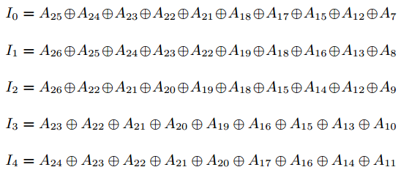
Idea# 3: Employing Pseudo Random Interleaving Caches (PRIC)
In this work, instead of bypassing, we employ a better cache indexing function, Pseudo Random Interleaving Caches (PRIC)
Rau, B. Ramakrishna. "Pseudo-randomly interleaved memory" MICRO 1991
Based on polynomial modulus mapping.
Near-randomly and fairly distributes memory requests over cache sets.
Simple Hardware: 2-3 levels of Xor-ing gates.

Slide 25
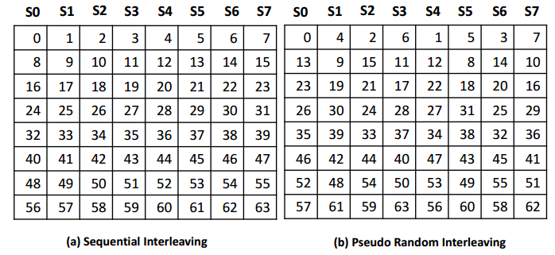
Sequential Interleaving vs PRIC

Slide 26
PRIC
L1 Cache
Set0
Set1
Set2
Warp Threads memory loads
Memory-coalescing
Indexer
Set3
Set4
Set5
Set6
Set7

Slide 27
PRIC
L1 Cache
Set0
Set1
Set2
Memory-coalescing
Indexer
Set3
Set4
Set5
Set6
Set7

Slide 28
Outline
Motivation
Problem Definition
Experimental Setup
Workload Characterization
Proposed Methods
Experimental Results
Conclusion and Future Work

Slide 29
Performance Improvement over Baseline
6.1
21.1
16.8
Normalized IPC
2.3
No loss
1.3
1.5

Slide 30
Miss rate Reduction
More than 80% reduction

Slide 31
Miss rate Reduction
More than 60% reduction

Slide 32
Miss rate Reduction
Nearly achieves the same miss rate of unbounded cache

Slide 33
Related Work
Cache-Conscious Wavefront Scheduling (CCWS) [Micro 2012]
Addresses thrashing problem only
Memory Request Prioritization Buffer (MRPB) [HPCA 2014]
Addresses thrashing and conflict problems.
Bypassing on associativity stalls.
Reorder prioritization buffer is used, so that requests from the same warp are grouped and sent to the cache together.
More Related Works in the paper

Slide 34
Compared to CCWS and MRPB
16X and 5X
1.06X and 1.3X
2.1X and 1.3X over CCWS and
MRPB respectively
Non-Steady
Thrashing
Steady
Thrashing
They benefit from both PRIC and DWT-CS
DWT-PRIC outperforms CCWS and MRPB by a harmonic mean 1.7X and 1.4X respectively

Slide 35
PRIC vs High Associativity
4way+PRIC outperforms 64-way cache by 1.16X while requiring simple hardware
4way+PRIC is able to achieve 97% of fully-associative cache's performance

Slide 36
Outline
Motivation
Problem Definition
Experimental Setup
Workload Characterization
Proposed Methods
Experimental Results
Conclusion and Future Work

Slide 37
Conclusions
We propose a low-cost thrashing-resistant conflict-avoiding streaming-aware GPGPU cache management scheme.
It dynamically detects and bypasses streaming applications.
Dynamic Warp Throttling via Cores Sampling (DWT-CS) is proposed to alleviate cache thrashing.
We employ a better cache indexing function, Pseudo Random Interleaving Cache (PRIC), to mitigate associativity stalls and eliminate conflict misses.
Our proposed method improves the average performance of streaming and contention applications by 1.2X and 2.3X respectively.
PRIC is able to outperform bypassing-on-stalls approach and high associativity caches.

Slide 38
Future Work (I): Fine-Grained Bypassing Mechanism

Slide 39
Future Work (II): Resistant to Unstable Thrashing

Slide 40
Thanks!

