Slide 1


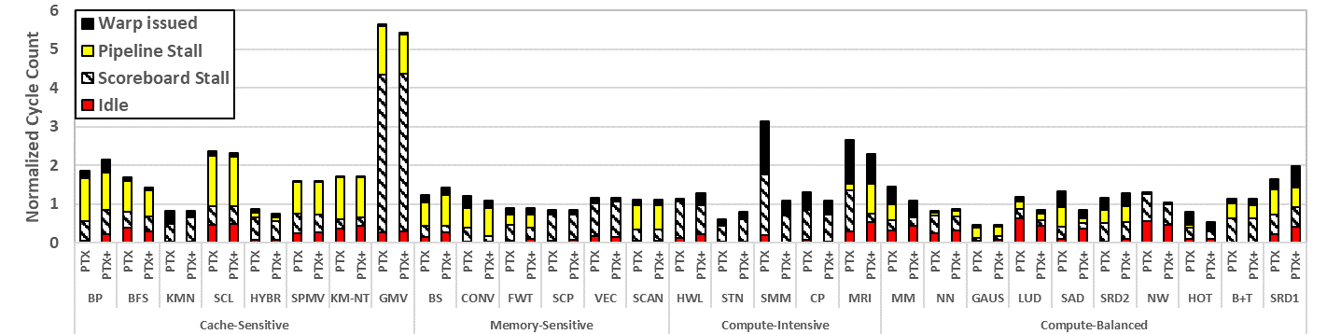
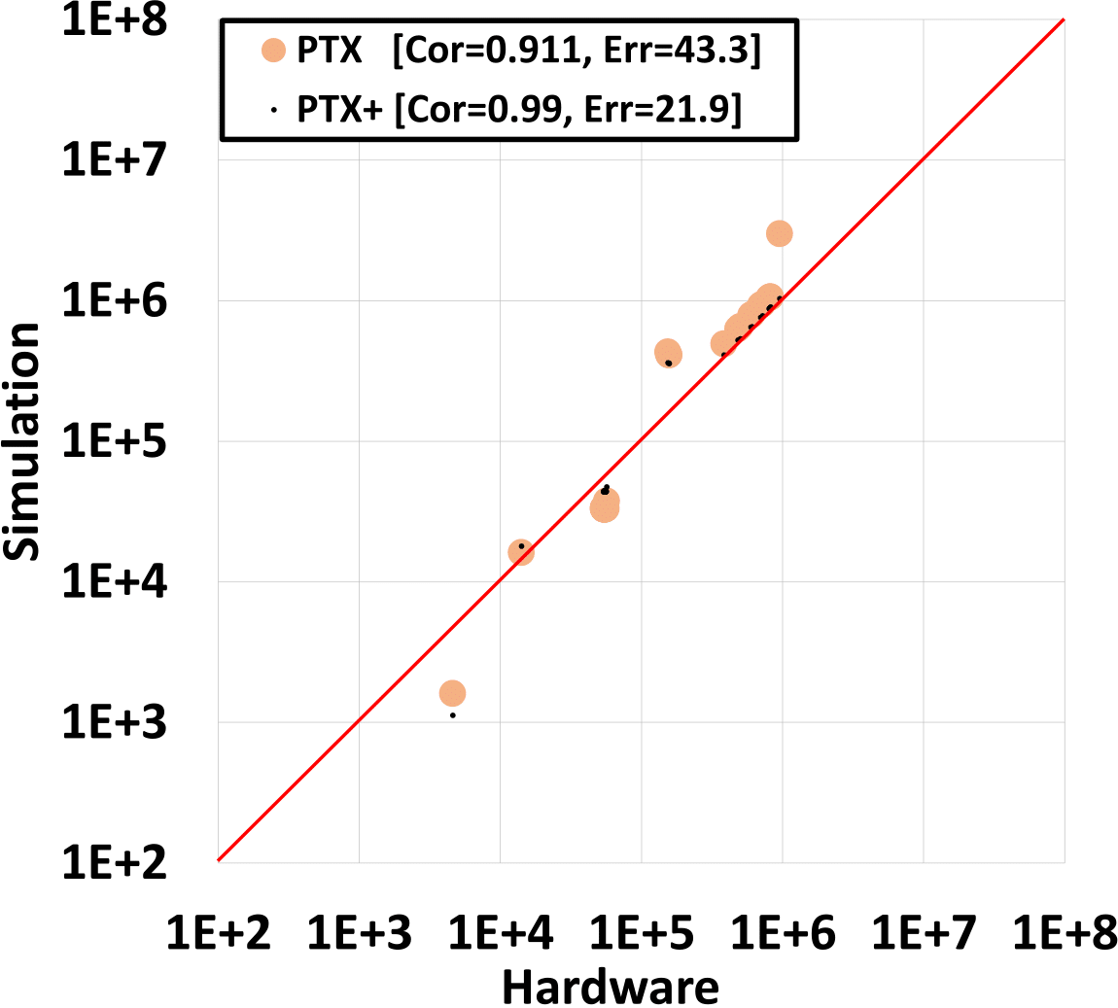
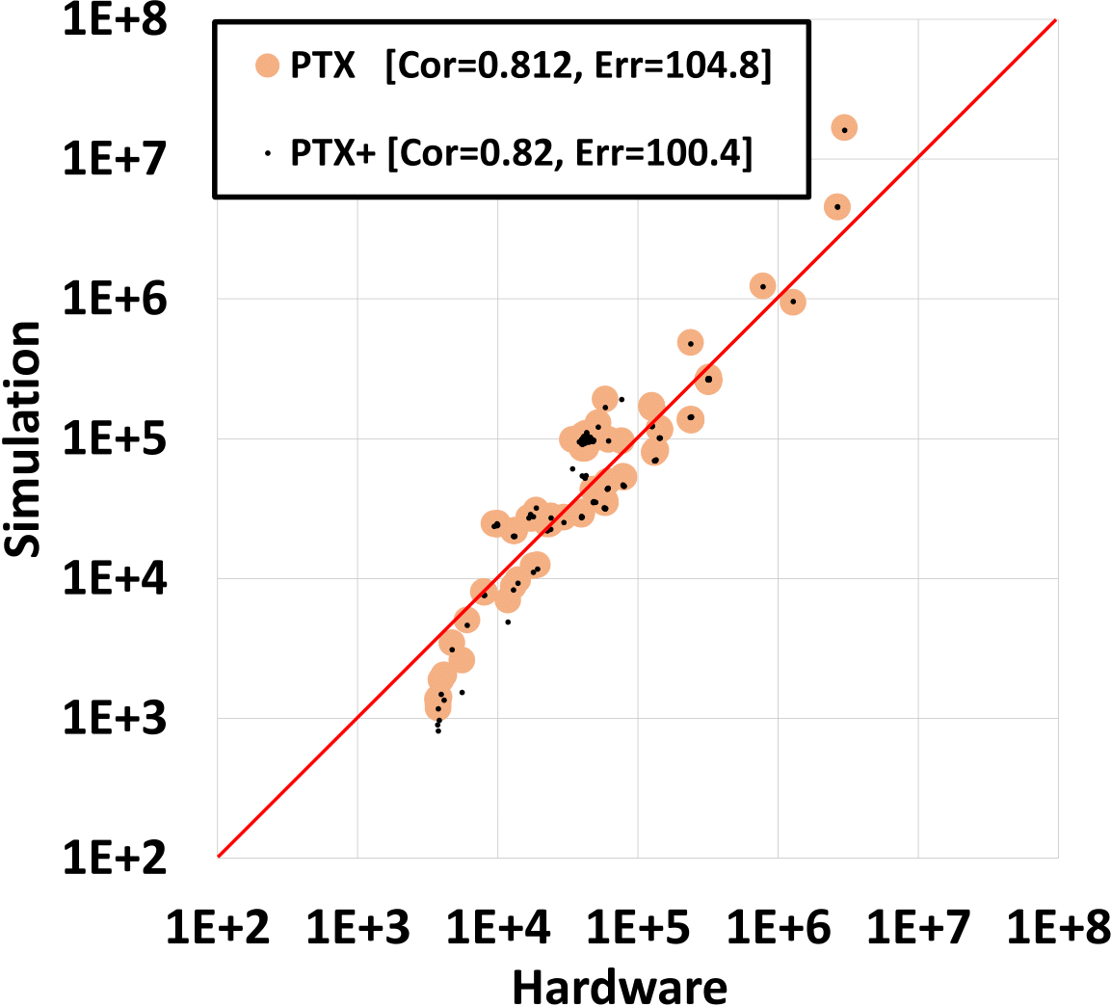
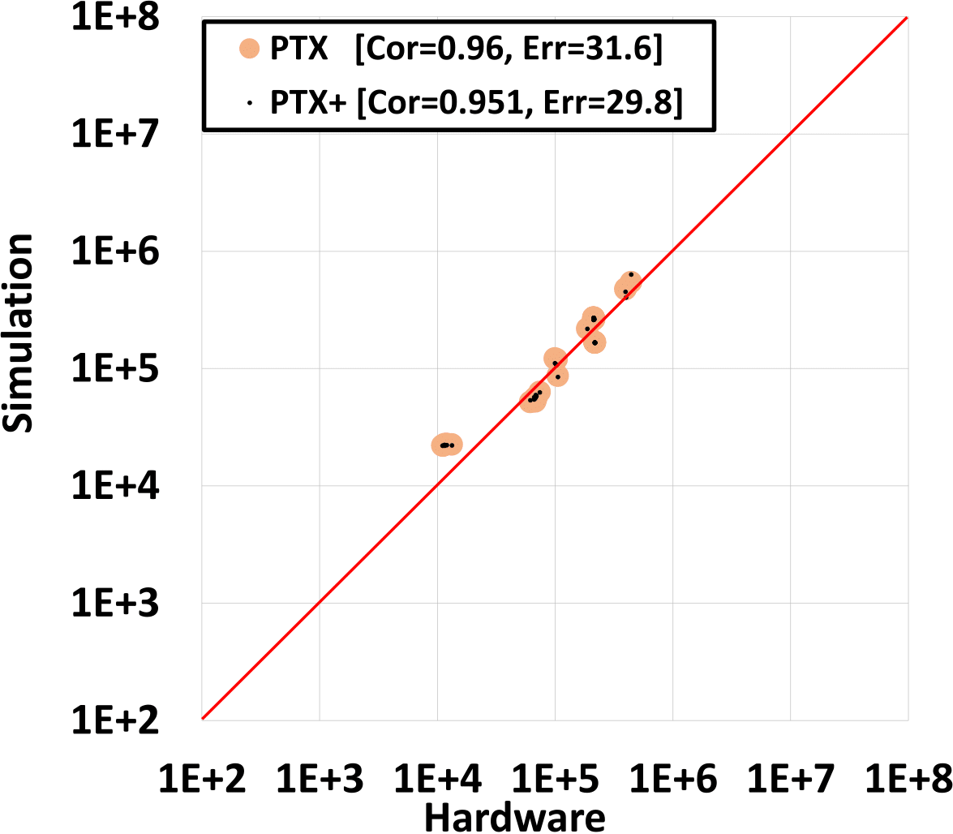
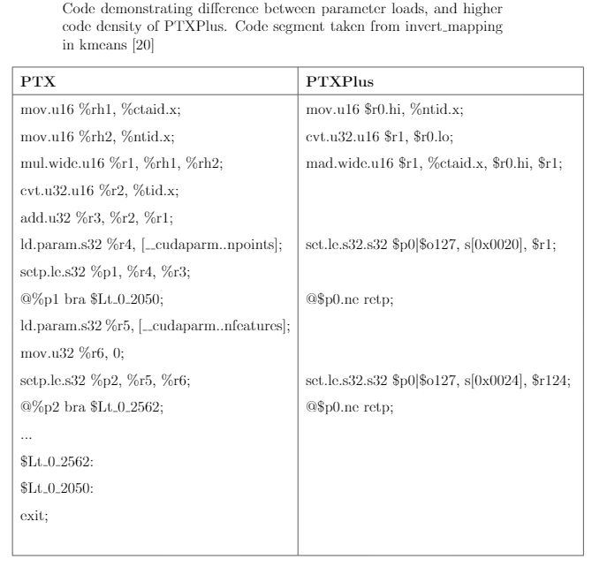
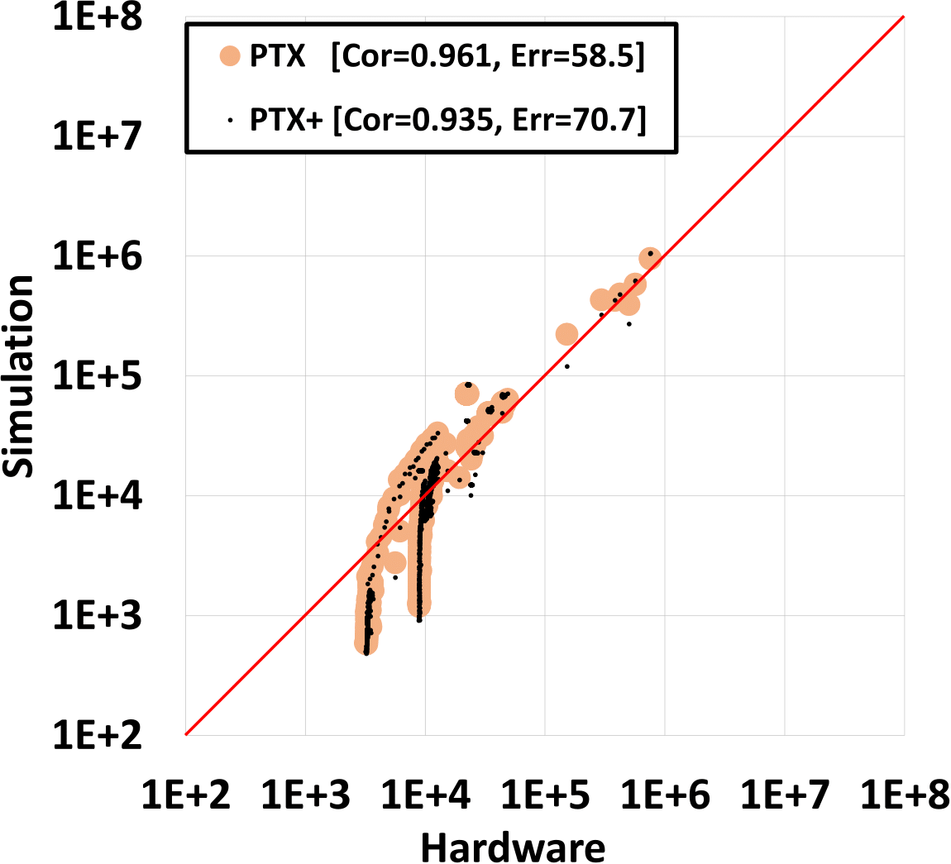
A Quantitative Evaluation of Contemporary GPU Simulation Methodology
Akshay Jain, Mahmoud Khairy, Timothy G. Rogers
Purdue University, Department of Electrical and Computer Engineering
akshayj@alumni.purdue.edu, abdallm@purdue.edu, timrogers@purdue.edu
SIGMETRICS 2018
Accelerator Architecture Lab at Purdue
Introduction
Experimental Results
Compute Intensive
We quantify error in the popular GPU architecture simulator, GPGPU-Sim (1100+ citations).
We demonstrate that the simulator's accuracy is highly dependent on the workload type.
Workload Characteristics
Type | IPC | L1 Miss | L2 Miss | Mem Util
cache-sensitive | Low | High | Mod | Low
memory-sensitive | Mod | High | High | High
compute-intensive | High | Mod | Mod | Mod
compute-balanced | Mod | Mod | Mod | Mod
Execution cycles in simulation relative to hardware. Figure shows a breakdown of stalls and useful execution from GPGPU-Sim.
Simulator supports 2 ISA representations of each app: a modern virtual ISA (vISA) and the machine ISA (mISA) for the decade old GT200 architecture.
vISA has infinite registers, is generally less optimized and more abstract.
vISA is called PTX and the GT200 mISA is PTXPlus
Low Correlation, high error
Over estimation and high error due to inaccurate caching model.
Cache system modeling needs to be improved.
Cache Sensitive
High Correlation, low error.
DRAM reads for these apps have high correlation with low error.
Improving DRAM modeling can decrease the error further.
Memory Sensitive
High correlation and low error with mISA.
mISA (even if old) is better than vISA.
mISA has high correlation wrt dynamic inst breakdown.
Supporting new mISA can improve correlation further.
Compute Balanced
Case Study
Performance predictions for an architectural study can vary depending on the ISA used.
mISA models the memory traffic due to register spilling (as it is register allocated).
We see performance improvement for HOT and BS only with the mISA.
Better results with vISA in certain apps.
vISA is able to hide the deficiencies of the old mISA.
Z5 kernel in SRAD1 uses one instruction in vISA for integer division, which gets expanded into 33 instructions in the old mISA
(a) Speedup using vISA (b) Speedup using mISA

