Slide 1
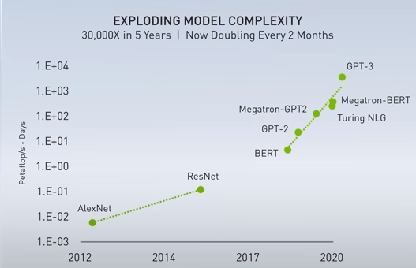
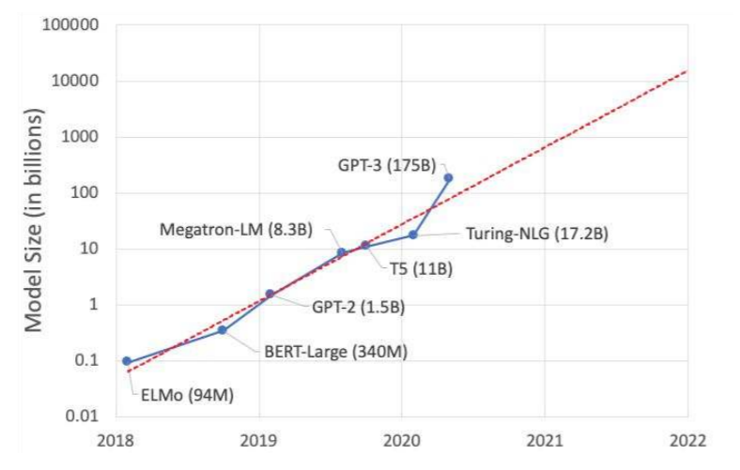
We need more Compute
We need more Memory
Deep learning compute trend in log scale, Credit: NVIDIA
Deep learning memory capacity trend in log scale, Credit: NVIDIA
Multi-GPU and Multi-Chiplet
Issue: How to overcome communication overhead?
→ Solution: LADM [MICRO 2020]
Heterogenous Memory (HBM + SSD)
Issue: How to manage and customize?
→ Enabling One Trillion Parameter Model [Future work]
+How to model and evaluate such rapidly evolving systems accurately?
→ Solution: Accel-Sim [ISCA 2020]
Notes:
Okay, Hello everyone, In this talk I will briefly present my PhD thesis work.
The slowing growth of Moore’s law along with the increasing demands of exa-scale applications, makes performance and memory scalability very challenging. As shown in figure, the compute and memory demands of deep learning applications have been increased exponentially over the last years.
To continue compute performance scaling beyond Moore’s law limitations, chip vendors breaks down monolithic GPU into multiple discrete GPUs and chiplets, as well as employing heterogeneous memory modules to continue memory capacity scaling. This new system raises critical issues such as, How to overcome the communication and NUMA overheads? and, How to efficiently manage and customize the heterogeneous memory to enable breakthrough one trillion parameter model?, Also, there is a need in academia for a new simulation infrastructure that can accurately model and evaluate these rapidly evolving systems. In conclusion, as David Patterson wrote last year that this is a Golden Age for Computer Architecture and I am proud to part of this age. Thanks for your watching.

