Slide 1
AI TEXT
DETECTION
SYSTEM
End-to-End AI Detection & Optional Humanization
PROJECT TEAM 2
• Mohamed Khaled
• Mohamed Azouz
• Khaled Tarek
• Abdelrahman Sherif
• Adham Abd Kader
1

Slide 2
1. Project Objective
What the system is designed to do
Detect AI-Generated Text
Optional Humanization
Simple User Experience
• Accept text or uploaded documents.
• Process long documents through chunks.
• Predict Human vs AI probabilities.
• Produce an overall document-level decision.
• Humanization can be enabled from the UI.
• T5-small is used as the generation component.
• The generated output is returned separately.
• Gradio interface.
• PDF / DOCX / TXT support.
• Pasted text is also supported.
• Results are displayed in one workflow.
2

Slide 3
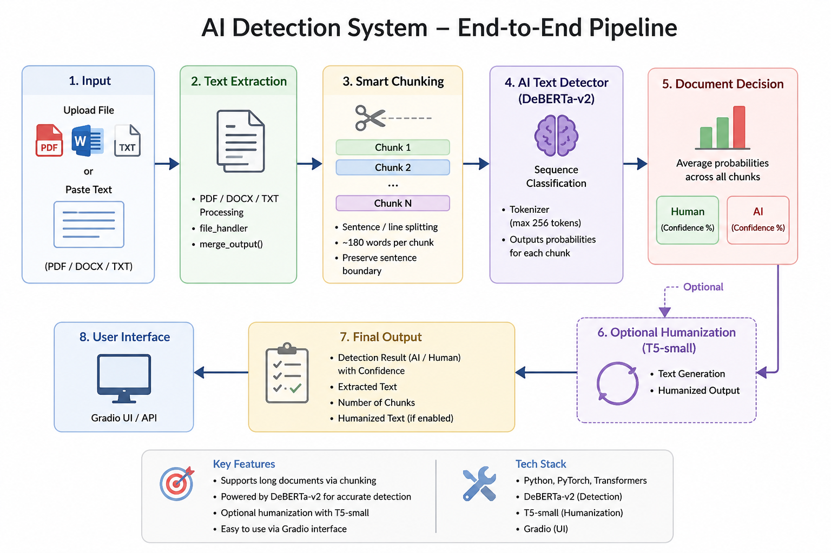
3

Slide 4
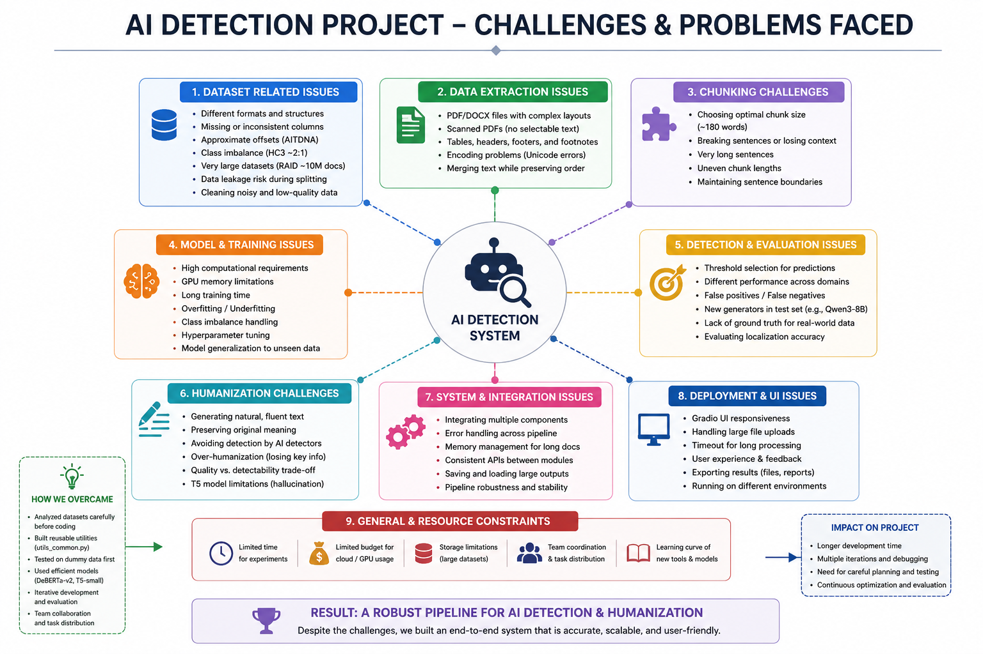

Slide 5
3. Input & Text Extraction
The first stage converts different input formats into usable text
Input Sources
Extraction
Why This Matters
• PDF documents
• DOCX documents
• TXT files
• Pasted text
• file_handler.process_file
• merge_output()
• Extracted text becomes the common representation.
• The same downstream pipeline is used for all inputs.
• Handles multiple document formats.
• Separates file processing from ML inference.
• Creates a clean input for chunking.
4

Slide 6
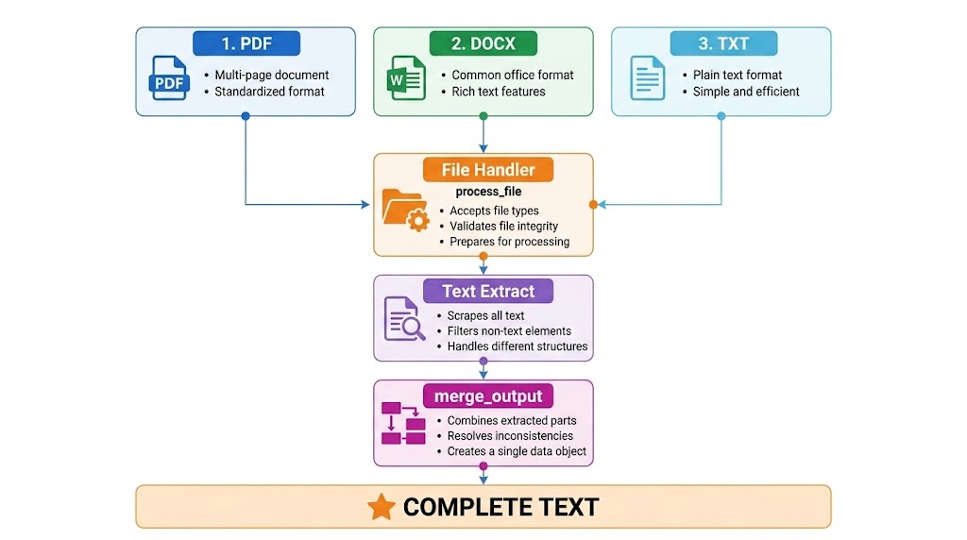

Slide 7
4. Smart Chunking
Long text is divided into manageable pieces before classification
Full Text
Sentence / Line Split
Chunk 1
Chunk 2
… Chunk N
Chunking Rules
Model Constraint
• Sentence / line splitting with regex.
• Target maximum of about 180 words per chunk.
• Long units are force-split to stay manageable.
• Each chunk is tokenized with truncation.
• Detector inference uses max_length = 256 tokens.
• Each chunk produces its own probabilities.
5

Slide 8
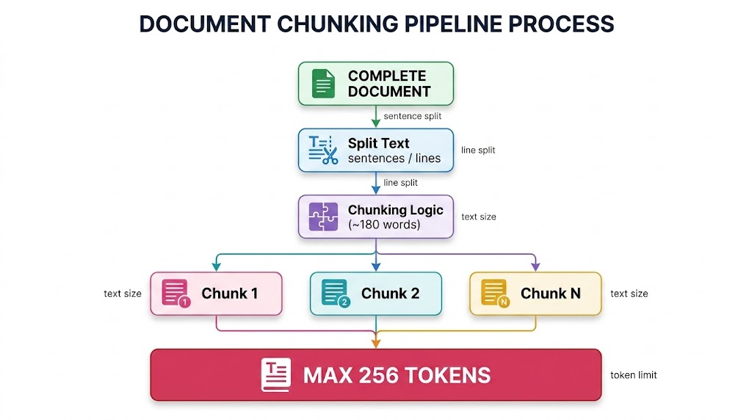

Slide 9
5. AI Text Detector — DeBERTa-v2
Sequence classification is applied independently to each chunk
Tokenizer
DeBERTa-v2 Model
Chunk Prediction
• AutoTokenizer from Transformers.
• Text → token IDs.
• Maximum sequence length: 256.
• AutoModelForSequenceClassification.
• Loaded from the trained predictor directory.
• Uses GPU when available.
• Softmax converts logits to probabilities.
• Human probability.
• AI probability.
• Prediction returned for every chunk.
6

Slide 10
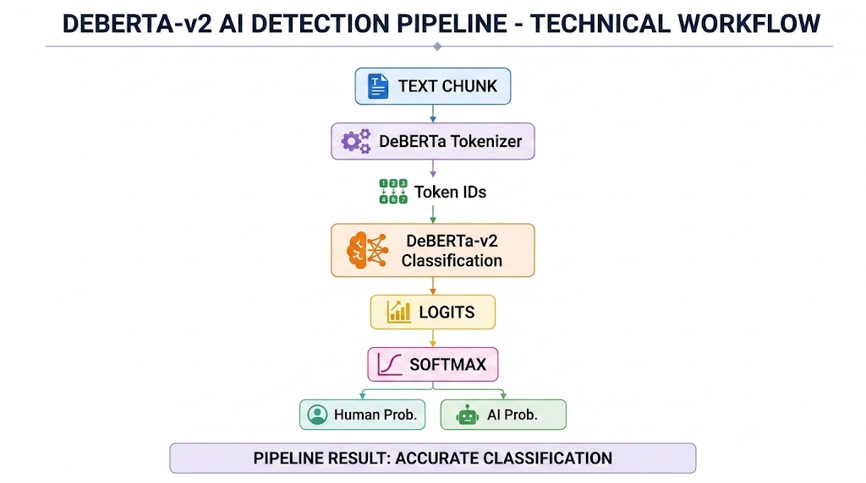

Slide 11
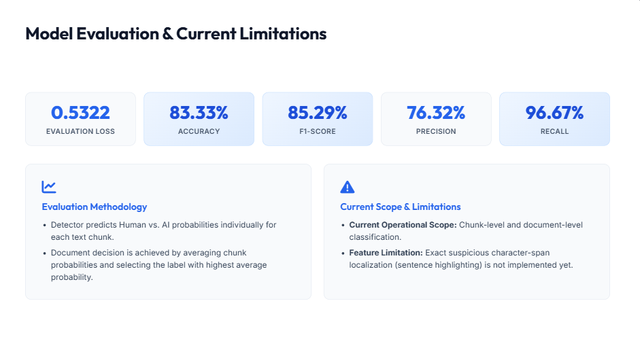

Slide 12
6. Document-Level Decision
Chunk predictions are aggregated into one overall result
Average probabilities across all chunks → select the label with the highest average
Human
AI
Metadata
• Overall Human probability.
• Reported with confidence.
• Overall AI probability.
• Reported with confidence.
• Number of chunks.
• Per-label probabilities.
7

Slide 13
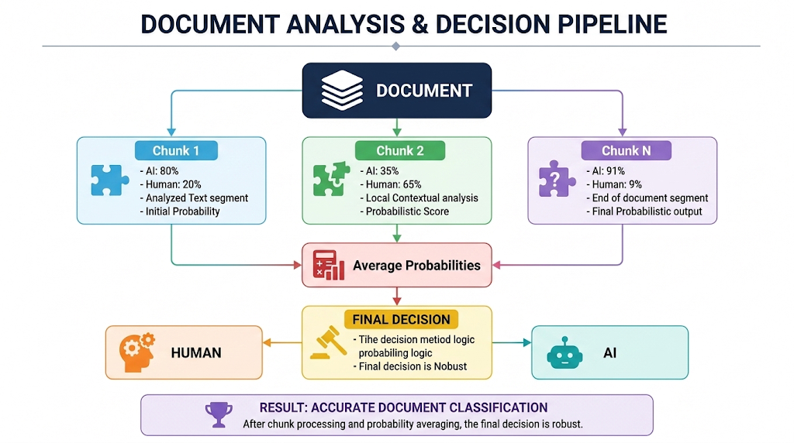

Slide 14
7. Optional Humanization
Enable Option
T5-small
Output
• User checks the humanization option.
• The generation stage runs as an optional branch.
• It is not required for detection.
• T5Tokenizer.
• T5ForConditionalGeneration.
• Used as the text generation component.
• Humanized text is returned separately.
• Detection result remains available.
• User can compare the outputs.
8

Slide 15
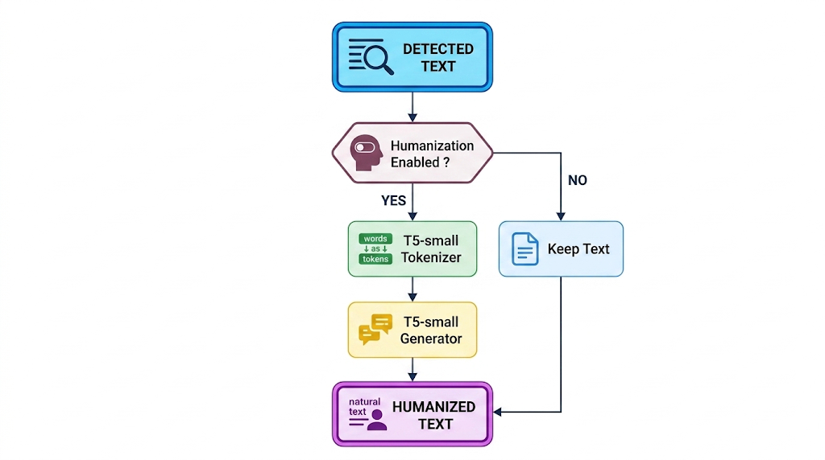

Slide 16
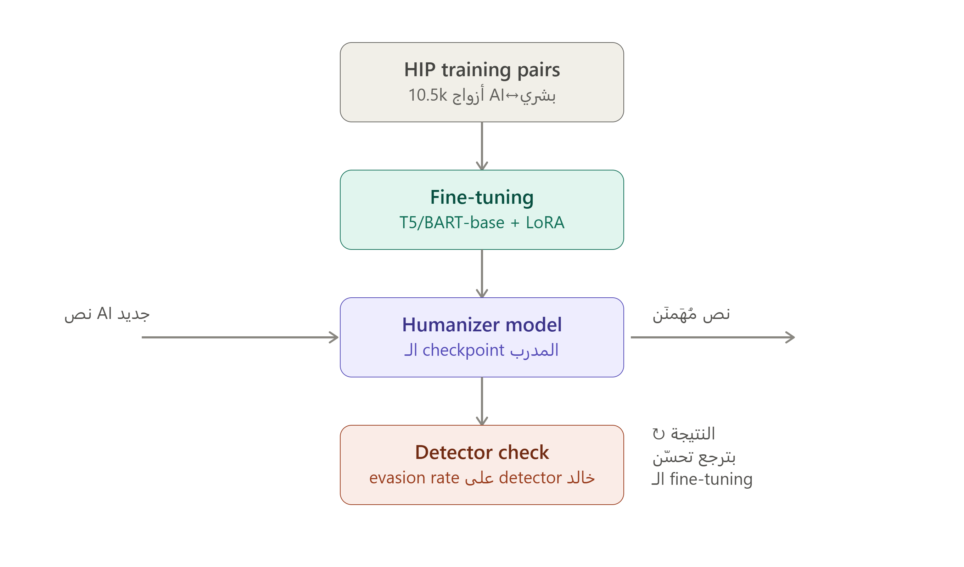

Slide 17
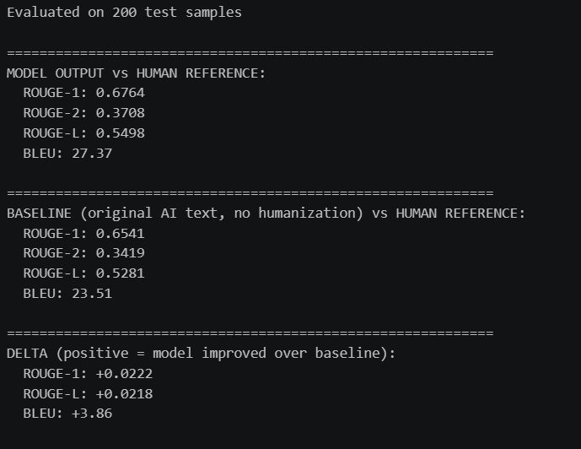

Slide 18
8. User Interface & Final Outputs
One interface connects the complete workflow
Gradio UI
Displayed Results
Deployment Layer
• Upload PDF / DOCX / TXT.
• Or paste text directly.
• Optional humanization checkbox.
• Simple interactive workflow.
• Status.
• Extracted text.
• AI detection result.
• Confidence / probabilities.
• Humanized text when enabled.
• FastAPI backend components.
• Uvicorn server.
• ngrok for external access.
• PyTorch + Transformers.
9

Slide 19
9. Technology Stack & Current Scope
Core Technologies
Application Layer
Important Scope Note
• Python
• PyTorch
• Hugging Face Transformers
• DeBERTa-v2
• T5-small
• Gradio UI
• FastAPI
• Uvicorn
• ngrok
• PyMuPDF / python-docx
• The current notebook performs chunk/document-level detection.
• It does not yet return exact suspicious character spans.
• True span localization is a future extension.
10

Slide 20
END-TO-END WORKFLOW
INPUT
EXTRACT
CHUNK
DETECT
DECIDE
OPTIONAL HUMANIZE
OUTPUT
PROJECT TEAM — TEAM 2
Mohamed Khaled • Mohamed Aziz • Khaled Tarek • Abdelrahman Sherif
11

