Slide 1



Addressing Challenges in Electric Vehicle Deployment and Environmental Impact

Slide 2
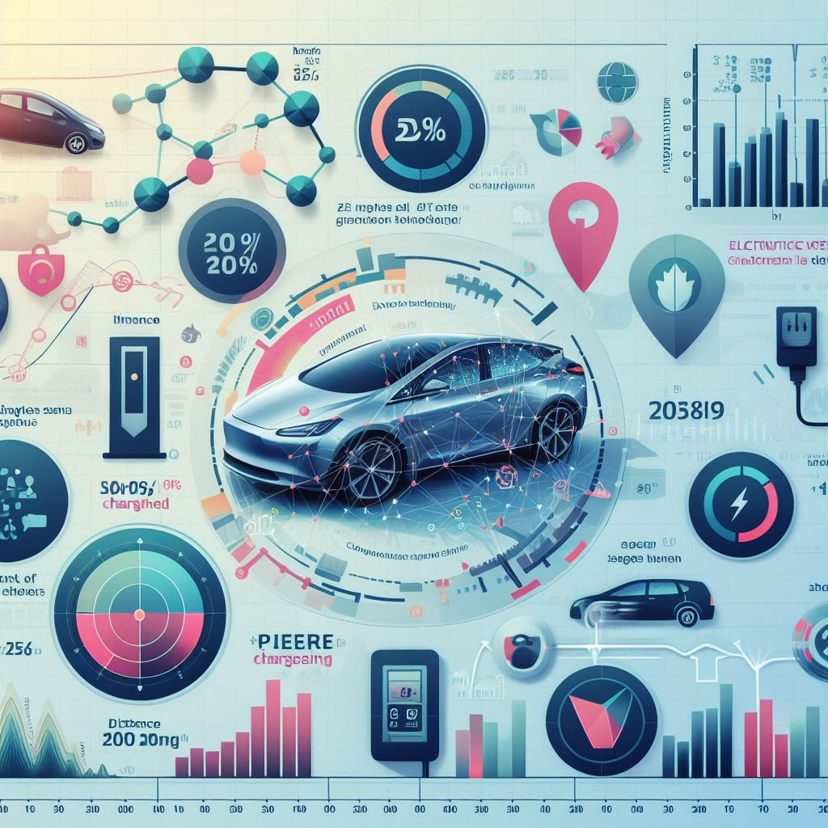
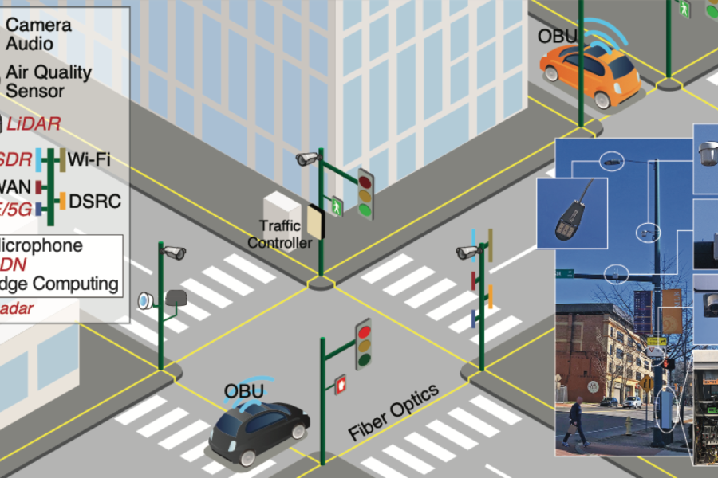
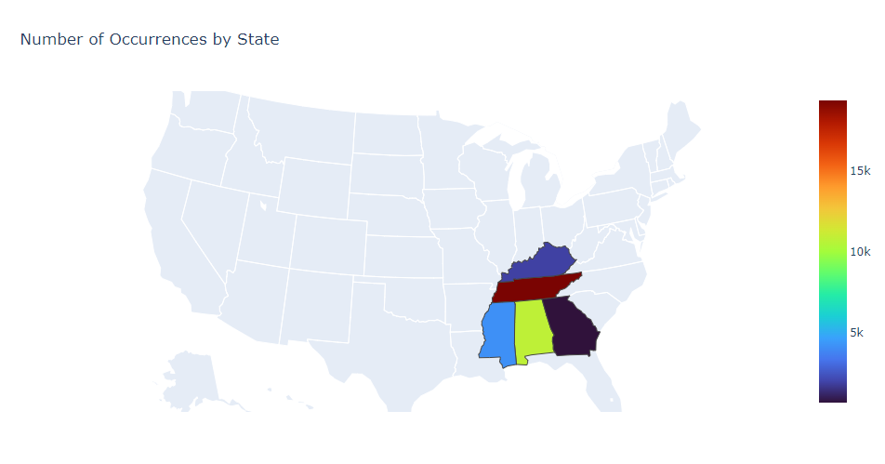

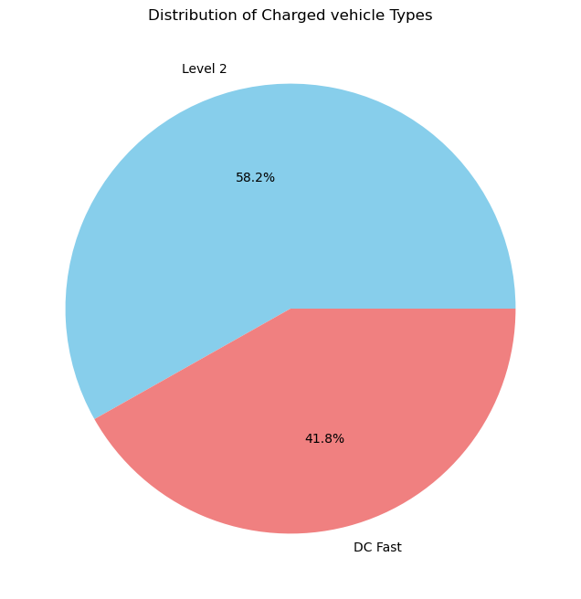
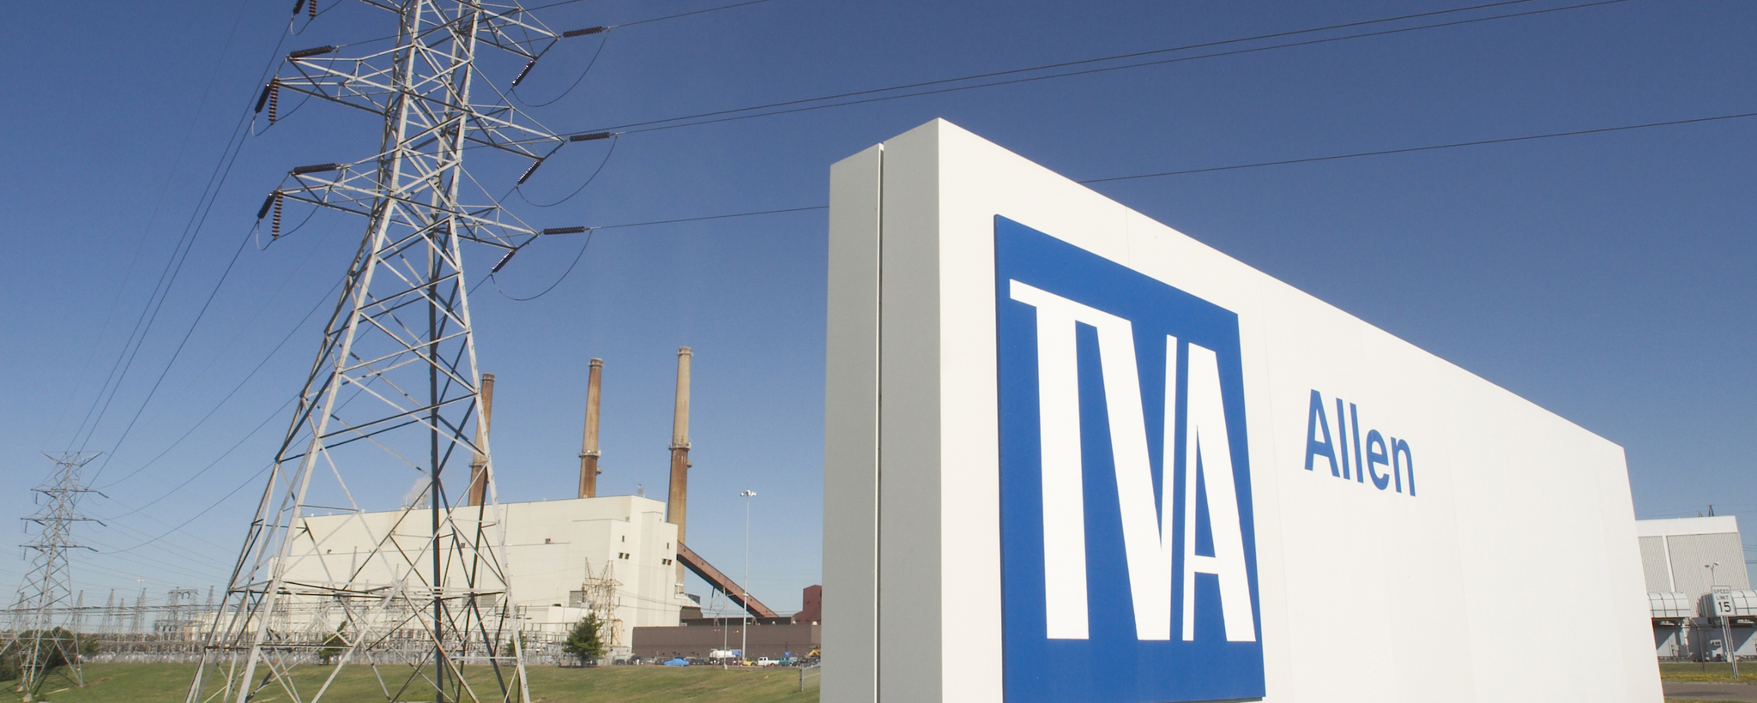








Problem Statement
Two key challenges:
Optimizing EV charging station locations and capacity
Accurately quantifying the environmental benefits of EVs.
External Factors
sources of energy
Usage Data
Data Analysis
maximizing station utility
Optimizing power delivery
Emissions Reductions

Slide 3
Collaborative Partnerships for EV Infrastructure & Emissions Analysis
Seven States Power
- Energy solutions cooperative in Tennessee Valley region
- Expertise in EV charging, solar, battery storage
- Real-world experience installing/operating EV charging stations
- Insights into usage patterns and power demand needs
- Data-driven modeling of optimal station locations/capacity
University of Tennessee Chattanooga & Center for Urban Informatics and Progress (CUIP) Partnership
- Leverage expertise in regional power, grid operations, sustainability
- Methodologies for calculating location-specific EV emissions reductions
- Based on local grid conditions and generation mixes
Benefits of Partnerships
- Ground research in practical knowledge & real-world applicability
- Leverage technical skills and regional focus
- Address pressing EV infrastructure & environmental analysis challenges
- Promote efficient, sustainable EV adoption in Tennessee Valley

Slide 4
Anticipated Infrastructure Improvements
Data Collection Systems
- Robust real-world EV charging usage data critical for modeling
- Upgrade monitoring & communications at charging locations
- Transmit higher resolution usage data over time
Grid Integration
- Direct data sharing between utilities & charging providers
- Generation sources and charging event data
- Enable precise location-specific emissions reduction calculations
Benefits
- Refine models as monitoring & grid integration upgrades implemented
- Work within current limitations, provide insights
- But maturing data systems in parallel would be advantageous

Slide 5
Improving Community Quality of Life (Next 5 Years)
Accelerate EV Adoption & Sustainability
- Data-driven optimal charging station locations & sizing
- Faster charging, seamless EV ownership & operation
- Quantify local GHG reductions from EV use
- Foster further investment in clean transportation
Public Health & Environmental Benefits
- More residents/businesses/municipalities transition to EVs
- Significantly improved local air quality
- Reduced greenhouse gas emissions
- Commitment to carbon-neutral economy
Informed Policy & Planning
- Verified sustainability impacts guide decision-making
- Better infrastructure planning for EVs & renewables
- Demonstrate leadership in sustainable mobility

Slide 6
Previous Efforts & Outcomes
Research Studies Over Past Few Years
- Focused on forecasting EV charging loads, mostly public stations
- Short-term forecasting (1-day horizons) using machine learning
- KNN, pattern sequence, ensembles based solely on past demand
Incorporating Non-Demand Features
- Recent work using traffic patterns, weather data
- E.g. Random forest + neural nets + LSTM with traffic flow data
- Still focused on individual locations, not full network planning
User Behavior & Fleet Studies
- EV user driving/charging history for demand prediction
- Privacy concerns and limited data availability
- Work on smart charging, fleet electrification optimization
Limitations
- Lacked holistic charging network planning component
- Didn't integrate power grid data for emissions analysis

