Slide 1
Order Services
Muhammed Khalid
Vibhuti Patel
Hussain Dar

Slide 2
Project Layout
RESTful API
Flask (python microweb framework)
GET and POST requests for orders
Deployed to heroku: https://order-services.herokuapp.com/api/v1/orders
Mobile App
Place, View, and delete orders
Make requests to the API
Web Application
A nice web application in conjunction to the Mobile App

Slide 3
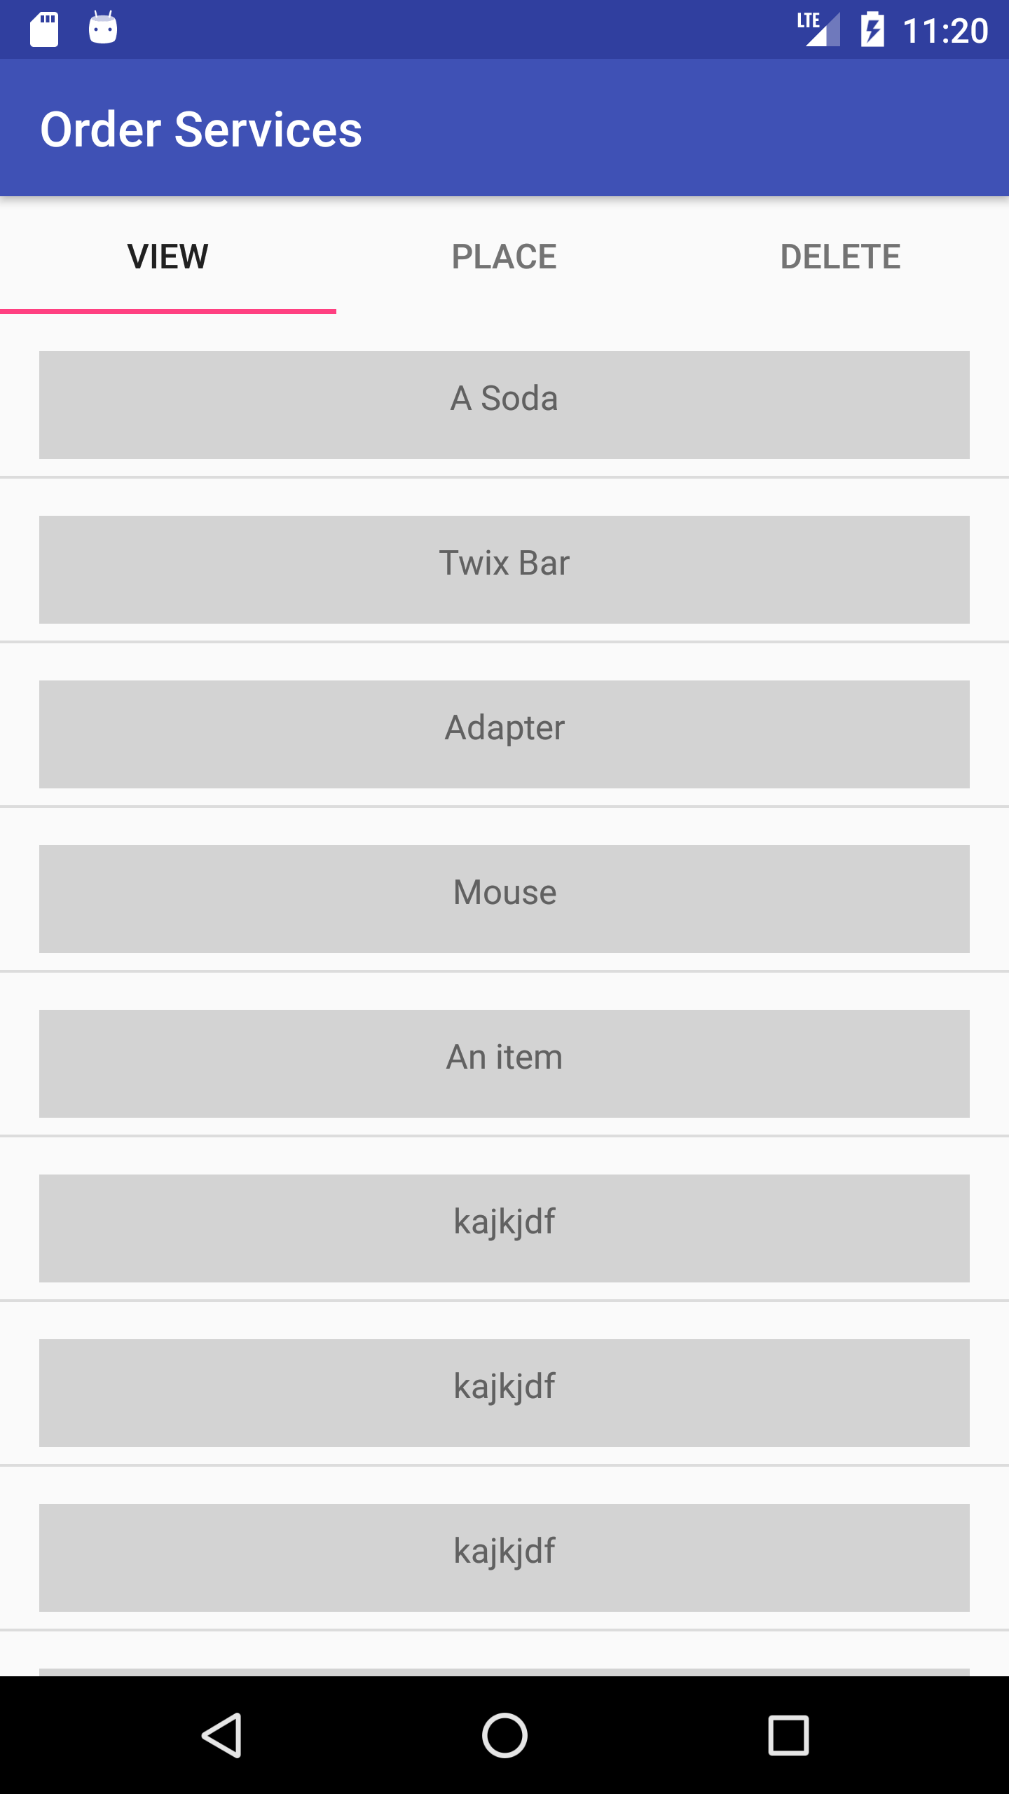
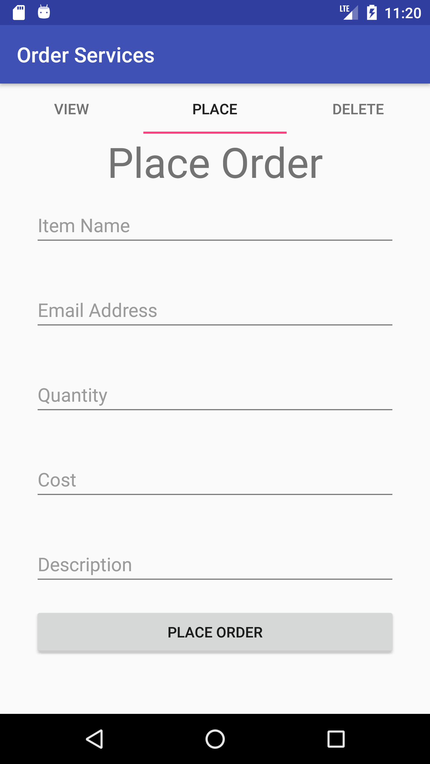
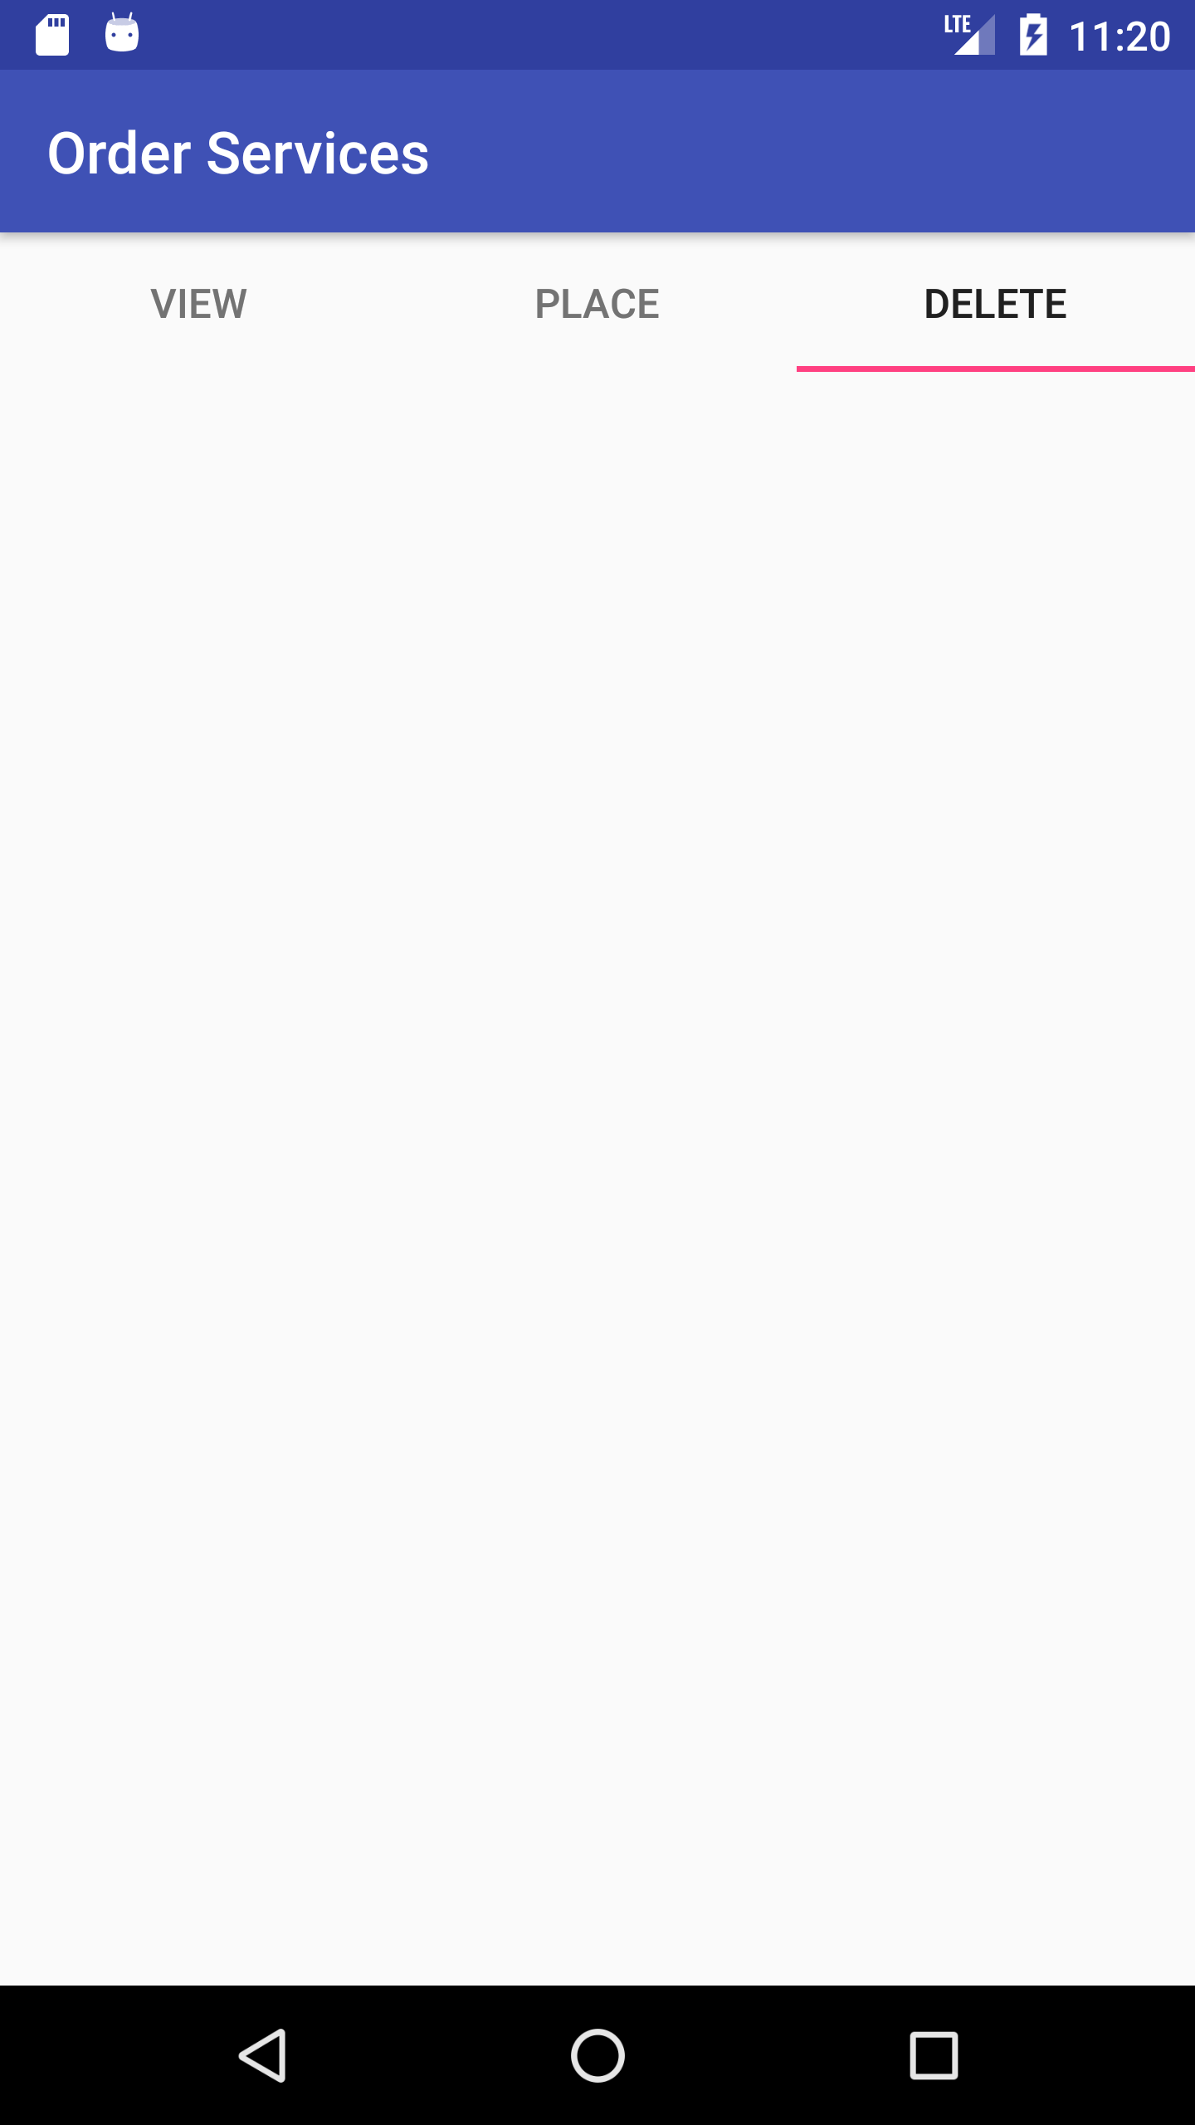
Mobile UI
View Order Fragment
Place Order Fragment
Delete Order Fragment

Slide 4
Things left to do
Finish up API
Add POST request functionality to Mobile App
Create supplemental web app
Github Repos:
Mobile App: https://github.com/mkhalid578/order-services-app
RESTful API: https://github.com/mkhalid578/order-services-api

Slide 5
Demo
If there’s time…

Slide 6
Questions…

