Slide 1
Order Processing Application
Muhammed Khalid (@mkhalid578)
Muhammed_Khalid@student.uml.edu
Michael Bertucci (@mbertucci1) (Retired)
Michael_Bertucci@student.uml.edu
Vibhuti Patel (@vibhutipatel18)
Vibhuti_Patel@student.uml.edu

Slide 2
Introduction
Proposing the creation of an Order Processing application
A business often needs to purchase items from external vendors
With this application, employees from across the company can see:
What has been ordered?
Who ordered it?
For which project/department?
How many? From where? Why?
What is the cost?
How long will it take to arrive?
Etc…

Slide 3
Why it is important to develop a system to solve this question?
Large companies can lose time and money from inefficiency and overspending
The Order Processing app would:
Give coordination between departments so company does not order more items than necessary
Make it easy to calculate the expenses of each project or department
Save time by automatically notifying manager when new order needs approval or notifying department when order has arrived
Centralize ordering so company doesn't need to provide financial account info to every department

Slide 4
Related Work
There already exist proprietary software systems for order management sold by a variety of companies
The Polish software company Exence¹ has a product that happens to be very similar to our idea, but is a desktop app
Ours is a web app for ease of access
Adding a desktop client for our application could be a feature for future extension of the project
¹https://www.exence.com/en/offer/internal-order-processing

Slide 5
Proposed Approach
User interface
HTML/CSS
JavaScript
Digital Order Form
Enter order information
Order Data
A List of orders that have been submitted within the department
Profile
A profile that contains information related to the users

Slide 6
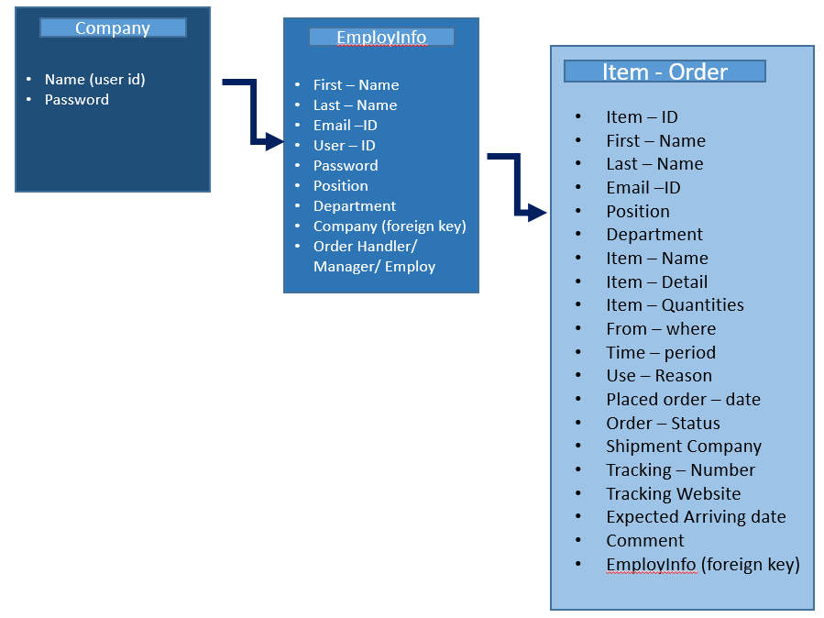
Proposed Approach (cont.)
MySQL Database w/ SQLAlchemy

Slide 7
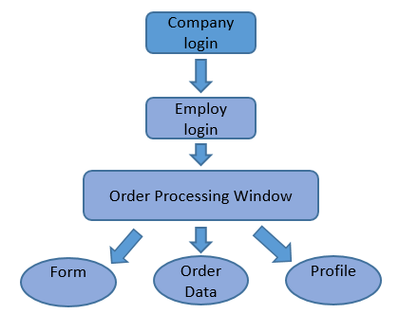
Proposed Approach (cont.)

Slide 8
Experiment Results and Discussion
- Created a front-end application with a company and user login
- A mySQL database hosted on Google Cloud
- Digital Order Form, List of pending and/or approved orders, and a user editable profile.
- Back-end supported using Python Flask and ajax calls within JavaScript
- Demo

Slide 9
Experiment Results and Discussion (cont.)
We were able to create the client side of the application using HTML/CSS and JavaScript. The front-end was accompanied by a back-end using python Flask, a powerful web framework. Through these technologies, we accomplished a company login and a user login to imitate a login system and invoice system. Standard employees can place orders and managers can approve or reject these orders.

Slide 10
Conclusion and the Future...
- We were able to include most of the things we had planned in our product backlog
- 2 Scrum Sprints – 13 Stories – 41 story pts. (hours)
- A working web application with a few exceptions
- We are novice web developers and still have a lot to learn. We wanted to challenge ourselves with this one.
Future Plans (SW Engineering II?):
- Include a proper notification system (login, order placements)
- Password encryption (hashing, hex)
- Domain and hosting
- Improved database schema
- Desktop Application

Slide 11
References:
Exence
https://www.exence.com/en/offer/internal-order-processing
Flask (Python Framework)
http://flask.pocoo.org/docs/0.12/
MySQL Database (by Oracle)
https://www.mysql.com/

