Slide 1
MOVEMENT QUEST
Movement Quest
A little movement. Your own pace.
CODING MASTER
Mohammed Afeefuddin / Muhammad Samad Khan
CSC4360 MAD / Undergraduate
01 / 12
Notes:
0:00–1:00. Both introduce themselves. Explain the app purpose: one exercise per plan, recording actual sets, no medical or competitive claims. Proposal approval must be verified before describing it as approved.
October 24 update: screenshots are real supplied captures. Afeef reports operation on two devices. Latest APK/source, complete Flutter/device logs, personal reflections and collaboration evidence remain to supply. Do not present suggested narration as a completed personal experience. Source: supplied course instructions, available project source and evidence/app_screenshots.

Slide 2
MOVEMENT QUEST
Scope and original roles
Five screen roles. Two local entities.
Afeef: UI, forms, navigation, settings and demo
Samad: SQLite, activity integrity, helper, tests and release
Shared review keeps the app and evidence consistent
02 / 12
Notes:
1:00–2:00. State original proposal responsibilities, not invented completed contributions. Afeef reviews accessibility/integration and helper reasoning. Samad coordinates quality. Explain that individual evidence appears later.
October 24 update: screenshots are real supplied captures. Afeef reports operation on two devices. Latest APK/source, complete Flutter/device logs, personal reflections and collaboration evidence remain to supply. Do not present suggested narration as a completed personal experience. Source: supplied course instructions, available project source and evidence/app_screenshots.

Slide 3
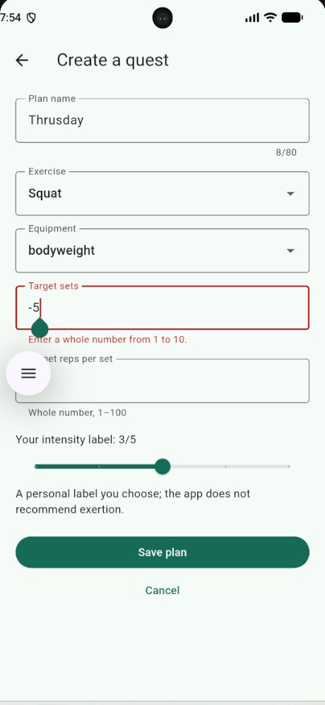
MOVEMENT QUEST
Catalog and plan editor
I1 · I2
Afeef: catalog and form walkthrough
Captured input: -5 target sets
The form shows the allowed range: 1 to 10
03 / 12
Notes:
2:00–4:30. Afeef demonstrates catalog then create/edit form. I1: compare StatelessWidget PlanCard in widgets/common.dart with StatefulWidget PlanEditor. build renders current state; expansion state belongs to CatalogScreen. I2: trace the intensity Slider callback to setState, then Save to WorkoutPlan and repository. Explain target versus actual reps. Show invalid name and numeric bounds.
October 24 update: screenshots are real supplied captures. Afeef reports operation on two devices. Latest APK/source, complete Flutter/device logs, personal reflections and collaboration evidence remain to supply. Do not present suggested narration as a completed personal experience. Source: supplied course instructions, available project source and evidence/app_screenshots.

Slide 4
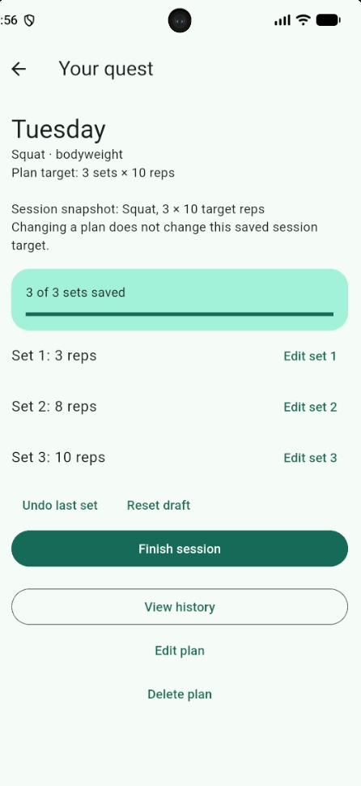
MOVEMENT QUEST
Saved workout progress
D1
Samad: saved-session walkthrough
Captured actual reps: 3, 8 and 10
Three sets saved; Finish remains available
04 / 12
Notes:
4:30–7:00. Samad demonstrates Start, repeated tap guard, logging, correction, Undo, Finish and Reset. Show start/saveSet/finish/reset in quest_repository.dart. Explain transaction, expected list length, unique draft index and stable token. Demonstrate both confirmed and cancelled reset or delete. Finish twice must leave one completed session.
October 24 update: screenshots are real supplied captures. Afeef reports operation on two devices. Latest APK/source, complete Flutter/device logs, personal reflections and collaboration evidence remain to supply. Do not present suggested narration as a completed personal experience. Source: supplied course instructions, available project source and evidence/app_screenshots.

Slide 5
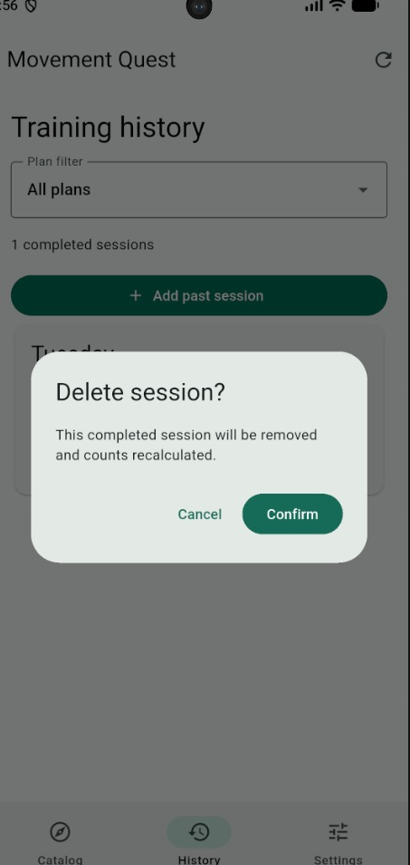
MOVEMENT QUEST
History and offline settings
D1 · D2
History capture shows one completed session
Delete asks for confirmation
Offline restart still needs recorded results
05 / 12
Notes:
7:00–9:00. Samad demonstrates child CRUD and cascade policy for D1. Afeef changes theme/equipment/motion and performs the actual offline restart for D2. Explain SQLite relationship data versus the small SharedPreferences object. GitHub/ClickUp/YouTube are coordination/submission tools, not runtime app backends. Do not claim restart success before demonstrating it.
October 24 update: screenshots are real supplied captures. Afeef reports operation on two devices. Latest APK/source, complete Flutter/device logs, personal reflections and collaboration evidence remain to supply. Do not present suggested narration as a completed personal experience. Source: supplied course instructions, available project source and evidence/app_screenshots.

Slide 6
MOVEMENT QUEST
State and lifecycle
A1 · A2
Screens own local input and navigation
QuestController refreshes shared saved records
Repository owns SQL and transactions
06 / 12
Notes:
9:00–11:00. Afeef answers A1 by tracing editor Save through controller.write to repository.savePlan and refresh. A2: show controller disposal in editor/detail, mounted checks after awaits, no timer dependency and root repository ownership. Samad explains close/reopen semantics. Demonstrate leaving a screen before a read finishes where feasible.
October 24 update: screenshots are real supplied captures. Afeef reports operation on two devices. Latest APK/source, complete Flutter/device logs, personal reflections and collaboration evidence remain to supply. Do not present suggested narration as a completed personal experience. Source: supplied course instructions, available project source and evidence/app_screenshots.

Slide 7
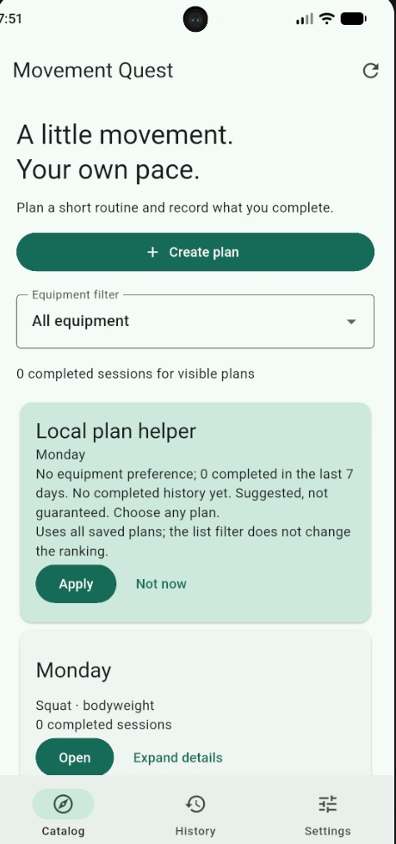
MOVEMENT QUEST
Explainable local helper
R4
Equipment match and recent history guide ranking
The card explains its suggestion
Apply and Not now preserve user choice
07 / 12
Notes:
11:00–13:00. Samad shows services/plan_helper.dart and input categories/count timestamps. Counts cover the preceding seven days inclusively and cap at two. Ties use lowest ID. Demonstrate reason text, Not now and manual override. Afeef explains how equipment preference changes the next ranking. Label the method rule-based, not trained ML.
October 24 update: screenshots are real supplied captures. Afeef reports operation on two devices. Latest APK/source, complete Flutter/device logs, personal reflections and collaboration evidence remain to supply. Do not present suggested narration as a completed personal experience. Source: supplied course instructions, available project source and evidence/app_screenshots.

Slide 8
MOVEMENT QUEST
Helper evaluation
R4
10 of 10 expected-output checks passed
Synthetic preference labels: helper 6/7, baseline 4/7
A counterexample exposes a missing preference
08 / 12
Notes:
13:00–14:30. Samad opens evidence/helper_results.json and tool/helper_fixtures.dart. The evaluator ran in Dart 3.13.5. The 7 valid labels exclude 3 empty/invalid cases. A user may prefer a recent plan, so the convenience ranking mismatches that label. Explain nearest-neighbor alternative and retained limitation. This is not held-out testing, population accuracy or health evidence.
October 24 update: screenshots are real supplied captures. Afeef reports operation on two devices. Latest APK/source, complete Flutter/device logs, personal reflections and collaboration evidence remain to supply. Do not present suggested narration as a completed personal experience. Source: supplied course instructions, available project source and evidence/app_screenshots.

Slide 9
MOVEMENT QUEST
Tests and failure recovery
T1 · T2
Earlier host SQLite checks: 9/9 passed
Afeef reports APK operation on two devices
Full Flutter and restart results still needed
09 / 12
Notes:
14:30–17:00. Samad answers T1 using manual acceptance matrix and actual run outputs when available. Host SQL checks do not run Dart repository or native plugins. Show two actual device configurations after testing. T2: run --dart-define=ENABLE_FAILURE_DEMO=true, arm bug icon, save a plan, observe retained input and retry. Describe this as deliberately tested failure, not an invented historical bug. Update this slide with real Flutter/device results before final recording.
October 24 update: screenshots are real supplied captures. Afeef reports operation on two devices. Latest APK/source, complete Flutter/device logs, personal reflections and collaboration evidence remain to supply. Do not present suggested narration as a completed personal experience. Source: supplied course instructions, available project source and evidence/app_screenshots.

Slide 10
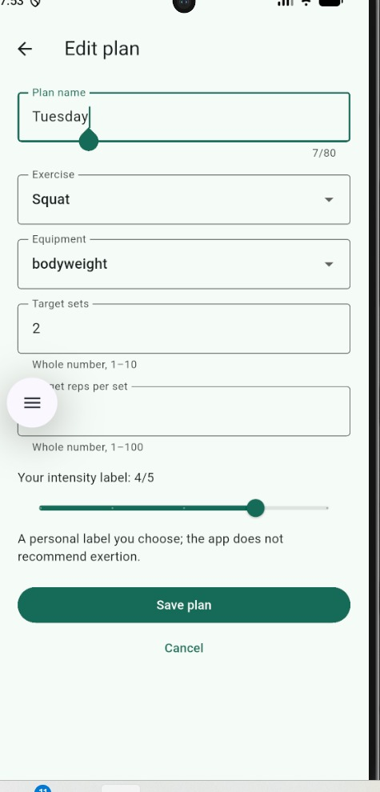
MOVEMENT QUEST
Accessibility and design review
Afeef demonstration
Readable progress shows saved sets and actual reps
Invalid set count receives an inline explanation
Peer review and settings evidence remain to capture
10 / 12
Notes:
17:00–19:00. Afeef shows enlarged text, landscape, keyboard access and reduced motion on the actual app. Compare a genuine before/after design revision after a peer review. Use docs/PEER_REVIEW.md. No fabricated observation is allowed; update this slide when the review has actually happened.
October 24 update: screenshots are real supplied captures. Afeef reports operation on two devices. Latest APK/source, complete Flutter/device logs, personal reflections and collaboration evidence remain to supply. Do not present suggested narration as a completed personal experience. Source: supplied course instructions, available project source and evidence/app_screenshots.

Slide 11
MOVEMENT QUEST
Individual task evidence
R1
Afeef: original UI ownership with actual code/review trace
Samad: original data/quality ownership with actual trace
ClickUp task, commit, code and test result
11 / 12
Notes:
19:00–21:30. Each member answers R1 with their real feature branch/PR/commit and review. Show task owner, acceptance criteria, exact code and test outcome. Include the four dated snapshots and one measured flow improvement. Do not claim generated files prove independent authorship. Refer to AI_Usage_Log.md for assistance.
October 24 update: screenshots are real supplied captures. Afeef reports operation on two devices. Latest APK/source, complete Flutter/device logs, personal reflections and collaboration evidence remain to supply. Do not present suggested narration as a completed personal experience. Source: supplied course instructions, available project source and evidence/app_screenshots.

Slide 12
MOVEMENT QUEST
Release and reflection
Final verification
APK launch reported on two devices
Finish acceptance tests and submission evidence
Each member adds their own learning reflection
12 / 12
Notes:
21:30–23:00. Each member summarizes one real learning experience and a next improvement. Check all selected IDs I1/I2/A1/A2/D1/D2/T1/T2/R1/R4 have been answered in the recording. The final package needs approved proposal, signed acknowledgment, final report, evidence, tested APK and accessible video. Keep total recording 20–25 minutes.
October 24 update: screenshots are real supplied captures. Afeef reports operation on two devices. Latest APK/source, complete Flutter/device logs, personal reflections and collaboration evidence remain to supply. Do not present suggested narration as a completed personal experience. Source: supplied course instructions, available project source and evidence/app_screenshots.

