Slide 1
AI Study Mentor
Unit 22: Application Development — Assignment Part 2
Nguyen Minh Khang (BC00720) · SE08201
Assessor: Mr. Le Nhat Quang
Group number and presentation date [PENDING]
DRAFT — NOT FOR FINAL SUBMISSION
DRAFT — NOT FOR FINAL SUBMISSION
1 / 12
Notes:
This is an evaluation of a built application against the Part 1 design, not a proposal. Every number on the following slides comes from the report and its evidence set.

Slide 2
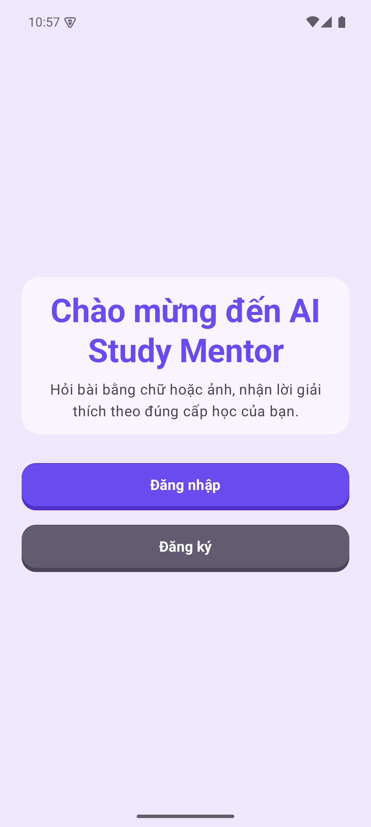
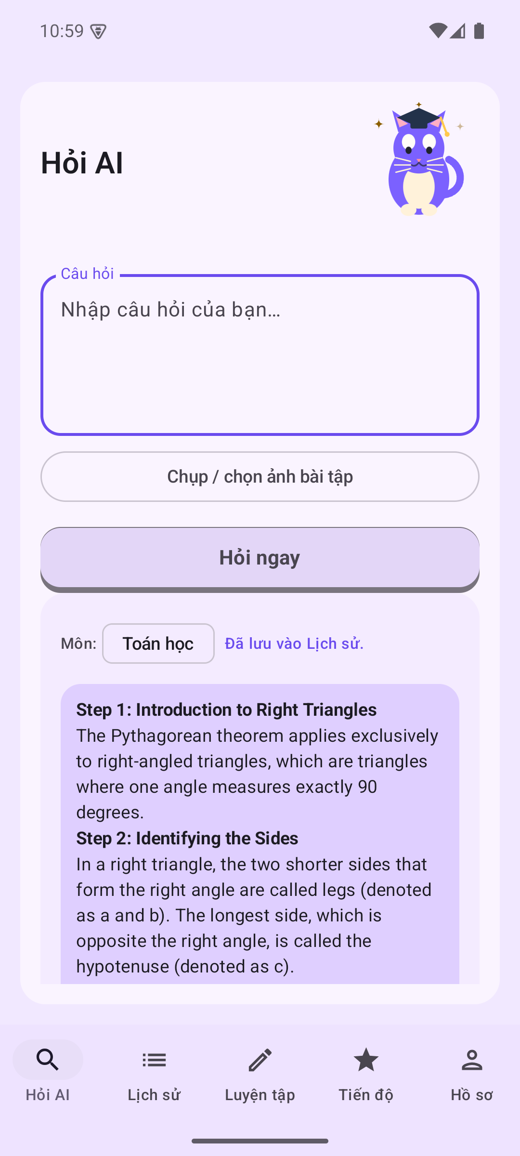
CONTEXT
The problem: help that is generic, unverified and lost
• Students working alone receive explanations that are hard to check and not tuned to their level.
• Answers disappear after the session, so progress cannot be seen.
• Target users: middle school, high school and university students; BrightPath owns the product.
• Constraints: junior team, 14-week MVP, limited budget and an API cost ceiling.
  – Design response: local-first storage, a cache in front of the provider, structured answers and a testable domain tier.
real-final/01-welcome.png
real-final/06-ask-gemini-answer.png
FINAL evidence — real Gemini, fixed APK
DRAFT — NOT FOR FINAL SUBMISSION
2 / 12
Notes:
Connect each constraint to a design decision shown later: cost ceiling to the cache, solo study to local-first storage, junior team to the test rule.

Slide 3
PART 1 BASELINE
Requirements and priorities
Band | Requirements | Why
MVP | FR1 auth, FR2 onboarding, FR3 text/image ask, FR4 structured answer, FR6 history, FR8 progress | Core study loop
Post-MVP | FR5 improvement blocks, FR7 practice, FR9 gamification, FR10 notifications | Scheduled after the loop
NFR | NFR1 responsiveness, NFR2 three actions, NFR3 API 33+, NFR4 encryption, NFR5 offline reading, NFR6 auth hardening | Quality constraints
Deferred items are scheduled work, not failures.
DRAFT — NOT FOR FINAL SUBMISSION
3 / 12
Notes:
FR5, FR7, FR9 and FR10 follow the core loop by plan. Say explicitly that deferral is not the same as failure, and that the report scores them as partial or unverified.

Slide 4
DESIGN BASELINE
Proposed solution and the frozen Part 1 design
• Kotlin + Jetpack Compose, single activity, one module.
• Room for local-first storage; manual dependency graph instead of a framework.
• Gemini called through HttpURLConnection and org.json.
• Ask path: normalise → exact hash → similarity policy → provider → persist → history.
• Cache before AI is the cost-control mechanism the brief requires.
4
98
layers: ui, domain,
data, platform
Kotlin files,
12,103 lines
Design decisions D-1…D-12 are the M4 baseline.
DRAFT — NOT FOR FINAL SUBMISSION
4 / 12
Notes:
The design is frozen before the build; the evaluation asks whether the built artefact matches it. Point out that the cache is a product decision driven by cost, not only a performance trick.

Slide 5
M4
Development method and toolchain
• One-week increments; Definition of Done per phase.
• Rule: every logic change ships with a test; tests never call the real provider.
• AGP 9.3.3 · Kotlin 2.2.10 · Compose BOM 2026.02.01 · Room 2.7.2 · KSP 2.3.12.
• CI runs ./gradlew test with no API key, so it builds against the offline fake client.
• Thirteen PlantUML sources are kept as text and reviewed as diffs.
  – Honest record: 10 of 14 sprint entries are empty; 13 commits on the audited branch, single author.
DRAFT — NOT FOR FINAL SUBMISSION
5 / 12
Notes:
State the sprint-record gap yourself before anyone asks. The toolchain evidence is in the build files and the workflow, not in prose.

Slide 6
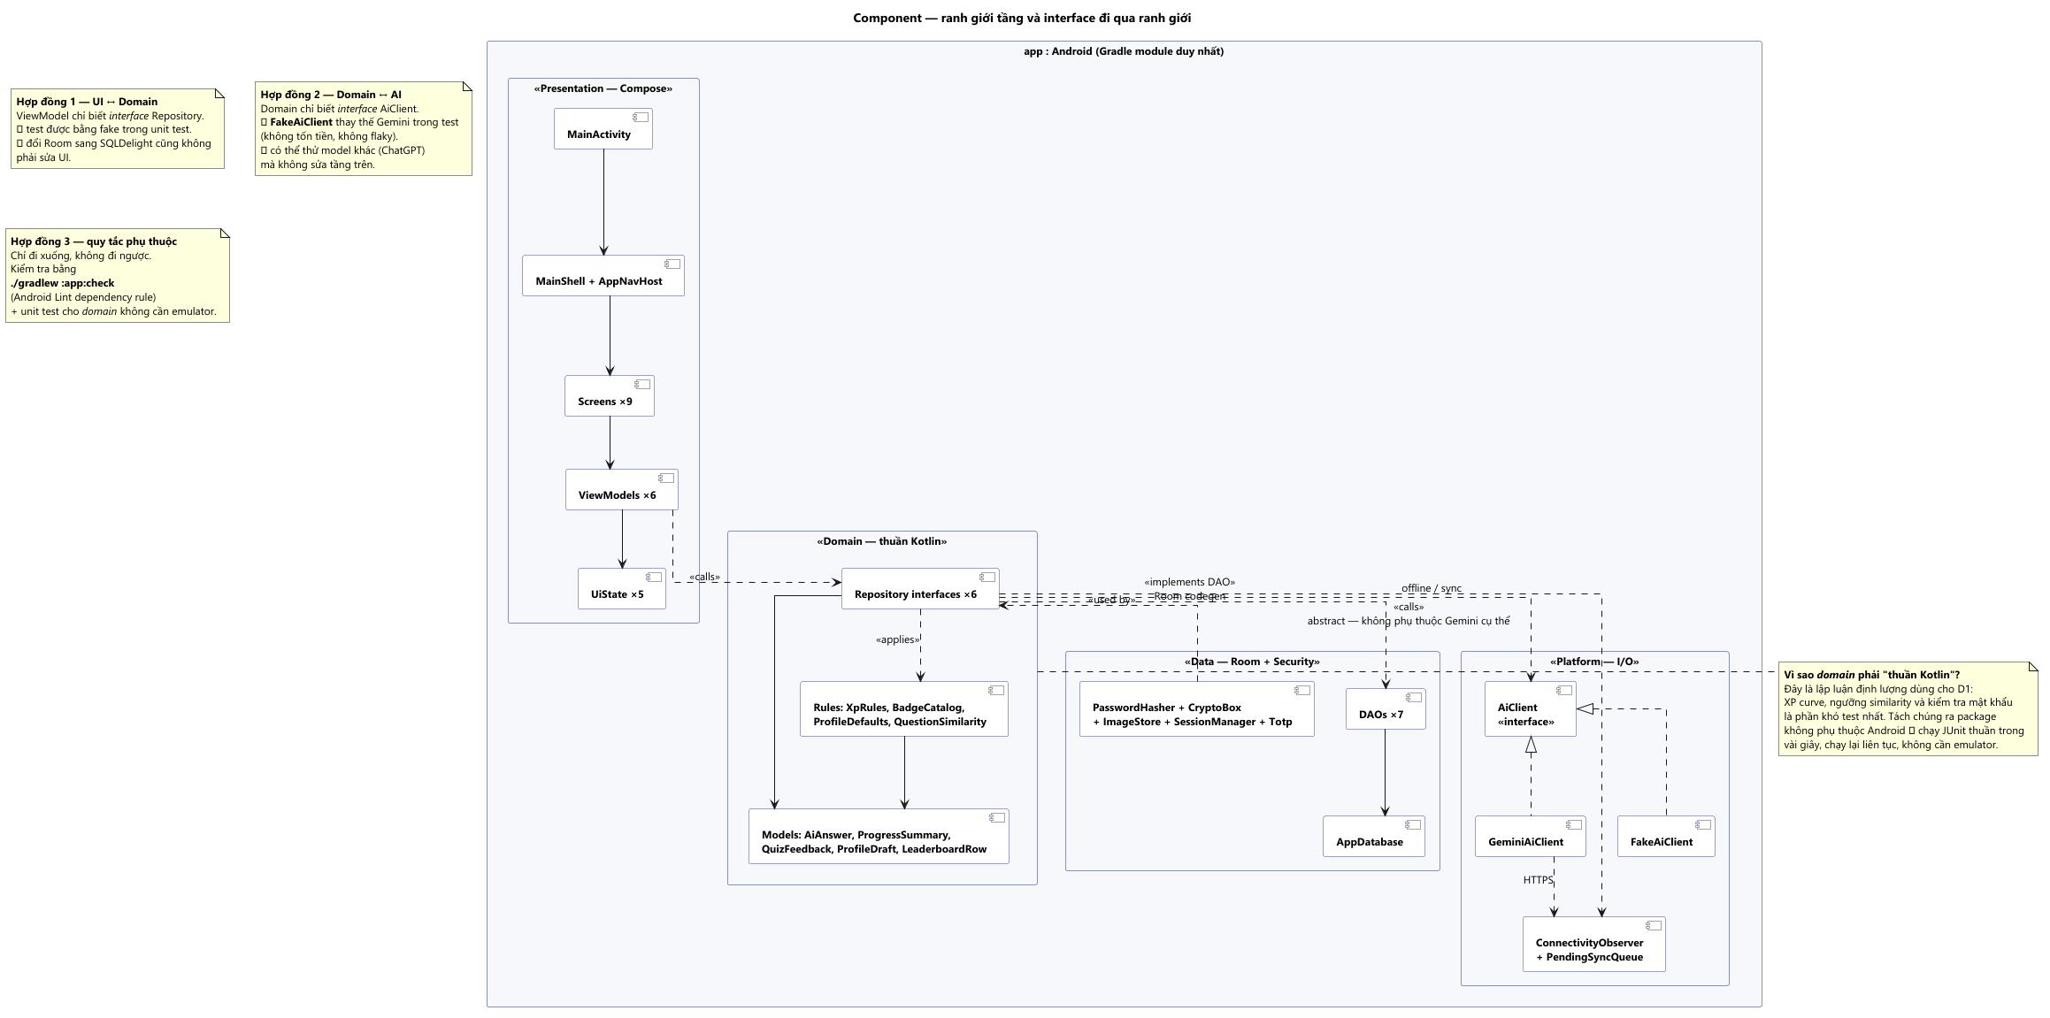
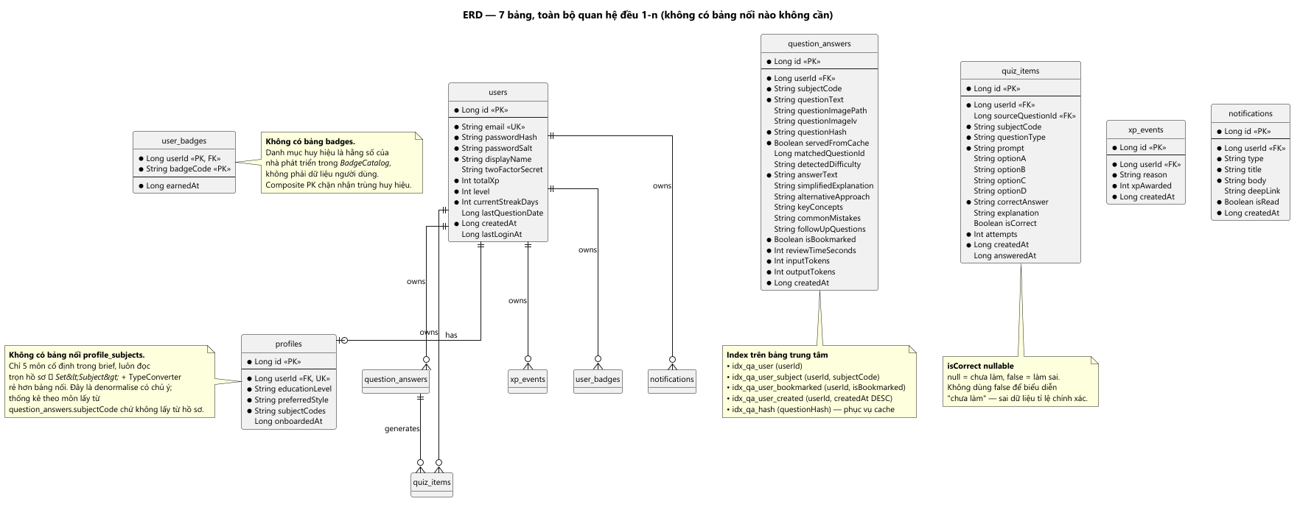
P5
As-built architecture and data flow
• Four layers: ui, domain, data, platform; one module.
• Room schema v1, seven tables: users, profiles, question_answers, quiz_items, xp_events, user_badges, notifications.
• Ask flow: normalise → hash → similarity → provider → persist → history.
• A cache hit costs no API call; a number or language difference forces a fresh call.
Component view — docs/uml/png/06_component.png
ERD, seven tables — docs/uml/png/09_erd.png
DRAFT — NOT FOR FINAL SUBMISSION
6 / 12
Notes:
The diagrams are rendered from text sources, so they can be reviewed as diffs. The ERD shows the seven-table schema referenced in the report.

Slide 7

P5 · RUNTIME
Demo 1: a real question, a real Gemini answer
• POST …:generateContent → HTTP 200, modelVersion gemini-3.5-flash-lite.
• Answer shows steps and is saved to history.
• One real response evidences the path; it does not establish answer quality.
01 · welcome
05 · question
06 · real answer
DRAFT — NOT FOR FINAL SUBMISSION
7 / 12
Notes:
This is the core loop. Say clearly that one response is a path demonstration, not an accuracy claim.

Slide 8


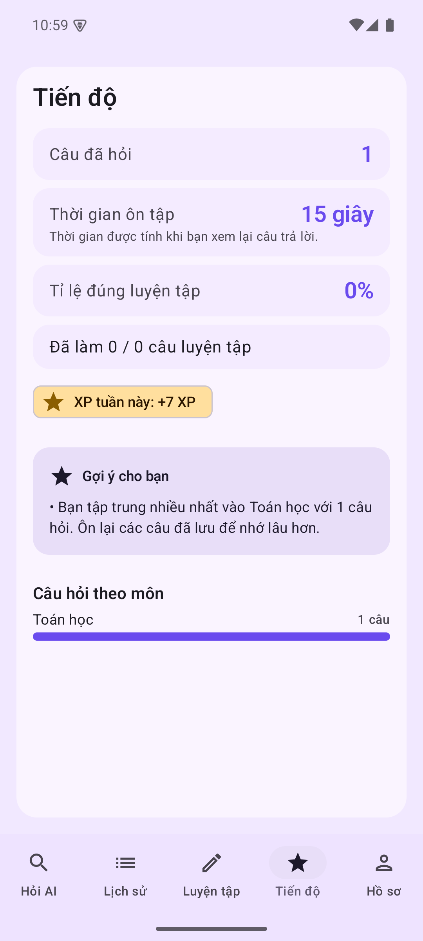
P5 · RUNTIME
Demo 2: history, detail and progress
• Progress observed: 1 question, 15 s, 0%, +7 XP.
• Search, bookmark and subject filters were not exercised.
07 · history
08 · detail
09 · progress
DRAFT — NOT FOR FINAL SUBMISSION
8 / 12
Notes:
The progress numbers come from the real-final capture. Do not claim search or filter behaviour; it was not exercised.

Slide 9
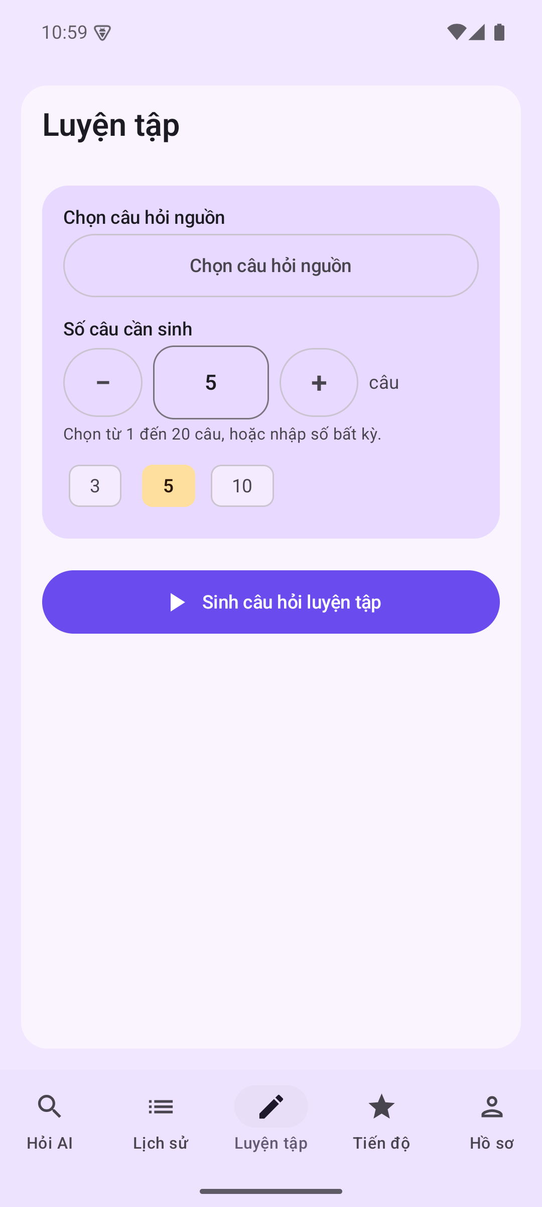
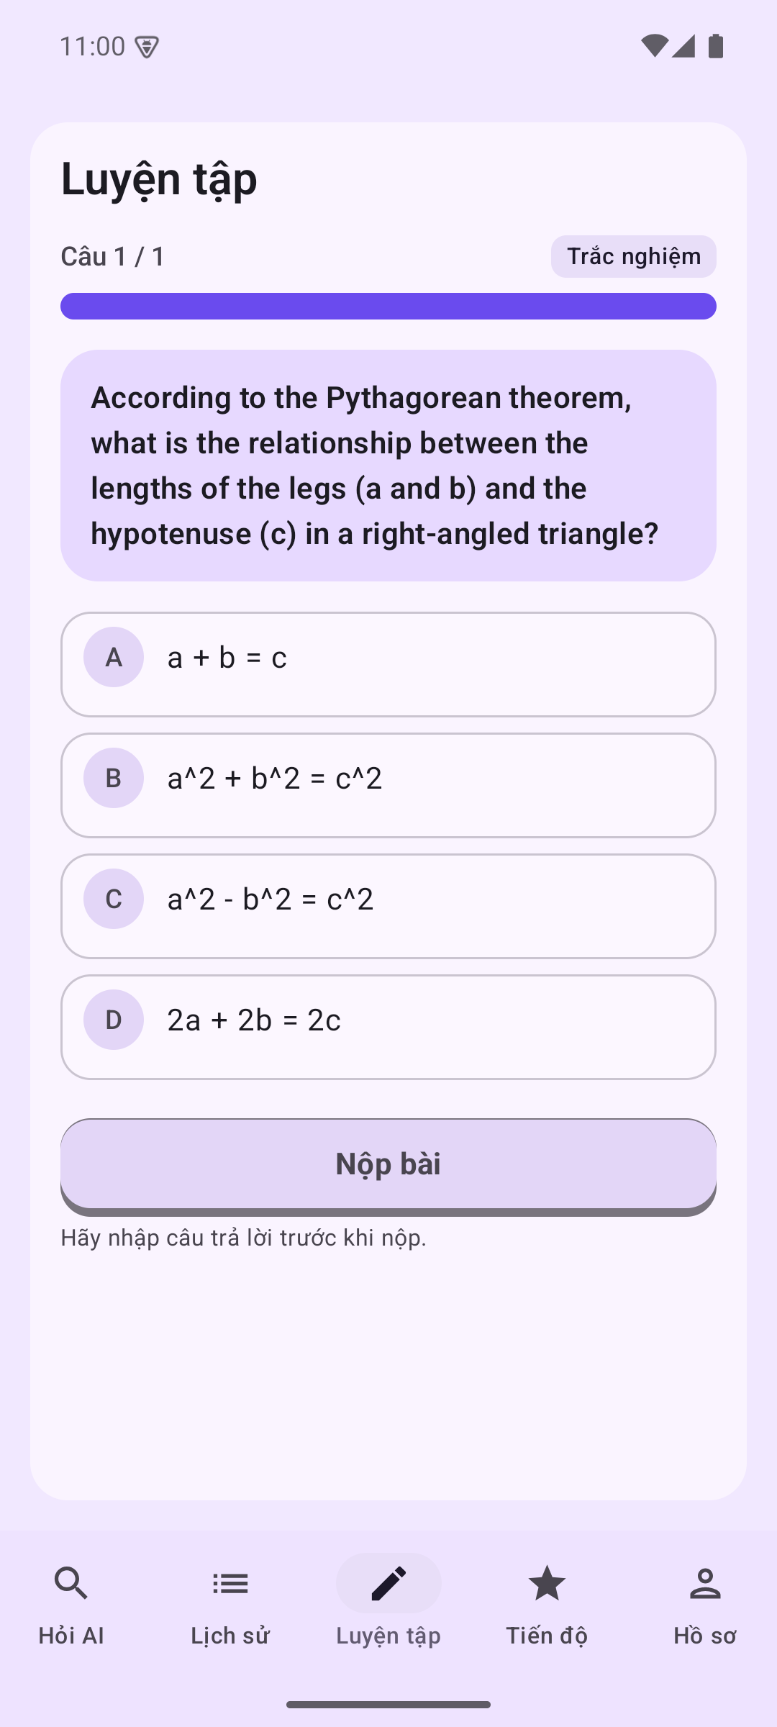
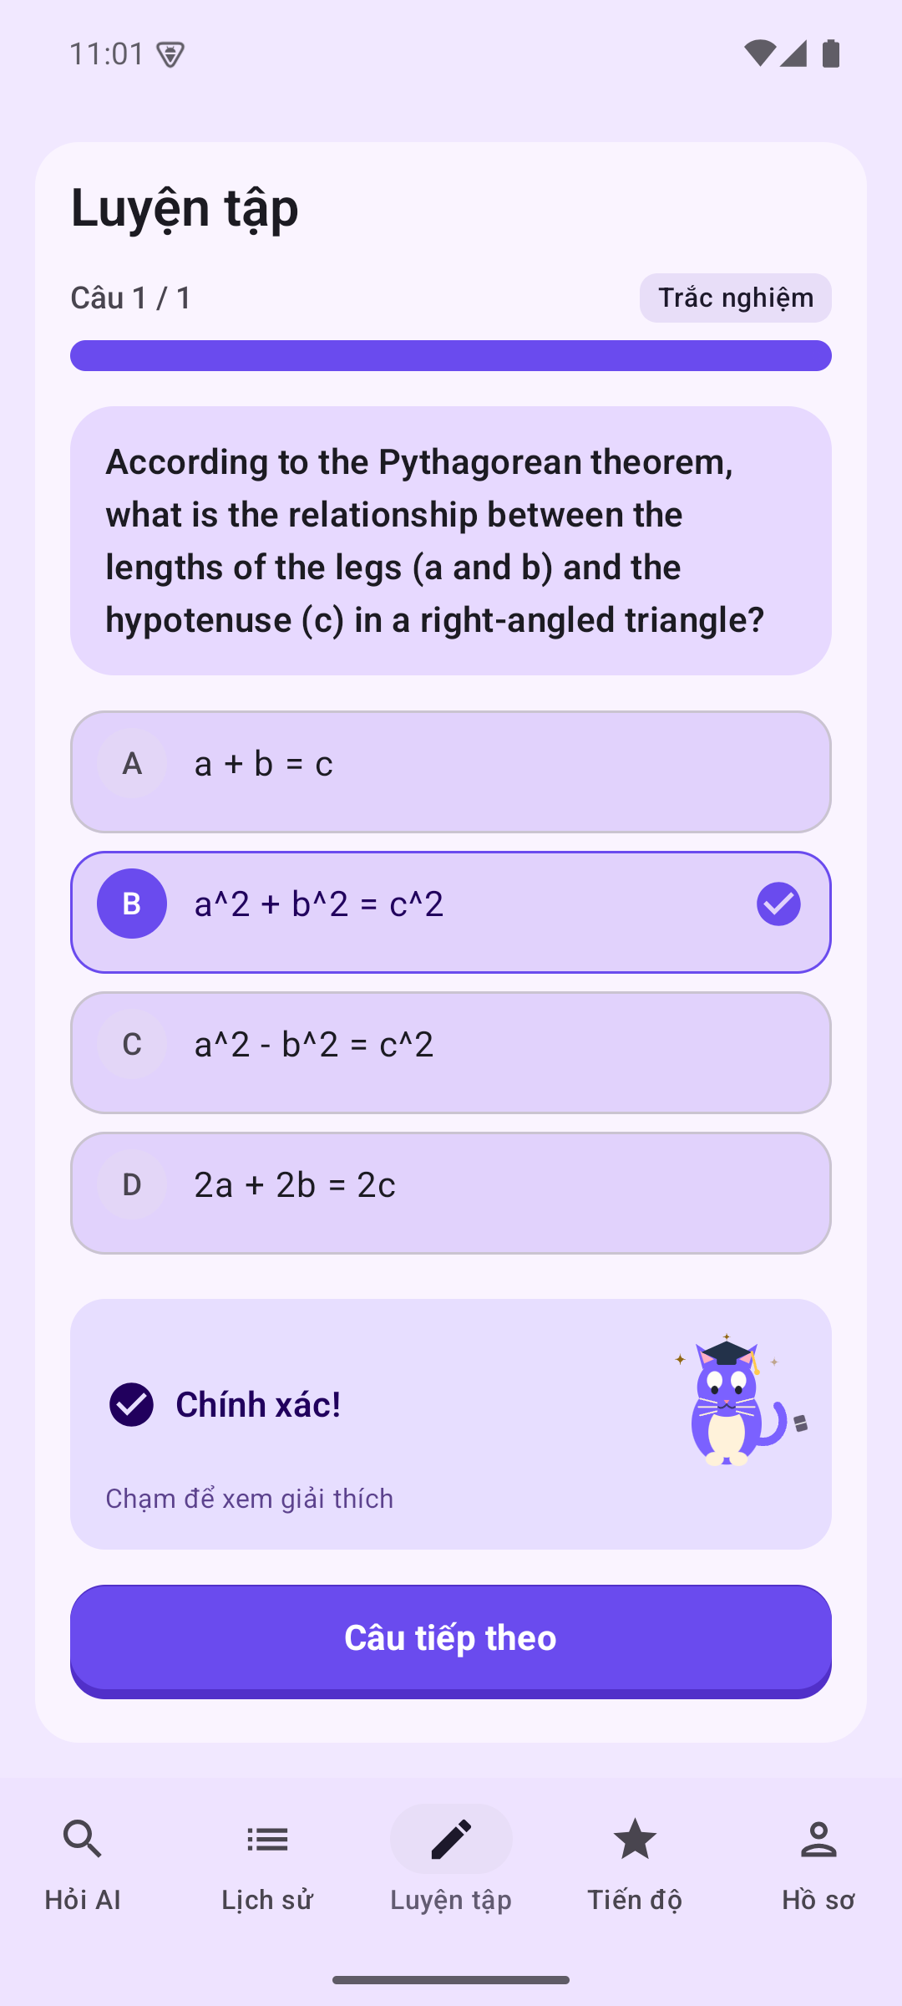
P5 · M5
Demo 3: practice and corrected feedback
• Letter/number keys now resolve to option text before comparison.
• Seven PracticeAnswerTest regressions; screenshot 12 shows “Chính xác!”.
• The screenshot used an option-text key; the letter-key path is unit-tested.
10 · setup
11 · quiz
12 · corrected
DRAFT — NOT FOR FINAL SUBMISSION
9 / 12
Notes:
Be precise about what the screenshot proves. The fix is real and tested, but the letter-key path is covered by tests rather than this capture.

Slide 10
P5 · P6
Evidence and testing
159
39/39
16
JVM tests, 13 classes, 0 failures
instrumented tests after the fix
real-final screenshots
• NFR1 cold start: 3041 / 3108 / 3284 / 3310 / 5139 ms — median 3284, n=5.
• Gemini Ask round trip: 861 / 913 / 2207 ms — median 913, 3/3 HTTP 200.
• Observations only: no project SLO is defined.
• Tests prove logic and data behaviour, not AI accuracy.
DRAFT — NOT FOR FINAL SUBMISSION
10 / 12
Notes:
These are measured observations, not compliance claims. The cold start includes the first-launch outlier; the round trip covers upload, server time and response read.

Slide 11
P6
Evaluation against requirements
Status | Requirements | Basis
Met | FR1, FR4 (one response), FR6 list/detail, FR7 generation/feedback, FR8 | Real-final runtime
Partial | FR2 subjects, FR3 image, FR9 leaderboard, FR10 reminders | Observed gaps
Unverified | FR5 improvement blocks | Not exercised
NFR | NFR1 measured observation; NFR3 met; NFR4–NFR6 partial | NFR2 and history timing pending
No row is rounded up; partial stays partial.
DRAFT — NOT FOR FINAL SUBMISSION
11 / 12
Notes:
Use the report matrix. NFR1 is a measured observation with no threshold; NFR2 action count and history timing remain pending. Offline reading is partial: saved data is readable, new questions fail without a queue.

Slide 12
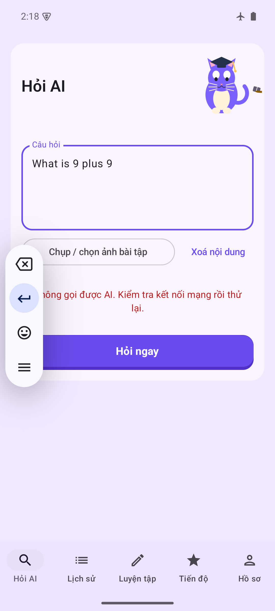
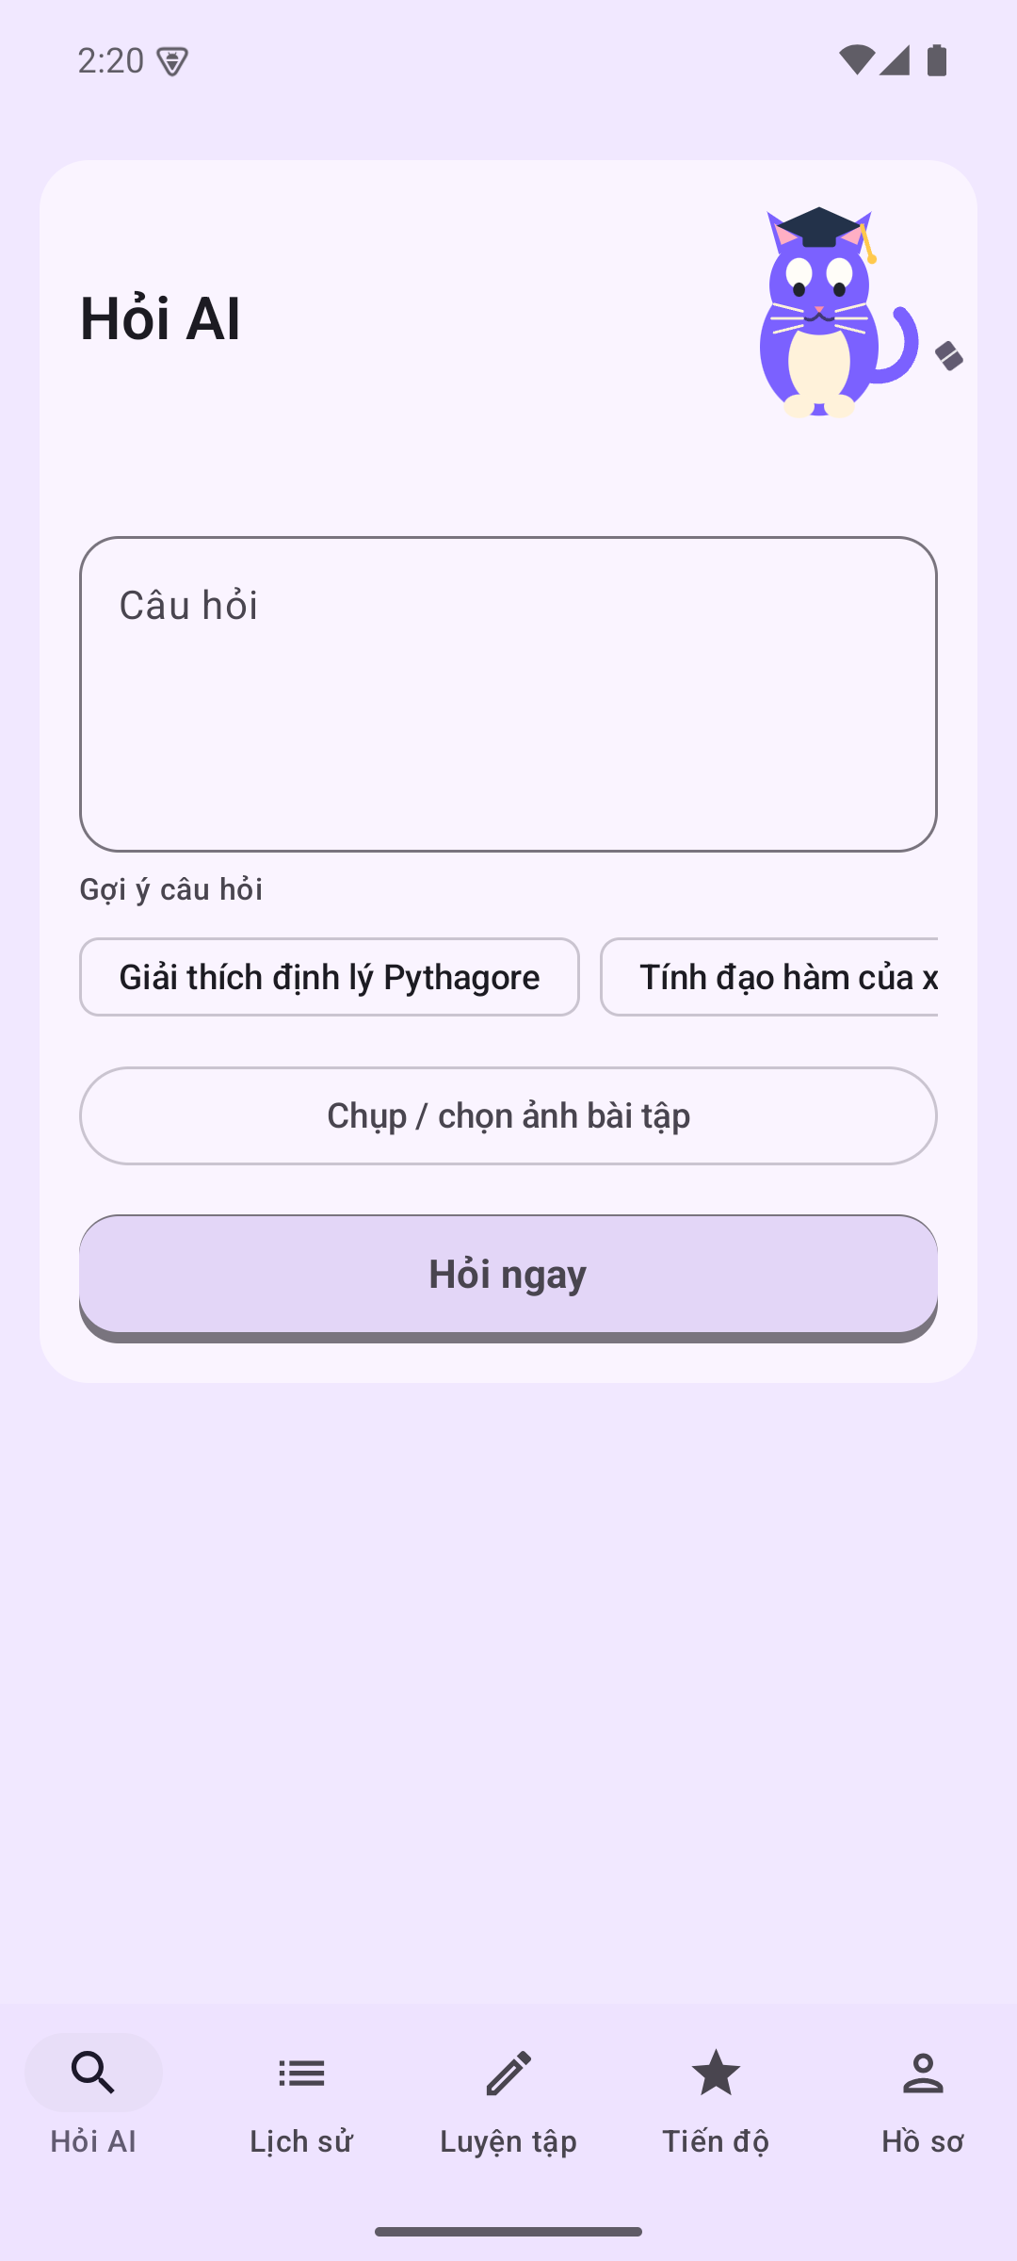
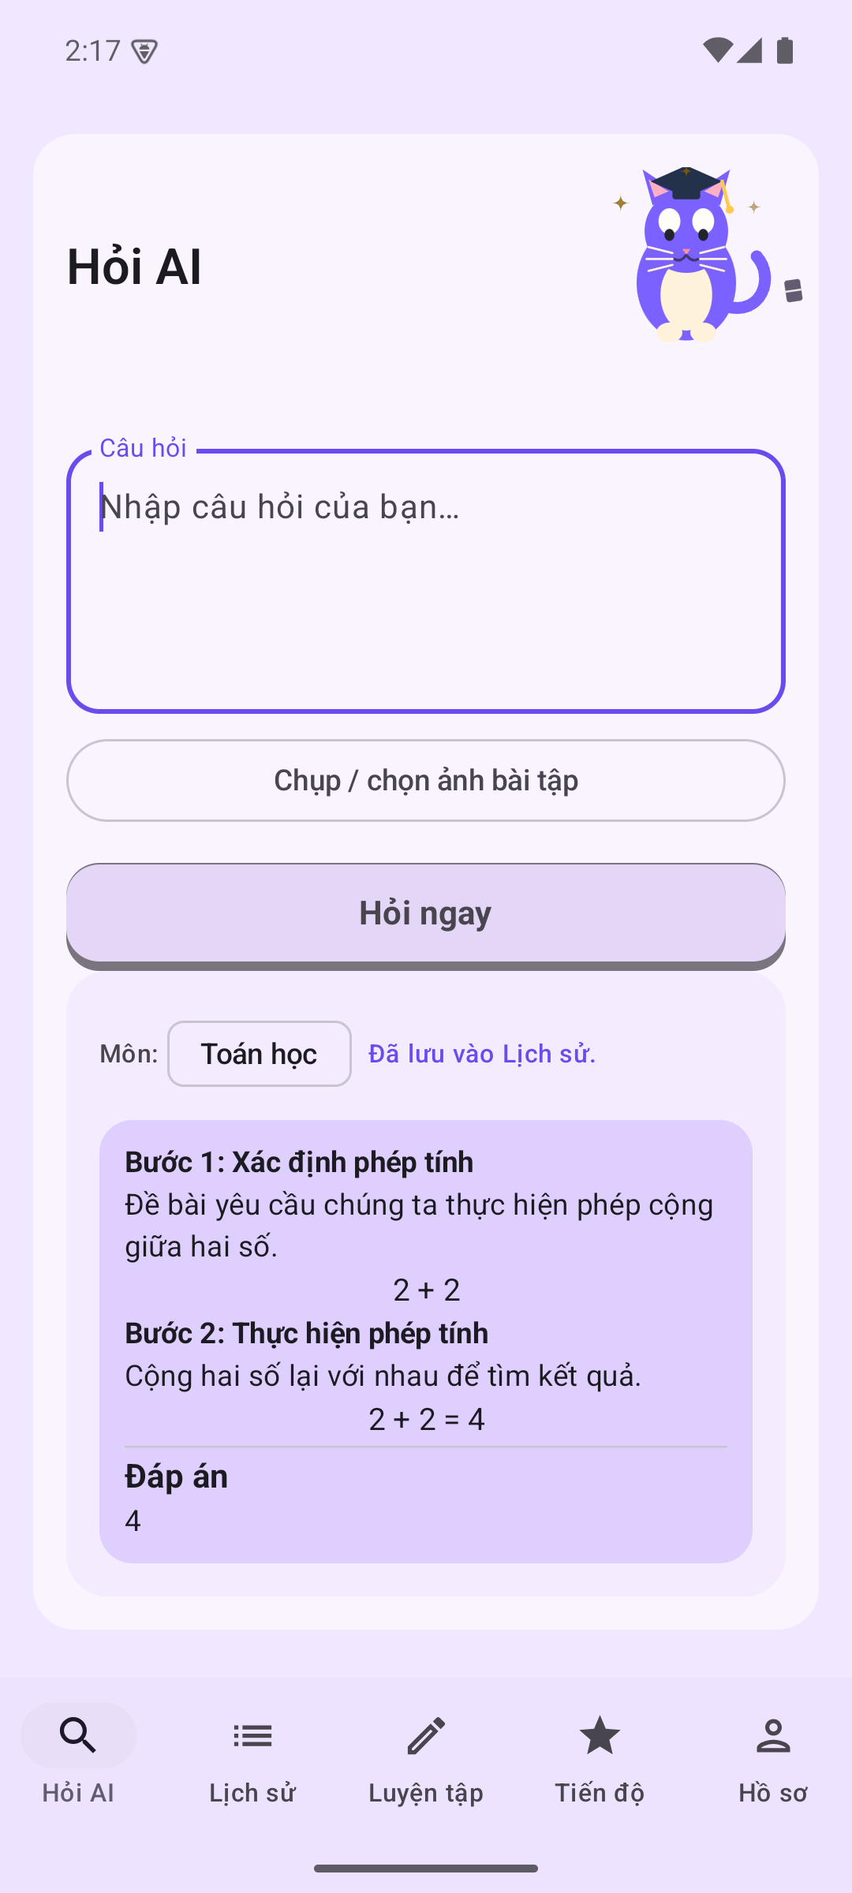
M5 · D2
Critical review, feedback and next steps
• Strengths: testable domain tier, disclosed trade-offs, measured cost control.
• Weaknesses: onboarding subjects, image lifecycle, inactive abuse filter, subject mapping.
• Risks: hallucinated content, cost ceiling, privacy scope, sprint-record gaps.
• Peer feedback and decisions: [PENDING: survey responses].
• Backlog: 2FA, image lifecycle, offline queue, abuse filter, server-backed leaderboard.
Supplementary evidence — not part of the 16-image final gate
offline error
login after logout
image answer
DRAFT — NOT FOR FINAL SUBMISSION
12 / 12
Notes:
Close on what is evidenced and what is honestly outstanding. The three thumbnails are supplementary captures for offline recovery, login after logout and the image question; they are not part of the sixteen-image final gate. Survey responses are still pending.

