Slide 1


Slide 2
Importance
Multi‑objective home health care routing: a variable
neighborhood search method
high costs of hospitalization
stressful environment
traffic problems
covid-19
Increase the need for HHC
scheduling and routing optimization to improve services
scheduling: time, service level, emission
routing: which nurse visits which patients
1

Slide 3
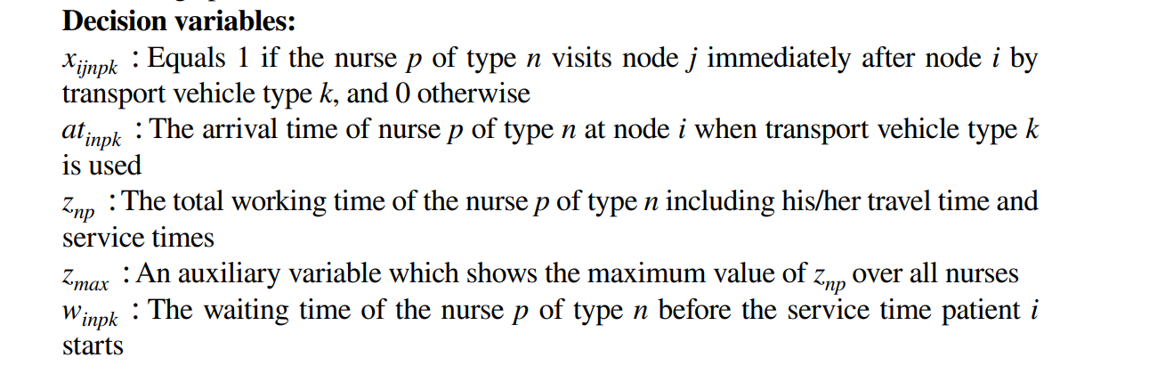
Decision Variables
1

Slide 4
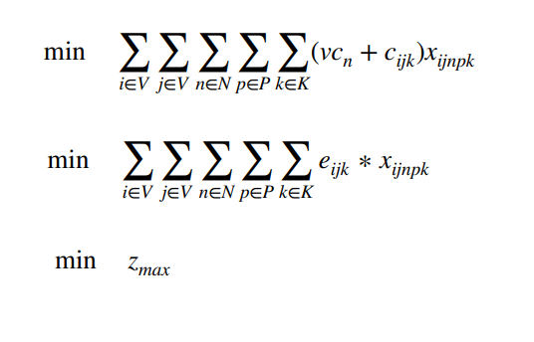
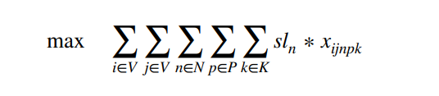
OBJECTIVES
Cost:
CO2 Emission:
Work Balance:
Service Quality:
2

Slide 5
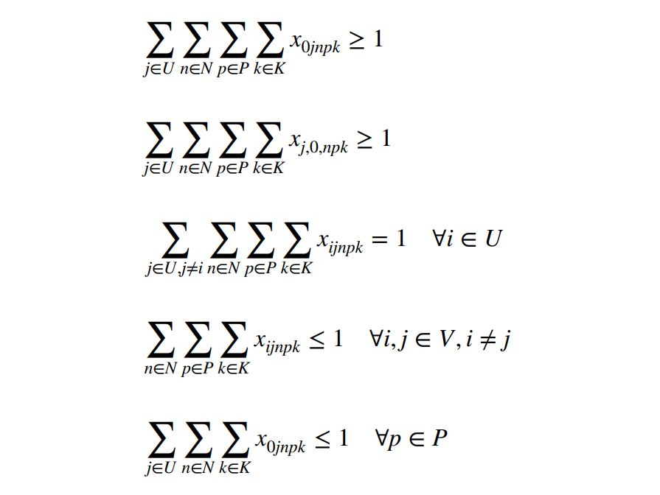
Constraints
(1)
(2)
(3)
Start and End Node of every nurse should be a depot.
At most one nurse with one vehicle type can move from node i to node j.
3

Slide 6
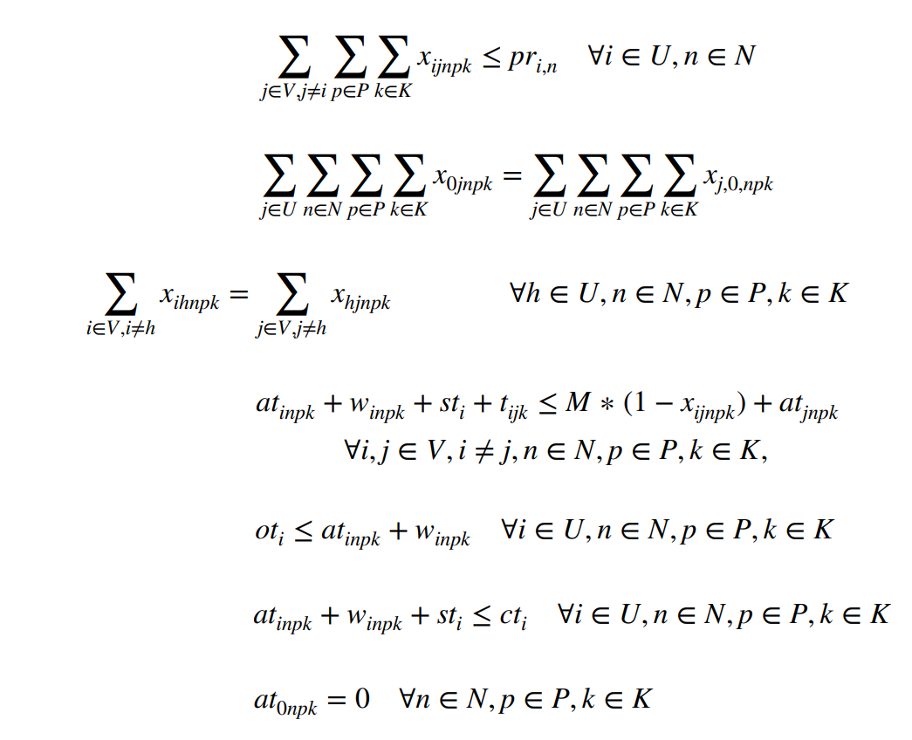
Constraints
(4)
(5)
(6)
Each patient is visited exactly once.
Each nurse can only be assigned to one route of visiting patients.
4

Slide 7
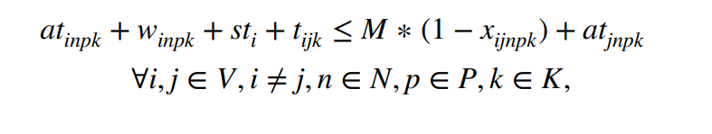
Constraints
Conservation Constraints:
(7)
(8)
(9)
Node i and j relationship:
5

Slide 8
Constraints
Time Windows:
(10)
(11)
(12)
Starting Time:
6

Slide 9
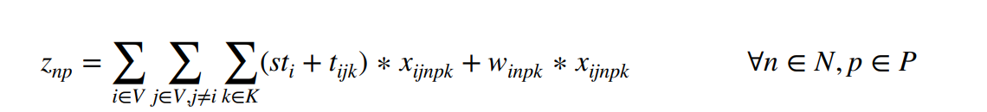

Constraints
(13)
(14)
7

Slide 10
Neighborhood
nurse 1: Patient A Patient B Patient C
Local move: Swap
Neighborhood1
(Patient A Patient C Patient B)
(Patient B Patient A Patient C)
(Patient C Patient B Patient A)
1

Slide 11
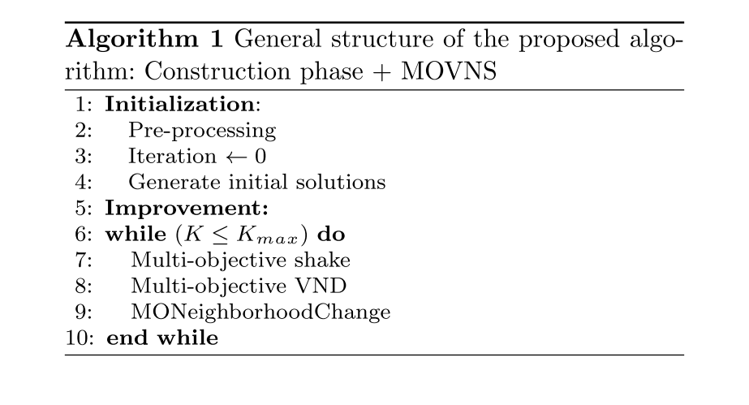
MOVNS
2

Slide 12
Pre-Processing
Cost
Service Level
Nurse Type
Vehicle Type
Cost
Speed
Emission
3

Slide 13
Initial Solutions
Strategies:
min cost (nurse and vehicle)
sorting according to corresponding cost
assigning the first nurse and vehicle type to patient1
max service level and min emission
max service level and speed
4

Slide 14
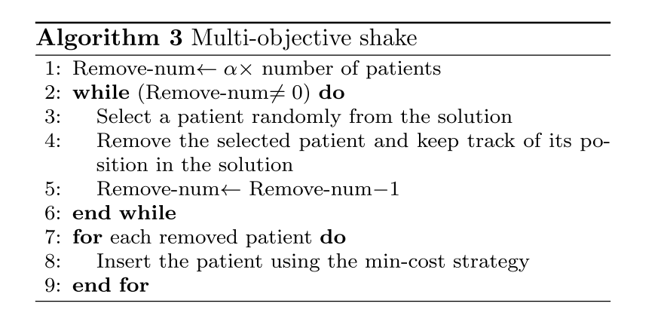
MO Shake
To escape from local optimum:
Applied to each solution in the current pareto list
5

Slide 15
MOVND
VND-i:
VND-1: minimize the total cost(visit cost and travel cost)
Swap-best swapping 2 nodes
Two-opt new edges
Patient-exchange-cost change the route of patient
Vehicle-exchange-cost change the vehicle type
VND-2: minimize the total environmental emission
Vehicle-exchange-emission choose the vehicle with the least emission
6

Slide 16
MOVND
VND-3: work balance
Patient-exchange-workload exchange patients between routes
Vehicle-exchange-workload choose the fastest vehicle
VND-4: maximize the service level
Patient-exchange-service level change the route of each patient
Nurse-exchange-service level change the nurse type of each route
7

Slide 17
MOVND
New C-list
VND-i
last move no improvement
Should make improvement
Next Local Move
First Local Move
improvement
8

Slide 18
Update Pareto List
4 C-list form each VND-i
A pareto list combining the answers of VND
Compare each solution in the pareto list with every solution in C-list.
9

Slide 19
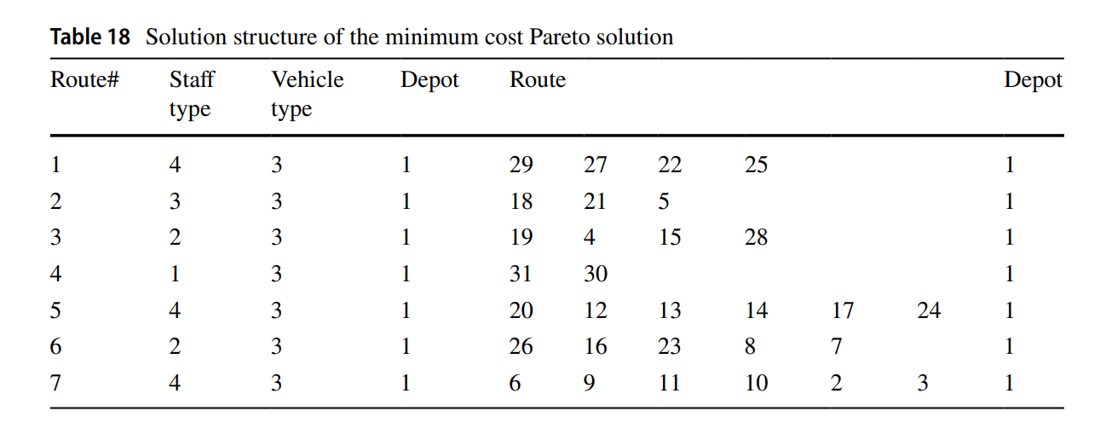
Case Study
Finding the best solution based on each objectives
1

Slide 20
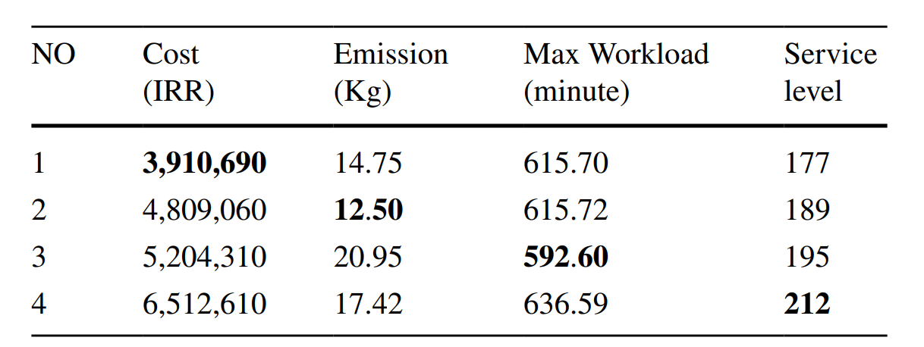
Case Study
DM chooses the solution
the best solutions in terms of each objective function
2

Slide 21
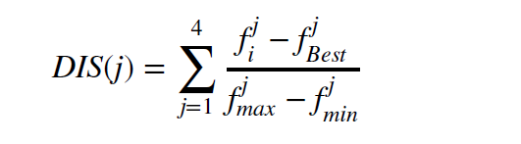
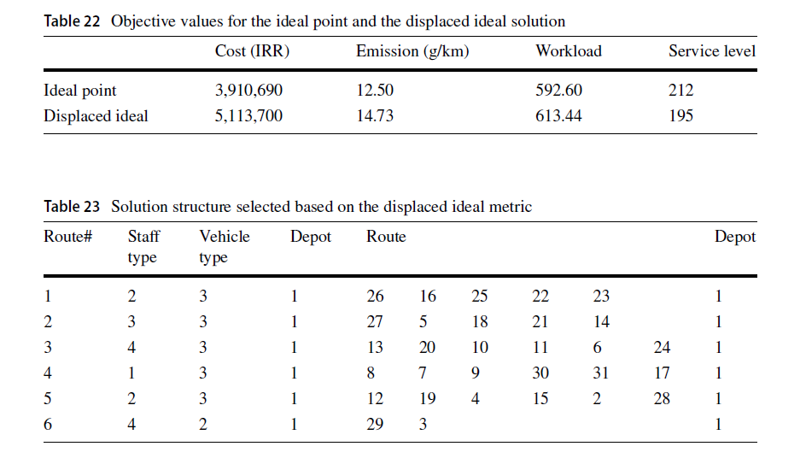
Case Study
3

Slide 22
Comparison
e-constraint:
not good for big instances
long computation time
limited pareto solutions
MOVNS:
short computation time
large number of pareto solutions
4

Slide 23


