Slide 1
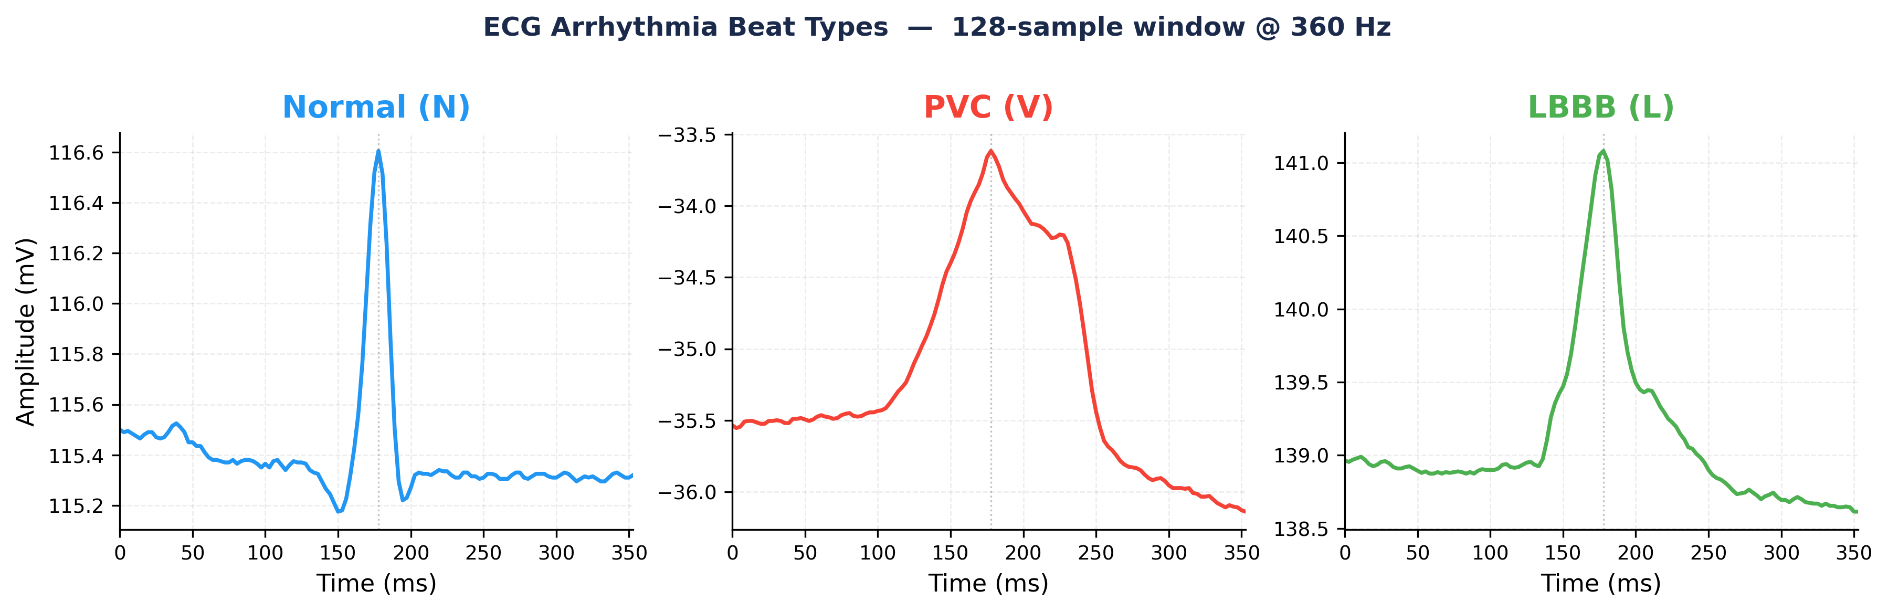
Hardware Implementation of CNN for ECG Analysis and Classification
Marly Barsoum
Toronto Metropolitan University | Dept. of Electrical, Computer and Biomedical Engineering | 2026
Capstone Design Project — FPGA-Based ECG Arrhythmia Classification

Slide 2
Motivation & Problem
Why ECG classification on FPGA?
• Cardiovascular disease is the #1 cause of death globally — 17.9 million deaths per year
• ECG is the primary non-invasive diagnostic tool — but manual reading requires specialists and is slow
• Automated classification enables real-time screening, wearable monitoring, and point-of-care diagnosis
• FPGAs offer deterministic low-latency inference at the edge — no cloud dependency, no CPU bottleneck
• Goal: Classify 8 arrhythmia types in 2.2 ms on a $100 FPGA board using a hardware CNN
17.9M
deaths/year from CVD
360 Hz
ECG sampling rate
2.2 ms
inference per beat
95.75%
classification accuracy
MIT-BIH Arrhythmia Database: 8 classes, 360 Hz, 9,368 validation beats

Slide 3
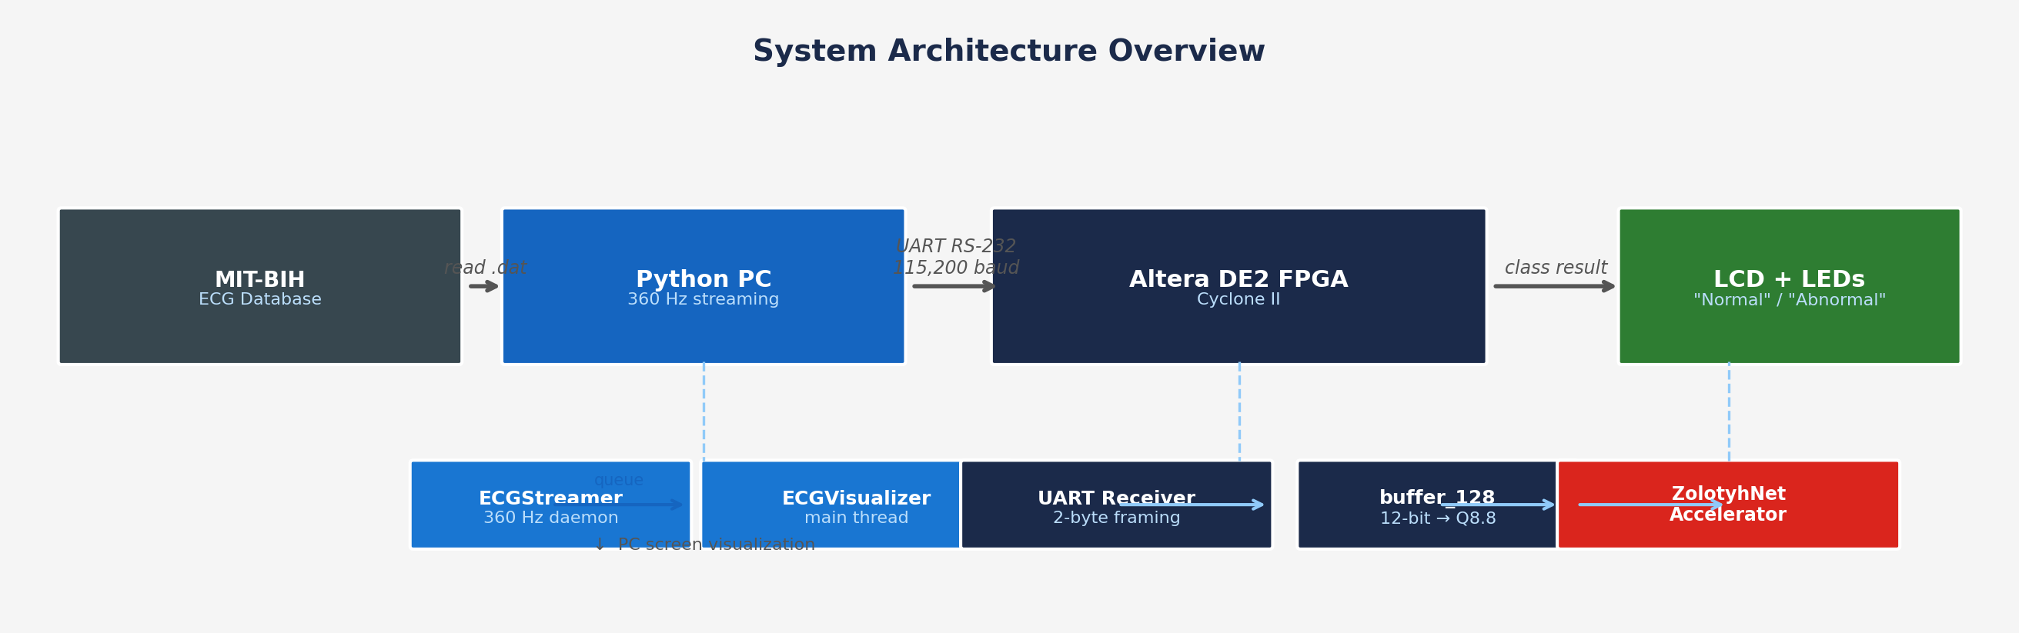
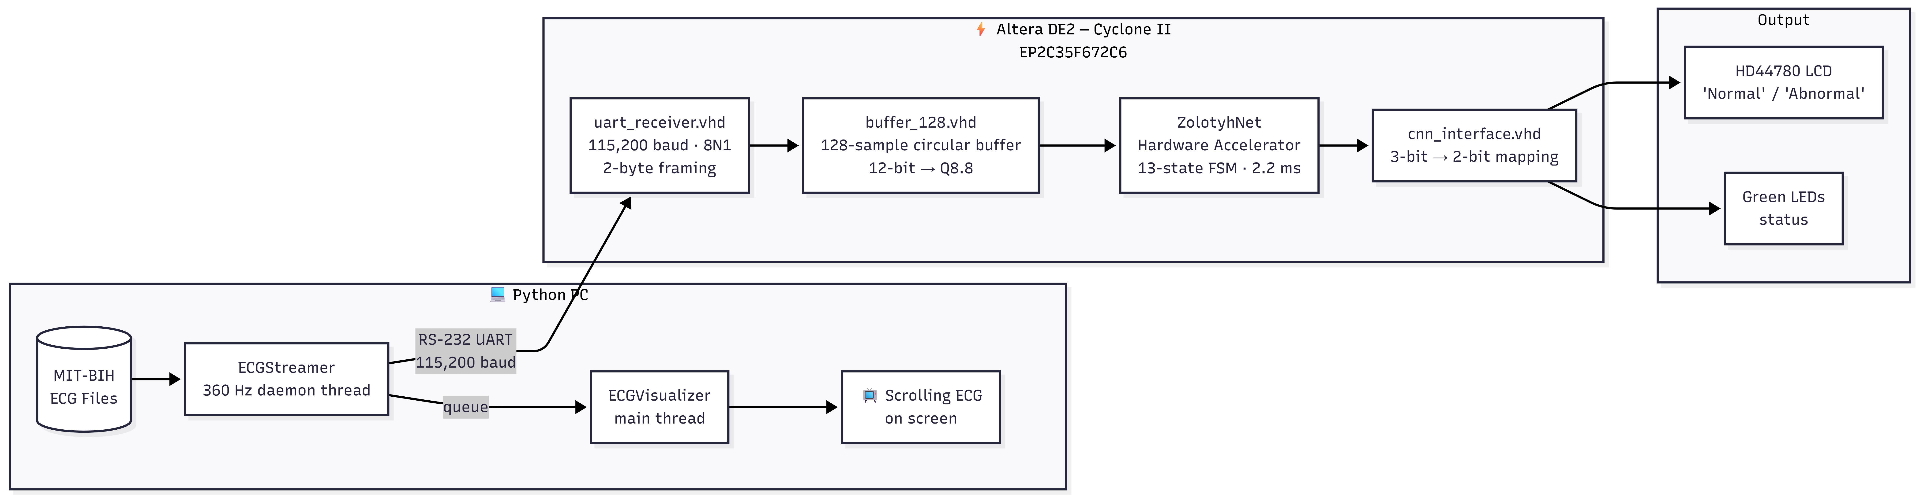
System Architecture
End-to-end data flow
• Python reads MIT-BIH ECG records → preprocesses to 12-bit → streams via RS-232 UART at 360 Hz
• FPGA receives samples → fills 128-sample buffer → runs ZolotyhNet CNN → drives LCD + LEDs
• PC visualizes the raw ECG waveform in real time on screen (matplotlib)

Slide 4
Dataset & Signal Preprocessing
MIT-BIH Arrhythmia Database
MIT-BIH DATABASE
• 48 records, 47 subjects, dual-lead ambulatory ECG
• Sampling rate: 360 Hz | MLII lead used
• 8 arrhythmia classes: N, L, R, V, A, E, !, _
• 128-sample window centered on R-peak (±64 samples ≈ 356 ms)
• 90% training / 10% validation split → 9,368 validation beats
Figure 1: 128-sample beat windows — Normal (N), PVC (V), LBBB (L) — MIT-BIH @ 360 Hz
PC-SIDE PREPROCESSING
The 8 arrhythmia classes:
• Raw ADC → physical mV: (ADC − zero − baseline) / gain
• UART path: min-max normalize → 12-bit signed integer
• Two-byte framing: Byte1 = lower 8 bits, Byte2 = upper 4 bits
N
Normal sinus beat
L
Left Bundle Branch Block
R
Right Bundle Branch Block
V
PVC
A
Atrial Premature Beat
E
Ventricular Escape Beat
!
Ventricular Flutter
_
Unclassified

Slide 5
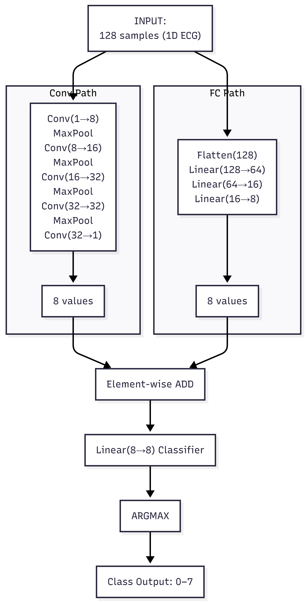
ZolotyhNet — Dual-Path 1D CNN
Novel architecture designed for FPGA resource constraints
• Upper path (Conv1D): 5 layers + 4 MaxPool — extracts local beat morphology
• Lower path (FC): 3 Linear layers — captures global signal statistics
• Fusion: element-wise ADD of both paths (8 values each)
• Classifier: Linear(8→8) → Argmax → 3-bit class output (0–7)
• ~14,700 parameters — 34× smaller than EcgResNet34 (~500K)
• Quantized to Q8.8 fixed-point — fits entirely in on-chip M4K ROM
14.7K
parameters
5+3
layer depth
8
output classes
Q8.8
quantization

Slide 6
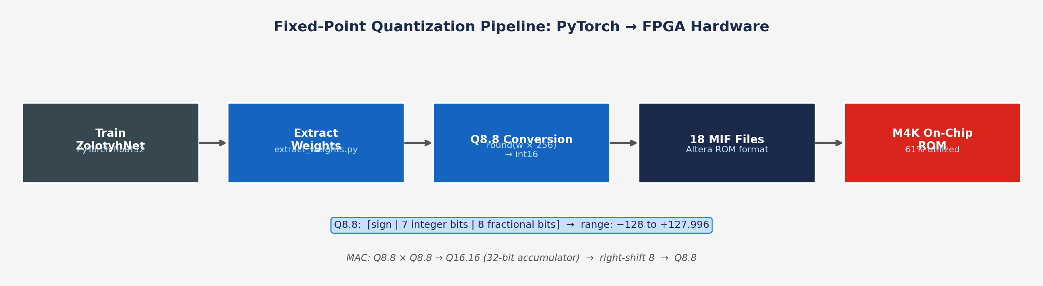
Fixed-Point Quantization
From PyTorch float32 weights to FPGA hardware
Q8.8 FORMAT
MAC ARITHMETIC
• 16-bit signed: 1 sign + 7 integer + 8 fractional bits
• Range: −128.0 to +127.996 | Resolution: 1/256 ≈ 0.004
• Conversion: round(weight × 256).astype(int16)
• Q8.8 × Q8.8 → Q16.16 product (32-bit accumulator)
• After accumulation: right-shift 8 bits → back to Q8.8
• 18 .mif files → 18 weight_rom instances in VHDL

Slide 7
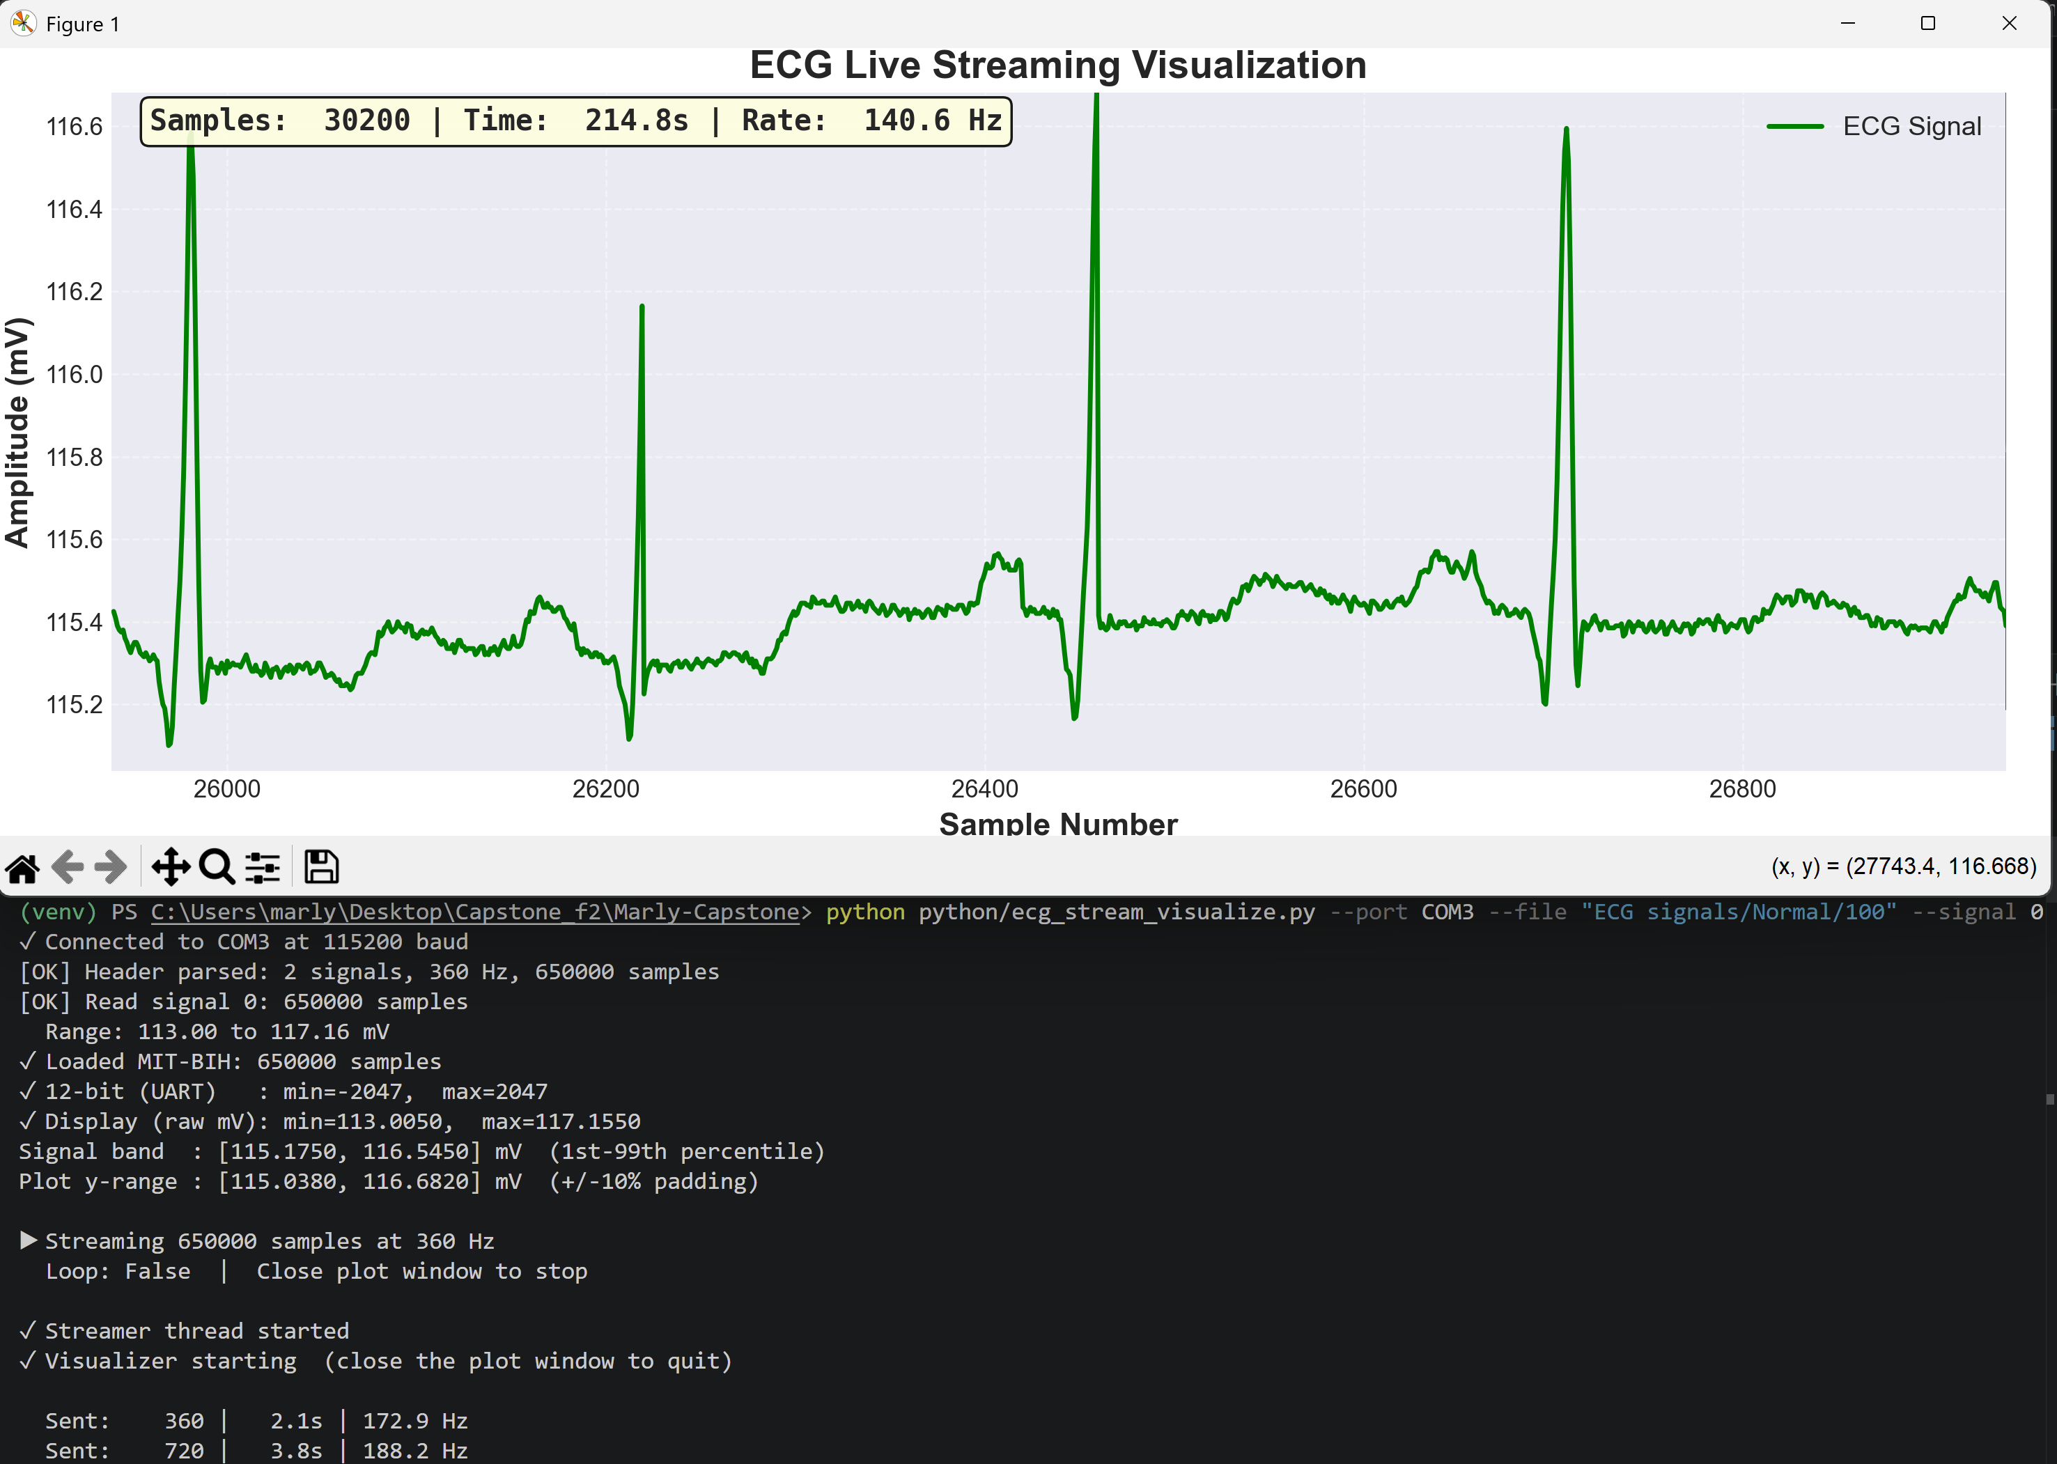
Python Infrastructure
Two-thread streaming + real-time visualization
ECG_STREAM_VISUALIZE.PY
• ECGStreamer: daemon thread — reads ECG file, streams at 360 Hz (time.sleep(1/360))
• ECGVisualizer: main thread — matplotlib animation (required by Tkinter)
• Thread-safe queue (maxsize=2000) between threads
• Display path: raw mV values → scrolling ECG plot on PC
• UART path: min-max normalize → 12-bit signed → two-byte frame → serial port
TWO-BYTE UART FRAMING
• Byte 1 = lower 8 bits of 12-bit sample
• Byte 2 = upper 4 bits, zero-padded to 8 bits
• 115,200 baud | 8N1 | CLKS_PER_BIT = 434

Slide 8
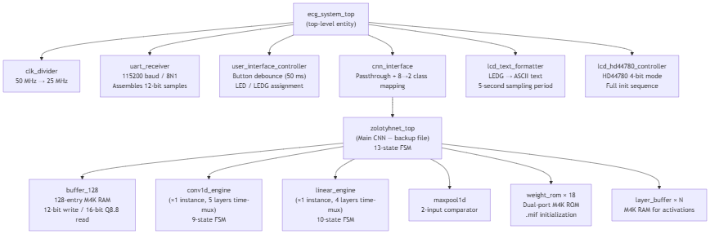
FPGA Hardware: UART & Input Buffer
uart_receiver.vhd + buffer_128.vhd
UART RECEIVER — TWO NESTED FSMS
• FSM 1 (byte-level): IDLE → START_BIT → DATA_BITS (×8) → STOP_BIT
• FSM 2 (sample assembly): WAIT_BYTE1 → WAIT_BYTE2 → pulse sample_valid
• 115,200 baud | 8N1 | CLKS_PER_BIT = 434 | 50 MHz clock
• uart_error asserted on bad stop bit
INPUT BUFFER — BUFFER_128.VHD
• 128-entry circular dual-port M4K RAM
• Write: 12-bit raw ADC | Read: 16-bit Q8.8
• 3-clock pipeline: sign-extend 12→16 → arithmetic right-shift 4
• Triggers CNN when 128 samples accumulated AND CNN is IDLE

Slide 9
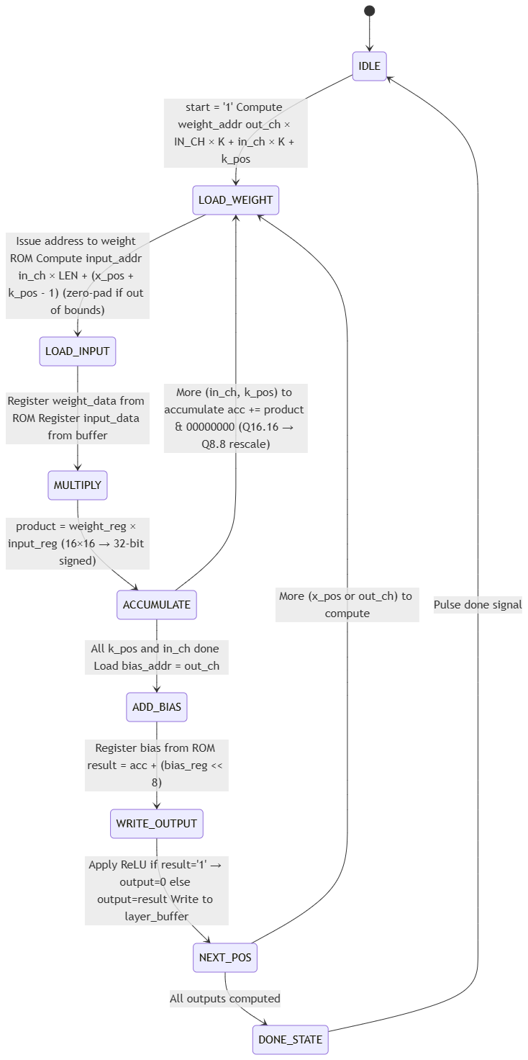
FPGA Hardware: CNN Accelerator
zolotyhnet_top + conv1d_engine + linear_engine
13-STATE TOP-LEVEL FSM
• IDLE → CONV1→2→3→4→5 → LINEAR1→2→3 → FUSION → CLASSIFIER → ARGMAX → OUTPUT
• OUTPUT holds result_valid='1' for 1,000 cycles (~20 µs)
• FUSION: upper[i] + lower[i] element-wise (not concatenation)
TIME-MULTIPLEXED MAC ENGINES
• Conv1D engine: 9-state FSM — handles all 5 conv layers sequentially
• Linear engine: 10-state FSM — handles Linear1, Linear2, Linear3, Classifier
• Both use 32-bit accumulator (Q16.16) → right-shift 8 → Q8.8
• ReLU inline in WRITE_OUTPUT (conv) / APPLY_RELU
18 WEIGHT ROMS
• weight_rom.vhd — ramstyle="M4K" | ram_init_file → .mif | 61% M4K used

Slide 10
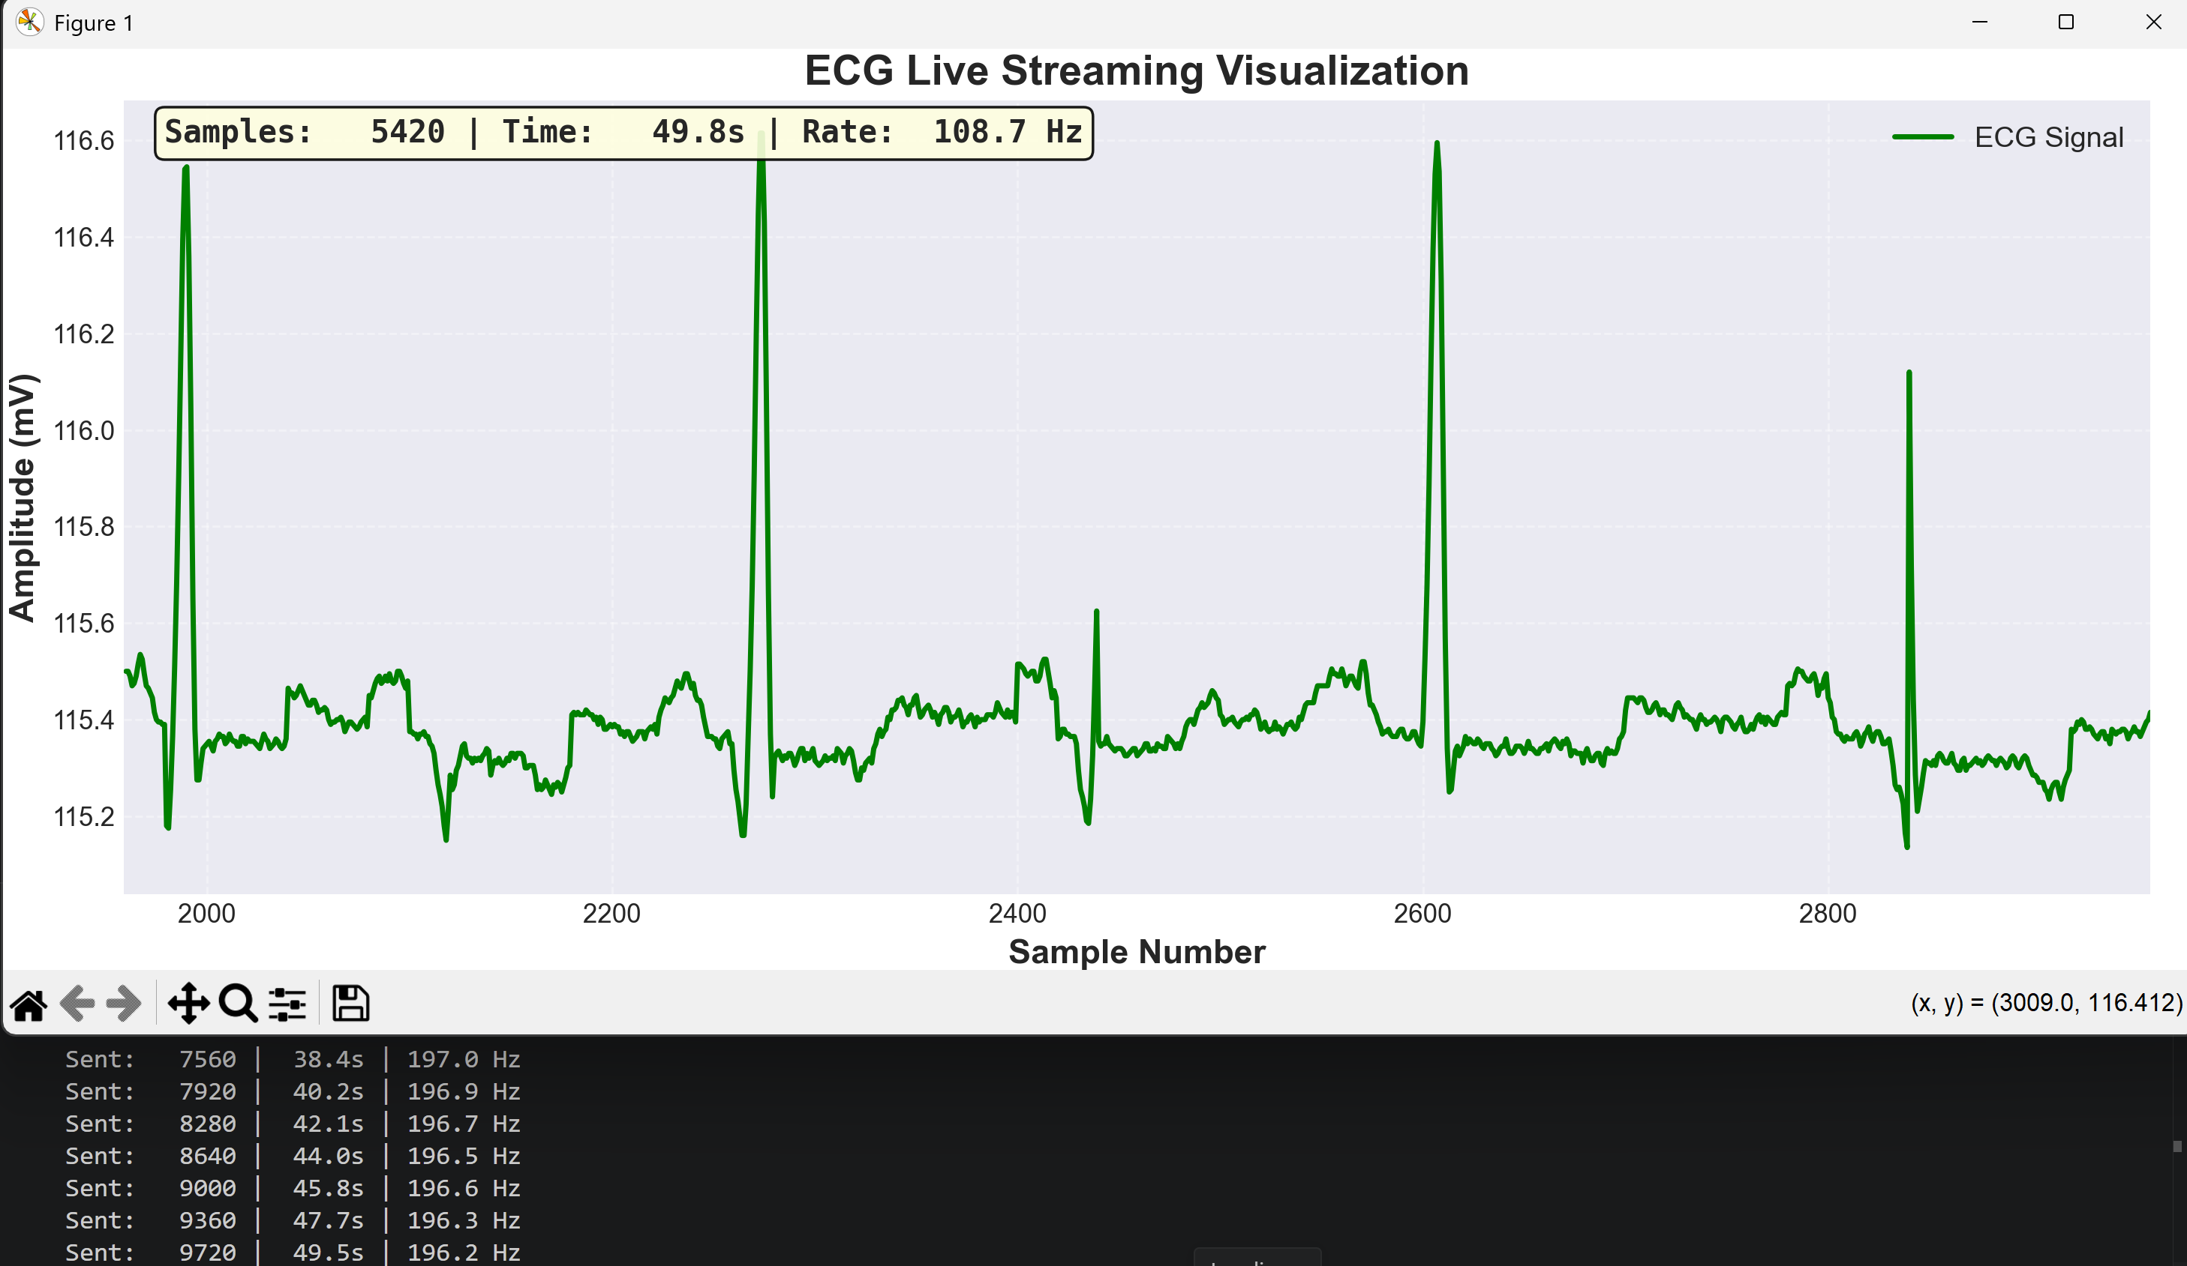
LIVE DEMONSTRATION
Streaming MIT-BIH ECG records from PC → FPGA → LCD classification in real time
[BOARD PHOTO] LCD: "Normal" High-res photo of DE2 board with Normal ECG streaming
[BOARD PHOTO] LCD: "Abnormal" High-res photo of DE2 board with Abnormal ECG streaming
[SCREENSHOT] Python ECG visualizer running
"NORMAL"
"ABNORMAL"
2.2 ms
CNN inference
360 Hz
stream rate
357 ms
end-to-end
~32 records tested
MIT-BIH validation

Slide 11
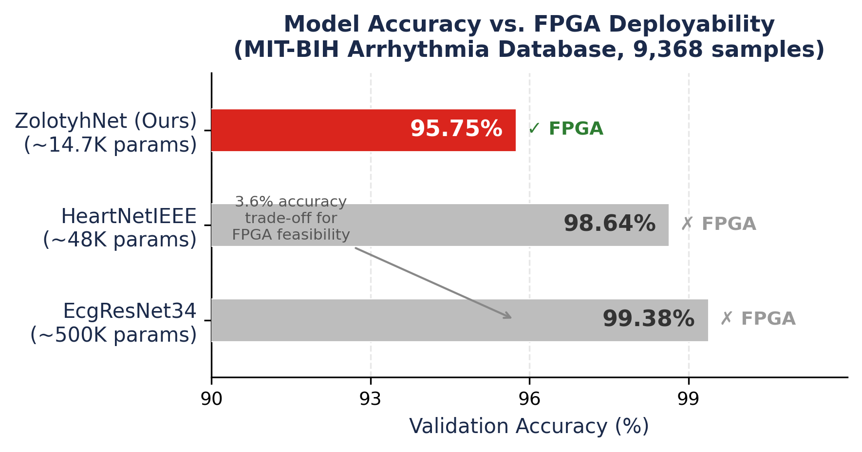
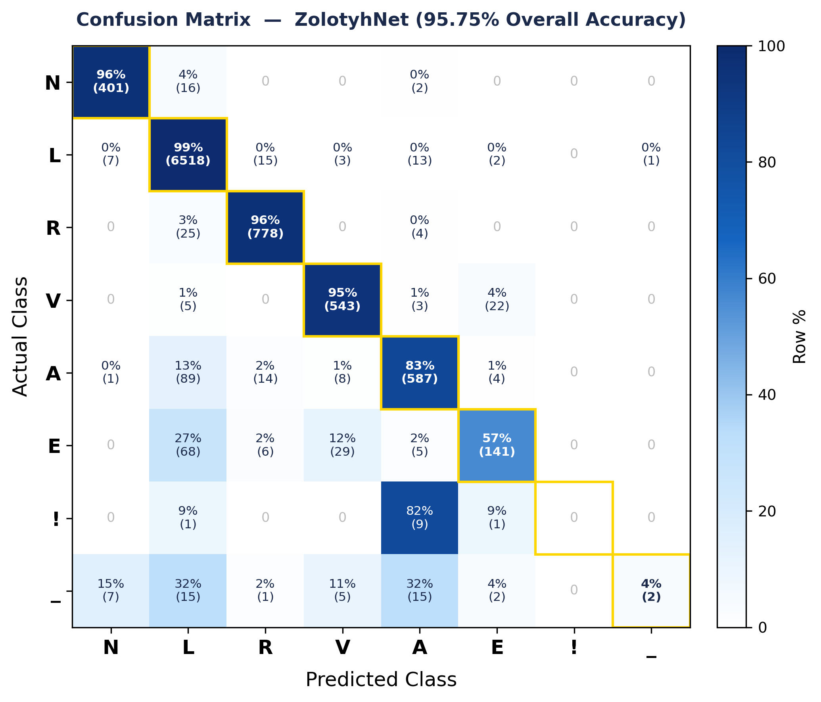
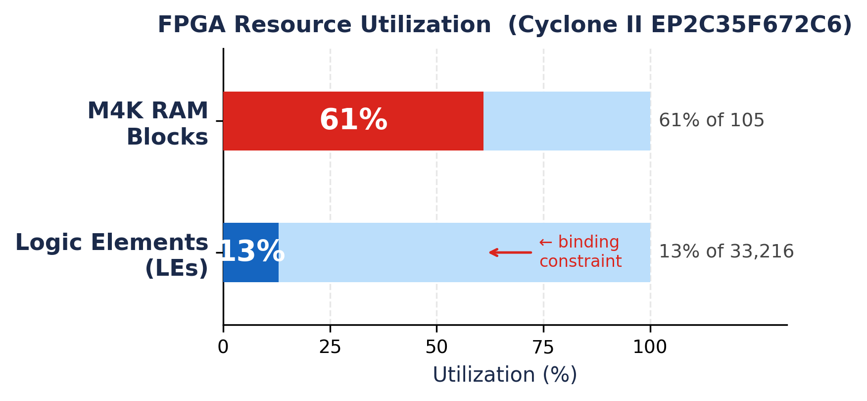
Classification Results
ZolotyhNet on 9,368-sample MIT-BIH validation set
95.75%
Overall Accuracy | 8,970 / 9,368 beats correct
• Normal (N): 99.37% — dominant class, 70% of dataset
• LBBB (L): 96.41% | RBBB (R): 94.76% — well learned
• PVC (V): 83.50% | APB (A): 56.63% — partial confusion
• VEB (E): 0.00% | Flutter (!): 4.26% — class imbalance
• 2.2 ms inference | Linear1 (128→64) is the dominant layer at ~45% of cycles
Trade-off: 3.6% accuracy reduction vs. best software model → enables full FPGA deployment

Slide 12
Key Contributions & Conclusions
WHAT WE BUILT
SYSTEM HIGHLIGHTS
• ✓ ZolotyhNet: a novel 14,700-parameter dual-path CNN — designed for FPGA resource constraints
• ✓ Q8.8 fixed-point pipeline: PyTorch training → extract_weights.py → 18 MIF files → on-chip ROM
• ✓ Time-multiplexed VHDL hardware: 1 Conv1D + 1 Linear MAC engine → 13% LEs, 61% M4K
• ✓ 95.75% accuracy on 8 arrhythmia classes — 2.2 ms inference per 128-sample beat window
• ✓ Complete Python infrastructure: MIT-BIH reader, preprocessing, streaming, visualization
• ✓ End-to-end validated: ~32 ECG records streamed to board — LCD and LED outputs correct
13%
Logic Elements used
61%
M4K RAM blocks used
14.7K
CNN parameters
2.2 ms
per-beat inference
95.75%
classification accuracy

