Slide 1
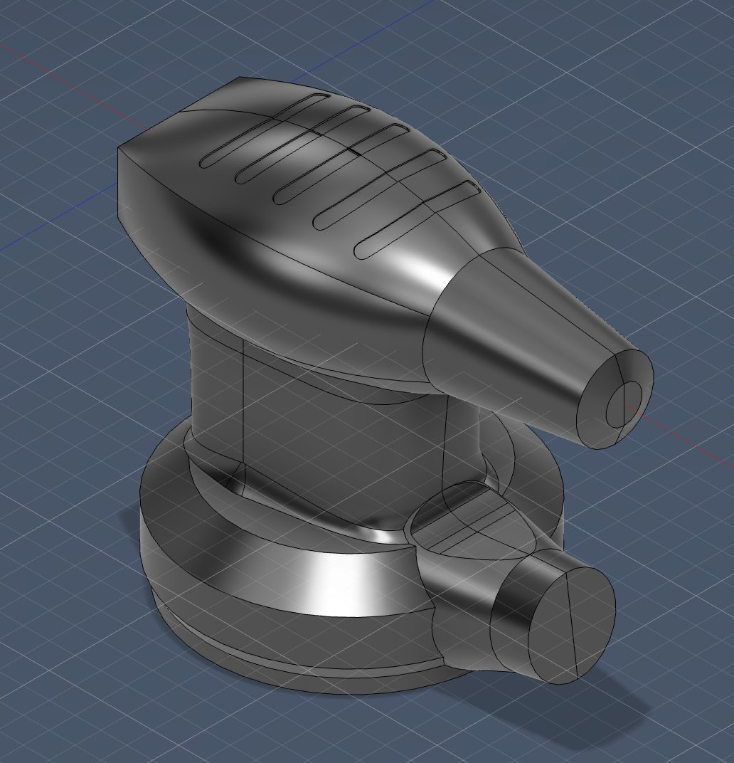
ME 1212 · Group 3-1 · Spring 2026
Human Interfaces
System
Inalsa Orbital (Rotary) Sander — Reverse Engineering
Mohamed Kheshouei · Dex Watson
Form · Fit · Function · Improvement

Slide 2




What Is the Human Interfaces System?
Outer Housing / Grip
Ergonomic 2-piece plastic shell — 172.2 mm long, tapered grip with longitudinal ridges
On/Off Rocker Switch
Press once to turn the sander ON, press again to turn it OFF —speed control, from 1-6 fixed speeds only
Power Cord
AC power delivery from wall to motor; 2.4 A rated
Strain Relief Boot
Fusion 360 — Full Sander Assembly
Rubber boot at cord entry — prevents fatigue cracking at highest-stress flex point
Fulfills: Control / Regulate Inputted Energy

Slide 3
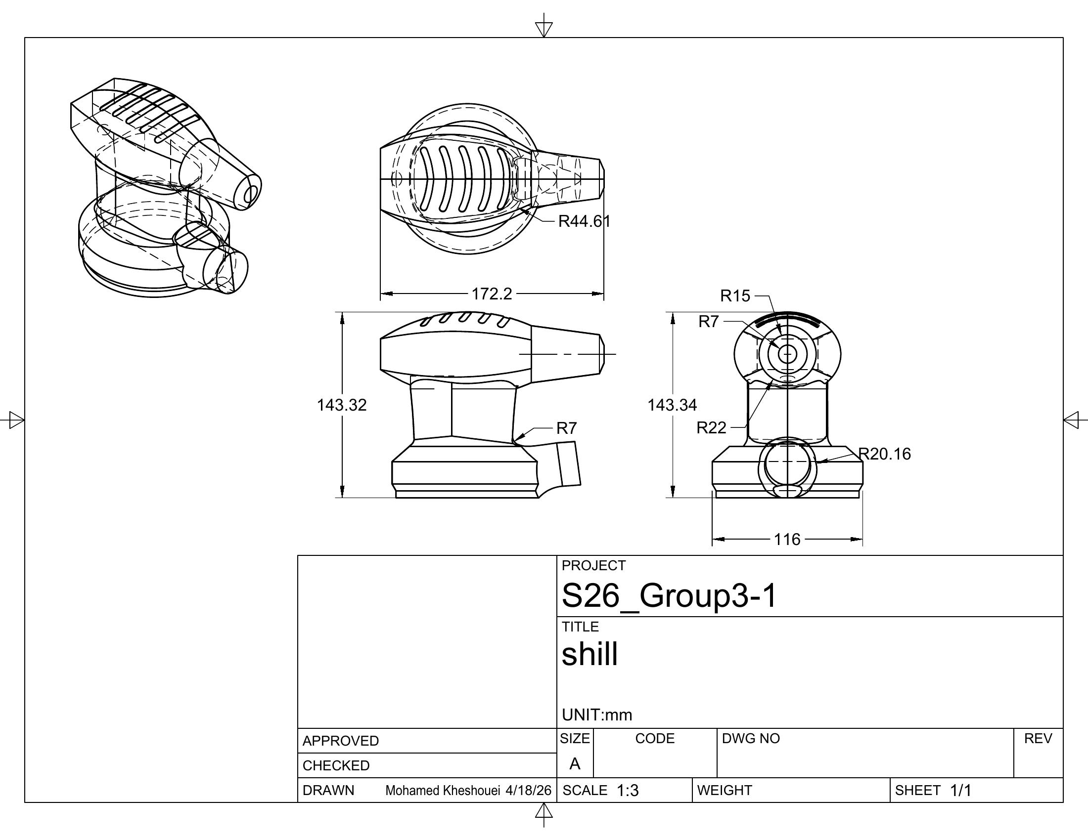
Form — What Does It Look Like?
Key Dimensions
Length
172.2 mm
Width (motor section)
143.34 mm
Height
116 mm
Grip taper — R22 / R20.16
palm-contour transitions
Strain relief Ø
≈ 11 mm at entry
Housing material
Injection-molded ABS plastic
Figure 7 — Housing Dimensioned Drawing (M. Kheshouei)

Slide 4
Fit & Function
Fit
Function
Two housing halves joined by self-tapping screws into molded bosses — rigid, flush seam
Shaped housing + ridges allow comfortable grip for extended use — reduces hand fatigue
On/off switch snaps into a molded rectangular cutout; held by integral locking tabs
Recessed rocker switch gives simple on/off control; recessed position prevents accidental activation
Strain relief boot press-fit via tapered interference — resists pull-out forces
Power cord routes 2.4 A AC power to the motor continuously during operation
Grip ridges co-molded with housing surface — prevents rubber from shifting under hand pressure
Strain relief prevents fatigue cracking at the highest-stress cord flex point
Fulfills: Control/Regulate Inputted Energy (Functional Decomposition Node 1)

Slide 5





Proposed Improvement — Smooth Speed Dial
The Problem
The Solution
The sander already has a speed dial, but it is limited to fixed settings (1–6). This makes it hard to choose the exact speed needed. Sometimes a setting is too fast or too slow, which can damage delicate surfaces like wood veneer or car paint.
Replace the fixed-step dial with a smooth, continuous speed dial. Instead of being limited to set numbers, the user can adjust the speed freely. Turning the dial right increases speed, and turning it left decreases speed, allowing precise control at any level.
Cost
Lifespan
User Experience
This improvement requires a more advanced speed control system instead of a basic stepped dial. While this increases cost slightly, it adds better performance and makes the product more valuable to users.
Having precise speed control allows the motor to run at appropriate speeds for different tasks. This reduces unnecessary stress on components and can extend the life of the sander.
Users can choose the exact speed they need instead of being stuck between fixed options. This improves control, reduces mistakes, and makes the tool easier and safer to use for detailed work.
ME 1212 · Group 3-1 · Human Interfaces System

