Slide 1
Data communication ENG Mosa ELkhedr

Slide 2

Course Introduction

Slide 3
Networking Technologies
Network:
is basically all the components (H/W &
S/W) involved in connecting computer across
small and large distance
Importance of Networks:
Easy access and sharing of information
Sharing of expensive devices and network
resources
Modern Technologies (IP telephony, Video
on Demand, ….etc)

Slide 4
Network components
Network has three main components
Computers (servers and hosts)
- Source of applications (network aware applications)
- ex: HTTP (Hyper Text Transmission Protocol),
FTP (File Transfer Protocol),
SNMP (Simple Network Management Protocol)
Telnet
Network Devices
- Devices that interconnect different computers together
- ex: Repeaters, hub, bridge, switch, router, NIC and modems
Connectivity
- Media that physically connect the computers and network devices
- ex: Wireless and cables

Slide 5
Network Types
LAN (Local Area Network):
It is a group of network components that work
within small area
WAN (Wide Area Network):
It is a group of LANs that are interconnected
within large area

Slide 6
Reference Models
- describe data transfer standards
- a framework (guideline) for network implementation and troubleshooting
- Reference model types :
- OSI
- TCP/IP

Slide 7
Reference Models
The OSI Model
The TCP/IP Model
7 Application
Application
6 Presentation
5 Session
4 Transport
Transport
3 Network
Internet
2 Data Link
Network Access
1 Physical

Slide 8
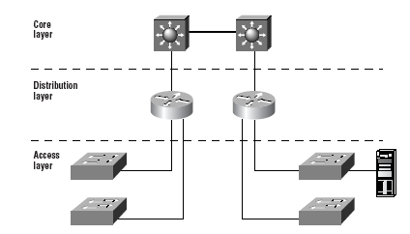
Hierarchical Network Model

Slide 9

The Physical Layer
9
Notes:
Purpose: This chapter introduces the Cisco IOS™ CLI on the Catalyst® 1900 switch and router.
Timing: This chapter should take about 2 hours to present.
Note: The Catalyst 1900 switch only has a subset of the router Cisco IOS commands available.
Contents:
Introduction to Cisco IOS. Explain to the student what is IOS?
Cisco Device startup procedures in general.
IOS configuration source.
General introduction to the IOS CLI.
Cat 1900 switch startup procedures.
Intro to Cat 1900 CLI. This part covers the basic configuration on the switch, like setting the IP address and hostname. More details about the various Cat 1900 switch configuration commands are explained in Chapter 6 and 7.
Router startup procedures. More details on the router startup process is discussed in chapter 5.
Router IOS CLI.

Slide 10
Physical Layer Responsibilities
Description of LAN/WAN cables & connectors
Description of LAN/WAN standards
(maximum length, bit rates, pin assignment, voltage levels)
Physical Layer Devices

Slide 11
LAN Physical Layer
Ethernet cables :
- Copper ( UTP , STP , Coaxial )
- Fiber

Slide 12
Unshielded Twisted Pair (UTP) Cable
prevents EMI , RFI
CAT5
CAT 5e , CAT6
RJ-45
to avoid attenuation

Slide 13
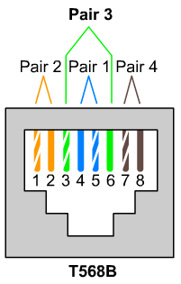
Using UTP cable to connect devices
1- straight cable
2- cross cable
3- roll over cable

Slide 14
Straight-Through or Crossover cables
switch
hub
modem
Cross cable
PC
router
Cross cable
straight cable

Slide 15
Straight Cable
Straight or cross
Straight Cable
Usually use straight cable to connect different type of devices. This type of cable will be used most of the time and can be used to:
1) Connect a computer to a switch/hub's normal port.
2) Connect a computer to a cable/DSL modem's LAN port.
Crossover Cable
Sometimes you will use crossover cable, it's usually used to connect same type of devices. A crossover cable can be used to:
1) Connect two computers directly.
2) Connect a router's LAN port to a switch/hub's normal port. (Normally used for expanding network)
3) Connect two switches/hubs by using normal port in both switches/hubs.

Slide 16
Shielded Twisted Pair (STP) Cable

Slide 17
Coaxial Cable
thick coaxial , thin coaxial (200 m)

Slide 18
Fiber Optic Cable

Slide 19
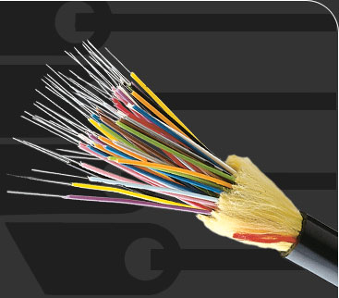
Fiber Optic Connectors
single mode fiber
multimode fiber

Slide 20
Transmission modes
- Full duplex :
devices can send , receive data at the same time (two ways for transmission)
- Half duplex:
one circuit for transmission , so only one device can use the bus (send or receive)
at a time , if two devices sent at the same time collision occurs .

Slide 21
Layer 1 devices 1- Repeater
A repeater is a network device used to regenerate a signal.
Repeaters regenerate analog or digital signals distorted by transmission loss due to attenuation. Rule : no more than four repeaters can be used between hosts on a LAN.

Slide 22
2- Hub
A Hub is a multi-port Repeater
Hubs takes data bits from input port and forward it to all other ports
repeater and hub work in half duplex mode

Slide 23
Task
1-Types of Network Topologies.
2- Advantages and disadvantages.

