Slide 1

The Data-Link Layer
1
Notes:
Purpose: This chapter introduces the Cisco IOS™ CLI on the Catalyst® 1900 switch and router.
Timing: This chapter should take about 2 hours to present.
Note: The Catalyst 1900 switch only has a subset of the router Cisco IOS commands available.
Contents:
Introduction to Cisco IOS. Explain to the student what is IOS?
Cisco Device startup procedures in general.
IOS configuration source.
General introduction to the IOS CLI.
Cat 1900 switch startup procedures.
Intro to Cat 1900 CLI. This part covers the basic configuration on the switch, like setting the IP address and hostname. More details about the various Cat 1900 switch configuration commands are explained in Chapter 6 and 7.
Router startup procedures. More details on the router startup process is discussed in chapter 5.
Router IOS CLI.

Slide 2
Data-Link Layer Responsibilities
Description of H/W addressing
MAC (Media Access Control) address
frame format
Error detection between hop to hop
Data-Link layer standards :
LAN: Ethernet, Token Ring, FDDI
WANs: HDLC, PPP, ISDN, X.25, Frame-Relay, ATM

Slide 3
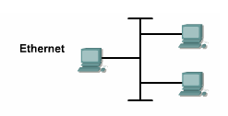
Ethernet Overview
- Ethernet is now the dominant LAN technology in the world.
- Ethernet is not one technology but a family of LAN
technologies.
- Ethernet specifications support different media,
bandwidths, and other Layer 1 and 2 variations.
Notes:
a system for connecting a number of computer systems to form a local area network,
with protocols to control the passing of information and to avoid simultaneous transmission by two or more systems.

Slide 4
MAC Address
- MAC address is 48 bits in length and expressed as twelve
hexadecimal digits.
- MAC addresses are burned into read-only memory (ROM) of the NIC
- each NIC has a unique MAC address
- MAC address can represent unicast , broadcast and multicast
ex. A34C.52BD.1234

Slide 5
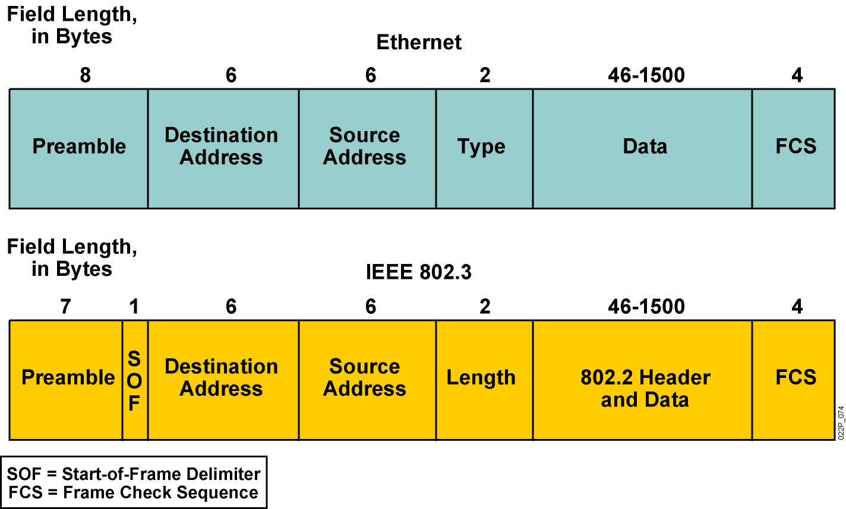
Ethernet Frame Structure
IEEE802.2
Type
Data

Slide 6


Layer 2 devices
A layer 2 device is a device that understand MAC,
for example:
NIC (Network Interface Card)
Bridge :
- address learning
- forwarding decisions are based on software
- bridge is used for LAN segmentation
Switch:
- a multi-port bridge
- forwarding decisions are based on hardware ASIC
(faster than bridge)

Slide 7
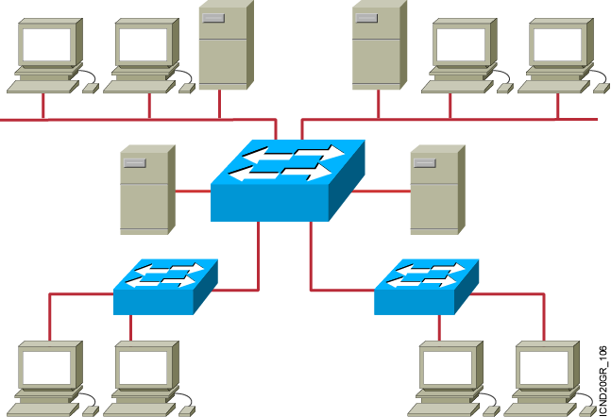
Ethernet Switches and Bridges
All ports of the Switch and Bridge are members in single broadcast domain, and
multiple collision domains
Transparent Bridge and Switche has 3 main functions
Address learning
Forward/filter decision
Loop avoidance
Notes:
Emphasize: The next few slides discuss the basic function of a bridge/switch:
1. How it learns the location of the hosts by reading the source MAC address of incoming frames.
2. How it makes forwarding/filtering decisions.
There are three conditions in which a switch will flood a frame out on all ports except to the port on which the frame came in, as follows:
Unknown unicast address
Broadcast frame
Multicast frame
3. How STP is used to avoid loops in a switched/bridged network.

Slide 8
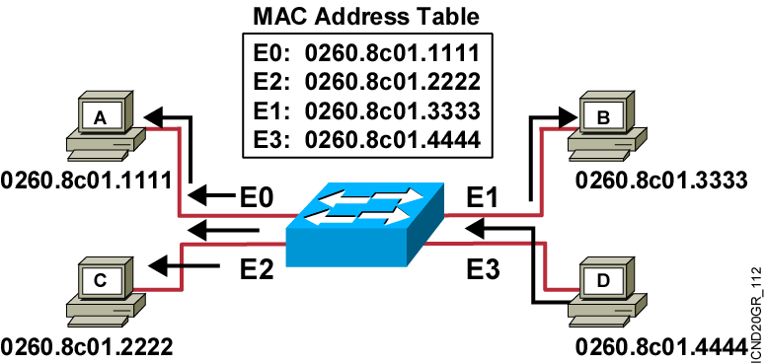
1- Address Learning
Switch learns which MAC’s are connected to which ports by checking the frame source MAC address .

Slide 9
2- Forwarding
- Forwarding is done by checking the destination MAC address
- If the destination MAC is unknown unicast or broadcast or multicast
the frame will be flooded (sent out of all switch ports)
- for the known unicast, switch will forward frame through the learned port only

Slide 10
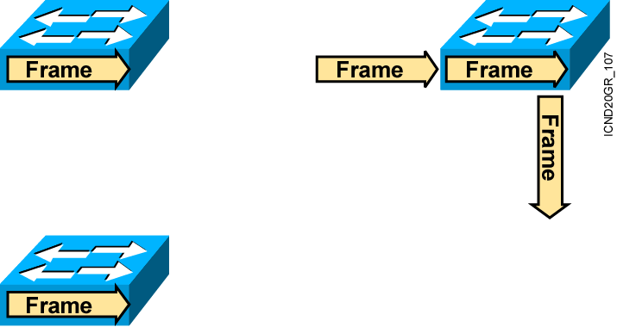

Forwarding modes
Cut-Through
Switch checks destination address and immediately begins forwarding frame.
Store and Forward
Complete frame is received and checked before forwarding.
Fragment-Free
Switch checks
the first 64 bytes, then begins forwarding frame.
Notes:
Layer 3 of 3
Note: 64 bytes is the minimum Ethernet frame size.
The command to switch the mode on the 1900 is:
wg_sw_a(config)#switching-mode ?
fragment-free Fragment Free mode
store-and-forward Store-and-Forward mode

Slide 11
Frame creation
Source MAC
Destination MAC
Source IP
Destination IP
Burned
on the NIC
- ARP
- Proxy ARP
- Static
- Dynamic (RARP , BOOTP , DHCP)
DNS

Slide 12
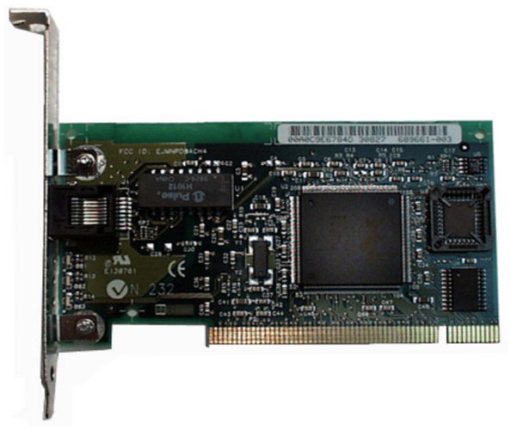
- Source MAC
Burned
on the NIC

Slide 13
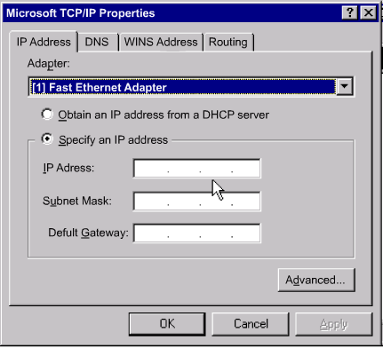
- Source IP
1- by static configuration

Slide 14
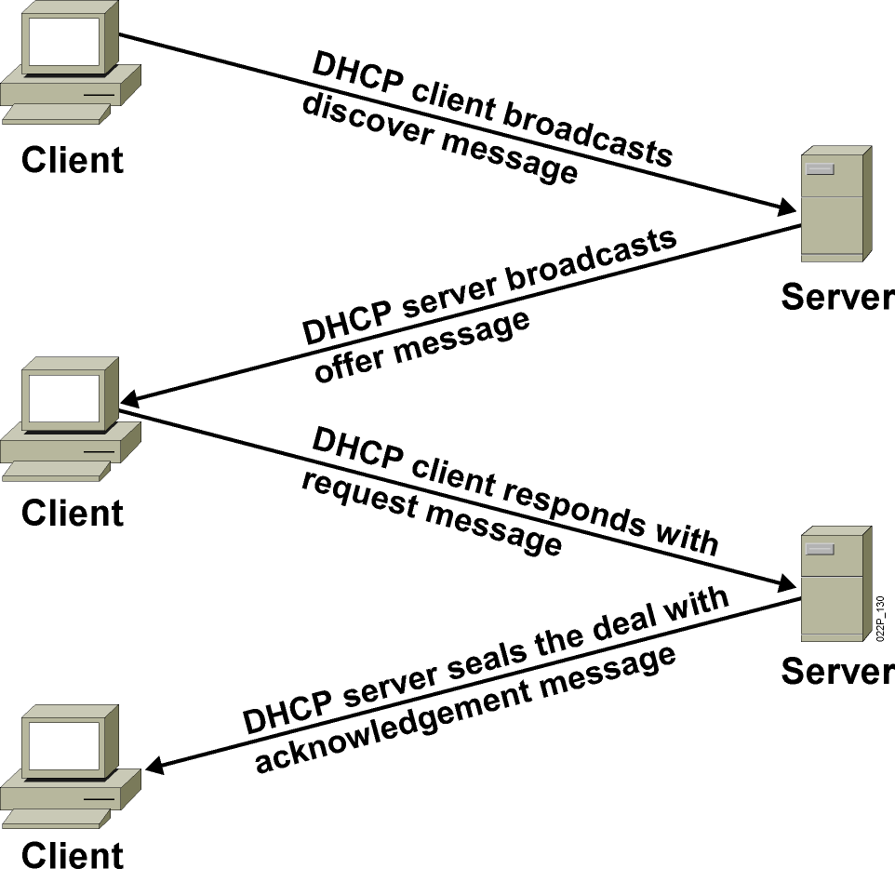
- Source IP
- DHCP :
- Dynamic host configuration protocol
- DHCP allows a host to obtain an IP address dynamically without the network administrator having to set up an individual profile for each device.
- a range of IP addresses on a DHCP server is defined .
- the entire network configuration of a computer can be obtained in one message from the server.
Notes:
Lesson Aim
<Enter lesson aim here.>

Slide 15
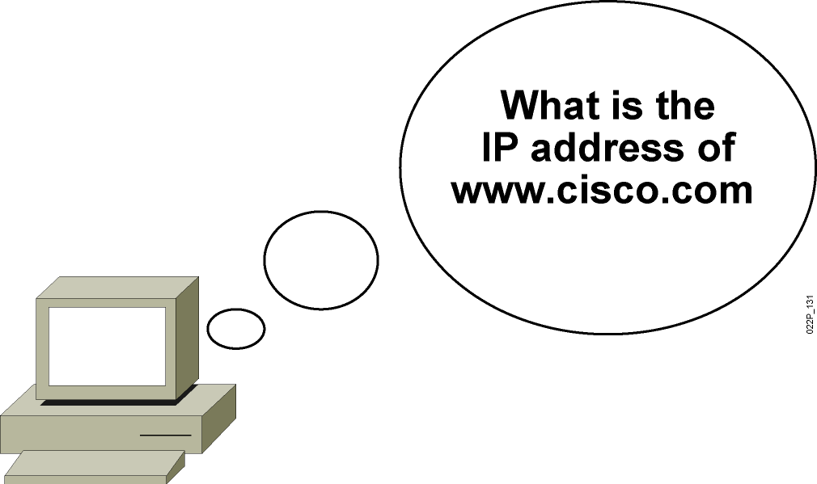
- Destination IP
DNS :
Application specified in the TCP/IP suite
Means to translate human-readable names into IP addresses

Slide 16
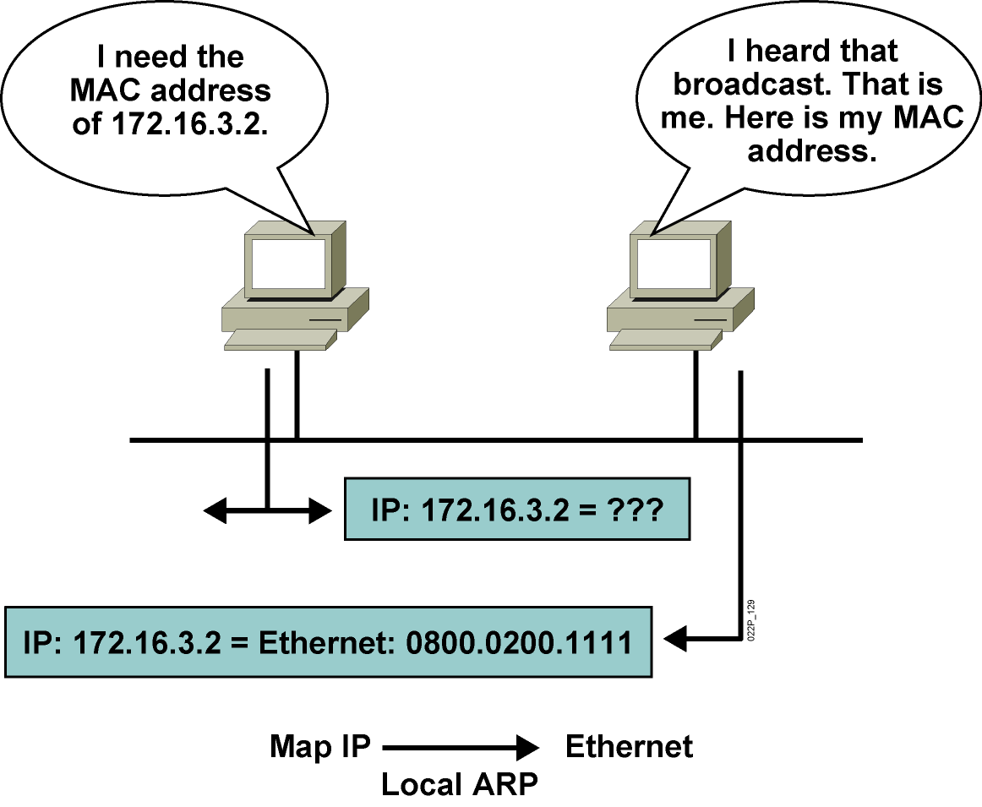
- Destination MAC
- ARP :
- each PC form an ARP table containing the learned MAC’s
Notes:
Lesson Aim
<Enter lesson aim here.>

Slide 17
The Transport Layer
17
Notes:
Purpose: This chapter introduces the Cisco IOS™ CLI on the Catalyst® 1900 switch and router.
Timing: This chapter should take about 2 hours to present.
Note: The Catalyst 1900 switch only has a subset of the router Cisco IOS commands available.
Contents:
Introduction to Cisco IOS. Explain to the student what is IOS?
Cisco Device startup procedures in general.
IOS configuration source.
General introduction to the IOS CLI.
Cat 1900 switch startup procedures.
Intro to Cat 1900 CLI. This part covers the basic configuration on the switch, like setting the IP address and hostname. More details about the various Cat 1900 switch configuration commands are explained in Chapter 6 and 7.
Router startup procedures. More details on the router startup process is discussed in chapter 5.
Router IOS CLI.

Slide 18
The Transport Layer
reliable service
unreliable service

Slide 19
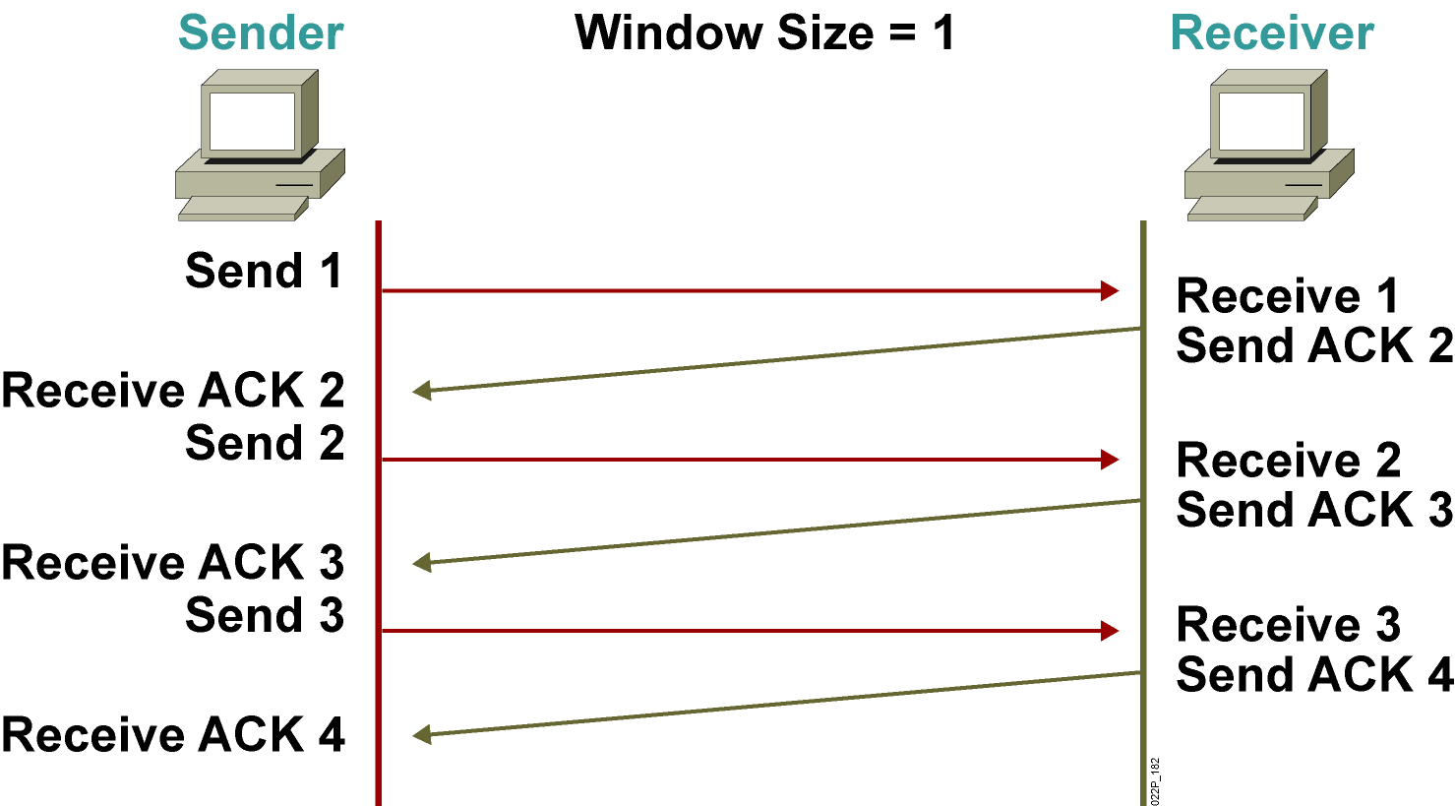
Flow Control
- Windowing (PAR):
error in
2
2
2
2
3
3
Notes:
Lesson Aim
<Enter lesson aim here.>

Slide 20
Flow Control
- Windowing (PAR):

Slide 21
Layer 4 Addressing
Port Numbers :
Port numbers are classified to
Well Known port (0-1023):
it identifies different applications,
ex:FTP(20,21), Telnet(23), SMTP(25), DNS(53), HTTP(80)
User defined port (1024-65535):
it is given randomly by the operating system for
each session initiated by the hot
Notes:
A port number is a way to identify a specific process to which an Internet or other network message is to be forwarded when it arrives at a server. For the Transmission Control Protocol and the User Datagram Proto

Slide 22
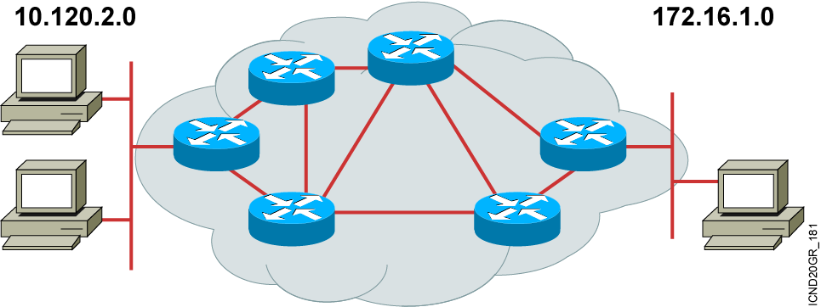
Multiplexing applications
2
1
12.0.0.1
13.0.0.1 web server
12.0.0.2
3
Source IP
Destination IP
Source port
Destination port
1
12.0.0.1
13.0.0.1
1200
80
2
12.0.0.1
13.0.0.1
1500
80
3
12.0.0.2
13.0.0.1
1200
80

Slide 23
The Application Layer
23
Notes:
Purpose: This chapter introduces the Cisco IOS™ CLI on the Catalyst® 1900 switch and router.
Timing: This chapter should take about 2 hours to present.
Note: The Catalyst 1900 switch only has a subset of the router Cisco IOS commands available.
Contents:
Introduction to Cisco IOS. Explain to the student what is IOS?
Cisco Device startup procedures in general.
IOS configuration source.
General introduction to the IOS CLI.
Cat 1900 switch startup procedures.
Intro to Cat 1900 CLI. This part covers the basic configuration on the switch, like setting the IP address and hostname. More details about the various Cat 1900 switch configuration commands are explained in Chapter 6 and 7.
Router startup procedures. More details on the router startup process is discussed in chapter 5.
Router IOS CLI.

Slide 24
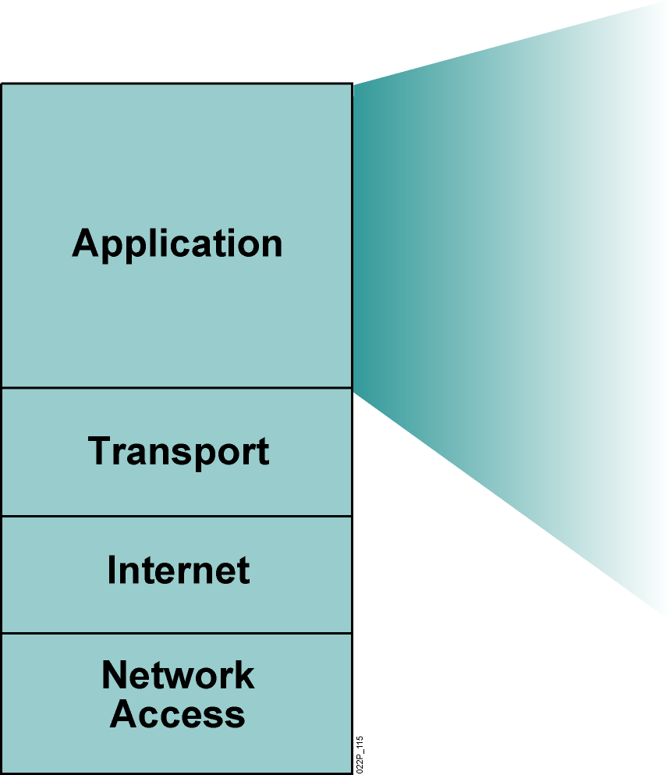
TCP/IP Application Layer Overview
File transfer
FTP
TFTP
E-mail
Simple Mail Transfer Protocol
Remote login
Telnet
Network management
Simple Network Management Protocol
Name management
Domain Name System
Notes:
Purpose: This figure discusses application-layer protocols.
Emphasize: The common network applications today include file transfer, remote login, network management, and e-mail.
We focus on TCP/IP in this course for several reasons:
TCP/IP is a universally available protocol and you will use it at work.
TCP/IP is a useful reference for understanding other protocols, because it includes elements that are representative of other protocols.
TCP/IP is important because the router uses it as a configuration tool. The router uses Telnet for remote configuration, TFTP to transfer configuration files and operating system images, and SNMP for network management.
Transition: The next section moves down the model to discuss the transport layer.

Slide 25
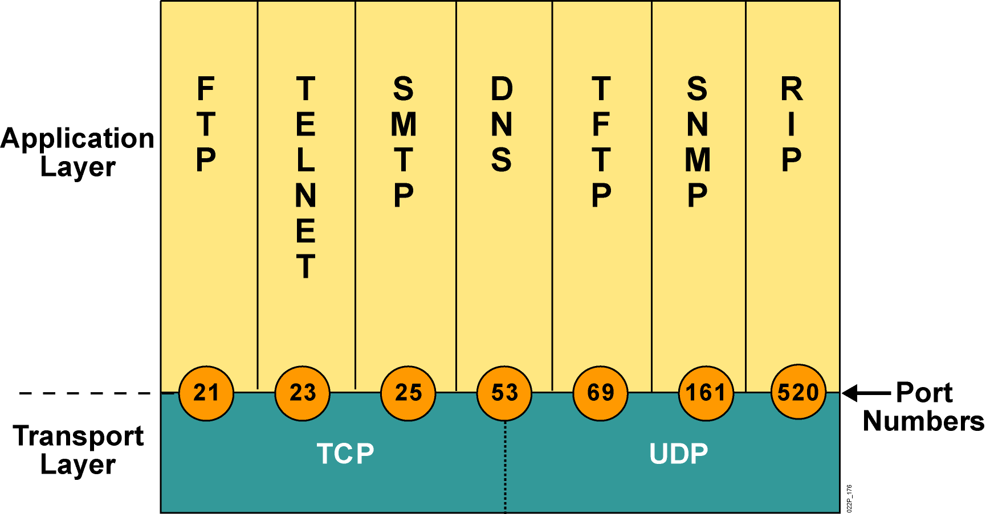
Port Numbers
Notes:
Lesson Aim
<Enter lesson aim here.>

