Slide 1

The TCP/IP Internet Layer
1
Notes:
Purpose: This chapter introduces the Cisco IOS™ CLI on the Catalyst® 1900 switch and router.
Timing: This chapter should take about 2 hours to present.
Note: The Catalyst 1900 switch only has a subset of the router Cisco IOS commands available.
Contents:
Introduction to Cisco IOS. Explain to the student what is IOS?
Cisco Device startup procedures in general.
IOS configuration source.
General introduction to the IOS CLI.
Cat 1900 switch startup procedures.
Intro to Cat 1900 CLI. This part covers the basic configuration on the switch, like setting the IP address and hostname. More details about the various Cat 1900 switch configuration commands are explained in Chapter 6 and 7.
Router startup procedures. More details on the router startup process is discussed in chapter 5.
Router IOS CLI.

Slide 2
A proxy server is a dedicated computer or a software system running on a computer that acts as an intermediary between an endpoint device, such as a computer, and another server from which a user or client is requesting a service. The proxy server may exist in the same machine as a firewall server or it may be on a separate server, which forwards requests through the firewall
Proxy ARP is a technique by which a device on a given network answers the ARP queries for an IP address that is not on that network. The ARP proxy is aware of the location of the traffic's destination, and offers its own MAC address as (ostensibly final) destination.The traffic directed to the proxied IP address is then typically routed by the proxy to the intended destination via another interface or via a tunnel.

Slide 3
- Destination MAC
- Proxy ARP :
A
B
A
B
Router R
I take care, to forward
IP packets to B
Broadcast Message to all:
If your IP address matches “B”
then please tell me your
Ethernet address
Yes, I know the destination
network, let me give you my
Ethernet address

Slide 4

Types of frame errors
1 – CRC error :
Frame contents changed during transmission
2 – Runt frame :
Frame size is less than 64 byte
3 – Giant Frame :
Frame size is larger than 1518 byte
Notes:
Layer 3 of 3
Note: 64 bytes is the minimum Ethernet frame size.
The command to switch the mode on the 1900 is:
wg_sw_a(config)#switching-mode ?
fragment-free Fragment Free mode
store-and-forward Store-and-Forward mode

Slide 5
Transmission Control Protocol (TCP) and User Datagram Protocol (UDP) are the two standard transport layers used with internet protocol (IP).
Both TCP and UDP use headers as part of packaging message data for transfer over network connections. TCP headers and UDP headers each contain a set of parameters called fields defined by the protocol technical specifications.
This is the layout of TCP headers:
Source TCP port number (2 bytes)
Destination TCP port number (2 bytes)
Sequence number (4 bytes)
Acknowledgment number (4 bytes)
TCP data offset (4 bits)
Reserved data (3 bits)
Control flags (up to 9 bits)
Window size (2 bytes)
TCP checksum (2 bytes)
Urgent pointer (2 bytes)
TCP optional data (0-40 bytes)

Slide 6
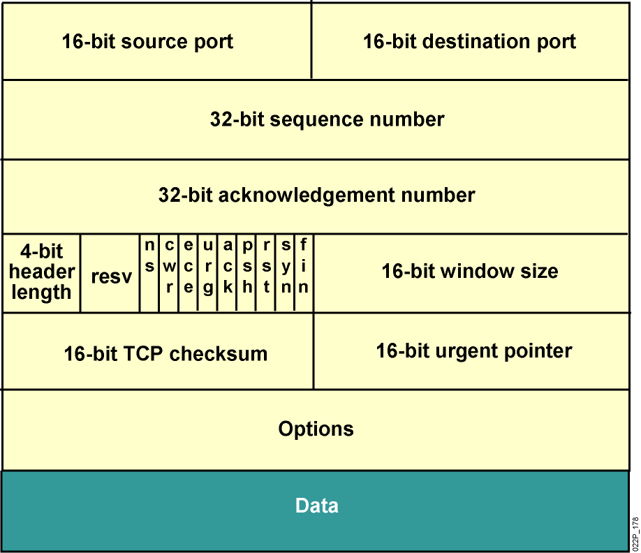
TCP Header
Notes:
he Transmission Control Protocol (TCP) is one of the main protocols of the Internet protocol suite. It originated in the initial network implementation in which it complemented the Internet Protocol (IP)
Internet protocol suite
The Internet protocol suite is the conceptual model and set of communications protocols used on the Internet and similar computer networks. It is commonly known as TCP/IP because the foundational protocols in the suite are the Transmission Control Protocol (TCP) and the Internet Protocol (IP

Slide 7
Internet Layer
Internet Layer is responsible for the following:
Support of logical addressing for network components
Routing (Finding the best path for data)
Layer 3 devices
Internet Layer protocols are
IP (Internet Protocol)
ICMP (Internet Control Management Protocol)
ARP (Address Resolution Protocol), RARP (Revere ARP)
Routing Protocols ex. OSPF , EIGRP ,
IP has the following characteristics
Provide Logical addressing
Provide connectionless “best effort” delivery of data

Slide 8
IP Packet
IP packets consist of the data from upper layers plus an IP header. The IP header consists of the following:

Slide 9
IP addressing
- Each host in the network must have a unique IP address
because duplicate addresses would make routing impossible
- IP Addressing is a hierarchical structure as the IP address
combines two identifiers into one number .
the first part identifies the network address , the second part,
called the host part, identifies which particular machine
it is on the network.
- IP address is a 32 bit (4 bytes= 4 octets) address that is mainly divided to network part (representing the network ID where the device is located in) & Host part (representing the ID of the host)
- It is represented in a dotted decimal form, where each octet
is transformed to its decimal value.
ex. 192.168.1.3

Slide 10
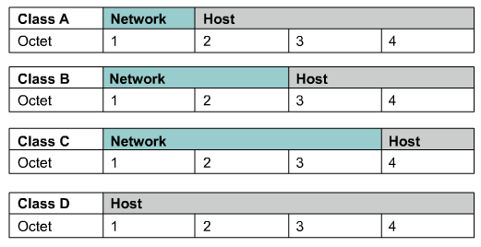
IP Address Classes
IP addresses are divided into classes to define the large, medium, and small networks.
Class A addresses are assigned to larger networks.
Class B addresses are used for medium-sized networks,
Class C for small networks,
Class D for Multicasting
Class E for Experimental purposes

Slide 11
Identifying Address Classes
Note : for Class A , networks 0 & 127 are reserved (class A range 1 - 126)

Slide 12
Public IP Addresses
- Unique addresses are required for each device on a network
- Originally, an organization known as the Internet Assigned Numbers Authority (IANA) handled this procedure.
- No two machines that connect to a public network can have the same IP address because public IP addresses are global and standardized.

Slide 13
Private IP Addresses
Private IP addresses are another solution to the problem of the impending exhaustion of public IP addresses.As mentioned, public networks require hosts to have unique IP addresses.
However, private networks that are not connected to the Internet may use any host addresses, as long as each host within the private network is unique.

Slide 14
IP address types
IP address could be one of three categories
Network address
Host address
Broadcast address

Slide 15
Network / Broadcast Addresses
- Network address :
the first IP address in it which all host part bits = 0
- Broadcast address:
the last IP address in the network which all host part bits = 1
no. of host bits
- other addresses are host addresses = 2 - 2
- Here are some examples:
Class Network Address Broadcast Address
A 12.0.0.0 12.255.255.255
B 172.16.0.0 172.16.255.255
C 192.168.1.0 192.168.1.255

Slide 16
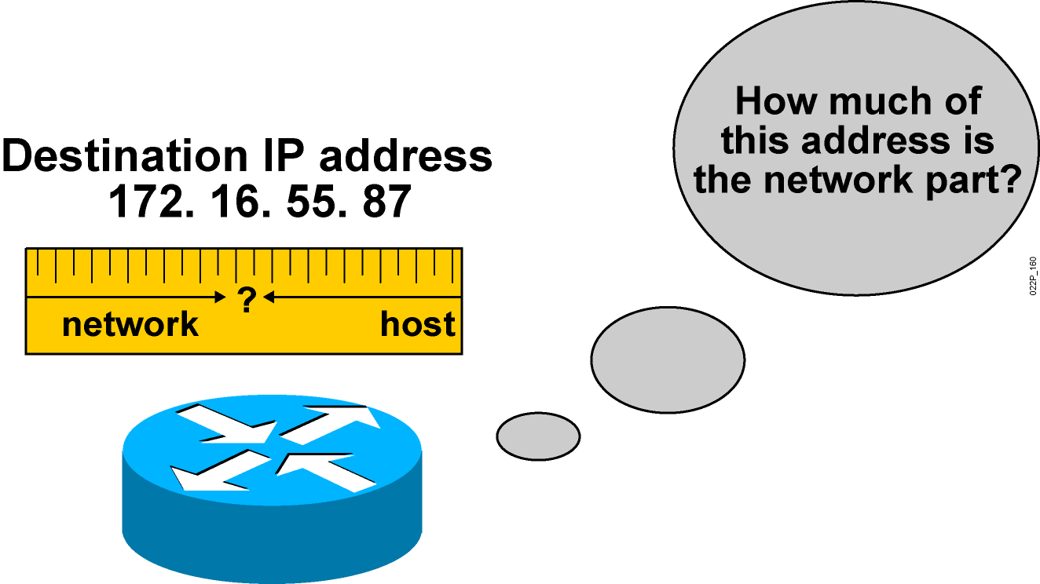
Subnet Mask
- 32 bit mask ( 1’s followed by 0’s )
- Used by routers and hosts to determine the number of
network- significant bits ( identified by 1’s )
and host- significant bits in an IP address (identified by 0’s)
- example :
Class Network Address Default subnet mask
A 12.0.0.0 255.0.0.0 or /8
B 172.16.0.0 255.255.0.0 or /16
C 192.168.0.0 255.255.255.0 or /24
Notes:
A subnet mask is a number that defines a range of IP addresses that can be used in a network

Slide 17
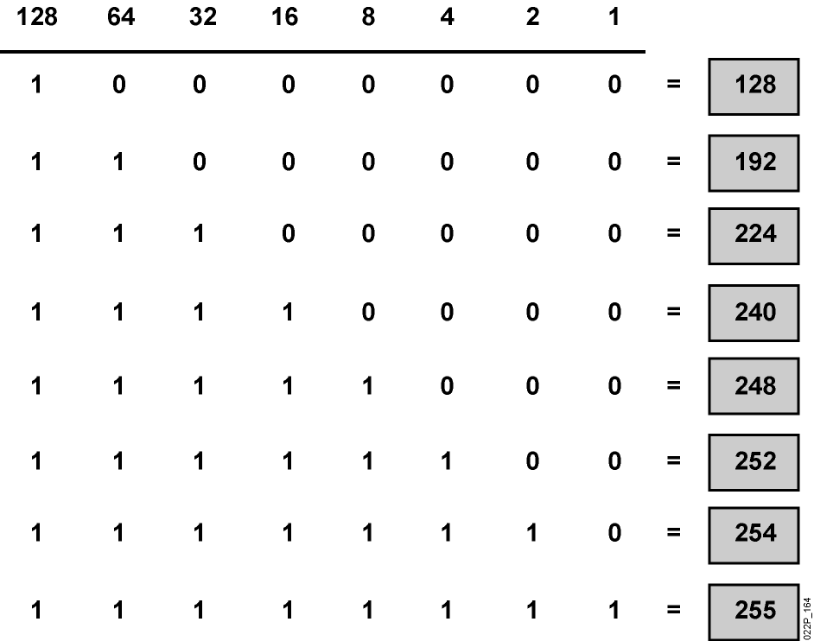
Octet Values of a Subnet Mask
Subnet masks like IP addresses can be represented in the dotted decimal format like 255.255.255.0.

Slide 18
Task
What is Subnetting?
What is ICMP function?

