Slide 1
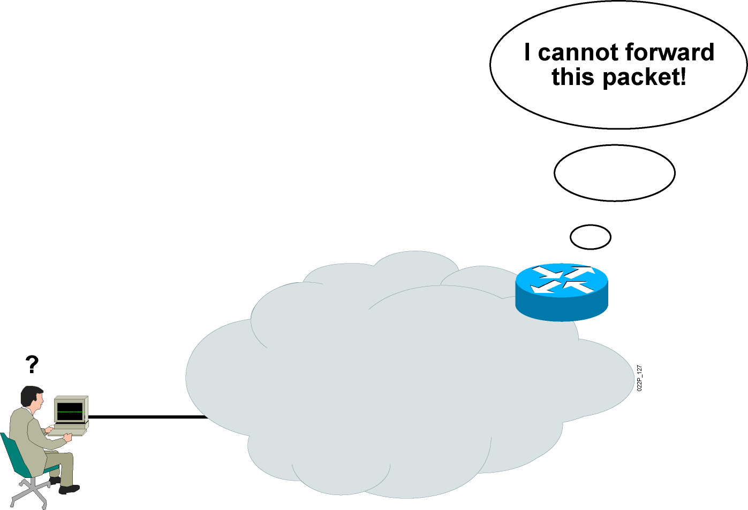
ICMP
Internet control message protocol verifies network devices connectivity (Ping)
D:\>ping 192.110.1.140
Pinging 192.110.1.140 with 32 bytes of data:
Request timed out

Slide 2
icmp
What is ICMP function? The Internet Control Message Protocol (ICMP): is a supporting protocol in the Internet protocol suite. It is used by network devices, including routers, to send error messages and operational information indicating, for example, that a requested service is not available or that a host or router could not be reached.
1- Assist Troubleshooting
2- Announce Timeouts.
3- 2-Announce network congestion

Slide 3
Subnetting
- Subnetting a network means to use the subnet mask to divide the
network and break a large network up into smaller, more efficient and
manageable segments, or subnets.
- Subnetting is done by taking part of host bits then add it to
the network part
IP address
Network part
Host part
Subnet bits
Network part
Host part

Slide 4
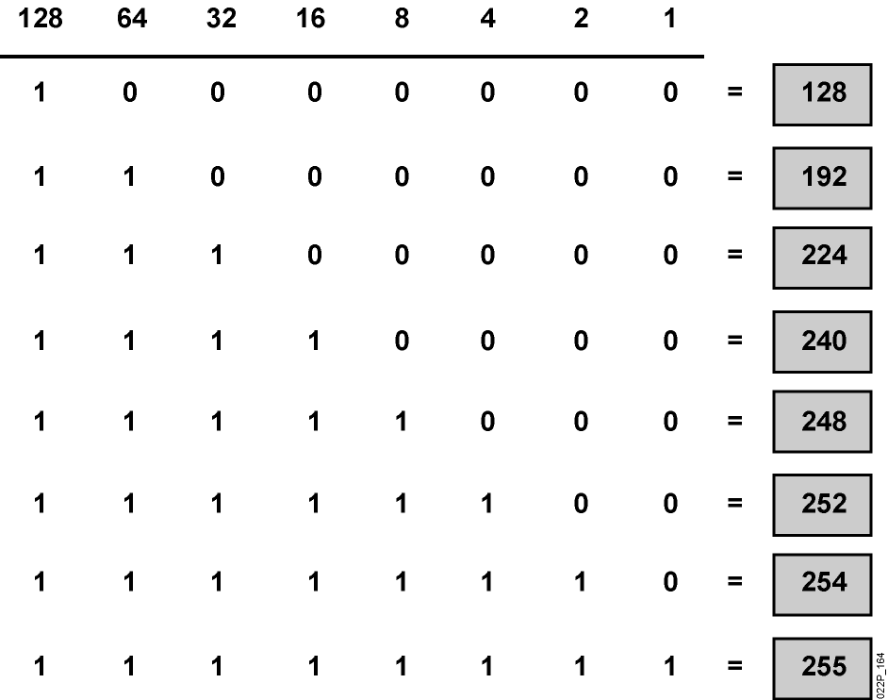
Octet Values of a Subnet Mask
Subnet masks like IP addresses can be represented in the dotted decimal format like 255.255.255.0.

Slide 5
Subnetting Example
Divide network 192.168.1.0/24 into 4 subnets
Solution: 4 subnets need 2 bits
192.168.1 . 0
192.168.1 . 0000 0000 to 0011 1111
192.168.1 . 0100 0000 to 0111 1111
192.168.1 . 1000 0000 to 1011 1111
192.168.1 . 1100 0000 to 1111 1111
subnet mask is 255.255.255.192 or /26
The first subnet is 192.168.1.0/26
The second subnet is 192.168.1.64/26
The third subnet is 192.168.1.128/26
The fourth subnet is 192.168.1.192/26
0 - 63
64 - 127
128 - 191
192 - 255

Slide 6
Divide network 192.168.1.0/24 into 4 subnets
Solution :
- 4 subnets need 2 bits
- subnet mask = 255.255.255.192
- interesting octet is 192
- hop count = 256 – 192 = 64
- The first subnet is 192.168.1.0/26
- The second subnet is 192.168.1.64/26
- The third subnet is 192.168.1.128/26
- The fourth subnet is 192.168.1.192/26

Slide 7
Determine if this IP is network address or host address or broadcast address 172.16.5.0/23
Solution :
- subnet mask = 255.255.254.0
- interesting octet is 254
- hop count = 256 – 254 = 2
- The first subnet is 172.16.0.0/23
- The second subnet is 172.16.2.0/23
- The third subnet is 172.16.4.0/23
- The fourth subnet is 172.16.6.0/23
So 172.16.5.0/23 is a host address
172.16.5.0/23

Slide 8


- Which IP address should be assigned to PC B ?
A . 192.168.5.5
B . 192.168.5.32
C . 192.168.5.40
D . 192.168.5.63
E . 192.168.5.75
A
B
192.168.5.33/27
?

