Slide 1
COSC 419 Topics in Computer Science Artificial intelligence
Mohamad Khajezade
Okanagan College
mkhajezade@okanagan.bc.ca

Slide 2
What is AI?

Slide 3
What is Artificial Intelligence
Artificial Intelligence (AI) is a branch of computer science that focuses on creating systems and machines capable of performing tasks that typically require human intelligence. These tasks include learning, reasoning, problem-solving, perception, language understanding, and decision-making. AI aims to mimic cognitive functions that humans associate with the human mind, such as learning from experience, recognizing patterns, and adapting to new information.

Slide 4
Key Components of AI
Machine Learning (ML):
A subset of AI that enables machines to learn from data without being explicitly programmed.
Uses algorithms to identify patterns, make decisions, and improve over time with experience.
Deep Learning:
A further subset of machine learning that uses neural networks with many layers (deep neural networks) to model complex patterns in data.
Especially effective for tasks like image and speech recognition.
Natural Language Processing (NLP):
Involves the interaction between computers and human language.
Enables machines to understand, interpret, and generate human language, including speech and text

Slide 5
Other Fields of AI
Computer Vision:
Enables machines to interpret and understand visual information from the world, such as images and videos.
Used in applications like facial recognition, object detection, and autonomous driving.
Robotics:
Involves creating intelligent robots that can perform tasks autonomously or semi-autonomously.
Combines AI with physical components to interact with the physical world.
Expert Systems:
AI programs that mimic the decision-making ability of a human expert in specific domains.
Used for tasks like medical diagnosis, financial forecasting, and troubleshooting.

Slide 6
What is an Artificial Intelligence Model?
An Artificial Intelligence (AI) model is a mathematical and computational framework that uses algorithms and data to perform tasks that typically require human intelligence.

Slide 7
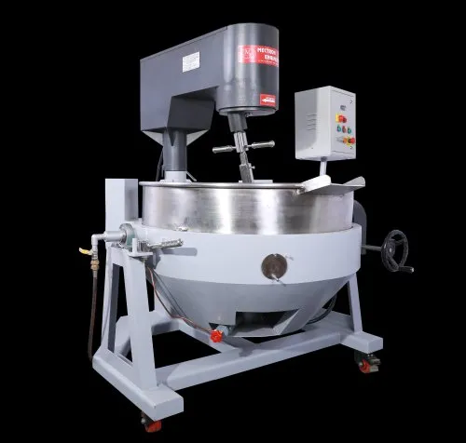
What is an Artificial Intelligence Model?
An Artificial Intelligence (AI) model is a mathematical and computational framework that uses algorithms and data to perform tasks that typically require human intelligence.
water
eggs
A delicious Cake
flavor

Slide 8





What is an Artificial Intelligence Model?
450 $×$
Temperature
2 $×$
water
4 $×$
eggs
A delicious Cake
3 $×$
flavor
20 $×$
Time

Slide 9







What is an Artificial Intelligence Model?
$$X_{1}$$
? $×$
$$X_{2}$$
Output (Y)
? $×$
? $×$
$$X_{3}$$

Slide 10
What is an Artificial Intelligence Model?
Regular Programming (Cooking Machine):
The machine will be provided with clear instructions. The coefficient of each feature is determined.
The machine executes the instructions and produces the output. It doesn’t consider the quality of the output.
Machine Learning Function
The machine learning function (algorithm) should find the coefficients of the input features
In some cases, the input features should also be explored by the machine.
The machine finds useful patterns inside the data.

Slide 11
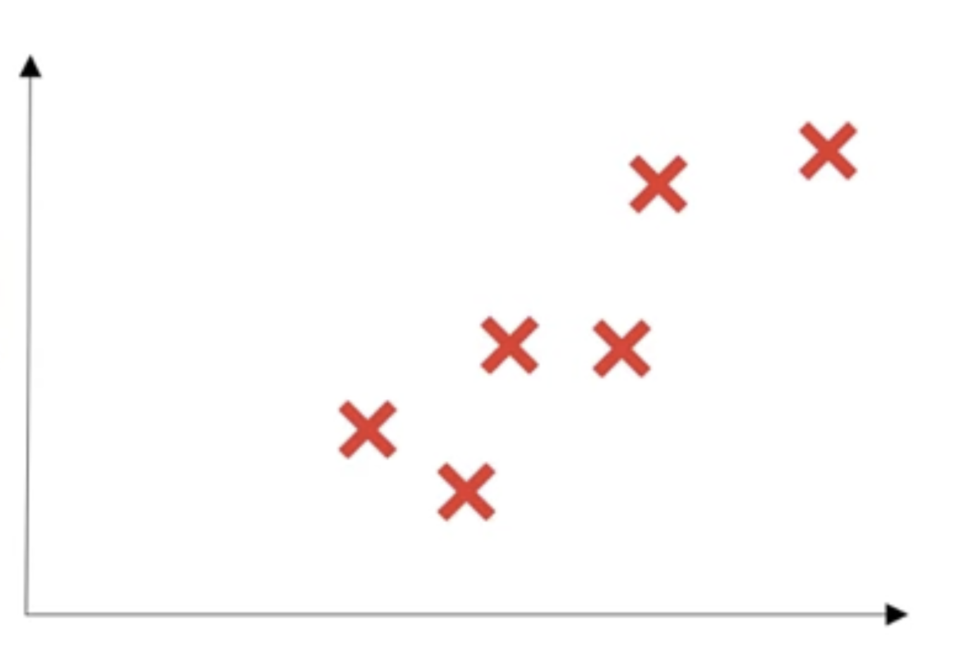
What is a Neural Network
Price
Size of House

Slide 12
What is a Neural Network
Price
Size of House

Slide 13
What is a Neural Network
We can consider this as a neural network
Neural take size as input, computes linear function, ignores negative outputs and calculates the price
Price
Size of House

Slide 14
What is a Neural Network
Neuron
Size
Price (Y)
X
Price
ReLu: Rectified Linear Unit
Size of House
Notes:
A real neural network will take many of these neurons and stack them together

Slide 15
What is a Neural Network (Housing price)
Size
Neuron
Family size
Number of bedrooms
Neuron
Location
Neuron
Price (Y)
Zip Code
Neuron
wealth
School Quality
Notes:
Similar to adding flavor and egg. We mix different features. Using this architecture, the price (output) is describe based on the combination of these features.

Slide 16
What is a Neural Network (Housing price)
Size
Neuron
Y
Family size
Number of bedrooms
Neuron
Location
Neuron
Price (Y)
Zip Code
Neuron
wealth
School Quality
X
Notes:
Similar to adding flavor and egg. We mix different features. Using this architecture, the price (output) is describe based on the combination of these features.
- Each neuron is consider for making a model for each new relation (in 3 D, 4D, multi-dimension)

Slide 17
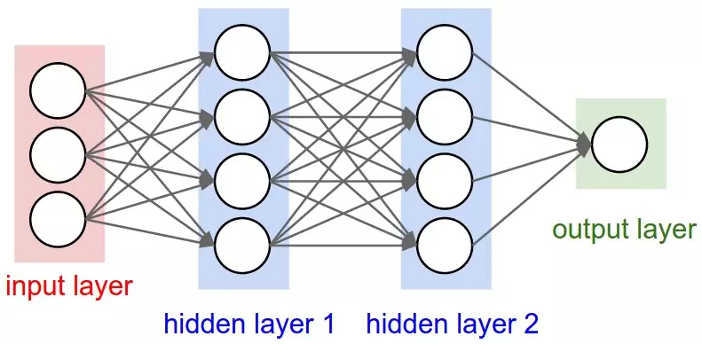
What is a Neural Network (Housing price)
Notes:
Similar to adding flavor and egg. We mix different features. Using this architecture, the price (output) is describe based on the combination of these features.

Slide 18
What is a Neural Network (Housing price)
Size
Number of bedrooms
Zip Code
Notes:
Similar to adding flavor and egg. We mix different features. Using this architecture, the price (output) is describe based on the combination of these features.

Slide 19
Different types of learning (Supervised learning)
Input (X) | Output (Y) | Application
Home features | Price | Real state
Persons features | gender | Statistical analysis
Ad, user info | Clicked on ad? (0/1) | Online advertisement
Code snippets | Perform the same functionality (0/1) | Code clone detection (code understanding)
Pixels of an image | Dog or Cat? | Image classification
English | French | Machine translation
Notes:
Similar to adding flavor and egg. We mix different features. Using this architecture, the price (output) is describe based on the combination of these features.

Slide 20
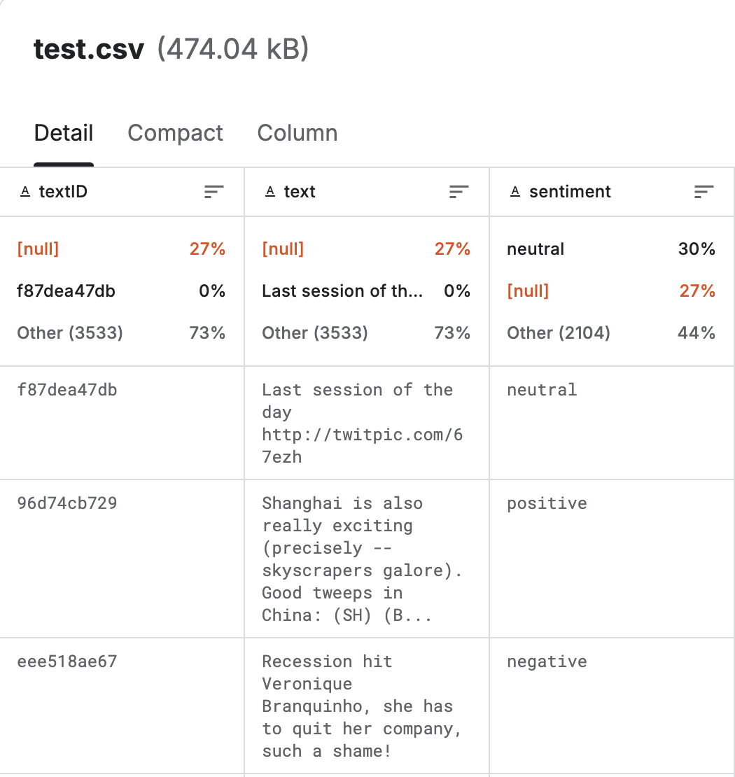
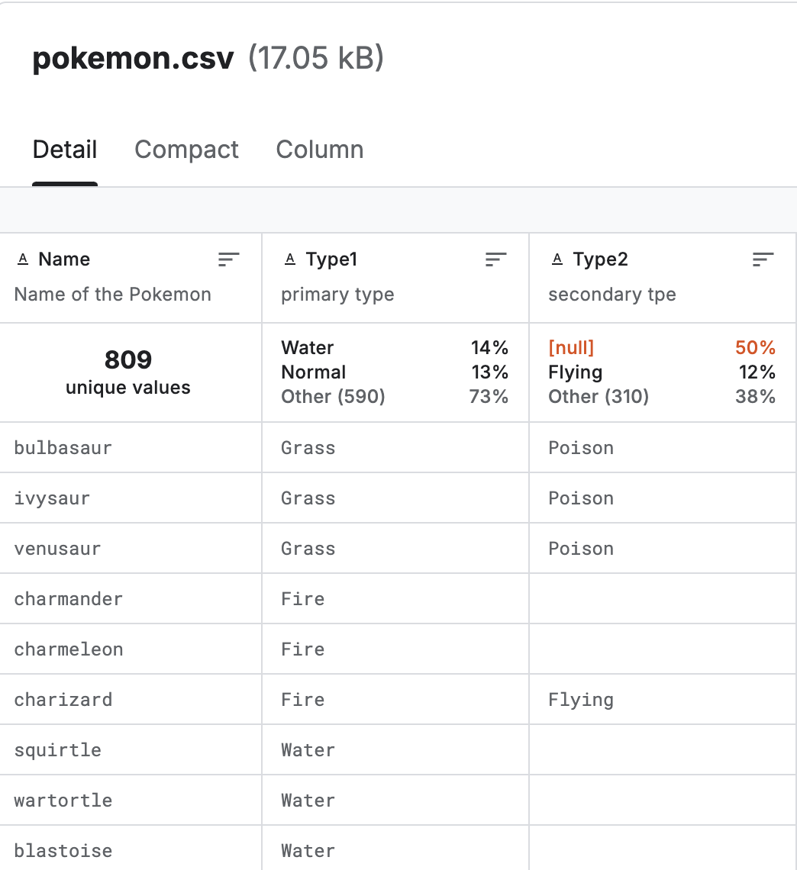

Different types of learning (Supervised learning)
Notes:
Similar to adding flavor and egg. We mix different features. Using this architecture, the price (output) is describe based on the combination of these features.

Slide 21
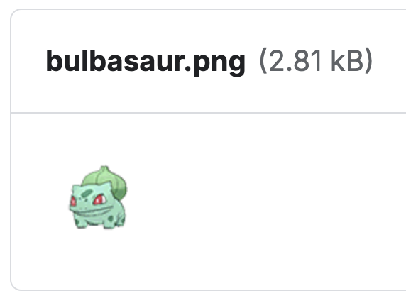
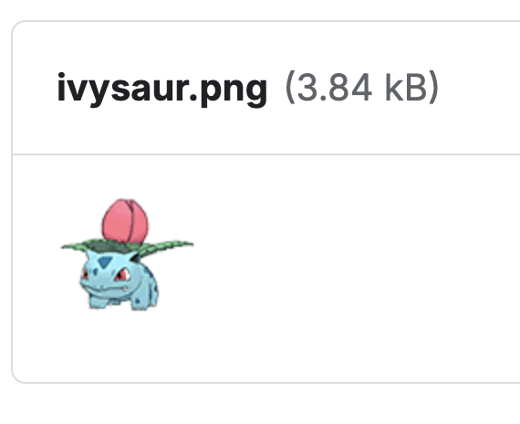
Supervised learning Dataset Examples
Notes:
Similar to adding flavor and egg. We mix different features. Using this architecture, the price (output) is describe based on the combination of these features.

Slide 22
Different types of learning (Supervised learning)
Input (X) | Output (Y) | Application
Home features | Price | Real state
Persons features | gender | Statistical analysis
Ad, user info | Clicked on ad? (0/1) | Online advertisement
Code snippets | Perform the same functionality (0/1) | Code clone detection (code understanding)
Pixels of an image | Dog or Cat? | Image classification
English | French | Machine translation
Notes:
Similar to adding flavor and egg. We mix different features. Using this architecture, the price (output) is describe based on the combination of these features.

Slide 23
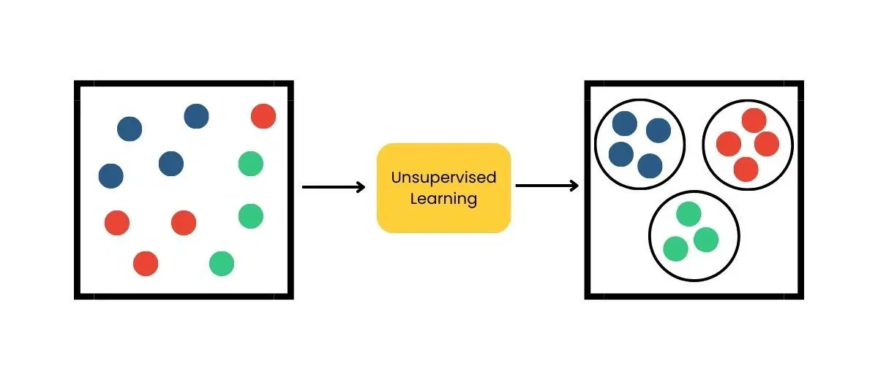
Different types of learning (Unsupervised learning)
No Labeled Data:
The data provided to the model does not have labeled outputs or target values. The model has to figure out patterns and relationships from the input data alone.
Discovering Patterns:
The model tries to learn the inherent structure of the data. This could involve grouping similar data points, reducing dimensionality, or identifying outliers.
Notes:
Similar to adding flavor and egg. We mix different features. Using this architecture, the price (output) is describe based on the combination of these features.

Slide 24
How about Language models
Pre-training is unsupervised
The initial phase of training LLMs involves unsupervised learning, where the model learns from vast amounts of text data without explicit labels. The model learns to predict the next word in a sentence (language modeling), fill in missing words (masked language modeling), or predict the next sentence, depending on the architecture.
Fine-Tuning on the down stream task is supervised
After the initial unsupervised pre-training, LLMs often undergo supervised fine-tuning on specific tasks or datasets with labeled data. During this phase, the model is trained with explicit input-output pairs to learn specific tasks, such as answering questions, summarizing text, or following instructions.
Notes:
Similar to adding flavor and egg. We mix different features. Using this architecture, the price (output) is describe based on the combination of these features.

Slide 25
How about Language models
Generation: This is a cat
This
is
Notes:
Similar to adding flavor and egg. We mix different features. Using this architecture, the price (output) is describe based on the combination of these features.

Slide 26
How about Language models
Generation: This is a cat
This
is
This is
a
Notes:
Similar to adding flavor and egg. We mix different features. Using this architecture, the price (output) is describe based on the combination of these features.

Slide 27
How about Language models
Generation: This is a cat
This
is
This is
a
This is a
cat
Notes:
Similar to adding flavor and egg. We mix different features. Using this architecture, the price (output) is describe based on the combination of these features.

Slide 28
How about Language models
Generation: This is a cat
This
is
This is
a
This is a
cat
Output of the model: This is a cat
Notes:
Similar to adding flavor and egg. We mix different features. Using this architecture, the price (output) is describe based on the combination of these features.

Slide 29
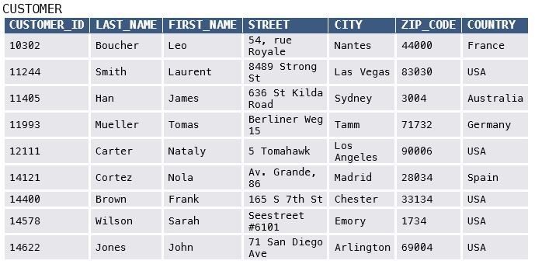


The Nature of the Data
structured data(tabular data)
Unstructured data
Notes:
Similar to adding flavor and egg. We mix different features. Using this architecture, the price (output) is describe based on the combination of these features.

