Slide 1
Travelling Salesman Problem
COSC 507
December 6, 2022
Mohamad Khajezade, Zixiao Zhao, Jumar M. Alem

Slide 2
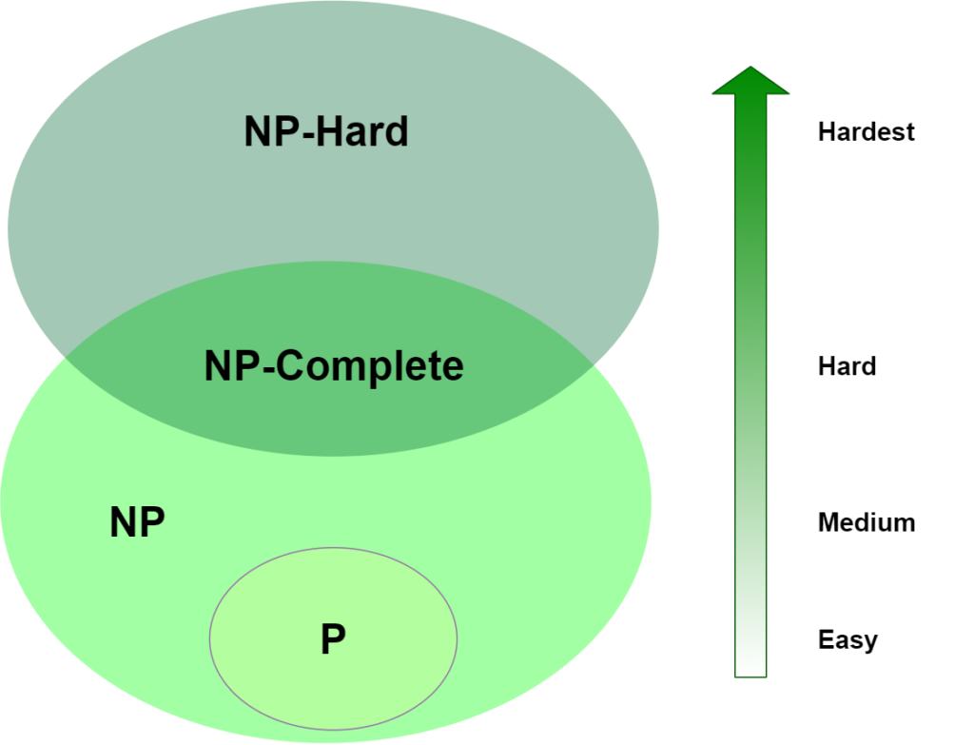
Travelling Salesman Problem (NP-Hard)
TSP is an NP-Hard problem
There is no solution that can be solved in Polynomial time
Some heuristic algorithms are proposed to solve a good solution

Slide 3
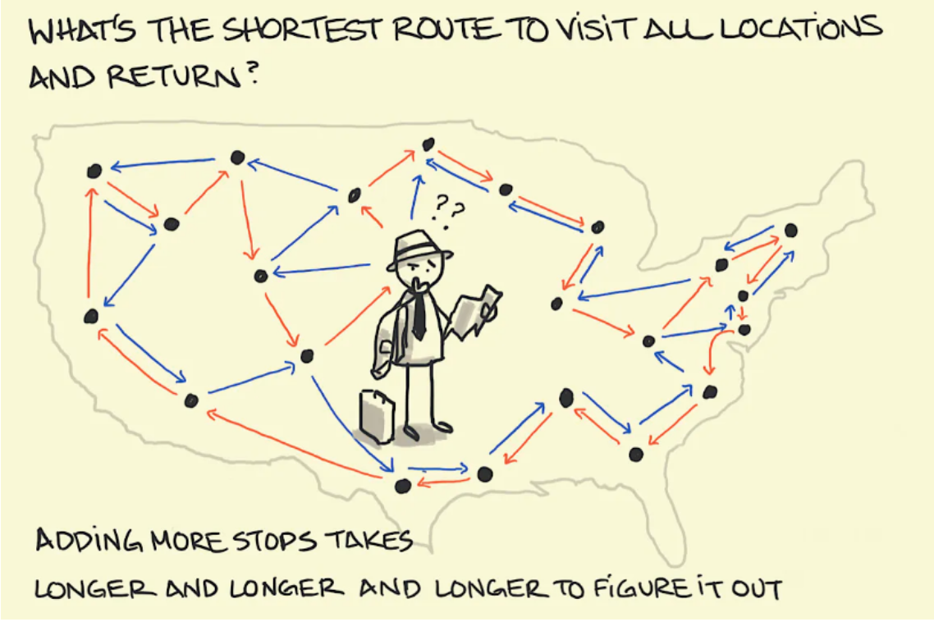
Travelling Salesman Problem - Definition
Given a list of cities and the distances between each pair of cities, what is the shortest possible route that visits each city exactly once and returns to the origin city
In airlines the solution is used to manage
The flight staff arrayments

Slide 4
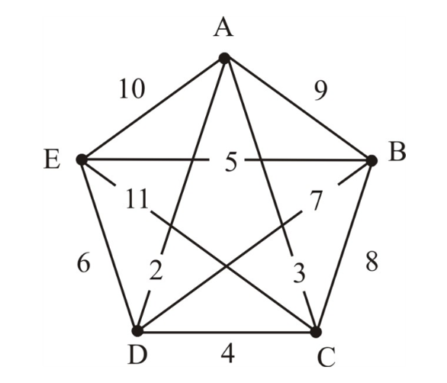
Travelling Salesman Problem - Formulation
Brute Force Algorithm
Considering city A as the starting and ending point
Generate (N-1)! Permutations
Compute the cost of each path
Return the permutation with the minimum cost
The time complexity is O(N!)
0 | 9 | 3 | 2 | 10
9 | 0 | 8 | 7 | 5
3 | 8 | 0 | 4 | 11
2 | 7 | 4 | 0 | 6
10 | 5 | 11 | 6 | 0

Slide 5
Cuda Implementation
Each thread computes a portion of permutations
A shared memory is used for blocks to compute the cost
The results of each block is reduced to compute the minimum cost (shortest path)
Blocks are organized in different grids
Blocks are synchronized by lunching different kernels

Slide 6
Results
Problem size | 4 | 6 | 8 | 10 | 11(S)-12(C) | 14
Serial Implementation | 0.005 | 0.019 | 0.26 | 26.17 | 192.65 | -
Cuda Implementation | 0.29 | 0.22 | 2.89 | 28.43 | 128.94 | 38956.66

Slide 7
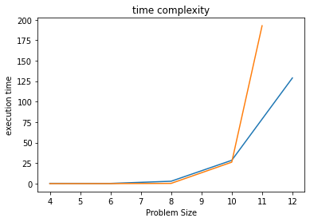
Results
Problem size | 3 | 5 | 7 | 9 | 10 | 11
Number of Permutations | 6 | 120 | 5040 | 362880 | 3,628,800 | 39,916,800

Slide 8
Results – Different Block Sizes
Block size 30 | 0.29 | 0.22 | 2.89 | 28.43 | 128.94 | 38956.66
Block size 15 | 0.30 | 0.22 | 2.90 | 26.7 | 129.44 | 67915.28
Block size 60 | 0.29 | 0.22 | 2.90 | 28.52 | 129.18 | 42514.27

Slide 9
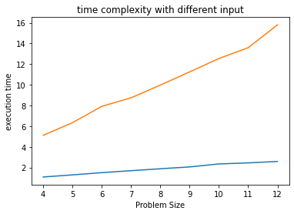
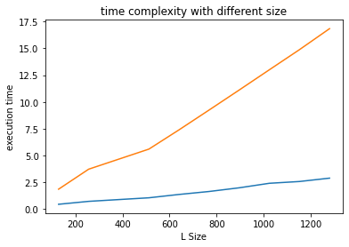

Slide 10
Questions?
Thanks for listening!
Notes:
Intros → Names, programs, research interests

