Slide 1


Event-triggered control over digital channels
Mohammad Javad (MJ) Khojasteh
Center for Autonomous Systems and Technologies (CAST)
California Institute of Technology
Joint work with:
  Jorge Cortés, University of California, San Diego
  Massimo Franceschetti, University of California, San Diego
  Mojtaba Hedayatpour, DOT Technology Corp.
  Pavankumar Tallapragada, Indian Institute of Science
Notes:
Hello!

Slide 2
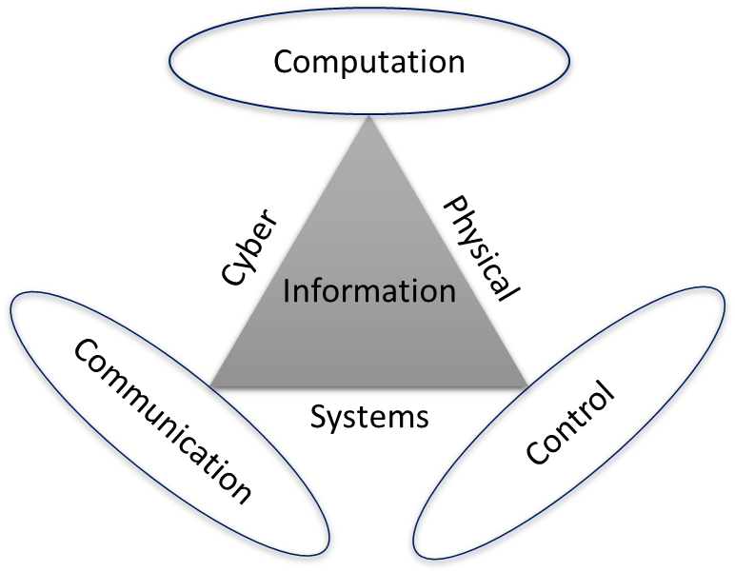
Cyber-physical systems (CPS)
Notes:
My general research area is Cyber-Physical Systems. These systems are largely regarded as the next-generation engineering systems. They integrate computing, communication, and control, and they arise in diverse areas such as robotics, energy, and transportation.

Slide 3
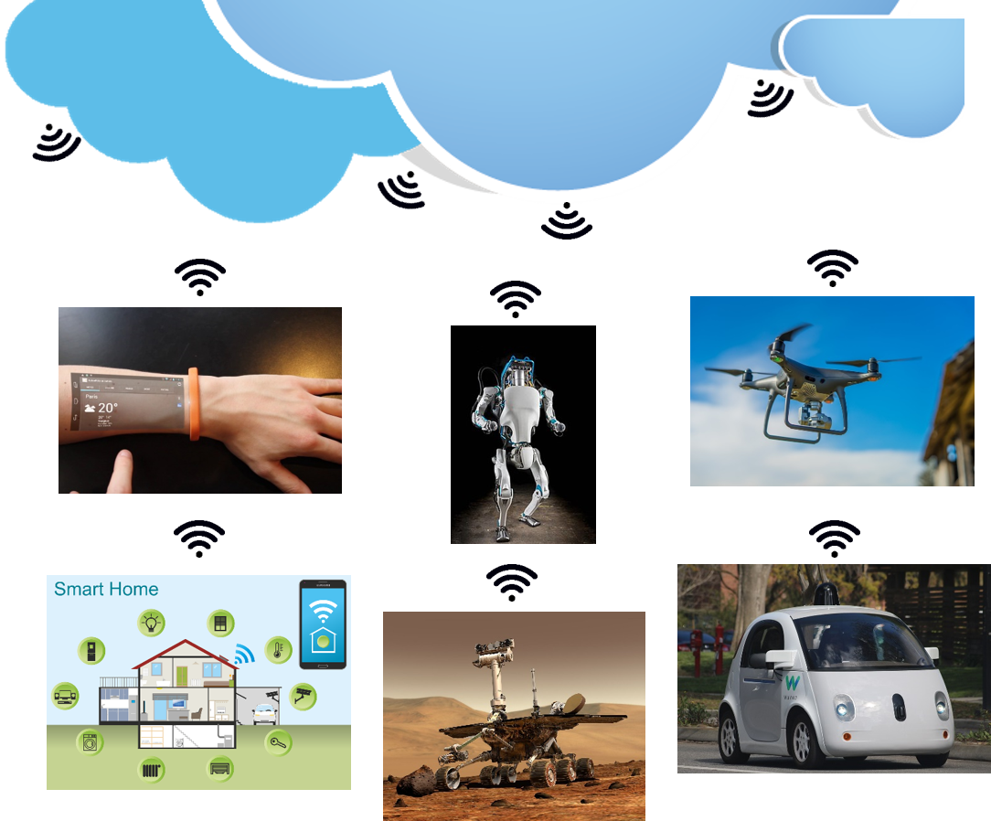
Cloud robots and automation systems
Notes:
CPS are
closely tied to cloud robotics, an emerging field in robotics and automation systems.
The cloud
enables robots to use wireless networking, cloud computing and storage, machine
learning, big data, and many other shared resources to enhance their performances.
The need for tight integration of different components means that the analysis, and design of these systems present new challenges.
Here, we focus on two aspects of these emerging systems
architecture.

Slide 4
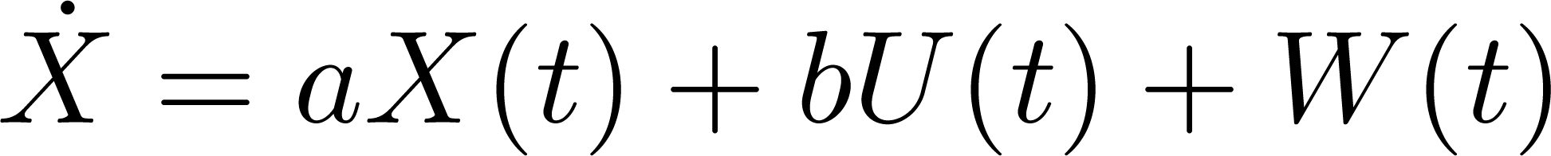
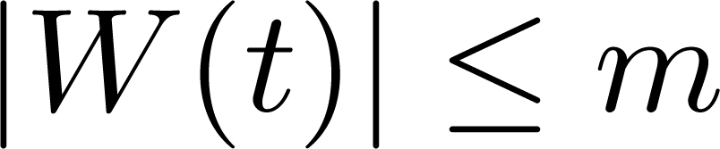
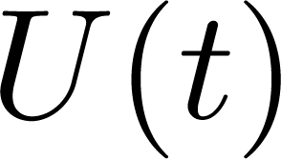
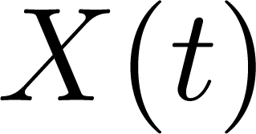
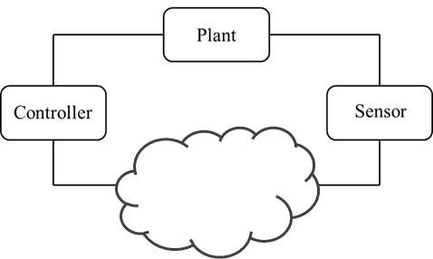
Networked Control Systems
Communication Channel
Notes:
Let us start with a low complexity model.
As discssed Networked control systems, where the feedback loop is closed over a communication channel, are a fundamental component of cyber-physical systems
The plant is scalar with dynamic xdot=Ax+bu+w. Here x is the state, u is the control input and w is the system disturbance which bounded at all time. In addition, the plant is unstable hence A is a positive real number. Sensory measurements are transmitted to the controller over a communication channel which is subject to a finite data rate and bounded unknown delay

Slide 5

Timing information
Delay
Timing Information
+
Data Payload
2.0 s
1 0 1 1
1.0 s
1 0 0 1
0.5 s
0 0 1 1
Communication Channel
Notes:
Our goal is to use the concept of timing information in networked control systems to communicate information about the state. In the encoding process we answer the questions of what and when to transmit. The sensor encode a quantized version of the state in a packet containing data payload as well as timing of the packet. In this setup, the delay is the the additivie noise for the timing. For instance here the first packet suffered from 2s delay, the next one 1 second, and the last one half of the second delay.

Slide 6





Transmission with delay
Packet transmission time
Packet reception time
Delay
number of bits in data payload transmitted up to time
information transmission rate
be the amount of information measured in bits included in data payload and timing information received at the controller until time
information access rate
Notes:
Let’s denote by ts the time at which the sensor transmit a packet and let tc be the time at which that packet is delivered to the controller. We assume that the communication delays are upper-bounded by gamma, a finite non-negative real number, namely, tc-ts is less than or equal to gamma.
Let bs(t) be the number of bits in the data payload transmitted by the sensor up to time t. Then we define the Rs the information transmission rate as the asymptotic average of bs(t). Let bc(t) to be the amount of information, measured in bits, contains both in data payload and timing information, received by the controller up to time t. Then we define the Rc the information access rate as the asymptotic average of bc(t). Here S stand for the sensor and C stands for the controller. So R_s is the rate at which the sensor transmits data payload and R_c is the rate at which controller recives information both from timing and data payload.

Slide 7
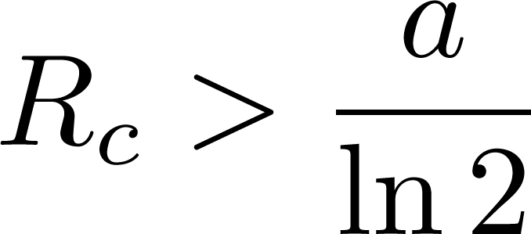
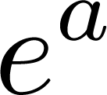
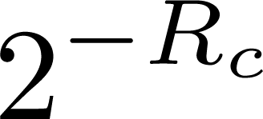
Data-rate theorem
We can stabilize the system if and only if the information access rate
State uncertainty
Notes:
In this context, we prove a data rate theorem which states that we can stabilize the system iff the information access rate,
Rc > A over ln of 2.
Here A is the open loop gain of the plant. The rate A/ln 2 is known as the entropy rate of the plant, and it captures the instability of the plant. Hence the data-rate theorem state that the rate at which controller receive information (R_c) should be larger than this entropy rate of the plant. Intuitively the uncertainty about the state grow with a factor of e^a at each unit of time and shrink with a factor of 2 to the power Rc and the data-rate theorem states that the uncertainty about the state should shrink faster than it expands.

Slide 8

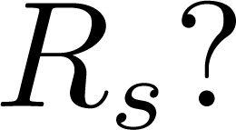
Data-rate theorem
State Expansion
Received information
    This information can be supplied to the controller by data payload and also by timing
Notes:
So the data-rate theorem corresponds to the balance between production and consumption of information, and R_c > a/ln 2 can be supplied to the controller by data payload and also by timing. The main question that we are trying to answer is that how much information we need to put in data payload to ensure the stability? What should be R_s the infromation transmission rate?.

Slide 9
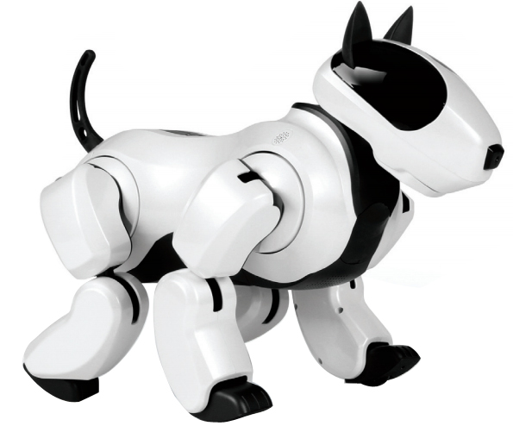
Event-triggering review
Periodic control is the most common and perhaps simplest solution for digital systems.
Step 1: Good Dog
Step 2: Good Dog
Step 3: Bad Dog
Step 4: Good Dog
.
.
.
Notes:
To answer this question let us continue with a short review of event-triggering control. Traditionally periodic control was used in digital systems simply because it was the simplest solution. For example, if we have a Robot dog, and we want to control it. At each step we send a message from sensor to the controller to say that the robot is on the right path or not.

Slide 10
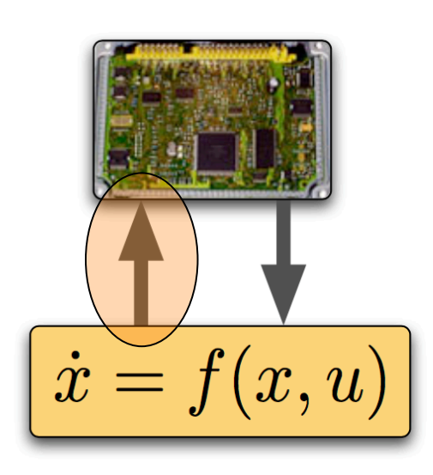
Event-triggering review
In CPS we need to share resources efﬁciently
Notes:
However, in CPS we need to use distributed resources efficiently. Periodic control can be inefﬁcient in sharing communication and computation resources in cyber physical systems. Therefore, event-triggered control was introduced to transmit sensory data in an opportunisitic manner only when needed to satisfy control objectives.

Slide 11
Event-triggering review
The main concept of event-triggered control is to transmit sensory data only when needed.
Step 1: --
Step 2: --
Step 3: Bad Dog
Step 4: --
.
.
.
“Wise men speak because they have something to say;
fools because they have to say” ― Plato
Notes:
For example, if we have the same robot, and we want to control it. We are only going to send a message to the controller when the dog robot take a bad step.

Slide 12
State dependent timing information encoding
Triggered!
No Triggering
1 0 1 1
Our goal is to propose an event-triggering strategy that utilizes
timing information by transmitting in a state-dependent fashion.
Triggering Threshold
Notes:
In our design, the sensor encodes information in timing via an event-triggering technique in a state dependent fashion.
As an intuitive example, consider stabilization of an inverted pendulum over a digital communincation channel. The control objective will be to keep pendulum angle within the given thresholds shown in red which we call it the triggering threshold. Assume the pendulum is initially at its upright position. At the first sampling time due to noise it starts falling a bit, but because it’s still within the given thresholds no triggering happens and therefore no transmission is required. It continues until the angle is equal or greater than the threshold and then a triggering happens, and the sensor transmits a packet to the controller about the state of the system. Here not only the packet content but also its timing deliver information to the controller, since the controller knows a transmission occurs only if the angle of pendulum cross the triggering treshhold.

Slide 13
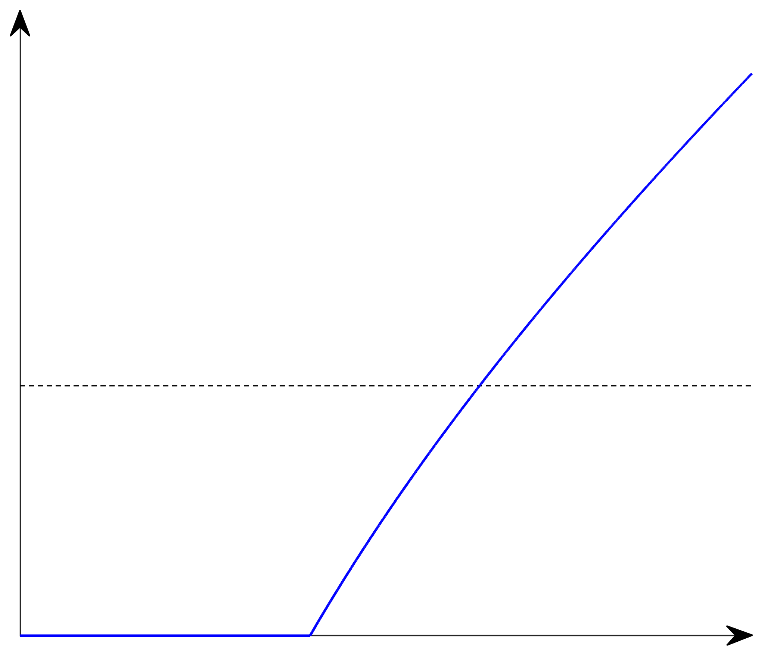
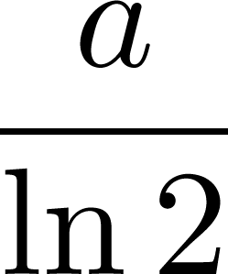
Information transmission rate
Information transmission rate for stabilization
Notes:
This plot shows the information transmission rate (the rate at which sensor tranmit data payload) required for stabilization as a function of delay upperbound gamma. For small values of delay, the inherent timing information in evenet-triggering is substantial and $R_s$ can be arbitrarily close to zero. As delay increases the timing information becomes so much out of date that the transmission rate must begin to increase.
For large value of the delay the required transmission rate even exceeds the rate imposed by the data-rate theorem. Since as the delay increases the uncertainty about the state at the controller increases.

Slide 14
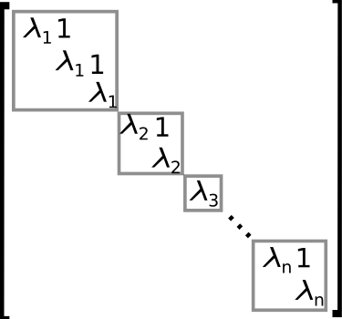
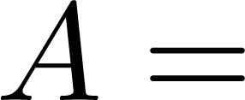
Vector and nonlinear systems
Possibly
Complex
Nonlinear systems: input-to-state practically stability (ISpS) under appropriate assumptions on the dynamic
Notes:
We first started with a low-complexity model; then to make the results more practical, we escalated the complexity of the model by studying the vector, and nonlinear systems.
In these kind of problems the usual way of dealing with vector system is to use Jordan Block decomposition. One of the challenges here is the off-dioganl ones that make some coupling between states of the system. The other issue is that these eigen value can be complex in general. So we developed a theroy for complex systems too.
Also for nonlinear systems we characterized information tranmission rate rquired for input-to-state practically stability under appropriate assumption on the dynamic.

Slide 15
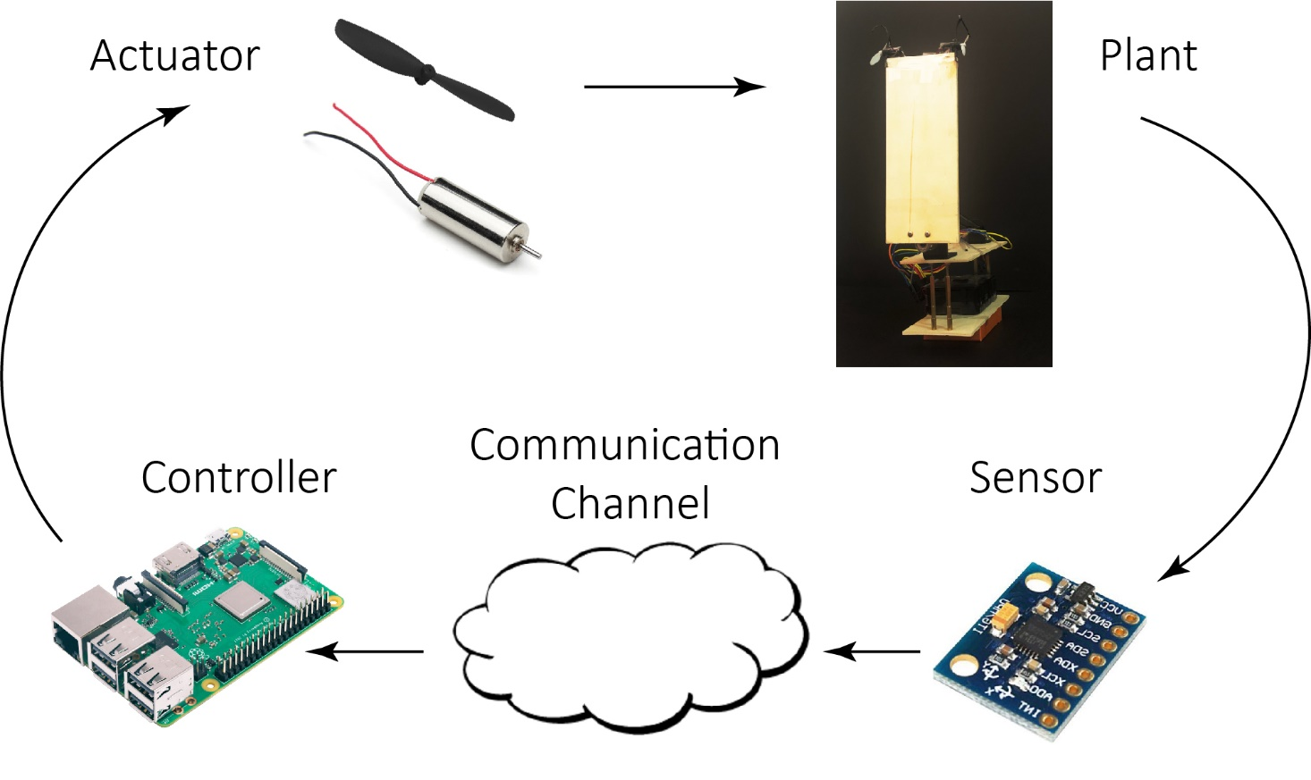
Experimental Validation
Notes:
We then implemented the proposed event triggering control scheme. This figure shows different components of the system. We built this system using off-the-shelf components. We choose Raspberry Pi Model 3 for the computation unit and the controller in the system. For actuation, we use two small DC motors and two identical propellers. We also use MEMS sensor which has a 3-axis accelerometer and a 3-axis gyroscope, and we use a complimentary ﬁlter to read the angle and angular velocity of the pendulum. At each triggering time using our design the sensor constructs a finite packet and this packet is delivered to the controller after an unknown but bounded delay.

Slide 16
Experimental Validation
A video that demonstrates our experimental results can be found at
https://youtu.be/1P0i-tWsPoA
Notes:
Let us look as some exprimental results. In the first expriment the delay is 2 sampling time and the packet constructed using our desing contains 1 bit.

Slide 17
References
Khojasteh, M.J., Tallapragada, P., Cortés, J. and Franceschetti, M., The value of timing information in event-triggered control. IEEE Transactions on Automatic Control. 2020.
Khojasteh, M.J., Tallapragada, P., Cortés, J. and Franceschetti, M., Time-triggering versus event-triggering control over communication channels. In 2017 IEEE 56th Annual Conference on Decision and Control (CDC) (pp. 5432-5437). IEEE.
Khojasteh, M.J., Hedayatpour, M., Cortés, J. and Franceschetti, M., Exploiting timing information in event-triggeredstabilization of linear systems with disturbances. arXiv preprint, 2018.
Khojasteh, M.J., Hedayatpour, M., Cortés, J. and Franceschetti, M., Theory and implementation of event-triggered stabilization over digital channels. In 2019 IEEE 58th Annual Conference on Decision and Control (CDC) (pp. 4183-4188). IEEE.
Notes:
To increase the security of the system, again the vector learning based attack the vector variant of the privacy enhancing signal can be used, which was similar to the random noise utilized to acheive differential privacy. We use this privacy-enhacing signal here to hamper the learning process of the attacker in the learning phase, where the attacker passively eavesdrops and tries to learn the plant dynamics.
This plot shows the attacker success rate versus size of the controller’s detection window. The black curve is the niminal control policy and the red curve are the authenticated one. As you can see by adding a carefully crafted privacy enhancing signal we can decrease the attacker success rate and improve the detection.

