Slide 1



Data modernization to the Cloud
Webinar series, April 2020

Slide 2

Introduction
Mihály Kiléber - Senior Azure Engineer
Mihaly.kileber@softline.com
Focus Area: SQL Server and Azure SQL services together with dependent components
Certifications:
MCS & MCP Implementing Microsoft Azure Infrastructure Solutions
MS RaaS (Risk Assesment as a Service) and RAP accreditation
1:1 Packaged Service Essentials accreditation
Cloud Mentor Program and Partner Learning Plans.

Slide 3
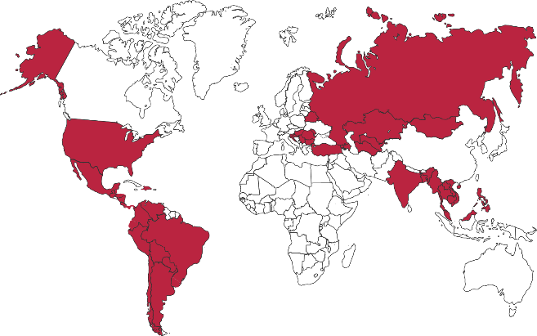

Softline Facts and Figures
4500+
team members
1500+
account managers
1000+
sales and technical presale professionals
2018
$1,36 bln
2012
$805 mln
1.36 Billion $
Sales Volume 2018 in the Group of companies
2006
$97,7 mln
1998
$1,5 mln
1000+
engineers and developers
50+ countries
95+ cities
26
years in the IT market
Turnover data

Slide 4
Agenda
Webinar 1: Prerequisites – Required Resource Providers; Storage Container preparation
Webinar 2: Prerequisites – Azure Fileshare; Azure Database Migration Tools
Webinar 3: Prerequisites – Azure App Service; Azure Database Migration Service
Webinar 4: Prerequisites – Azure SQL DB (PaaS)
Webinar 5: Prerequisites – Azure SQL VM (IaaS), Azure SQL MI (IaaS)
Webinar 6: Migration – Migrate SQL to Azure SQL DB
Webinar 7: Migration – Migrate SQL to Azure SQL VM using Backup/Restore technique
Webinar 8: Migration – Migrate SQL to Azure SQL VM Assess/Migrate using DMA
Webinar 9: Migration – Migrate SQL to Azure SQL MI Assess/Migrate using DMS
Webinar 10: Migration – Migrate Website/Web Application to Azure App Service using DMS; Recap

Slide 5

Engage customers
Empower employees
Systems & Experiences
Intelligent
Data
& AI
Optimize operations
Transform products
Digital Feedback Loop

Slide 6
Why migrate – a customer perspective
Enable Innovation
Mitigate Risk
Optimize Cost
Leverage Cloud+Data+AI to unlock your digital transformation scenarios
Dynamic scale, Global scale by default; accelerate speed to market and create new business models
Versionless, Managed platform freeing yourself from patching, upgrade, and EOS cycles forever
Automated, Modern security capabilities such as Advanced Threat Protection built-into the service
Platform-as-a-Service Machine Learning based, continuous performance optimization lowers costs significantly
Lowest TCO driven by pay-for-what-you-use, automated admin, HA/DR built-in, maximum efficiency with latest HW and SW

Slide 7
A transformation strategy drives innovation and growth
Organizations that harness data, the cloud, and AI outperform their peers²
~
2X
Operating margin
$100M
Additional
operating income
Infrastructure 80% reduction in administrative work
Apps Websites running in minutes
Data New data analysis approaches
Remove patching, network setup, firewall configuration
Enable application innovation - Forrester TEI of Azure¹
Remove the need to wait for servers²
Improve app delivery time by 50%¹
—Forrester TEI of Azure¹
With cloud, we collect data we couldn’t before
Make personal connections that standout in sea of information - Anheuser-Busch InBev
¹The Total Economic Impact™ Of Microsoft Azure Platform-As-A Service, Forrester Consulting, June 2016
²Source: Keystone Strategy interviews October 2015—March 2016

Slide 8


DEMO Required Resource Provider Storage Container preparation

Slide 9

Questions?
You can reach out to me at: mihaly.kileber@softline.com
Contact us at any of our counry e-mail addresses:
Bulgaria: info@softline.bg
Croatia: info@softline.hr
Hungary: info@softline.hu
Romania: info@softline.ro
Serbia: info.serbia@softline.com
Slovenia: info@softline.si

Slide 10
