Slide 1



Data modernization to the Cloud
Webinar series, April 2020

Slide 2

Introduction
Mihály Kiléber - Senior Azure Engineer
Mihaly.kileber@softline.com
Focus Area: SQL Server and Azure SQL services together with dependent components
Certifications:
MCS & MCP Implementing Microsoft Azure Infrastructure Solutions
MS RaaS (Risk Assesment as a Service) and RAP accreditation
1:1 Packaged Service Essentials accreditation
Cloud Mentor Program and Partner Learning Plans.

Slide 3
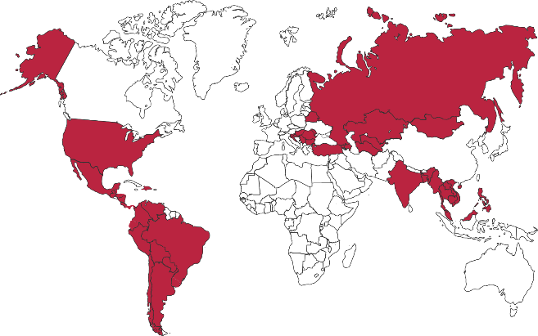

Softline Facts and Figures
4500+
team members
1500+
account managers
1000+
sales and technical presale professionals
2018
$1,36 bln
2012
$805 mln
1.36 Billion $
Sales Volume 2018 in the Group of companies
2006
$97,7 mln
1998
$1,5 mln
1000+
engineers and developers
50+ countries
95+ cities
26
years in the IT market
Turnover data

Slide 4
Agenda
Webinar 1: Prerequisites – Required Resource Providers; Storage Container preparation
Webinar 2: Prerequisites – Azure Fileshare; Azure Database Migration Tools
Webinar 3: Prerequisites – Azure App Service; Azure Database Migration Service
Webinar 4: Prerequisites – Azure SQL DB (PaaS)
Webinar 5: Prerequisites – Azure SQL VM (IaaS), Azure SQL MI (IaaS)
Webinar 6: Migration – Migrate SQL to Azure SQL DB
Webinar 7: Migration – Migrate SQL to Azure SQL VM using Backup/Restore technique
Webinar 8: Migration – Migrate SQL to Azure SQL VM Assess/Migrate using DMA
Webinar 9: Migration – Migrate SQL to Azure SQL MI Assess/Migrate using DMS
Webinar 10: Migration – Migrate Website/Web App to Azure App Service using DMS; Recap

Slide 5
Azure Migration Program Available to all Azure customers, scaled through specialized migration partners
Best practice guidance
Offers and incentives
Technical skill building
Infrastructure and data foundations
Migration planning and execution
Digital resources
Free tools
(Azure Migrate)
Azure trainers
Azure engineering (FastTrack)
Specialized partners
Reduce cost and risk | Accelerate migration velocity | Deliver customer success
Learn more | Azure.com/AMP

Slide 6
Key Migration references
Migration Guide - https://datamigration.microsoft.com​
Azure Database Migration Service – https://aka.ms/AzureDms​
Data Migration Assistant - https://aka.ms/get-dma​
SQL Server Migration Assistant - https://aka.ms/get-ssma​
Database Experimentation Assistant - https://aka.ms/dea-tool​
​
Preview and Feedback​
Preview signup: https://aka.ms/dms-preview​
DMS Feedback alias: dmsfeedback@microsoft.com​
DMA Feedback alias: dmafeedback@microsoft.com​
SSMA feedback alias: ssmahelp@microsoft.com​
DEA feedback alias: deafeedback@microsoft.com​
​
Azure migration center – https://azure.com/migration​
​

Slide 7


DEMO Migrate Website/Web App to Azure App Service using DMS

Slide 8

Questions?
You can reach out to me at: mihaly.kileber@softline.com
Contact us at any of our counry e-mail addresses:
Bulgaria: info@softline.bg
Croatia: info@softline.hr
Hungary: info@softline.hu
Romania: info@softline.ro
Serbia: info.serbia@softline.com
Slovenia: info@softline.si

Slide 9
