Slide 1



Data modernization to the Cloud
Webinar series, April 2020

Slide 2

Introduction
Mihály Kiléber - Senior Azure Engineer
Mihaly.kileber@softline.com
Focus Area: SQL Server and Azure SQL services together with dependent components
Certifications:
MCS & MCP Implementing Microsoft Azure Infrastructure Solutions
MS RaaS (Risk Assesment as a Service) and RAP accreditation
1:1 Packaged Service Essentials accreditation
Cloud Mentor Program and Partner Learning Plans.

Slide 3
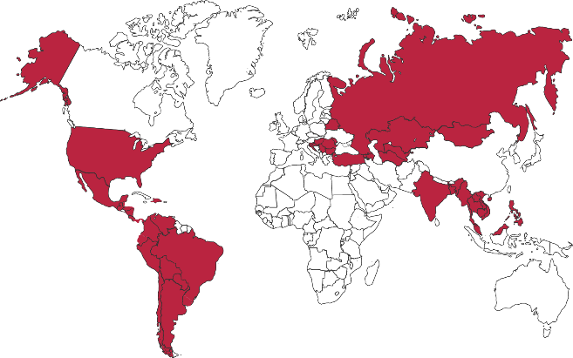

Softline Facts and Figures
4500+
team members
1500+
account managers
1000+
sales and technical presale professionals
2018
$1,36 bln
2012
$805 mln
1.36 Billion $
Sales Volume 2018 in the Group of companies
2006
$97,7 mln
1998
$1,5 mln
1000+
engineers and developers
50+ countries
95+ cities
26
years in the IT market
Turnover data

Slide 4
Agenda
Webinar 1: Prerequisites – Required Resource Providers; Storage Container preparation
Webinar 2: Prerequisites – Azure Fileshare; Azure Database Migration Tools
Webinar 3: Prerequisites – Azure App Service; Azure Database Migration Service
Webinar 4: Prerequisites – Azure SQL DB (PaaS)
Webinar 5: Prerequisites – Azure SQL VM (IaaS), Azure SQL MI (IaaS)
Webinar 6: Migration – Migrate SQL to Azure SQL DB
Webinar 7: Migration – Migrate SQL to Azure SQL VM using Backup/Restore technique
Webinar 8: Migration – Migrate SQL to Azure SQL VM Assess/Migrate using DMA
Webinar 9: Migration – Migrate SQL to Azure SQL MI Assess/Migrate using DMS
Webinar 10: Migration – Migrate Website/Web Application to Azure App Service using DMS; Recap

Slide 5
Software and hardware refresh
Security threats
Urgent capacity needs
Compliance
Quickly integrate acquisitions
Application innovation
Software end of support
Datacenter contracts expiry
Migration & modernization triggers

Slide 6
Why migrate to Azure?
Unmatched security
Unparalleled innovation
Unbeatable offers
6.5 trillion threat signals analyzed daily
3,500 security experts
$1 billion per year investment in security
Intelligent capabilities, trained on millions of DBs
Only cloud with evergreen SQL, which never needs to be patched or updated
Only fully-managed service for any .NET app
5x less expensive than AWS
Azure Hybrid Benefit
Free Extended Security Updates
Leadership in performance and scale
Built-in hybrid
Operate seamlessly across your datacenter and the cloud
Only cloud provider with end-to-end hybrid infrastructure
2.5M+ hybrid enabled Windows Servers through Windows Admin Center
Most comprehensive backward and forward SQL compatibility with Azure SQL DB Managed Instance

Slide 7
Azure Data: common services for all data engines on intelligent performance, security, hyperscale with built-in HA
Power BI
Azure App Services
Azure Data Factory
Azure Analysis Services
Azure Machine Learning
Azure Cognitive Services
Azure Bot Service
Azure SQL Database
Azure SQL Data Warehouse
Azure Database for PostgreSQL
Azure Database for MySQL
Azure Database for MariaDB
Database Services Platform
Intelligent Advisors, tuning, monitoring
Flexible Independent scaling of compute & storage, resource governance
Trusted HA/DR, backup/restore, security, audit, isolation
GEO Replication
Azure compute
Azure storage
Globally Available in 54 Regions

Slide 8


DEMO Azure Fileshare; Azure Database Migration Tools

Slide 9

Questions?
You can reach out to me at: mihaly.kileber@softline.com
Contact us at any of our counry e-mail addresses:
Bulgaria: info@softline.bg
Croatia: info@softline.hr
Hungary: info@softline.hu
Romania: info@softline.ro
Serbia: info.serbia@softline.com
Slovenia: info@softline.si

Slide 10
