Slide 1



Data modernization to the Cloud
Webinar series, April 2020

Slide 2

Introduction
Mihály Kiléber - Senior Azure Engineer
Mihaly.kileber@softline.com
Focus Area: SQL Server and Azure SQL services together with dependent components
Certifications:
MCS & MCP Implementing Microsoft Azure Infrastructure Solutions
MS RaaS (Risk Assesment as a Service) and RAP accreditation
1:1 Packaged Service Essentials accreditation
Cloud Mentor Program and Partner Learning Plans.

Slide 3
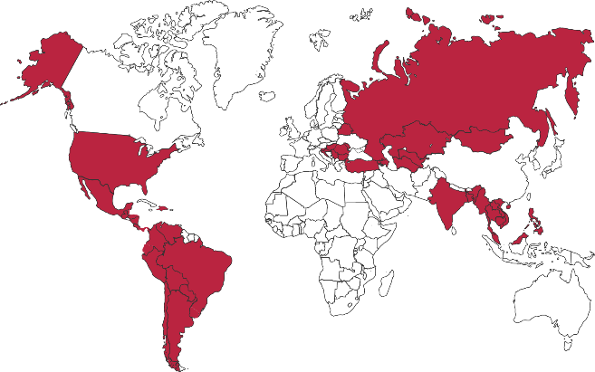

Softline Facts and Figures
4500+
team members
1500+
account managers
1000+
sales and technical presale professionals
2018
$1,36 bln
2012
$805 mln
1.36 Billion $
Sales Volume 2018 in the Group of companies
2006
$97,7 mln
1998
$1,5 mln
1000+
engineers and developers
50+ countries
95+ cities
26
years in the IT market
Turnover data

Slide 4
Agenda
Webinar 1: Prerequisites – Required Resource Providers; Storage Container preparation
Webinar 2: Prerequisites – Azure Fileshare; Azure Database Migration Tools
Webinar 3: Prerequisites – Azure App Service; Azure Database Migration Service
Webinar 4: Prerequisites – Azure SQL DB (PaaS)
Webinar 5: Prerequisites – Azure SQL VM (IaaS), Azure SQL MI (IaaS)
Webinar 6: Migration – Migrate SQL to Azure SQL DB
Webinar 7: Migration – Migrate SQL to Azure SQL VM using Backup/Restore technique
Webinar 8: Migration – Migrate SQL to Azure SQL VM Assess/Migrate using DMA
Webinar 9: Migration – Migrate SQL to Azure SQL MI Assess/Migrate using DMS
Webinar 10: Migration – Migrate Website/Web Application to Azure App Service using DMS; Recap

Slide 5
Migration Options for your SQL Databases The best destination for SQL workloads in the cloud
Move to PaaS w/ Azure SQL DB Managed Instance (MI)
Lift-and-shift to MI for fully managed database services. Your app always runs on evergreen features, avoiding manual patching, upgrade, and End of Support
SQL
Modernize to Azure
SQL Server on premises
Move to IaaS with Azure SQL VM
Upgrade to SQL Server 2019 on Azure VMs, or
Move “as-is” with Resource Provider for auto backup, patching, etc and get 3 years of Extended Security Updates* for free for SQL 2008/R2
Modernize on premises
Upgrade on premises
Upgrade to SQL Server 2019 and Windows Server 2019

Slide 6
Azure IaaS vs Paas
On-premises
Infrastructure
as a Service
Platform
as a Service
Threat Detection, Risk Management
Threat Detection, Risk Management
Threat Detection, Risk Management
Performance Management
Performance Management
Performance Management
Different Azure Data Services give you different levels of control and flexibility for your data.
For a high level of control including the ability to pick SQL Server and OS version, choose IaaS.
For automated management and administration, choose PaaS.
Applications
Applications
Applications
Data
Data
Data
High availability /DR/Backups
High availability /DR/Backups
High Availability/ DR/Backups
Database Provision/ Patch/Scaling
Database Provision/ Patch/Scaling
Database Provision/ Patch/Scaling
O/S provision /patching
O/S
O/S
Virtualization
Virtualization
Virtualization
Hardware
Hardware
Hardware
Datacenter Management
Datacenter Management
Datacenter Management
SQL Server 2017
MySQL/PostgreSQL/MariaDB
Azure SQL VMs
Azure Win/Linux VMs
Azure SQL Database
Azure Database for MySQL/PostgreSQL/MariaDB
Managed by customer
Managed by Cloud provider
Azure Database Platform differentiation

Slide 7
SQL Resource Provider – Bringing the benefits of Marketplace Images to Self-Installed VM Images
Comprehensive feature set
Dashboard view for VM awareness
Simple license conversions
Self-installed VMs registered with RP now can access automation features in Azure Marketplace images
Leverage auto-backup,
auto-patching, and automate Always On Availability Groups to avoid time-consuming admin
and VM customization
Azure VMs are now discoverable on the new Azure SQL blade in Azure Marketplace
Easily manage your SQL VM and SQL PaaS deployments from one central location
Self-installed VMs with RP can be easily converted to PAYG images
Save money by converting variable workloads with Software Assurance to PAYG images
Learn more aka.ms/sqlvm_rp and aka.ms/sqlvm_rp_documentation

Slide 8


DEMO Azure App Service; Azure DB Migration Service

Slide 9

Questions?
You can reach out to me at: mihaly.kileber@softline.com
Contact us at any of our counry e-mail addresses:
Bulgaria: info@softline.bg
Croatia: info@softline.hr
Hungary: info@softline.hu
Romania: info@softline.ro
Serbia: info.serbia@softline.com
Slovenia: info@softline.si

Slide 10
