Slide 1



Data modernization to the Cloud
Webinar series, April 2020

Slide 2
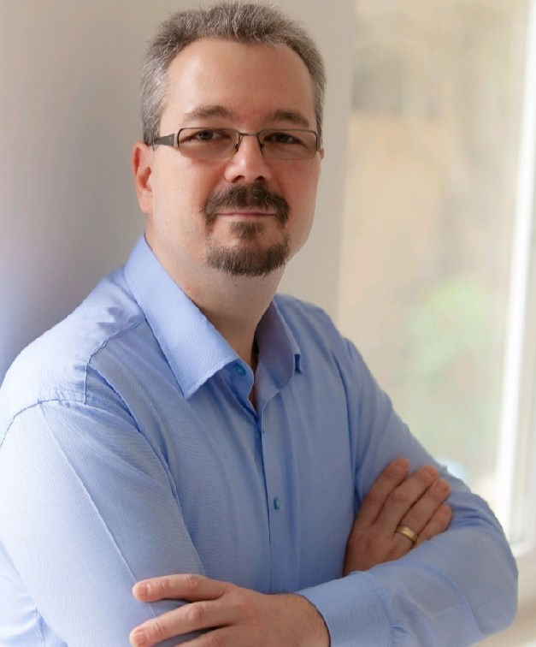
Introduction
Mihály Kiléber - Senior Azure Engineer
Mihaly.kileber@softline.com
Focus Area: SQL Server and Azure SQL services together with dependent components
Certifications:
MCS & MCP Implementing Microsoft Azure Infrastructure Solutions
MS RaaS (Risk Assesment as a Service) and RAP accreditation
1:1 Packaged Service Essentials accreditation
Cloud Mentor Program and Partner Learning Plans.

Slide 3
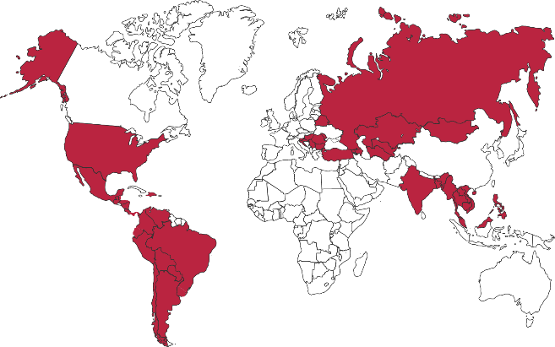

Softline Facts and Figures
4500+
team members
1500+
account managers
1000+
sales and technical presale professionals
2018
$1,36 bln
2012
$805 mln
1.36 Billion $
Sales Volume 2018 in the Group of companies
2006
$97,7 mln
1998
$1,5 mln
1000+
engineers and developers
50+ countries
95+ cities
26
years in the IT market
Turnover data

Slide 4
Agenda
Webinar 1: Prerequisites – Required Resource Providers; Storage Container preparation
Webinar 2: Prerequisites – Azure Fileshare; Azure Database Migration Tools
Webinar 3: Prerequisites – Azure App Service; Azure Database Migration Service
Webinar 4: Prerequisites – Azure SQL DB (PaaS)
Webinar 5: Prerequisites – Azure SQL VM (IaaS), Azure SQL MI (IaaS)
Webinar 6: Migration – Migrate SQL to Azure SQL DB
Webinar 7: Migration – Migrate SQL to Azure SQL VM using Backup/Restore technique
Webinar 8: Migration – Migrate SQL to Azure SQL VM Assess/Migrate using DMA
Webinar 9: Migration – Migrate SQL to Azure SQL MI Assess/Migrate using DMS
Webinar 10: Migration – Migrate Website/Web Application to Azure App Service using DMS; Recap

Slide 5
Migration planning and execution A step by step approach
Migration plan
TCO | Target workloads | Approach (e.g., Rehost) | Timelines
Assess
Migrate
Optimize
Secure and manage
Azure Migrate | Azure Database Migration Service | Azure Cost Management | Azure Security & Management
FastTrack for Azure + Specialized migration partners

Slide 6
Best practice guidance Leverage a consistent methodology
Plan
Microsoft
Cloud Adoption
Framework for Azure
Proven guidance from Microsoft to accelerate cloud adoption journey
Govern
Manage
Define strategy
Adopt
Ready

Slide 7
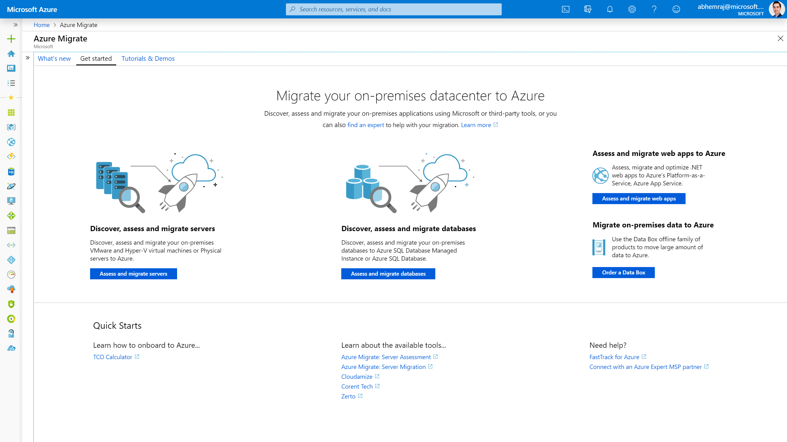
Azure Migrate is a hub for migration

Slide 8


DEMO Azure SQL DB (PaaS)

Slide 9

Questions?
You can reach out to me at: mihaly.kileber@softline.com
Contact us at any of our counry e-mail addresses:
Bulgaria: info@softline.bg
Croatia: info@softline.hr
Hungary: info@softline.hu
Romania: info@softline.ro
Serbia: info.serbia@softline.com
Slovenia: info@softline.si

Slide 10
