Slide 1



Data modernization to the Cloud
Webinar series, April 2020

Slide 2

Introduction
Mihály Kiléber - Senior Azure Engineer
Mihaly.kileber@softline.com
Focus Area: SQL Server and Azure SQL services together with dependent components
Certifications:
MCS & MCP Implementing Microsoft Azure Infrastructure Solutions
MS RaaS (Risk Assesment as a Service) and RAP accreditation
1:1 Packaged Service Essentials accreditation
Cloud Mentor Program and Partner Learning Plans.

Slide 3
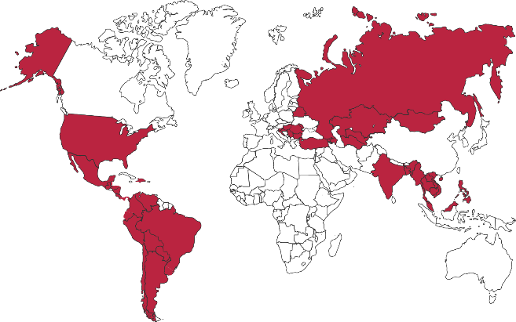

Softline Facts and Figures
4500+
team members
1500+
account managers
1000+
sales and technical presale professionals
2018
$1,36 bln
2012
$805 mln
1.36 Billion $
Sales Volume 2018 in the Group of companies
2006
$97,7 mln
1998
$1,5 mln
1000+
engineers and developers
50+ countries
95+ cities
26
years in the IT market
Turnover data

Slide 4
Agenda
Webinar 1: Prerequisites – Required Resource Providers; Storage Container preparation
Webinar 2: Prerequisites – Azure Fileshare; Azure Database Migration Tools
Webinar 3: Prerequisites – Azure App Service; Azure Database Migration Service
Webinar 4: Prerequisites – Azure SQL DB (PaaS)
Webinar 5: Prerequisites – Azure SQL VM (IaaS), Azure SQL MI (IaaS)
Webinar 6: Migration – Migrate SQL to Azure SQL DB
Webinar 7: Migration – Migrate SQL to Azure SQL VM using Backup/Restore technique
Webinar 8: Migration – Migrate SQL to Azure SQL VM Assess/Migrate using DMA
Webinar 9: Migration – Migrate SQL to Azure SQL MI Assess/Migrate using DMS
Webinar 10: Migration – Migrate Website/Web Application to Azure App Service using DMS; Recap

Slide 5
Azure SQL Database Managed Instance: The best destination for fully-managed SQL in the cloud
Evergreen SQL
Eliminates manual patching, upgrades and end of support
Best TCO
Meets mission-critical requirements while costing up to 86% less than SQL Server on AWS RDS¹
SQL parity
Full parity based on 100% code consistency, supporting source version back to SQL 2005
SQL support
Up to 99.995% availability SLA, industry’s only business continuity SLA
PaaS ++
Machine-Learning based, intelligent performance and security on top of PaaS
Price-performance claim based on data from a study commissioned by Microsoft and conducted by GigaOm in August 2019. Learn more: https://azure.microsoft.com/en-us/services/sql-database/campaign/

Slide 6
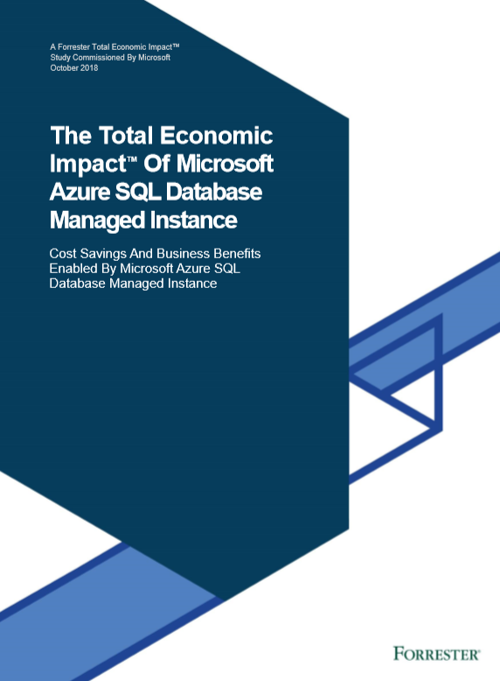
The Total Economic Impact of Azure SQL Database Managed Instance
Key report benefits and findings
212% Total ROI
3 years after initial investment & migration to Azure SQL Database Managed Instance
$1.8M
Savings from avoided hardware, network, storage and ongoing maintenance costs
6 months or less
Payback post migration
“
Azure SQL Database Managed Instance is part of our strategic mandate to move all of our application, database, and services footprint to the Azure cloud. We can quickly integrate and are more nimble and more efficient as a result.
Head of development, technology company
40%
20%
Improvement in productivity for in-house DBAs
Increase in productivity for IT teams
“
Initial investment
Year 1
Year 2
Year 3
Cost
Benefit
Download the full Total Economic Impact™ of Azure SQL Database Managed Instance report
Notes:
Microsoft commissioned Forrester Consulting to conduct a Total Economic Impact™ study to examine potential cost savings and business benefits enterprises would achieve from migrating on-premises workloads to Azure SQL Database Managed Instance.

Slide 7

Mission critical SQL Server performance in Azure costs up to 87% less than alternatives
Azure SQL DB
GigaOm Price-Performance Benchmark
October 2019
Azure SQL VM
GigaOm Price-Performance Benchmark
December 2019
$2,119.10
$445.65
3-year pricing / tps
86% LESS
3-year pricing / tps
87% LESS
$290.72
$59.02
*Source: GigaOm.com

Slide 8


DEMO Azure SQL VM (IaaS); Azure SQL MI (IaaS)

Slide 9

Questions?
You can reach out to me at: mihaly.kileber@softline.com
Contact us at any of our counry e-mail addresses:
Bulgaria: info@softline.bg
Croatia: info@softline.hr
Hungary: info@softline.hu
Romania: info@softline.ro
Serbia: info.serbia@softline.com
Slovenia: info@softline.si

Slide 10


