Slide 1



Data modernization to the Cloud
Webinar series, April 2020

Slide 2

Introduction
Mihály Kiléber - Senior Azure Engineer
Mihaly.kileber@softline.com
Focus Area: SQL Server and Azure SQL services together with dependent components
Certifications:
MCS & MCP Implementing Microsoft Azure Infrastructure Solutions
MS RaaS (Risk Assesment as a Service) and RAP accreditation
1:1 Packaged Service Essentials accreditation
Cloud Mentor Program and Partner Learning Plans.

Slide 3
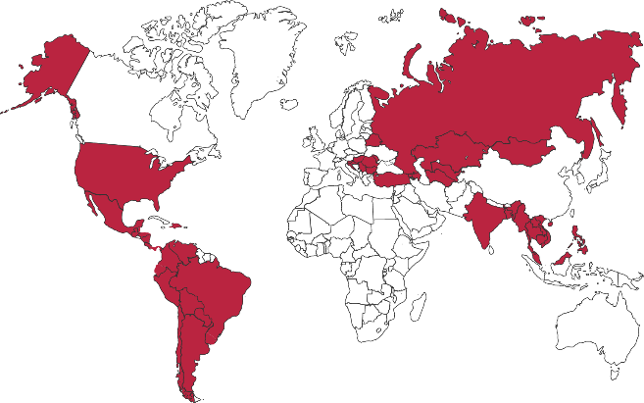

Softline Facts and Figures
4500+
team members
1500+
account managers
1000+
sales and technical presale professionals
2018
$1,36 bln
2012
$805 mln
1.36 Billion $
Sales Volume 2018 in the Group of companies
2006
$97,7 mln
1998
$1,5 mln
1000+
engineers and developers
50+ countries
95+ cities
26
years in the IT market
Turnover data

Slide 4
Agenda
Webinar 1: Prerequisites – Required Resource Providers; Storage Container preparation
Webinar 2: Prerequisites – Azure Fileshare; Azure Database Migration Tools
Webinar 3: Prerequisites – Azure App Service; Azure Database Migration Service
Webinar 4: Prerequisites – Azure SQL DB (PaaS)
Webinar 5: Prerequisites – Azure SQL VM (IaaS), Azure SQL MI (IaaS)
Webinar 6: Migration – Migrate SQL to Azure SQL DB
Webinar 7: Migration – Migrate SQL to Azure SQL VM using Backup/Restore technique
Webinar 8: Migration – Migrate SQL to Azure SQL VM Assess/Migrate using DMA
Webinar 9: Migration – Migrate SQL to Azure SQL MI Assess/Migrate using DMS
Webinar 10: Migration – Migrate Website/Web Application to Azure App Service using DMS; Recap

Slide 5









Database migration process overview
Post-migration
Optimize
Based on the tests you performed, address any perfor-mance issues, and then retest to confirm the performance improvements
Pre-migration
Migration
Discover
Assess
Convert
Migrate
Data sync
Cutover
Remediate applications
Iteratively make any necessary changes to your applications
Inventory database assets, and application stack discovery
Assess workloads and fix recommen-dations
Convert the source schema to work in the target environment. This is only relevant for hetero-geneous migrations.
Migrate the source schema, and then migrate the source data to the target
Sync your target schema and data with the source. This is only relevant for minimal-downtime migrations
Cut over from the source to the target environment. This is only relevant for minimal-downtime migrations
Run functional & performance tests
Iteratively run functional and performance tests

Slide 6





ASP.NET Application Migration to Azure
On-premises
Azure
VMware
LOB App
App Service
Migration Assistant
LOB App
App layer
Azure App Service
App layer
Windows Server
Data layer
Azure SQL Database
Managed Instance
Data layer
SQL Server
Azure Database Migration Service

Slide 7











Tools and services for your migration journey
On-premises
Microsoft Azure
Assessment
Azure Migrate, SSMA, DMA, DEA
Migration
Azure Database Migration Service

Slide 8


DEMO Migrate SQL to Azure SQL DB

Slide 9

Questions?
You can reach out to me at: mihaly.kileber@softline.com
Contact us at any of our counry e-mail addresses:
Bulgaria: info@softline.bg
Croatia: info@softline.hr
Hungary: info@softline.hu
Romania: info@softline.ro
Serbia: info.serbia@softline.com
Slovenia: info@softline.si

Slide 10
