Slide 1



Data modernization to the Cloud
Webinar series, April 2020

Slide 2
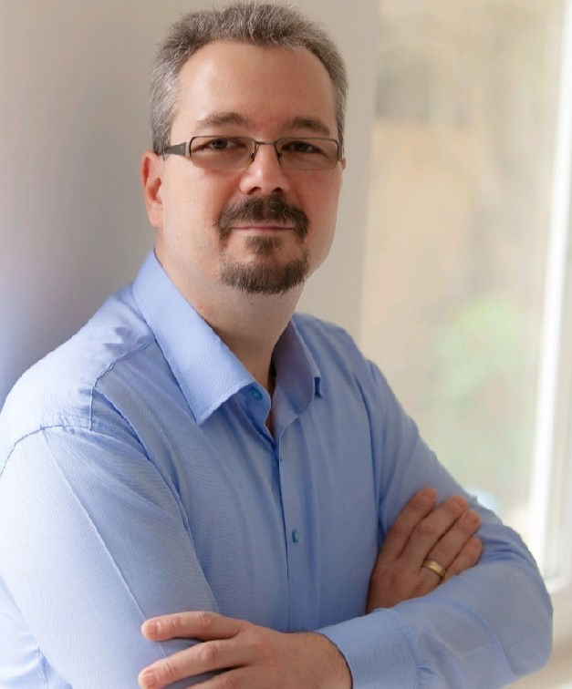
Introduction
Mihály Kiléber - Senior Azure Engineer
Mihaly.kileber@softline.com
Focus Area: SQL Server and Azure SQL services together with dependent components
Certifications:
MCS & MCP Implementing Microsoft Azure Infrastructure Solutions
MS RaaS (Risk Assesment as a Service) and RAP accreditation
1:1 Packaged Service Essentials accreditation
Cloud Mentor Program and Partner Learning Plans.

Slide 3
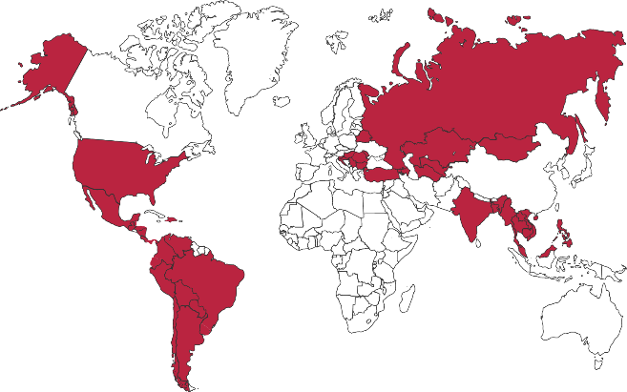

Softline Facts and Figures
4500+
team members
1500+
account managers
1000+
sales and technical presale professionals
2018
$1,36 bln
2012
$805 mln
1.36 Billion $
Sales Volume 2018 in the Group of companies
2006
$97,7 mln
1998
$1,5 mln
1000+
engineers and developers
50+ countries
95+ cities
26
years in the IT market
Turnover data

Slide 4
Agenda
Webinar 1: Prerequisites – Required Resource Providers; Storage Container preparation
Webinar 2: Prerequisites – Azure Fileshare; Azure Database Migration Tools
Webinar 3: Prerequisites – Azure App Service; Azure Database Migration Service
Webinar 4: Prerequisites – Azure SQL DB (PaaS)
Webinar 5: Prerequisites – Azure SQL VM (IaaS), Azure SQL MI (IaaS)
Webinar 6: Migration – Migrate SQL to Azure SQL DB
Webinar 7: Migration – Migrate SQL to Azure SQL VM using Backup/Restore technique
Webinar 8: Migration – Migrate SQL to Azure SQL VM Assess/Migrate using DMA
Webinar 9: Migration – Migrate SQL to Azure SQL MI Assess/Migrate using DMS
Webinar 10: Migration – Migrate Website/Web Application to Azure App Service using DMS; Recap

Slide 5

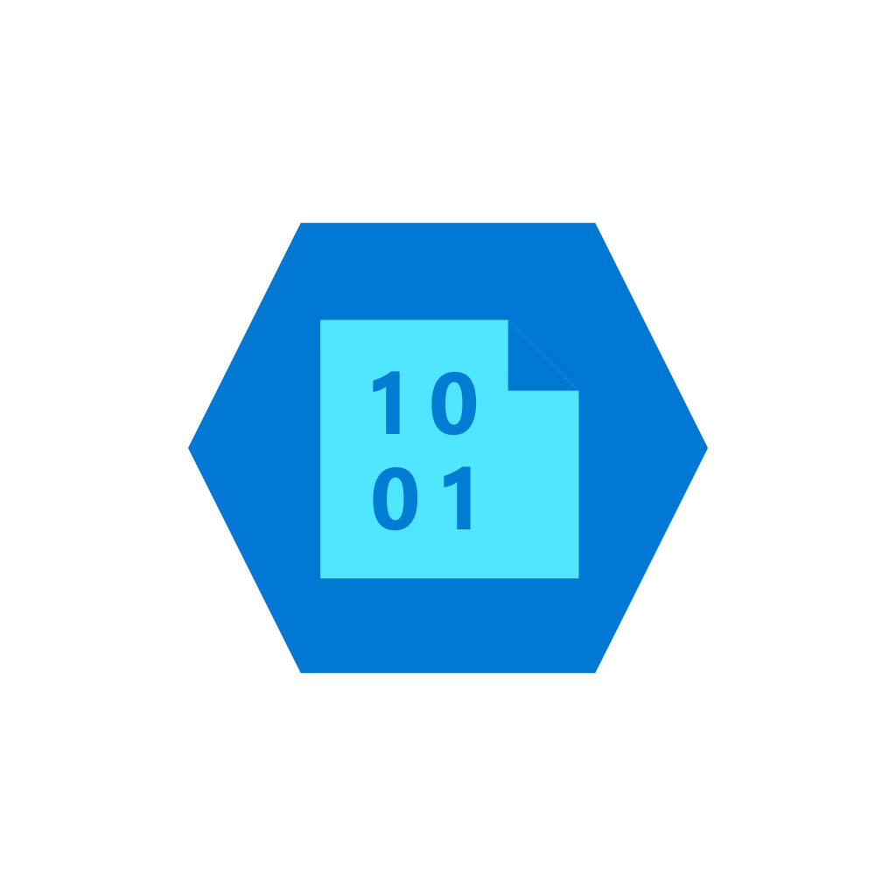






Online migration with backup and restore technology SQL Server to Azure SQL Database Managed Instance example
Provide existing backups in network share
DMS upload backup files to Azure storage
DMS initiate the migration to Managed Instance
Full backup restored and Transaction log backups continuously applied until cutover
Stop incoming traffic to source databases, provide Tail-Log backup, initiate cutover in DMS and change the application connection strings
Virtual Network (VNET)
1
2
Subnet used for MI
3
Cloud network
Azure Blob Storage
4
2
4
SQL DB Managed Instance
3
Subnet used for DMS
Legend
SMB Network Share
Full Database backup files
1
Transaction log backup files
On-premises
Site to site connectivity (VPN or ExpressRoute)

Slide 6


DEMO Migrate SQL to Azure SQL VM using Backup/Restore technique

Slide 7

Questions?
You can reach out to me at: mihaly.kileber@softline.com
Contact us at any of our counry e-mail addresses:
Bulgaria: info@softline.bg
Croatia: info@softline.hr
Hungary: info@softline.hu
Romania: info@softline.ro
Serbia: info.serbia@softline.com
Slovenia: info@softline.si

Slide 8
