Slide 2
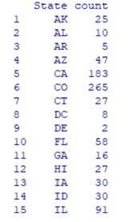
. How many breweries are present in each state?

Slide 3
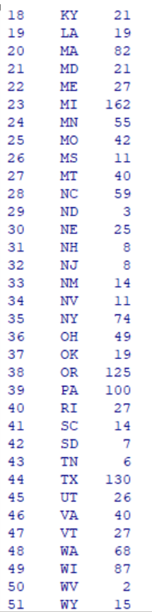
How many breweries are present in each state?
t
[Apple Inc. was founded in 1977 and is headquartered in Cupertino, California.\",\"ceo\":\"Tim Cook\",\"company_url\":\"www.apple.com\",\"business_address\":\"ONE APPLE PARK WAY, CUPERTINO, CA 95014\",\"mailing_address\":\"ONE APPLE PARK WAY, CUPERTINO, CA 95014\",\"business_phone_no\":\"(408) 996-1010\",\"hq_address1\":\"1 Infinite Loop\",\"hq_address2\":null,\"hq_address_city\":\"Cupertino\",\"hq_address_postal_code\":\"95014\",\"entity_legal_form\":\"INCORPORATED\",\"cik\":\"0000320193\",\"latest_filing_date\":\"2019-07-31\",\"hq_state\":\"California\",\"hq_country\":\"United States of America\",\"inc_state\":\"California\",\"inc_country\":\"United States of America\",\"employees\":132000,\"entity_status\":\"ACTIVE\",\"sector\":\"Consumer Goods\",\"industry_category\":\"Consumer Durables\",\"industry_group\":\"Electronic Equipment\",\"template\":\"indu\",\"standardized_active\":true,\"first_fundamental_date\":\"2007-09-29\",\"last_fundamental_date\":\"2019-06-29\",\"first_stock_price_date\":\"1980-12-12\",\"last_stock_price_date\":\"2019-08-19\"}"
> get_prices

Slide 4
Inference: Top 3 Highest No Breweries in USA
 | No of Breweries | State
1 | 265 | CO- Colorado
2 | 183 | CA- California
3 | 162 | MI- Michigan

Slide 5
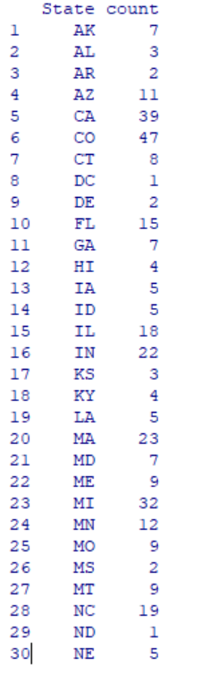
How many breweries are present in each state?

Slide 6
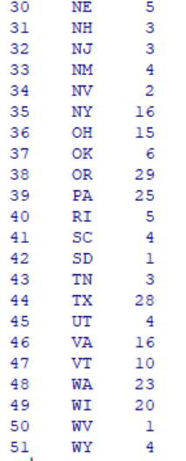
How many breweries are present in each state?

Slide 7
Inference: Top 3 Highest No Breweries in USA
 | No of Breweries | State
1 | 47 | CO- Colorado
2 | 39 | CA- California
3 | 32 | MI- Michigan

Slide 8
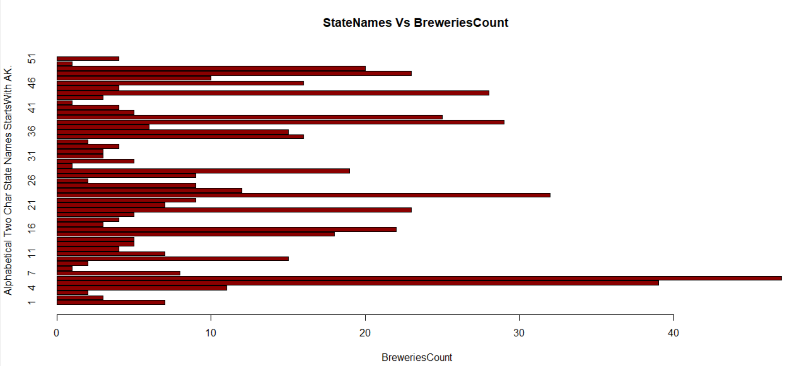
Barplot- State Vs Breweries Count

Slide 9
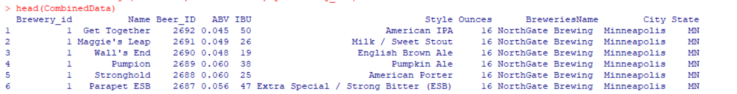
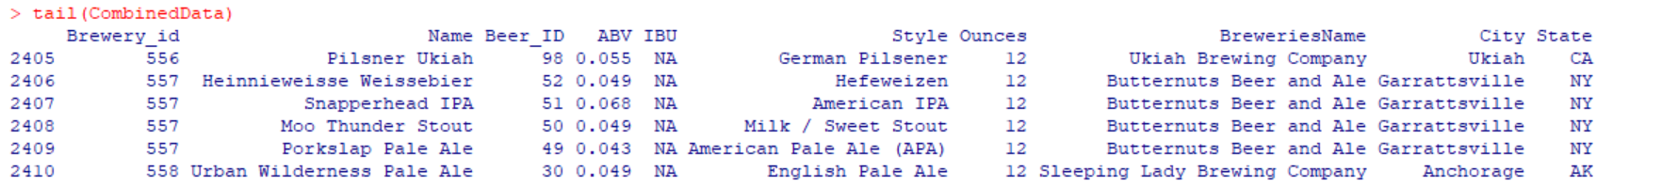
Merge beer data with the breweries data. Print the first 6 observations and the last six observations to check the merged file. (RMD only, this does not need to be included in the presentation or the deck.)

Slide 10
Which state has the maximum alcoholic (ABV) beer? Which state has the most bitter (IBU) beer?
ABV | IBU | State
ABV |  | MA-Massachusetts
 | IBU | NJ- New Jersey

Slide 11
. Address the missing values in each column.
ABV | IBU | Style
62 | 1005 | 5

Slide 12
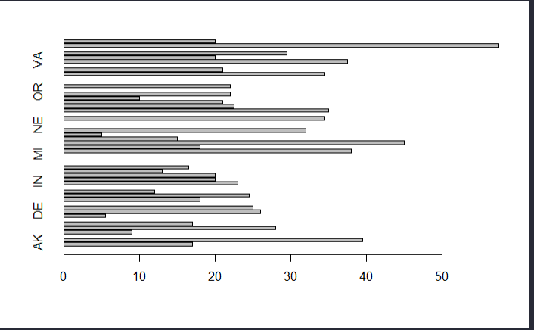
Compute the median alcohol content and international bitterness unit for each state. Plot a bar chart to compare. ABV per State

Slide 13
Compute the median alcohol content and international bitterness unit for each state. Plot a bar chart to compare. IBU per State

Slide 14
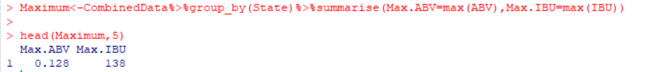
Which state has the maximum alcoholic (ABV) beer? Which state has the most bitter (IBU) beer?

Slide 15
Comment on the summary statistics and distribution of the ABV variable.
- ABV is normally in the range of 0.001 to 0.128.
- But most of the beers in the country have a ABV of 0.059
Based on the histogram and qqplot we can see that the distribution is normally distributed

Slide 16

Comment on the summary statistics and distribution of the ABV variable.

Slide 17
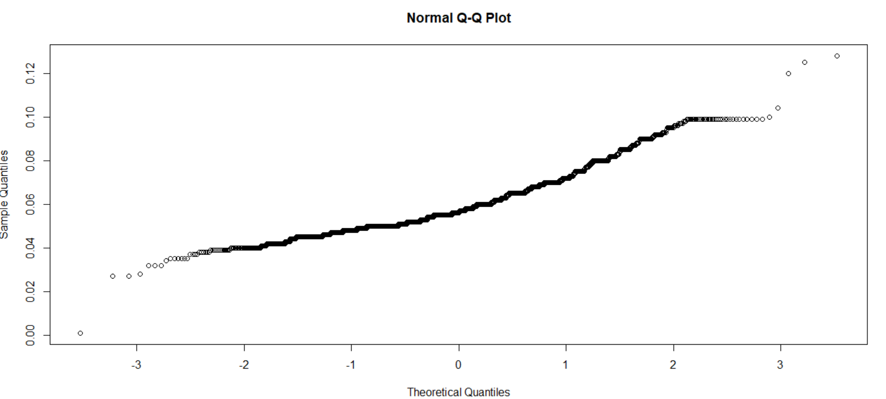
QQ Plot Distribution

Slide 18
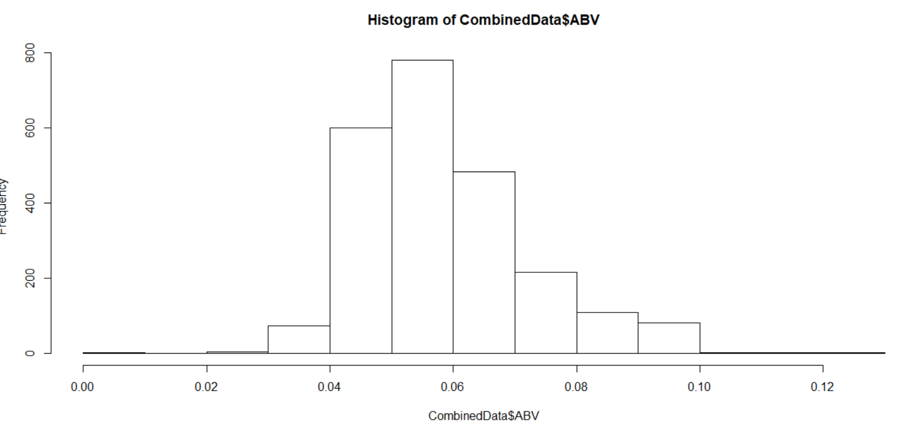
Comment on the summary statistics and distribution of the ABV variable.

Slide 19
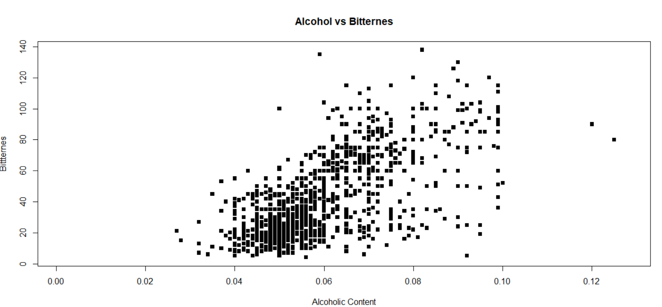
Is there an apparent relationship between the bitterness of the beer and its alcoholic content? After Removing NA Value/Draw a scatter plot.

Slide 20
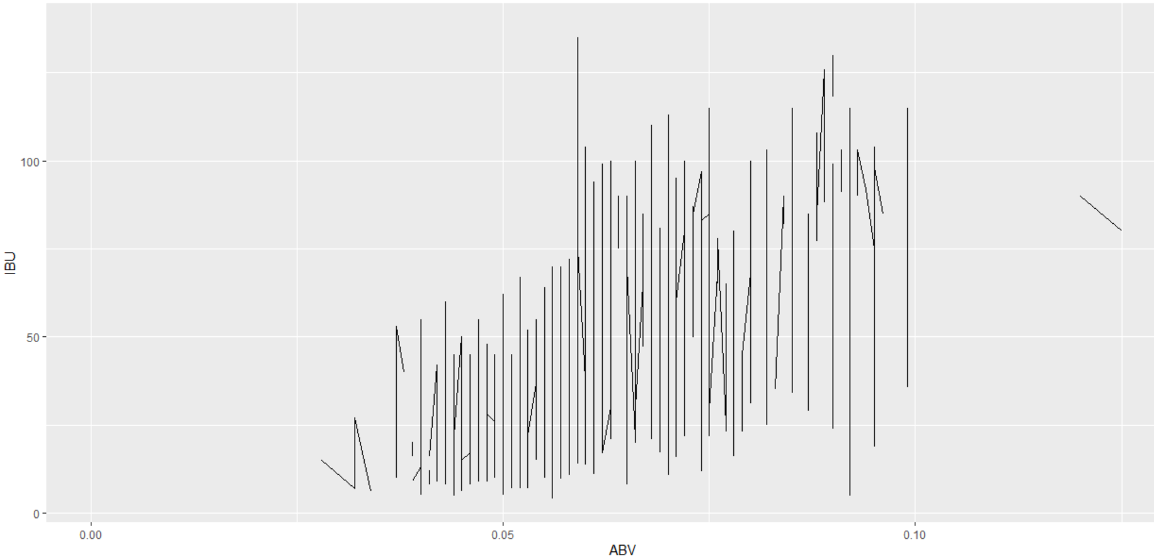
Is there an apparent relationship between the bitterness of the beer and its alcoholic content? Draw a scatter plot.

Slide 21
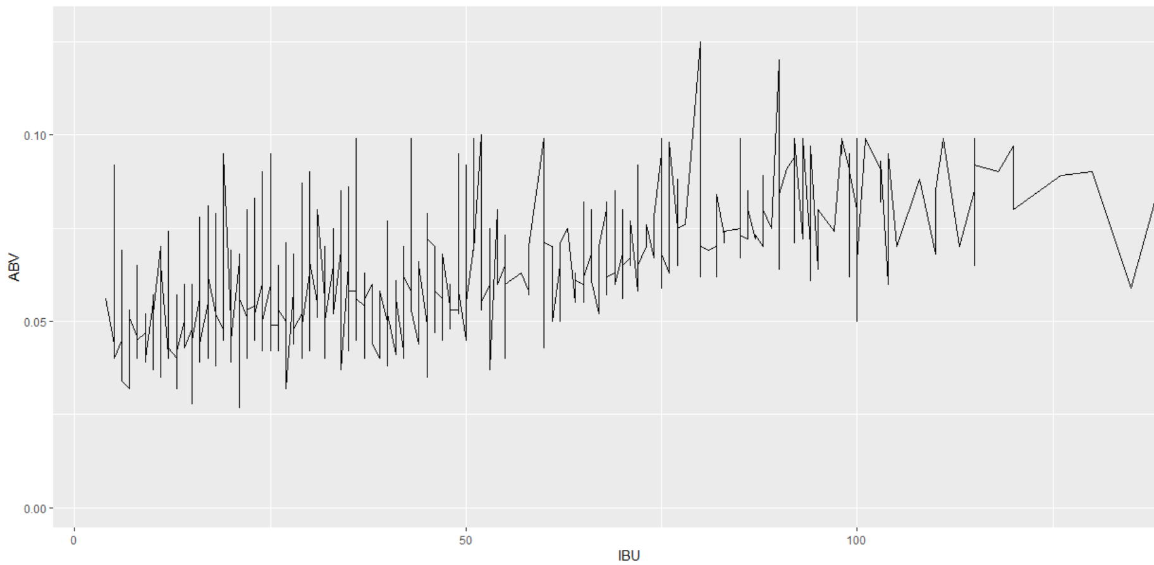
Is there an apparent relationship between the bitterness of the beer and its alcoholic content? Draw a scatter plot.

