Slide 1

Exploratory Data Analysis
<G2M Case Study>
<21. 05. 2024>

Slide 2

Agenda
Executive Summary
Problem Statement
Approach
EDA
EDA Summary
Recommendations

Slide 3
Background –G2M(cab industry) case study
XYZ, a US-based private equity firm, is exploring investment opportunities in the cab industry, which has seen significant growth and increased competition in recent years.
Goal: Offer insights to assist XYZ in selecting the optimal company for investment in the cab industry.
Analysis Segments:
Data Analysis results
Data Clustering results
Investment Strategy Recommendations

Slide 4
Data Exploration
24 Features( including 9 derived features)
Timeframe of the data: 2016-01-31 to 2018-12-31
Total data points :355,032
Cab_Data.csv
Customer_ID.csv
Transaction_ID.csv
City.csv
USholiday.csv
Final cab data

Slide 5
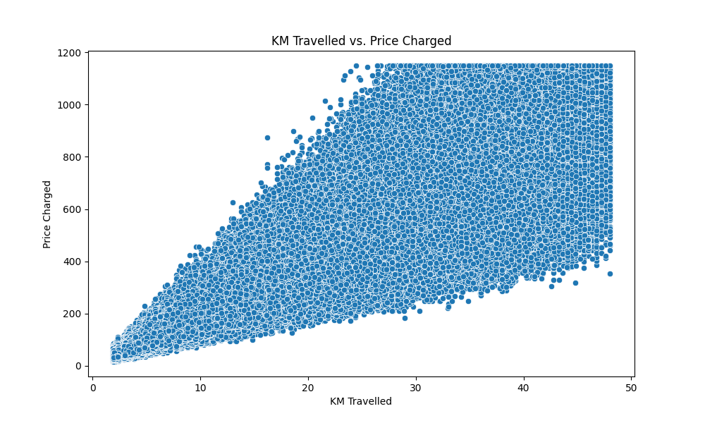
Agenda
Executive Summary
Problem Statement
Approach
EDA
EDA Summary
Recommendations

Slide 6
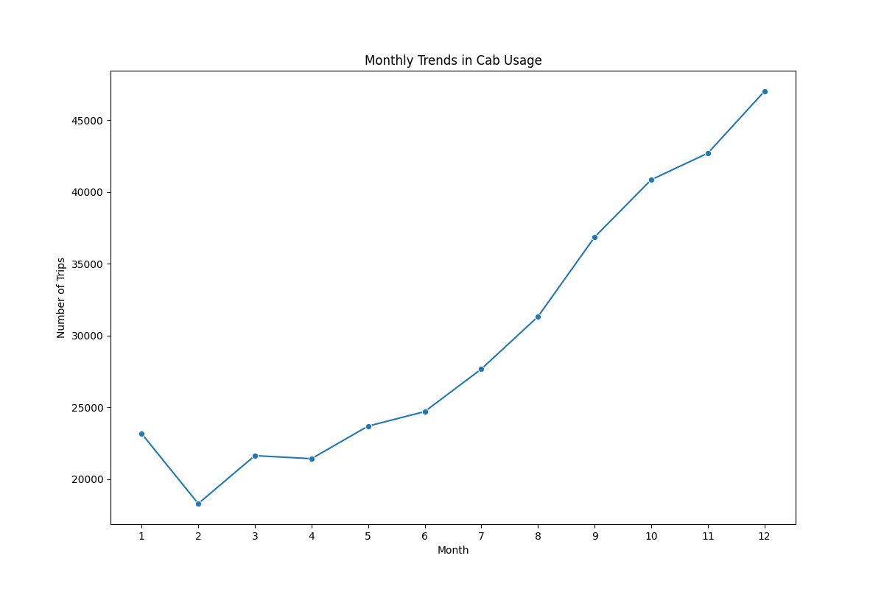
Agenda
Executive Summary
Problem Statement
Approach
EDA
EDA Summary
Recommendations

Slide 7
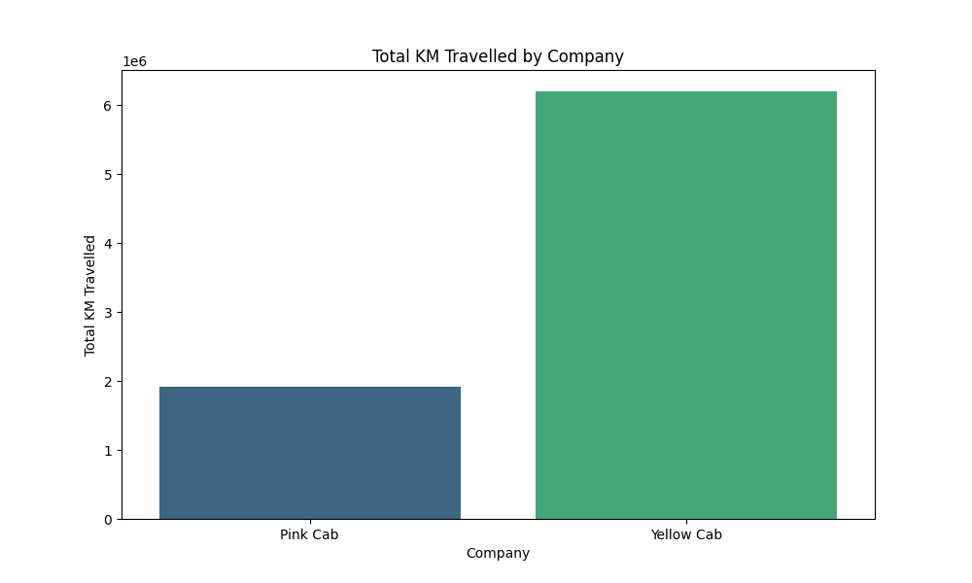
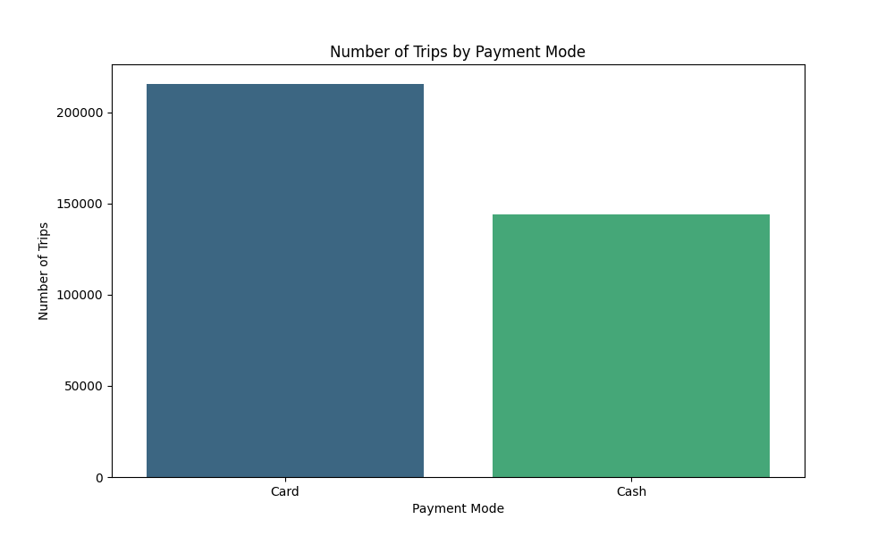
Agenda
Executive Summary
Problem Statement
Approach
EDA
EDA Summary
Recommendations

Slide 8
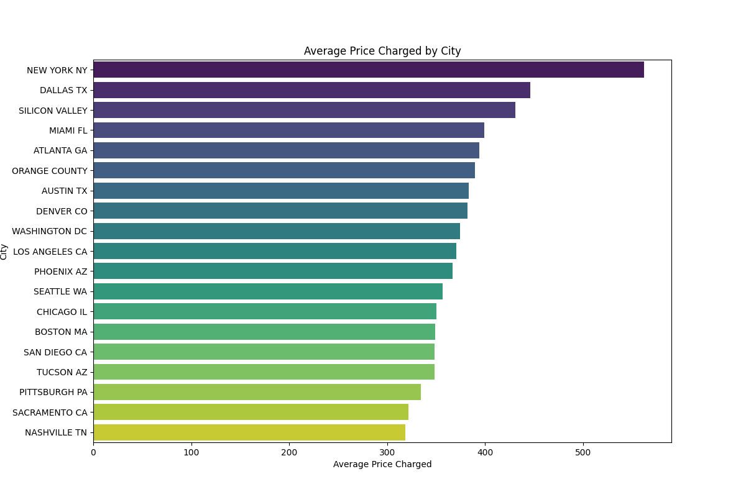
Agenda
Executive Summary
Problem Statement
Approach
EDA
EDA Summary
Recommendations

Slide 9
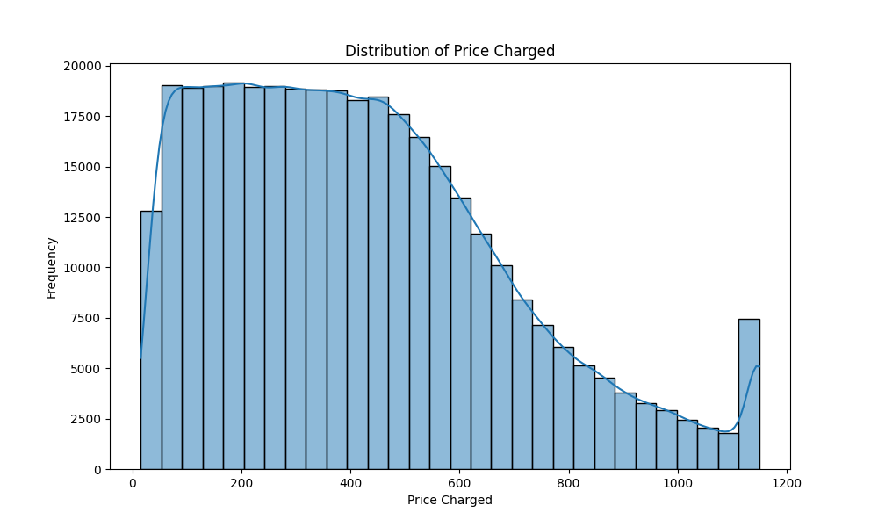
Agenda
Executive Summary
Problem Statement
Approach
EDA
EDA Summary
Recommendations

Slide 10
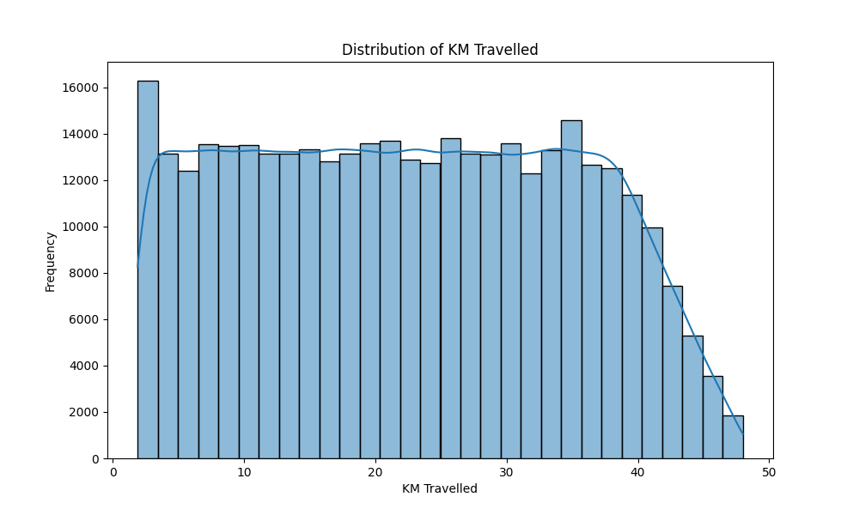
Agenda
Executive Summary
Problem Statement
Approach
EDA
EDA Summary
Recommendations

Slide 11
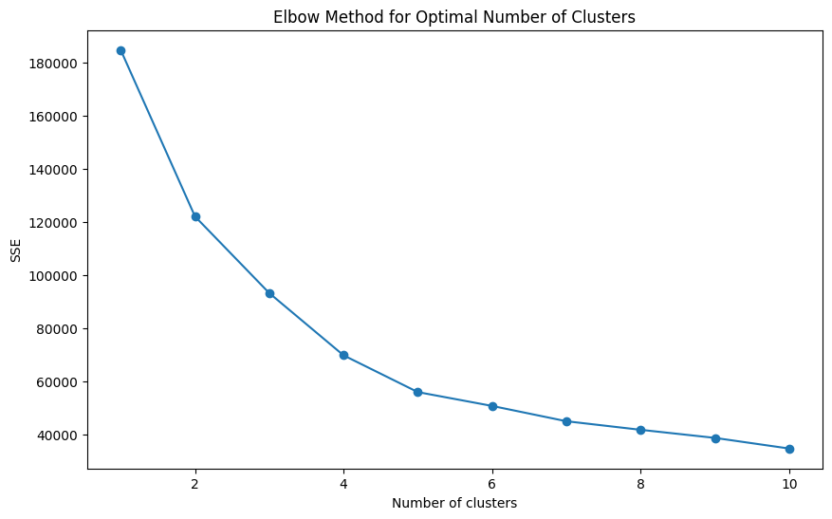
Agenda
Executive Summary
Problem Statement
Approach
EDA
EDA Summary
Recommendations

Slide 12
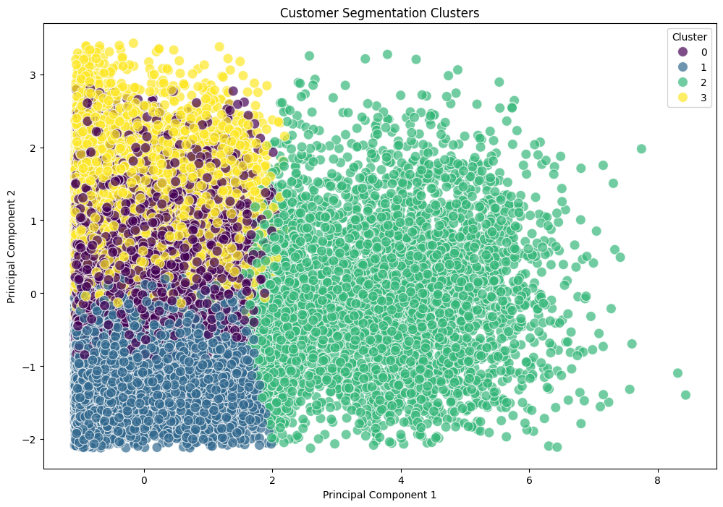
Agenda
Executive Summary
Problem Statement
Approach
EDA
EDA Summary
Recommendations

Slide 13
Recommendations
EDA Recommendations
Seasonal Promotions:
Insight: There is significant seasonality in cab usage, with certain months showing higher demand.
Recommendation: Implement targeted promotions during months with lower usage to balance demand throughout the year.
Distance-Based Pricing:
Insight: There is a strong positive correlation between the distance travelled and the revenue generated.
Recommendation: Optimize pricing strategies based on the distance travelled to maximize revenue.
Focus on High-Performing Company:
Insight: There is a significant difference in revenue generated by the two companies, with one company consistently generating higher revenue.
Recommendation: Focus investment on the company that generates higher revenue to capitalize on its performance.

Slide 14
Recommendations
Customer Demographics:
Insight: Age and income do not have a significant impact on the distance travelled.
Recommendation: Consider other demographic factors or preferences in marketing strategies, such as occupation, lifestyle, or travel frequency.
City-Specific Strategies:
Insight: There are no significant differences in overall cab usage across different cities.
Recommendation: Develop tailored marketing strategies for each city based on its unique characteristics and preferences, even if overall usage is similar.
Payment Mode Optimization:
Insight: There is a significant preference for one payment mode over another.
Recommendation: Enhance support and incentives for the preferred payment mode to improve customer satisfaction and streamline transactions.

Slide 15
Thank You

