Slide 1
Analysis of Product Pricing & Sales
Subtitle: Insights and Recommendations
Presenter: Michael Kingston
Date:

Slide 2
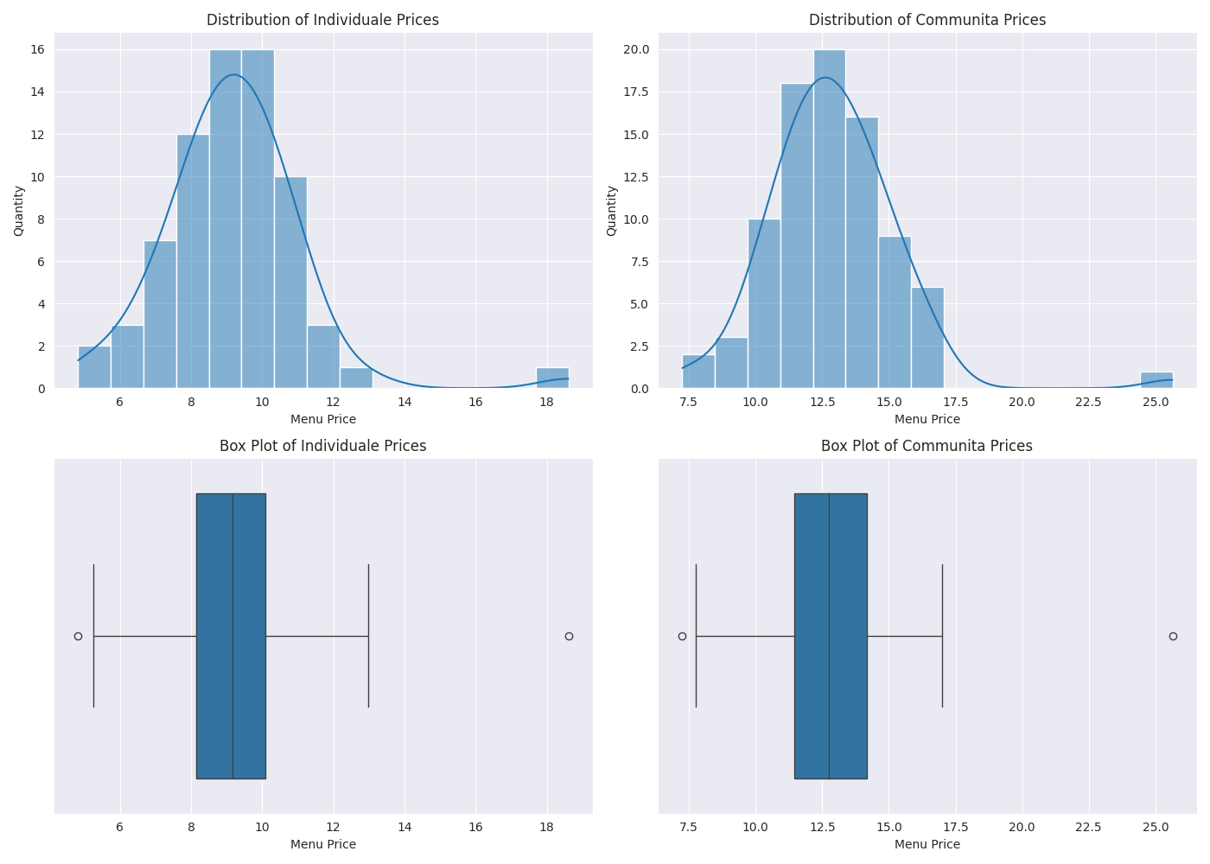
Exploratory Data Analysis

Slide 3
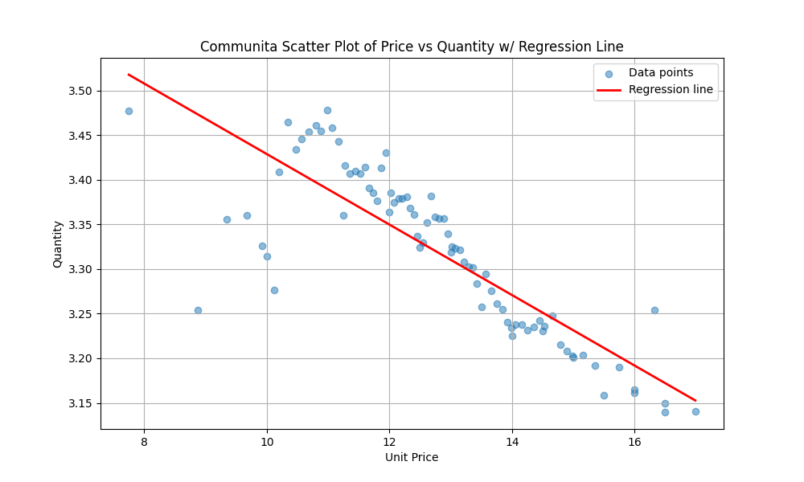
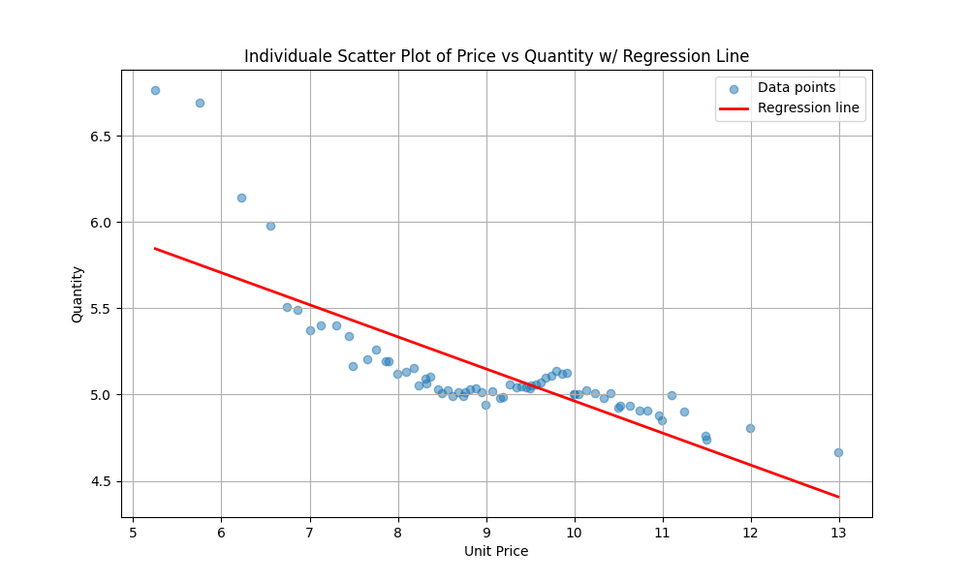
Relationship Between Product Price & Sales
Notes:
In general terms we can express price elasticity of demand algebraically as:
$$\text{PED} = \dfrac{\Delta{Q}/Q}{\Delta{P}/P}$$
Where:
- $\Delta{Q}$ is the change in quantity demanded.
- $Q$ is the initial quantity demanded.
- $\Delta{P}$ is the change in price.
- $P$ is the initial price.
In general, the slope of the regression line is negative, indicating that as price increases, quantity demanded decreases. There are special exceptions to this, such as Giffen goods, but in our case we expect PED to be quite elastic

Slide 4
Price Elasticity Comparison
Individuale: -0.3287256858579022
Communita: -0.1523560773619287
Comparison: Individuale is twice as price elastic as Communita
Notes:
The definition of Price Elasticity of demand is

Slide 5
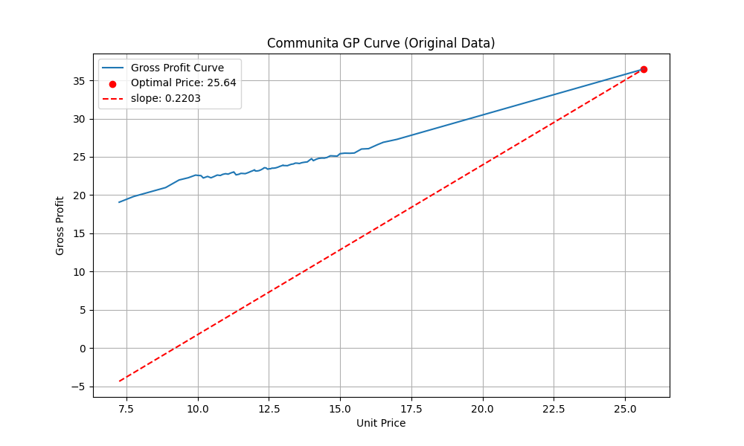
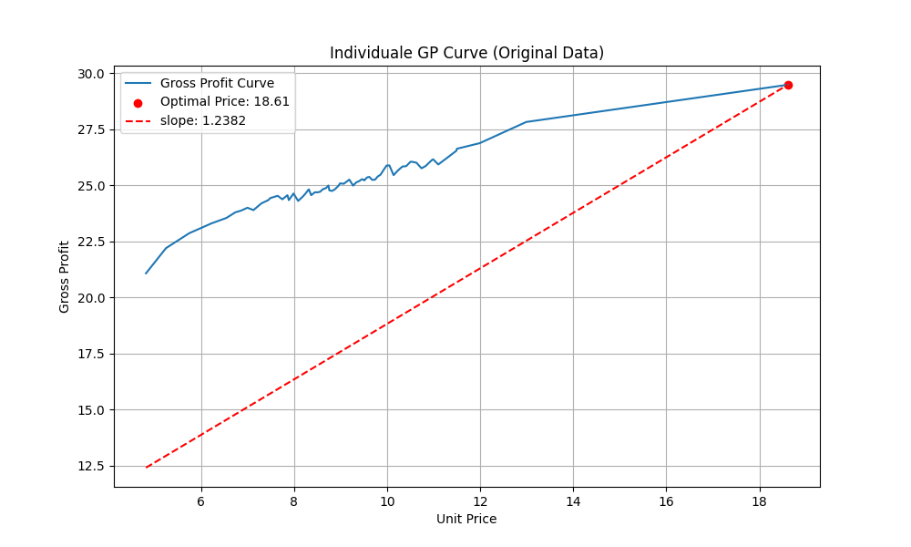
Finding the Optimal Price Point #1
Notes:
The gross profit, \( G \), is given by:
\[ G = (P - C) \times Q \]
where:
- \( P \) is the unit price,
- \( C \) is the unit cost,
- \( Q \) is the quantity sold.
To find the optimal price point, we need to take the second derivative of the gross profit function and set it to zero.
1. First Derivative: Calculate the first derivative of the gross profit function with respect to the price:
\[ G'(P) = \frac{d}{dP} \left( (P - C) \times Q \right) \]
2. Second Derivative: Calculate the second derivative of the gross profit function \[ G''(P) = \frac{d^2}{dP^2} \left( (P - C) \times Q \right) \]
3. Set the Second Derivative to Zero: Solve for \( P \) when the second derivative is equal to zero to find the optimal price:
\[ G''(P) = 0 \]
This means that the second derivative, which is tangential to the gross
profit curve, has a slope of zero, it indicates the maximum point of the curve. By solving this equation, we can determine the price $P$ that maximises the gross profit.
You'll note something interesting about these plots. The optimal price
point based on this is the maximum value of Menu_Price.
Further, the second derivative is not zero.
Both points indicate that we have not achieve the optimal price point, as our dataset is limited to the range of prices in the dataset.

Slide 6
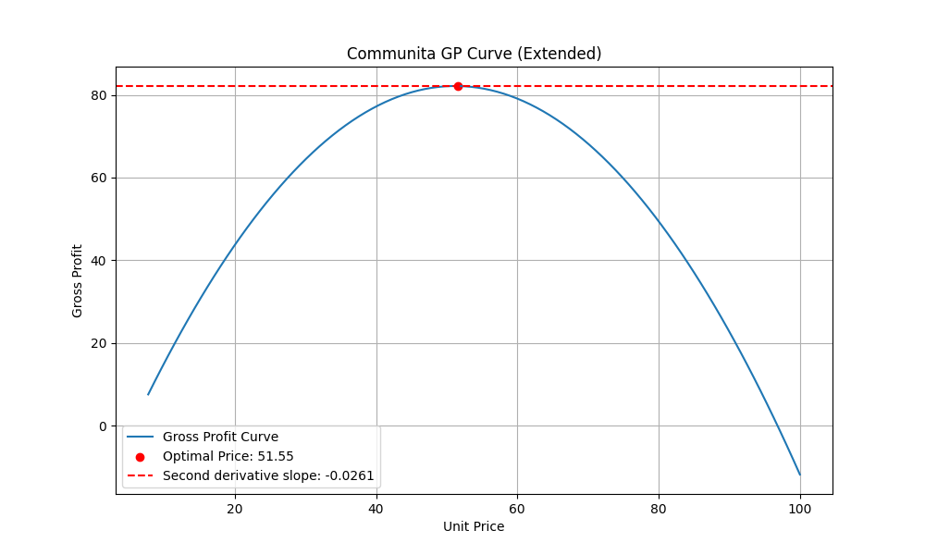
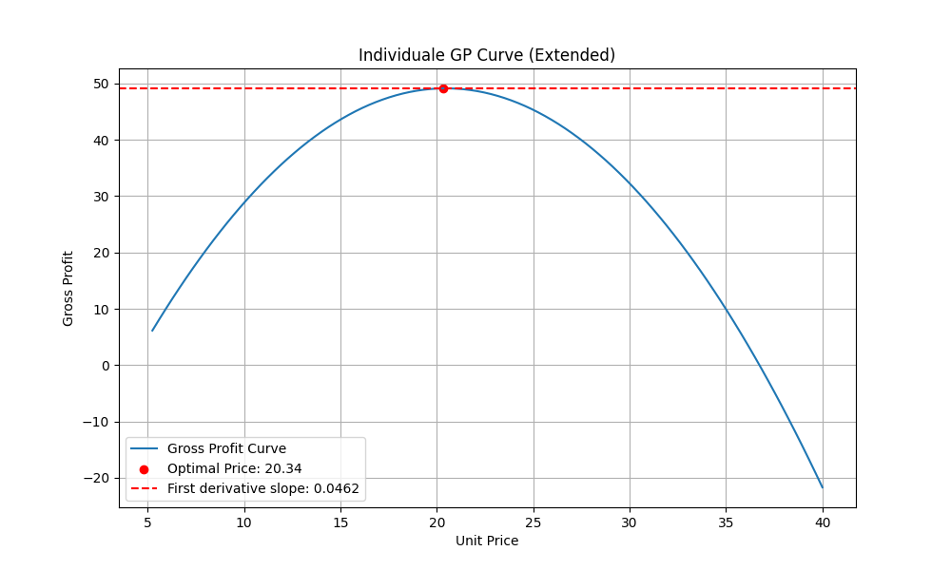
Finding the Optimal Price #2
Notes:
If we extend our predictions based on our equation, we start to see plots that make sense. We can see that it predicts that the optimal price point falls outside the range of prices captured in the dataset.
We have to be really careful about making predictions outside the range. At this point we should at most note this for further investigation and strongly suggest proper A/B testing, which we'll discuss in the next section.

Slide 7
Insights for Growth
Experiment
Understand Costs & Units Sold
More Data
With More Features
Test Different Models

Slide 8
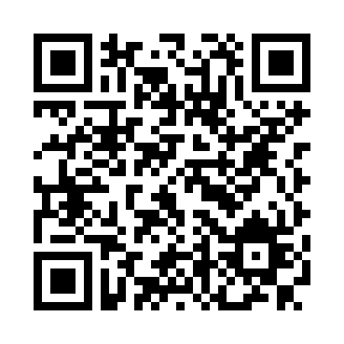
GitHub Repository

