Slide 1
Analysis of Product Pricing & Sales
Subtitle: Insights & Recommendations
Presenter: Michael Kingston
Date: 7th August 2024
Objective: Maximize gross profit

Slide 2
Summary of data provided
 | Samples | Avg Price ($) | Avg Qty | Sales ($) | Qty Sold | GP ($)
Ind | 71 | 9.09 | 5.14 | 3,300.72 | 365 | 1,782.03
Comm | 85 | 12.80 | 3.32 | 3,614.80 | 275.41 | 1,977.24
Total | 156 |  | 8.46 | 6,915.52 | 640 | 3,759.27
Notes:
Price elasticity of demand measures how the quantity sold of a good changes in response to a change in its price.
This table is important because it establishes a baseline against which we’ll compare our results

Slide 3
Assumptions
Sam’s Pizza is the only pizza retailer
The total number of transactions does not change
Only price and quantity change
Consumer preferences remain constant
Notes:
Assumptions
- Sam's Pizza is the Only Pizza Seller Available
- Reasoning: We lack data on competitors, so we assume a monopoly for Sam's Pizza.
- Validity: This simplifies the model by eliminating market competition variables. While not realistic, it's appropriate given the constraints.
- Total Number of Transactions Remains Constant
- Reasoning: We assume that consumers have already decided to purchase pizza, and the primary variables is the quantity purchased at different prices.
- Substitutes: We lack data on substitutes (e.g., burgers), so we assume the decision is between different quantities of pizza from Sam's Pizza.
Only Price and Quantity Change
- Reasoning: All other variables (e.g., marketing efforts, economic conditions) are held constant to isolate the effect of price changes on quantity demanded.
Consumer Preferences and Behaviors Remain Constant
- Reasoning: We assume that consumer preferences, tastes, and behaviors do not change during the period of analysis.
- Validity: This is a common assumption in short-term studies but may not hold in the long term.

Slide 4
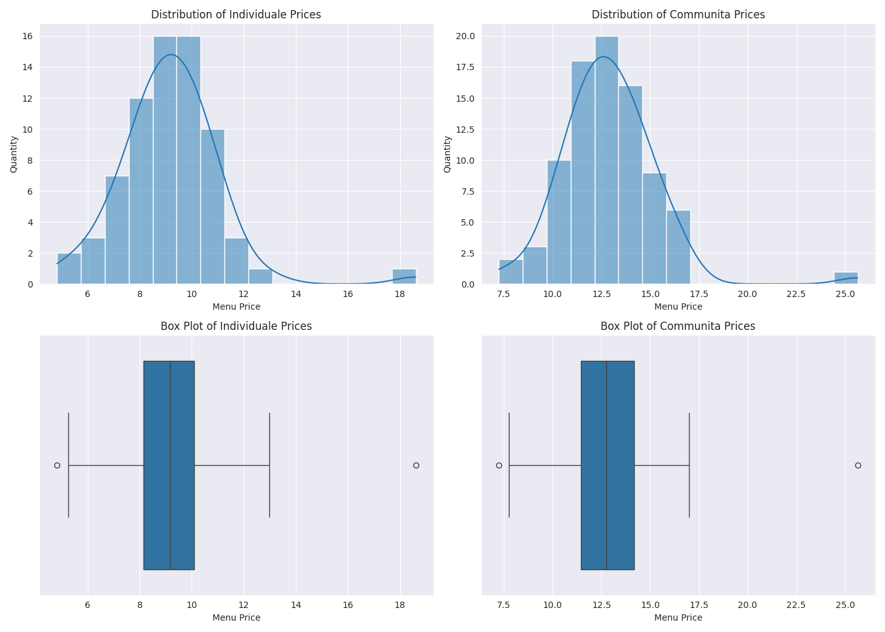
Exploratory Data Analysis
Notes:
We can see evidence of outliers, skewness and kurtosis and we need to deal with these before modelling

Slide 5
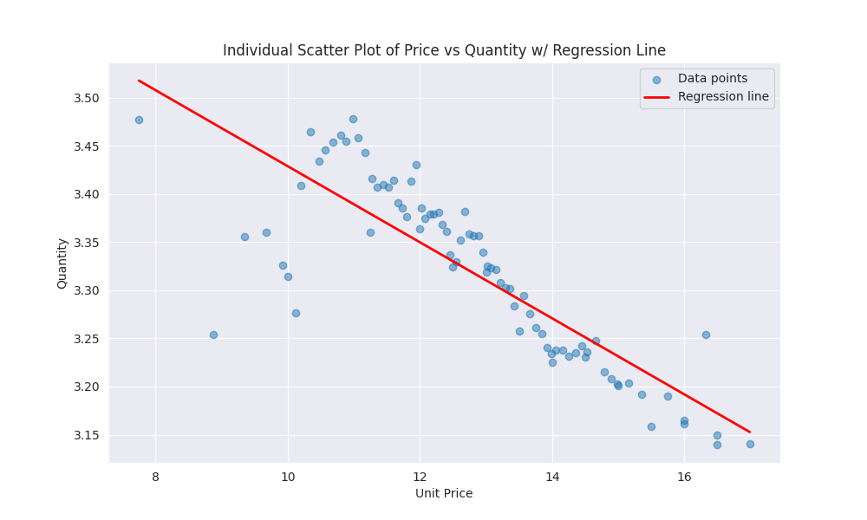
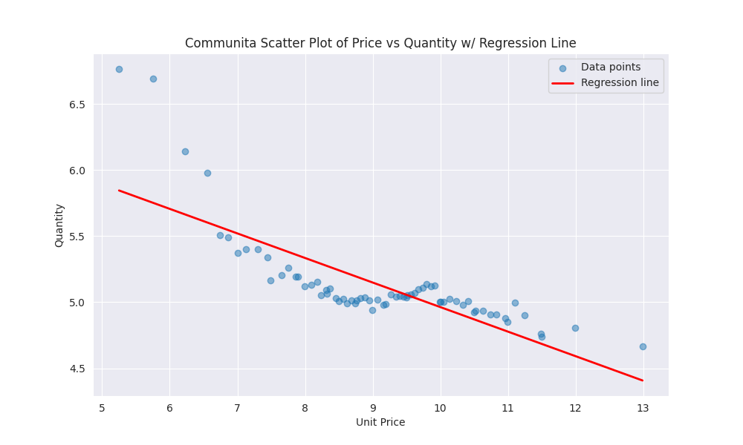
Relationship Between Product Price & Quantity Sold
Notes:
In general terms we can express price elasticity of demand algebraically as the change in quantity resulting from 1 unit change in price,
In general, the slope of the regression line is negative, indicating that as price increases, quantity demanded decreases.
There are special exceptions to this, such as Giffen goods, but in our case we expect PED to be quite elastic.

Slide 6
Price Elasticity Comparison
Individuale: -0.3287
Communita: -0.1524
Comparison: Individuale is twice as price elastic as Communita

Slide 7
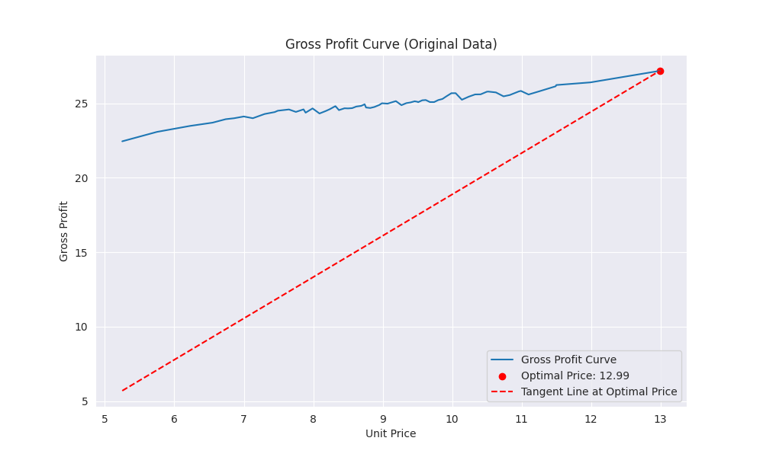
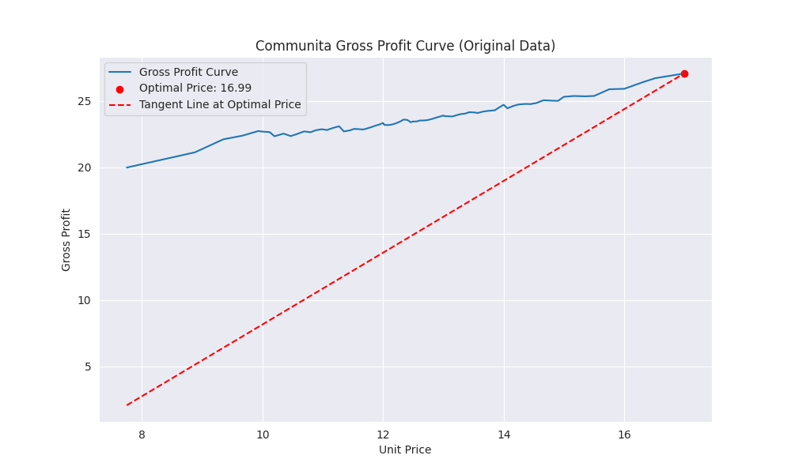
Finding the Optimal Price Point #1
Notes:
The gross profit, calculation is: (cost - price) x quantity sold
To find the optimal price point, we need to take the first derivative of the gross profit function and set it to zero.
You'll note something interesting about these plots. The optimal price
point based on this is the maximum value of Menu_Price.
Further, the second derivative is not zero.
Both points indicate that we have not achieve the optimal price point, as our dataset is limited to the range of prices in the dataset.

Slide 8

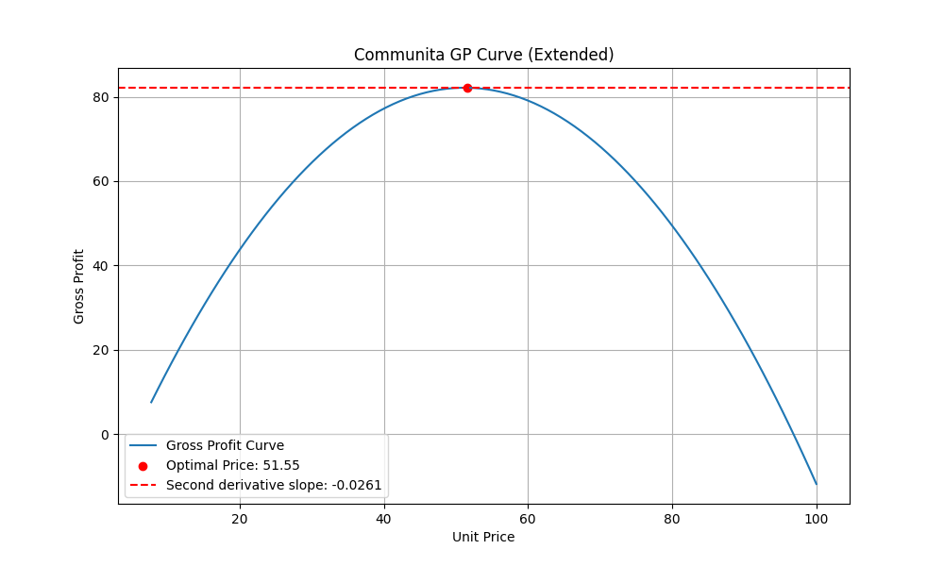
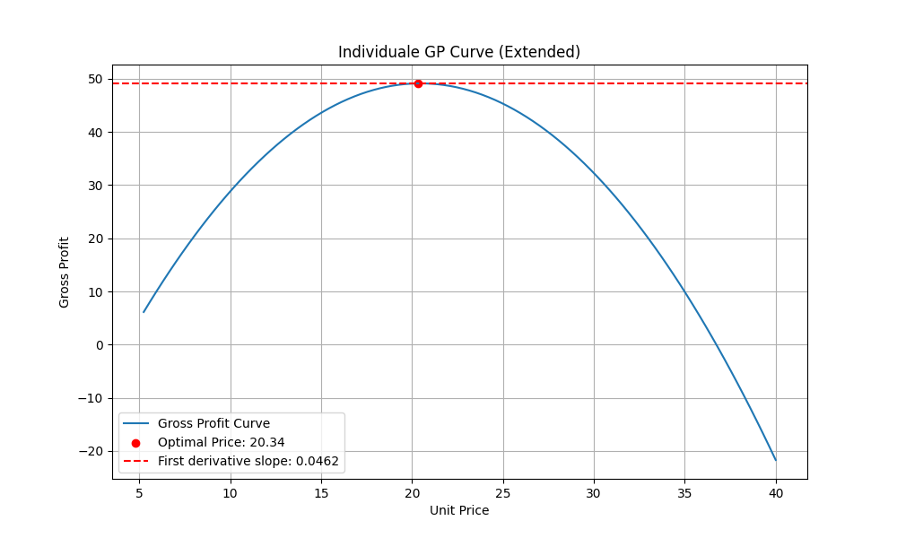
Finding the Optimal Price #2
Notes:
If we extend our predictions based on our equation, we start to see plots that make sense. We can see that it predicts that the optimal price point falls outside the range of prices captured in the dataset.
We have to be really careful about making predictions outside the range. At this point we should at most note this for further investigation and strongly suggest proper A/B testing, which we'll discuss in the next section.

Slide 9
Recommendations
 | Samples | Recommended Price ($) | Avg qty | Sales ($) | Qty sold | Gross Profit ($) | Change ($)
Individuale | 71 | 12.99 | 4.41 | 4,067.30 | 313.11 | 1,930.49 | 148.46
Communita | 85 | 16.99 | 3 | 4,332.45 | 255 | 2,300.10 | 322.86
Total | 156 |  |  | 8399.75 | 568.11 | 4230.59 | 471.32
Notes:
As expected, when we compare our results from price optimisation for gross profit, we can see that
total sales ($) goes down,
total quantity sold goes down,
but gross profit goes up by more than 11.14%
Thus we’ve achieved our objective of increasing gross profit by optimising price.
However, as evidenced by the previous slide, I believe that we can improve further by performing some experiments, ie A/B testing

Slide 10
Insights for Growth & Improvement
Experiment
Understand Costs & Units Sold
More Data
With More Features
Test Different Models
Notes:
We should test some of the implications of extending our inference beyond sample, by performing A/B testing
Many of the assumptions stated at the beginning of this presentation are unrealistic and can be addressed by building a dataset with more features that allow us to explore other drivers of price elasticity
With more data we can take a more sophisticated approach that better reflects all the variables that make up market dynamics and consumer decision making.
Cost dynamics need further analysis. I had expected to see that costs were constant however they are not. This needs to be investigated

Slide 11

GitHub Repository

