Slide 1
Staying Organized Across Machines
PRACTICAL WORKFLOWS FOR DATA SCIENTISTS WITH BUSY BRAINS
Morgana Kinlan
Senior Strategic Services Analyst, DeepSeas
Founder, Tell-Tale Data, LLC

Slide 2
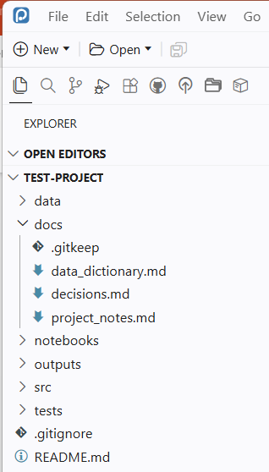
Steps in a nutshell
Download from GitHub
Adjust folders to your style
Set parent directory
Load with devtools
Run new_project command
End up with this

Slide 3
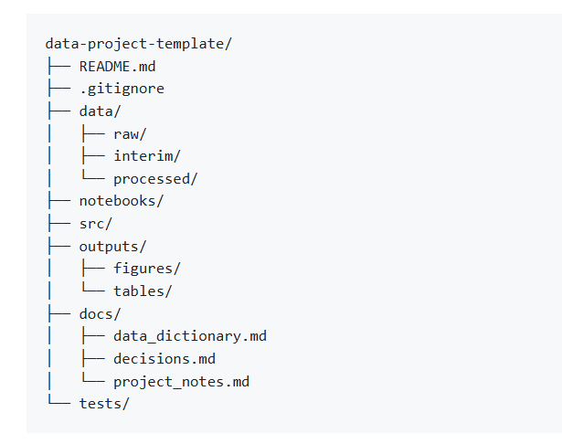
myTemplates
Local package for use in Positron to create this (or any) repeatable folder structure

Slide 4
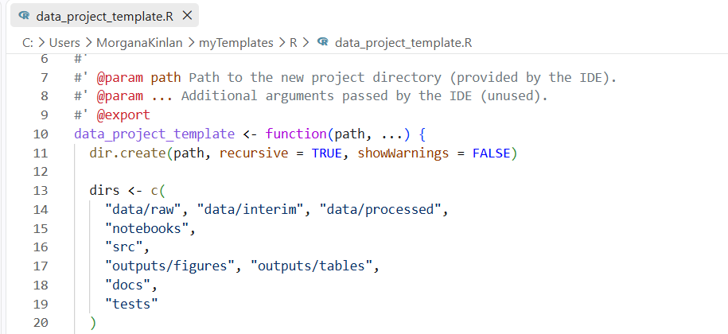
Installation
Download package from GitHub and unzip somewhere permanent (Ex. “C:/Users/YourName”)
Make any folder structure changes in this file

Slide 5
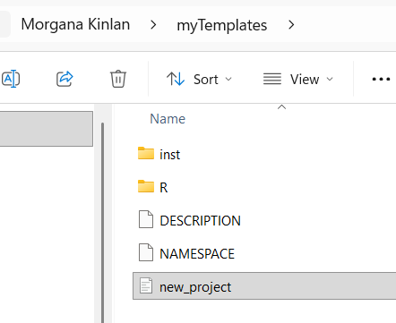
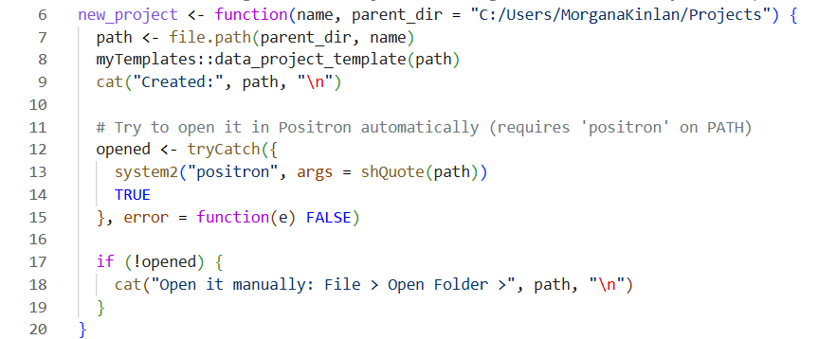
Installation
Download package from GitHub and unzip somewhere permanent (Ex. “C:/Users/YourName”) then
Add to your .Rprofile so it’s loaded automatically every time R starts
2. Update your parent directory in the helper script “new_project.R”

Slide 6
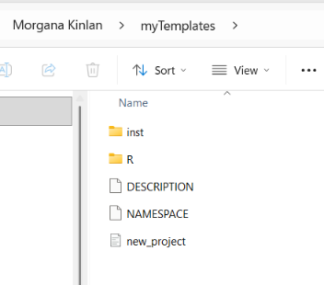
usage
In Positron console, run devtools::install("C:/Users/YourName/myTemplates")
Then run new_project(“name-of-your-project”)
Activates the helper script “new_project.R”

Slide 7
Result

