Slide 1
Global optimization software library for research and education Nadia Udler
Created for students and researchers
Has its roots in potential theory
Optimization methods with desired properties are created based on basic modules, by varying parameters of generalized algorithm
Allows
to design optimization methods with guaranteed convergence but without the use of derivatives of objective function
to compare existing optimization methods
to understand principles of learning algorithms
to design custom variations or hybrids of known heuristic optimization methods.

Slide 2
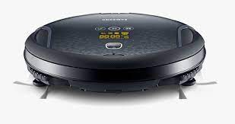




Selecting cleaning strategy
Example 1 : Vacuum cleaners
Goal: cover the entire surface
Possible strategies
Spiral-like motion from inside
30-degrees zigzag-like motion
Spiral-like motion from inside
90-degrees zigzag-like motion

Slide 3

Selecting cleaning strategy
Example 1 : Vacuum cleaners
Question: How to choose a strategy

Slide 4
Selecting cleaning strategy
Example 1 : Vacuum cleaners
Question: How to choose a strategy
Possible Answer:
1. Let user to navigate the vacuum cleaner
2. Have several buttons on the vacuum cleaner to let the user to switch between the strategies (automatic VC)
3. Let vacuum cleaner choose the best strategy ( AI solution)

Slide 5
Selecting cleaning strategy
Example 1 : Vacuum cleaners
Do you have more questions
?

Slide 6
Selecting cleaning strategy
Example 1 : Vacuum cleaners
Question: what are important things to consider if the user has to come up with best strategy
What is the goal
What are the constraints
What is the surface
……
How easy is it to judge if selected strategy is the best? Or good enough? Or better than the other strategy? It would be nice to have a systematic approach to compare strategies!

Slide 7
Example 1 : Vacuum cleaners
Questions about first example?

Slide 8

Selecting optimal path
Example 2: find the best path down from the top of the mountain
Strategy 1
Strategy 2
Strategy 3

Slide 9

Selecting optimal path
Example 2: find the best path down from the top of the mountain
Strategy 1
Strategy 2
Strategy 3

Slide 10
Selecting optimal path
Question: what are important things to consider if the user has to come up with best strategy to come down from the top of the mountain
What is the goal
What are the constraints
What is the surface
……
How easy is it to judge if selected strategy is the best? Or good enough? Or better than the other strategy? It would be nice to have a systematic approach to compare strategies!

Slide 11
Our software
why
It would be nice to have a systematic approach to compare strategies!
It would be nice to have a way to teach someone to apply and compare such strategies!
how
Our software is based on the systematic approach to construct global optimization methods ( in other words, strategies)
Our software allows to construct your own strategy based on standard modules provided in the library

Slide 12
Next slides - More about our software

Slide 13
Global optimization software library
for research and education
Created for students and researchers
Has its roots in potential theory
Optimization methods with desired properties are created based on basic modules, by varying parameters of generalized algorithm
Allows:
to design optimization methods with guaranteed convergence but without the use
of derivatives of objective function
to compare existing optimization methods
to understand principles of learning algorithms
to design custom variations or hybrids of known heuristic optimization methods.

Slide 14
Connecting Introductory example
with general intent of our software MinPy
Optimization lies at the heart of machine learning and data science.
One of the most relevant problems in machine learning is automatic selection of optimization algorithm depending on the objective.
This is necessary in many applications such as robotics, simulating biological or chemical processes, trading strategies optimization, to name a few.

Slide 15
Connecting Introductory example
with general intent of our software MinPy
Optimization methods in this library work with all objectives including very onerous ones, such as black box functions and functions given by computer code, and the convergence of methods is guaranteed.

Slide 16
Connecting Introductory example
with general intent of our software MinPy
This library allows to create customized derivative free learning algorithms with desired properties by combining building blocks from this library or other Python libraries.

Slide 17
MinPy code Organization
Minimization – most important class in MinPy.
Its methods are building blocks for creating your own optimization strategies.
Attributes Methods
dim
distribution
initial_guess
n_max_iterations
n_points
objective_function
step_size
tolerance
Initialize()
contract()
reflect()
shrink()
update_m()
update_c()
stop()

Slide 18
MinPy code Organization
A new strategy should be created as follows:
Create a class that inherits from Minimization class.
Add a method that implements your strategy. It should rely on building blocks from Minimization class that can be used as is or be overwritten.

Slide 19
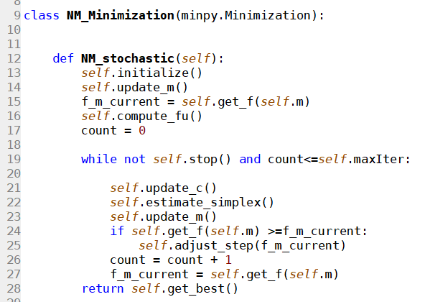
For example, below is the code that implements NM_minimization strategy

