Slide 1
Global optimization software library for research and education Nadia Udler
Created for students and researchers
Has its roots in potential theory
Optimization methods with desired properties are created based on basic modules, by varying parameters of generalized algorithm
Allows
to design optimization methods with guaranteed convergence but without the use of derivatives of objective function
to compare existing optimization methods
to understand principles of learning algorithms
to design custom variations or hybrids of known heuristic optimization methods.

Slide 2





Selecting cleaning strategy
Example 1 : Vacuum cleaners
Goal: cover the entire surface
Possible strategies
Spiral-like motion from inside
30-degrees zigzag-like motion
Spiral-like motion from inside
90-degrees zigzag-like motion

Slide 3

Selecting cleaning strategy
Example 1 : Vacuum cleaners
Question: How to choose a strategy

Slide 4
Selecting cleaning strategy
Example 1 : Vacuum cleaners
Question: How to choose a strategy
Possible Answer:
1. Let user to navigate the vacuum cleaner
2. Have several buttons on the vacuum cleaner to let the user to switch between the strategies (automatic VC)
3. Let vacuum cleaner choose the best strategy ( AI solution)

Slide 5
Selecting cleaning strategy
Example 1 : Vacuum cleaners
Do you have more questions
?

Slide 6
Selecting cleaning strategy
Example 1 : Vacuum cleaners
Question: what are important things to consider if the user has to come up with best strategy
What is the goal
What are the constraints
What is the surface
……
How easy is it to judge if selected strategy is the best? Or good enough? Or better than the other strategy? It would be nice to have a systematic approach to compare strategies!

Slide 7
Example 1 : Vacuum cleaners
Questions about first example?

Slide 8

Selecting optimal path
Example 2: find the best path down from the top of the mountain
Strategy 1
Strategy 2
Strategy 3

Slide 9

Selecting optimal path
Example 2: find the best path down from the top of the mountain
Strategy 1
Strategy 2
Strategy 3

Slide 10
Selecting optimal path
Question: what are important things to consider if the user has to come up with best strategy to come down from the top of the mountain
What is the goal
What are the constraints
What is the surface
……
How easy is it to judge if selected strategy is the best? Or good enough? Or better than the other strategy? It would be nice to have a systematic approach to compare strategies!

Slide 11
Our software
why
It would be nice to have a systematic approach to compare strategies!
It would be nice to have a way to teach someone to apply and compare such strategies!
how
Our software is based on the systematic approach to construct global optimization methods ( in other words, strategies)
Our software allows to construct your own strategy based on standard modules provided in the library

Slide 12
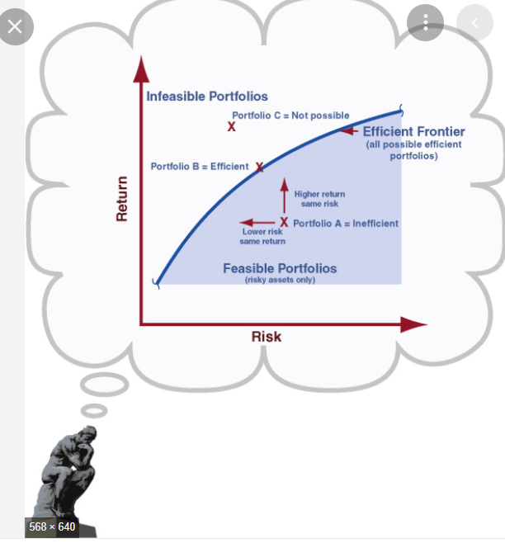
Real word example from finance
More complicated ( 100+ dimensions)
Portfolio Selection
(standard problem in investment)
In portfolio selection one finds/compares investment strategies systematically!
Our software can do this, too!

Slide 13
What is portfolio selection
The portfolio selection problem is concerned with finding an optimal portfolio x of assets from a given set of n risky assets out of a pre-specified asset universe such that the requirements of the respective investor are met. In general, investors seek to optimize their portfolio in regard of the trade-off between return and risk, such that the meta optimization problem can be formulated as
minimize Risk(x)
maximize Return(x)
This bi-criteria optimization problem is commonly reduced to a single-criteria problem by just focusing on the risk and constraining the required mean, i.e. the investor sets a lower expected return target µ, minimize Risk(x) subject to Return(x) ≥ µ

Slide 14
What is portfolio selection
Measure of risk:
L1: Mean Absolute Deviation (MAD)
L2: Standard Deviation
Linf: Maxmin
Distribution based: VaR (value-at-Risk), CVaR (Expected shortfall), Omega
Entropy based: Rho
Risk Parity
Classical approach - Mean Variance Optimization
(Happy Marriage of L2 Risk and Assumption of Normality of Returns)
Portfolio Volatility as Measure of Risk
Returns of all market assets are assumed to be multivariate normal with the given vector of means and covariance matrix
Solution is easy to find

Slide 15
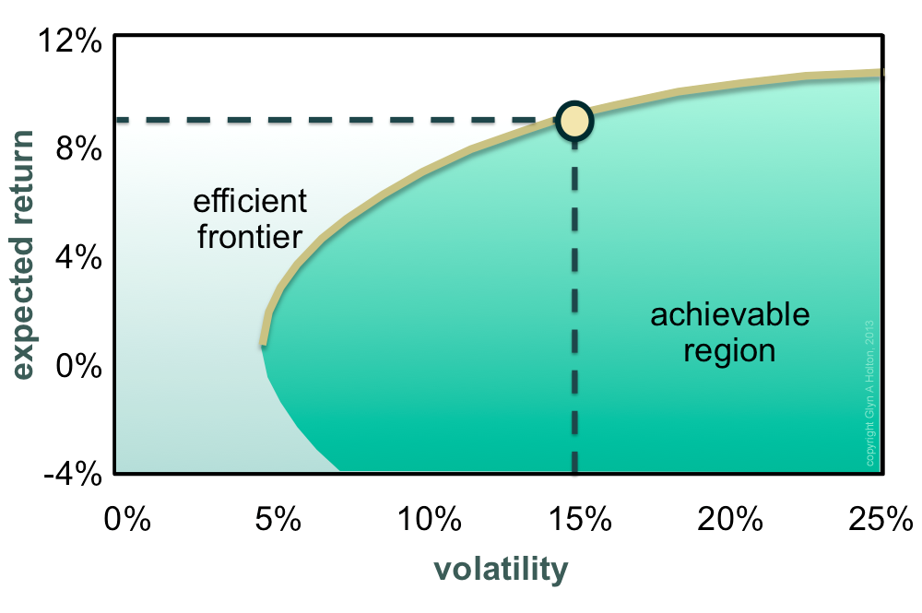
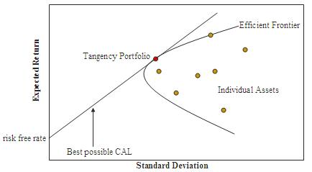
What is portfolio selection
Classical approach - Mean Variance Optimization
Markowitz bullet Tangency portfolio

Slide 16
What is portfolio selection
Classical approach - Mean Variance Optimization
Solving quadratic optimization problem poses numerical stability challenge!

Slide 17
What is portfolio selection
Ways to correct classical approach
Relax the assumptions of joint normality of returns (possibly take into account higher moments)
Use another risk measure, e.g. MAD, or CVAR
Switching to L1 doesn’t help much, portfolios obtained using estimates from a limited set of scenarios are still performing poorly…
One important technique used for practical portfolio purposes are risk-parity portfolios, where the assets are weighted such that they equally contribute risk to the overall risk of the portfolio.
Within this approach the focus is on allocation of risk, usually defined as volatility, rather than allocation of capital. The risk parity approach asserts that when asset allocations are adjusted (leveraged or deleveraged) to the same risk level, the risk parity portfolio can achieve a higher Sharpe ratio and can be more resistant to market downturns than the traditional portfolio.
Roughly speaking, the approach of building a risk parity portfolio is similar to creating a minimum-variance portfolio subject to the constraint that each asset (or asset class, such as bonds, stocks, real estate, etc.) contributes equally to the portfolio overall volatility.

Slide 18
What is portfolio selection
It is sometimes difficult to disentangle the formulation of an optimization problem and the technicalities of its solution
Approaches to portfolio optimization become more pragmatic: maybe we don’t need to seek the optimal solution, but rather find a good one…
As a result, there is a clear trend to use heuristic optimization methods, and we need a systematic way of generating and combining them…

Slide 19
Next slides - More about our software

Slide 20
Global optimization software library
for research and education
Created for students and researchers
Has its roots in potential theory
Optimization methods with desired properties are created based on basic modules, by varying parameters of generalized algorithm
Allows:
to design optimization methods with guaranteed convergence but without the use
of derivatives of objective function
to compare existing optimization methods
to understand principles of learning algorithms
to design custom variations or hybrids of known heuristic optimization methods.

Slide 21
Connecting Introductory example
with general intent of our software MinPy
Optimization lies at the heart of machine learning and data science.
One of the most relevant problems in machine learning is automatic selection of optimization algorithm depending on the objective.
This is necessary in many applications such as robotics, simulating biological or chemical processes, trading strategies optimization, to name a few.

Slide 22
Connecting Introductory example
with general intent of our software MinPy
Optimization methods in this library work with all objectives including very onerous ones, such as black box functions and functions given by computer code, and the convergence of methods is guaranteed.

Slide 23
Connecting Introductory example
with general intent of our software MinPy
This library allows to create customized derivative free learning algorithms with desired properties by combining building blocks from this library or other Python libraries.

Slide 24
MinPy code Organization
Minimization – most important class in MinPy.
Its methods are building blocks for creating your own optimization strategies.
Attributes Methods
dim
distribution
initial_guess
n_max_iterations
n_points
objective_function
step_size
tolerance
Initialize()
contract()
reflect()
shrink()
update_m()
update_c()
stop()

Slide 25
MinPy code Organization
A new strategy should be created as follows:
Create a class that inherits from Minimization class.
Add a method that implements your strategy. It should rely on building blocks from Minimization class that can be used as is or be overwritten.

Slide 26
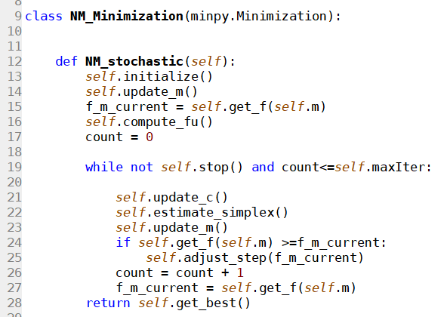
For example, below is the code that implements NM_minimization strategy

Slide 27
Optimization methods classification
LEGEND
Nelder Mead
Hooke Jeeves
SGD

Slide 28
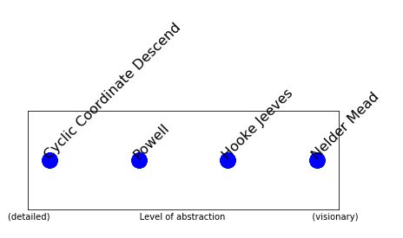
Multidimensional Direct Search Methods

Slide 29
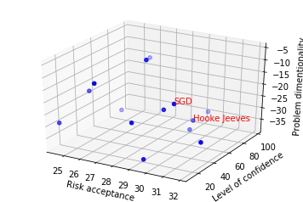
Optimization methods classification

