Slide 1
Global optimization software library for research and education Nadia Udler
Created for students and researchers
Has its roots in potential theory
Optimization methods with desired properties are created based on basic modules, by varying parameters of generalized algorithm
Allows
to design optimization methods with guaranteed convergence but without the use of derivatives of objective function
to compare existing optimization methods
to understand principles of learning algorithms
to design custom variations or hybrids of known heuristic optimization methods.

Slide 2
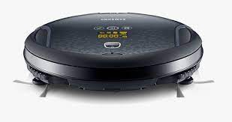




Selecting cleaning strategy
Example 1 : Vacuum cleaners
Goal: cover the entire surface
Possible strategies
Spiral-like motion from inside
30-degrees zigzag-like motion
Spiral-like motion from inside
90-degrees zigzag-like motion

Slide 3
Selecting cleaning strategy
Example 1 : Vacuum cleaners
Question: How to choose a strategy
Possible Answer:
1. Let user to navigate the vacuum cleaner
2. Have several buttons on the vacuum cleaner to let the user to switch between the strategies (automatic VC)
3. Let vacuum cleaner choose the best strategy ( AI solution)

Slide 4
Selecting cleaning strategy
Example 1 : Vacuum cleaners
Question: what are important things to consider if the user has to come up with best strategy
What is the goal
What are the constraints
What is the surface
……
How easy is it to judge if selected strategy is the best? Or good enough? Or better than the other strategy? It would be nice to have a systematic approach to compare strategies!

Slide 5
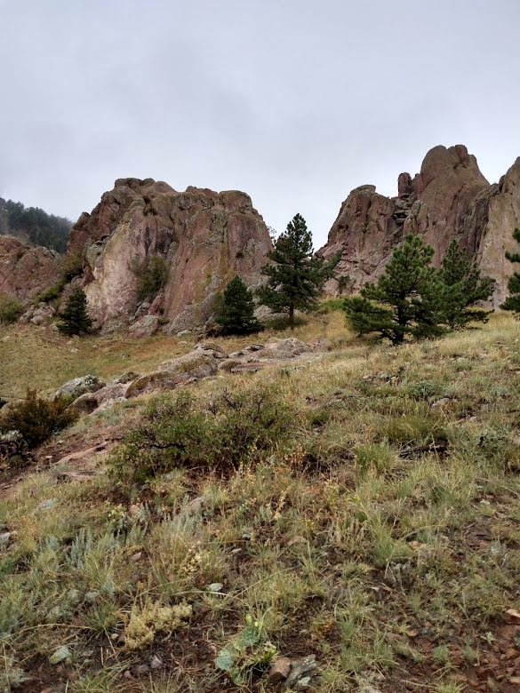
Selecting optimal path
Example 2: find the best path down from the top of the mountain
Strategy 1
Strategy 2
Strategy 3

Slide 6
Our software
why
It would be nice to have a systematic approach to compare strategies!
It would be nice to have a way to teach someone to apply and compare such strategies!
how
Our software is based on the systematic approach to construct global optimization methods ( in other words, strategies)
Our software allows to construct your own strategy based on standard modules provided in the library

Slide 7
Optimization Strategies Design

Slide 8
Optimization Strategies Design

Slide 9
Optimization Strategies Design
Construct optimization strategies based on systematic approach
Obtain the library of essential modules (parsimonious set of building blocks that comprise the foundation of any optimization strategy )
‘Generalized’ algorithm – consists of all building blocks in their full form
Example: arrive to well known heuristic strategy (Nelder and Mead algorithm, also called downhill simplex or polytope algorithm) by changing parameters of ‘generalized’ algorithm

Slide 10
Optimization Strategies Design
Construct machine learning strategies based on systematic approach (see [1] for derivation)
Obtain the library of essential modules (parsimonious set of building blocks that comprise the foundation of any optimization strategy )
‘Generalized’ algorithm – consists of all building blocks in their full form
Example: arrive to well known heuristic strategy (Nelder and Mead algorithm, also called downhill simplex or polytope algorithm) by changing parameters of ‘generalized’ algorithm

Slide 11
Optimization Strategies Design
Real world problems examples
robot parameter tuning, optimization of chemical processes
biological systems analysis
financial engineering:
model calibration,
pricing,
hedging,
VaR/CVaR computation,
credit rating assignment,
forecasting,
strategy optimization in electronic trading systems.

Slide 12
Optimization Strategies Design
What are the properties of good algorithms for decision making?
How to select the algorithm that satisfy your needs?
Things to consider:
type of the objective function
availability of a priori information (for example, data is available one a time)
constrains (such as budget)
Examples:
Genetic algorithm works well on multi modal smooth functions, does not require derivative information but is expensive (requires many function evaluations)
Nelder and Mead algorithm requires only few function evaluations and does not require derivatives of the objective function but has to be restarted from different points, to make sure the function domain is fully explored. It can be efficiently combined with random search. Nelder and Mead algorithm can work with ranked values of objective function (rather than with quantitative information)

Slide 13
Optimization Strategies Design
Parameters of optimization algorithms
Search direction
Step size
With / without memory
Examples:
Nelder and Mead algorithm – no memory
Shor r-algorithm – with memory

Slide 14
Building Blocks
Householder transformation (compare to reflections in Nelder and Mead algorithm),
Shor operator (operator of space dilation)
Rotation of the coordinate system (in variable metric algorithms, such as Covariance Matrix Adaptation and Shor r-algorithm, to achieve separability needed for parallel computations)
Automatic differentiation (computing derivatives of algorithmically defined functions, and thus applying methods of smooth optimisation to non smooth functions).

Slide 15
Building Blocks
Feasible direction search
Construction of penalty functions
Finding optimum function value (Chichinadze algorithm)
Decomposition of the vector field into potential and non divergent parts

Slide 16
Building Blocks
Newtonian potential
Smoothing: independent (convolution) and dependent variables
MLE/Stochastic approximation
Natural Gradient – substitute for gradient in stochastic gradient descent and similar algorithms

Slide 17
Nonlocal Optimization Methods Based on Potential Theory
Basics of the approach
Similar to one in smooth optimization but instead of the derivative of the objective function, the derivative of the so called potential function is used
Based on the randomization of the original problem
Directional derivative of the randomized functional is computed
Decomposition of the vector field into potential and non divergent part
The original problem of optimizing objective function is reduced to optimizing the potential function

Slide 18
Nonlocal Optimization Methods Based on Potential Theory
Advantages
New algorithms can be constructed using this framework by varying certain parameters.
The parameterization of optimization algorithms allows to create adaptive (automated) systems, where the selection of the optimization method is determined by the input data including, for example, availability of the information about the distribution or the class of the distributions, availability of derivatives, etc.
In some cases the derivatives of algorithmically defined functions can still be computed using automatic differentiation

Slide 19
Nonlocal Optimization Methods Based on Potential Theory
Advantages
If derivatives of objective function are available, they can be accommodated
Space dilation operator is obtained in the course of derivation, as corrective matrix in iterative algorithms
Obtain the extensions of well known optimization methods (Nelder and Mead, Tunnelling, Simulated Annealing, Covariance Matrix Adaptation Evolution Strategy, Natural Gradient Evolution Strategy) based on the generic framework

Slide 20
Nonlocal Optimization Methods Based on Potential Theory
The use of standard modules speeds up the development of the hybrids and ensures performance and reliability of the software
It allows the decision maker to construct the hybrids herself/himself, as it doesn't require extensive knowledge in statistics, linear algebra and stochastic calculus, necessary for development of optimization algorithms. Allows high school/college students to participate in the design of strategies

Slide 21
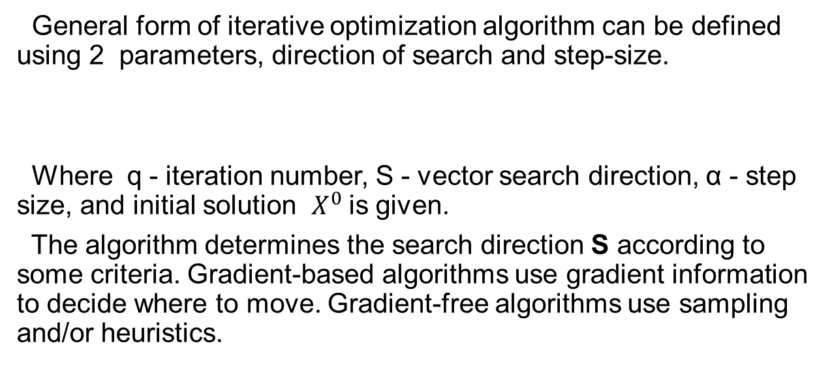
Smooth optimization reminder
General form of iterative optimization algorithm can be defined using 2 parameters, direction of search and step-size.
Where q - iteration number, S - vector search direction, α - step size, and initial solution $X^{0}$is given.
The algorithm determines the search direction S according to some criteria. Gradient-based algorithms use gradient information to decide where to move. Gradient-free algorithms use sampling and/or heuristics.

Slide 22

Smooth optimization reminder
Consider a function ,
the gradient of at a point $X^{0}$is a vector of length n
Each element in the vector is evaluated at the point $X^{0}$

Slide 23

Smooth optimization reminder
Hessian matrix: Consider a function ,
The second derivative of at a point $X^{0}$is a matrix of size nXn
Each element in the matrix is evaluated at the point $X^{0}$.

Slide 24
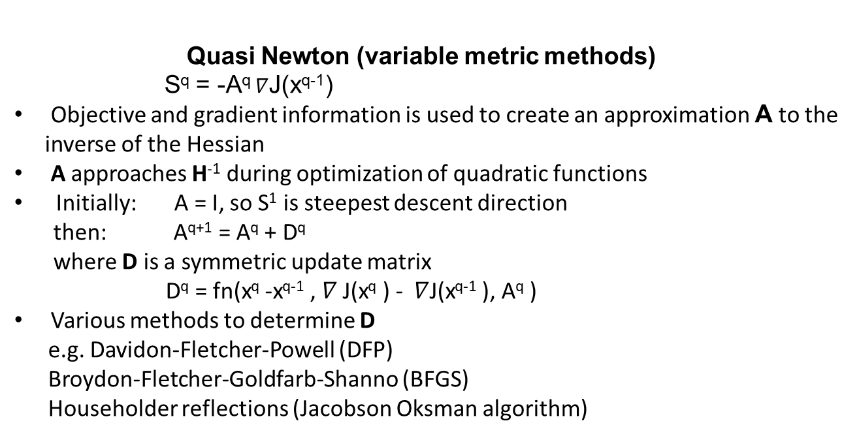
Smooth optimization reminder
Quasi Newton (variable metric methods)
S^{q} = -A^{q} $∇$J(x^{q-1})
Objective and gradient information is used to create an approximation A to the inverse of the Hessian
A approaches H⁻¹ during optimization of quadratic functions
Initially: A = I, so S¹ is steepest descent direction
then: A^{q+1} = A^{q} + D^{q}
where D is a symmetric update matrix
D^{q} = fn(x^{q} -x^{q-1} , $∇$ J(x^{q} ) - $∇$J(x^{q-1} ), A^{q} )
Various methods to determine D
e.g. Davidon-Fletcher-Powell (DFP)
Broydon-Fletcher-Goldfarb-Shanno (BFGS)
Householder reflections (Jacobson Oksman algorithm)

Slide 25
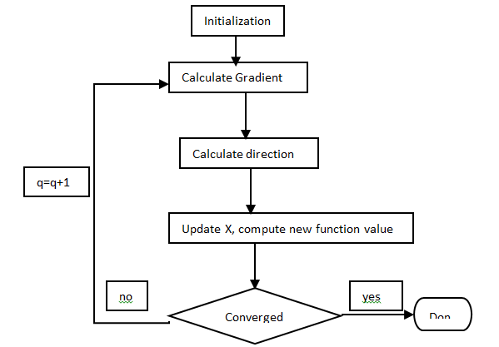
Smooth optimization reminder
Gradient-based optimization process:

Slide 26
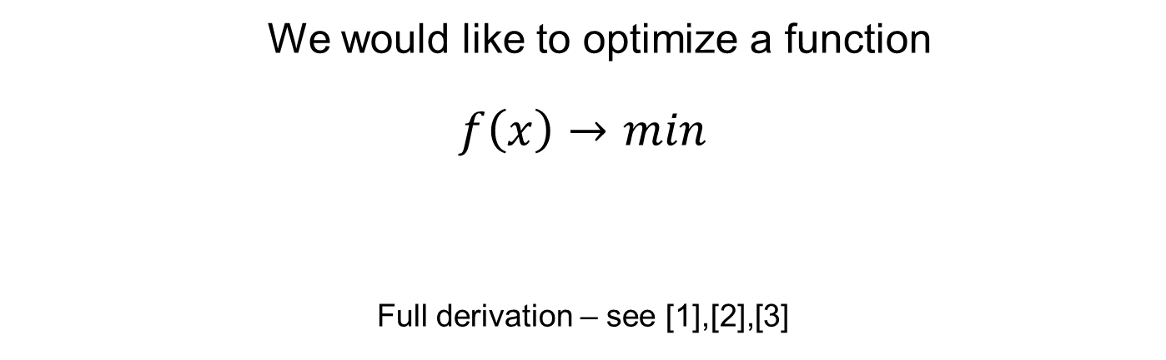
Derivation: Step1 - Initial Setup
We would like to optimize a function
$$f\left(x\right)→min$$
Full derivation – see [1],[2],[3]

Slide 27
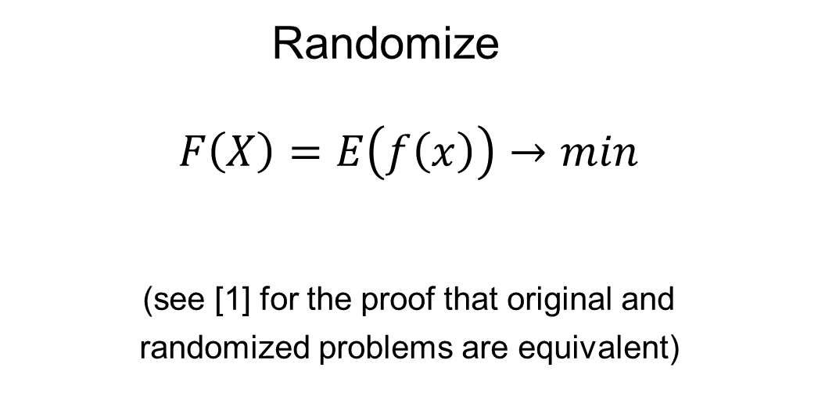
Derivation: Step 2 – Function Randomization
Randomize
$$F\left(X\right)=E\left(f\left(x\right)\right)→min$$
(see [1] for the proof that original and
randomized problems are equivalent)

Slide 28
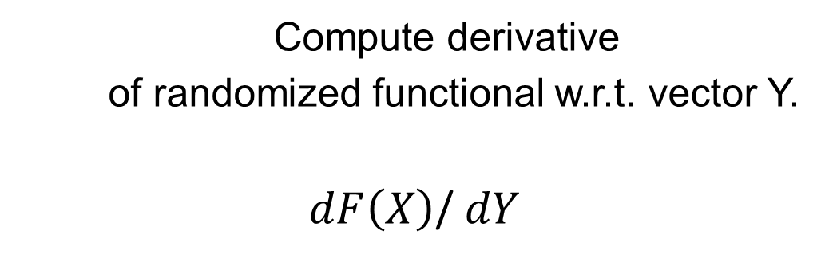
Derivation: Step3 – Compute Directional Derivative
Compute derivative
of randomized functional w.r.t. vector Y.
$dF\left(X\right)$/ $dY$

Slide 29

Derivation: Step 3 –
Compute Directional Derivative
Derivative of the target functional $F(X)$ in the direction of the random vector $Y$
at the point $X^{0}$is :
where $p_{x^{ε}}(x)$- density function of the random vector $X^{ε}$

Slide 30
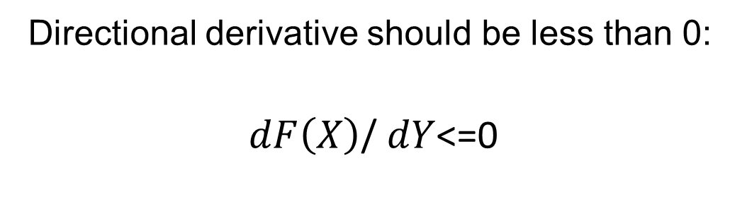
Derivation: Step 4 – Сondition for Сhoosing the Search Direction on the Next Iteration Step
Directional derivative should be less than 0:
$dF\left(X\right)$/ $dY$<=0

Slide 31
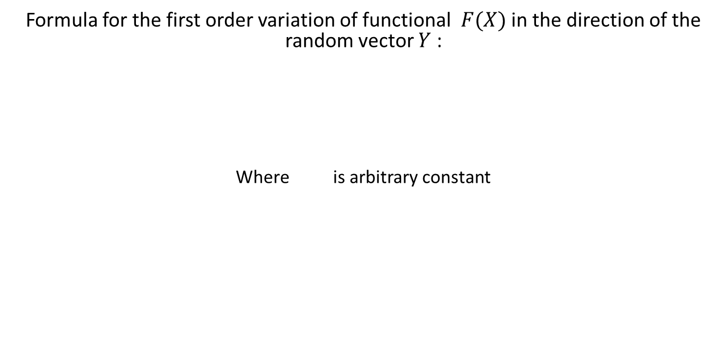
Derivation: Results
Formula for the first order variation of functional $F(X)$ in the direction of the random vector $Y$ :
Where is arbitrary constant

Slide 32
Algorithms for Nonsmooth Optimization
The iterative procedure in random vector space has the following form:
This rule of going from step N to step (N+1) of the algorithm can be written in distributional characteristics:
The estimation of the expectations in the formula above can be obtained from the following considerations:

Slide 33
Algorithms in Nonsmooth Optimization
Let us note that we can write
and then the rule of going from step n to step (n+1) in the optimization algorithms is
expectation of the vector Y can be estimated from the following
where - potential field

Slide 34
Algorithms in Nonsmooth Optimization
We can write
Where
is some statistical estimation of expectation.

Slide 35
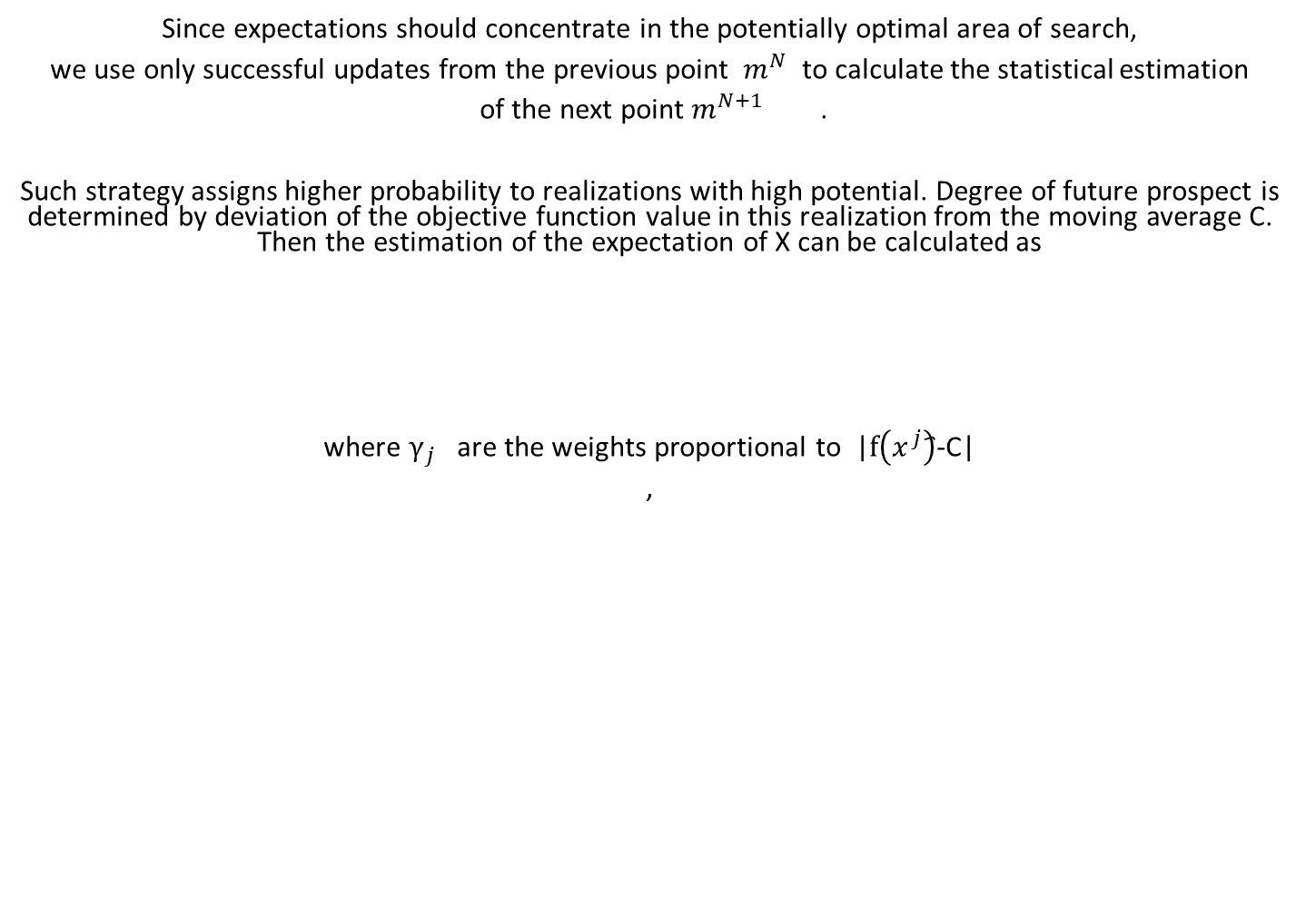
Algorithms in Nonsmooth Optimization
Since expectations should concentrate in the potentially optimal area of search,
we use only successful updates from the previous point $m^{N}$ to calculate the statistical estimation
of the next point $m^{N+1}$ .
Such strategy assigns higher probability to realizations with high potential. Degree of future prospect is determined by deviation of the objective function value in this realization from the moving average C. Then the estimation of the expectation of X can be calculated as
where $γ_{j}$ are the weights proportional to |$f\left(x^{j}\right)$҄-C|
,

Slide 36
Building Blocks and Analytical Techniques
Householder transformation,
Space dilation operator,
Rotation of the system of coordinates,
Separability,
Parallel computations

Slide 37
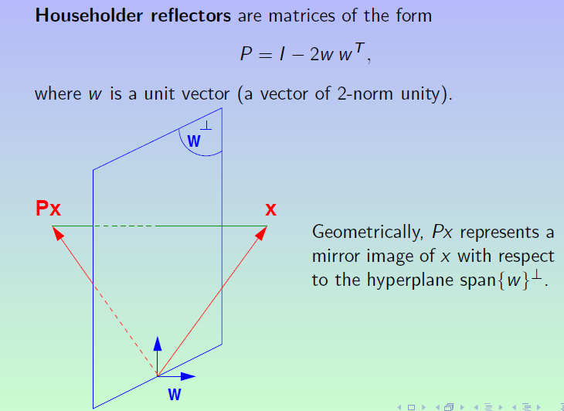
Householder Transformation

Slide 38
Householder Transformation
def householder(x):
x[0] = x[0] + np.sign(x[0]) * np.linalg.norm(x)
x /= np.linalg.norm(x)
return x

Slide 39
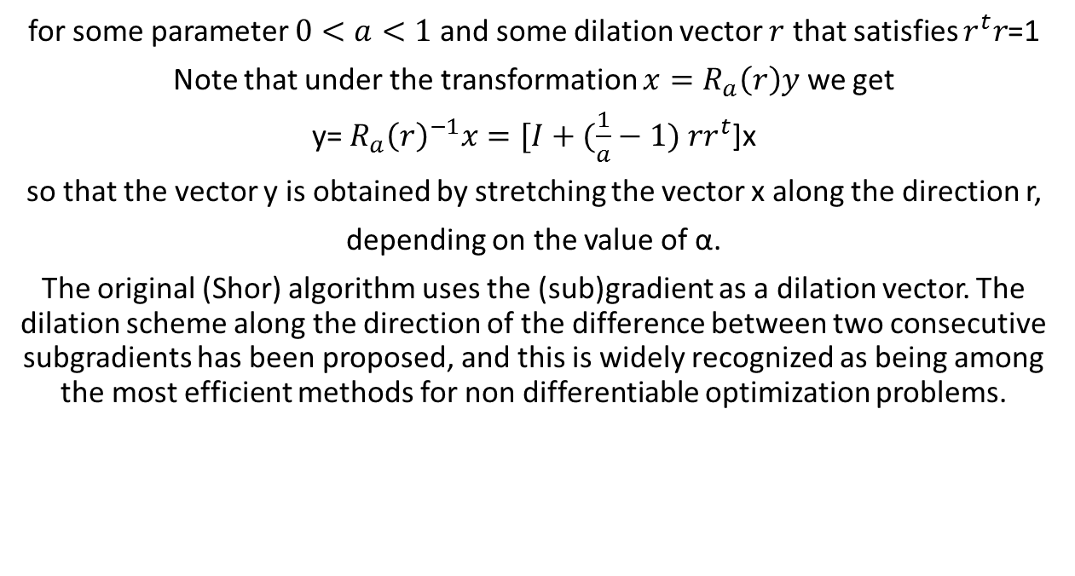
Space Dilation Operator
$$R_{a}\left(r\right)=I+(a−1)rr^{t}$$
for some parameter $0<a<1$and some dilation vector $r$ that satisfies $r^{t}r$=1
Note that under the transformation ${x=R}_{a}\left(r\right)y$ we get
y= ${R_{a}\left(r\right)}^{−1}x=[I+(\frac{1}{a}−1)$ $rr^{t}$]x
so that the vector y is obtained by stretching the vector x along the direction r,
depending on the value of α.
The original (Shor) algorithm uses the (sub)gradient as a dilation vector. The dilation scheme along the direction of the difference between two consecutive subgradients has been proposed, and this is widely recognized as being among the most efficient methods for non differentiable optimization problems.

Slide 40

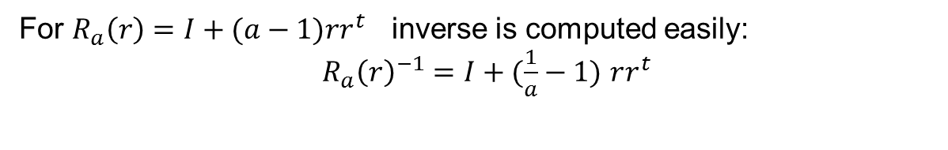
Space Dilation Operator
For $R_{a}\left(r\right)=I+(a−1)rr^{t}$ inverse is computed easily:
${{ R}_{a}\left(r\right)}^{−1}=I+(\frac{1}{a}−1)$ $rr^{t}$
when $a$=-1 we get Householder reflection
$R_{a}\left(r\right)=I−2rr^{t}$

Slide 41
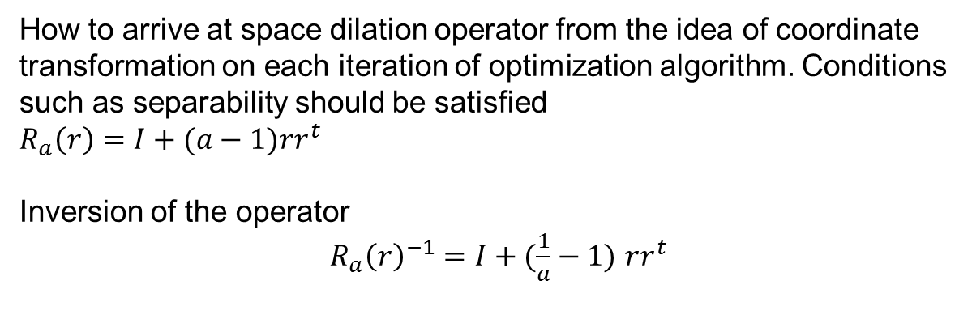
Space Dilation Operator
How to arrive at space dilation operator from the idea of coordinate transformation on each iteration of optimization algorithm. Conditions such as separability should be satisfied
$R_{a}\left(r\right)=I+(a−1)rr^{t}$
Inversion of the operator
${{ R}_{a}\left(r\right)}^{−1}=I+(\frac{1}{a}−1)$ $rr^{t}$

Slide 42
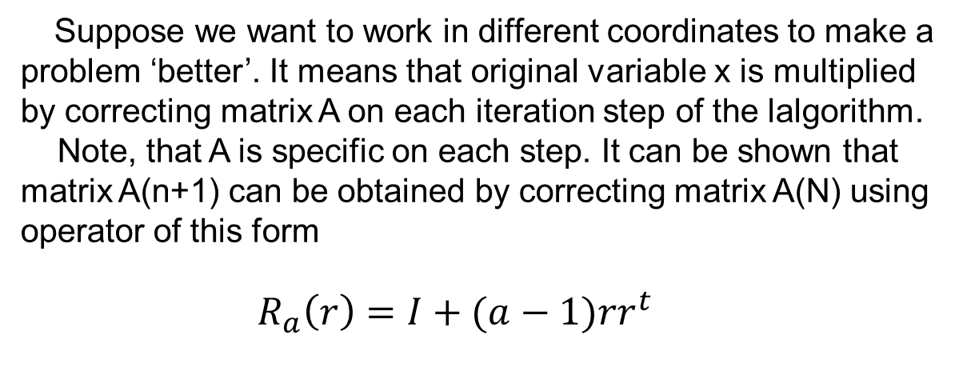
Space Dilation Operator
Suppose we want to work in different coordinates to make a problem ‘better’. It means that original variable x is multiplied by correcting matrix A on each iteration step of the lalgorithm.
Note, that A is specific on each step. It can be shown that matrix A(n+1) can be obtained by correcting matrix A(N) using operator of this form
${ R}_{a}\left(r\right)=I+(a−1)rr^{t}$

Slide 43

Additive Separability and Parallel Computations
Function of n variables $f\left(x_{1},x_{2}…x_{n}\right)$ is additively separable if it can be written as
$f\left(x_{1},x_{2}…x_{n}\right)=f_{1}$($x_{1}$)$+_{2}$($x_{2}$)+…${+f}_{n}$($x_{n}$)
To find minimum of separable function:
$minf\left(x_{1},x_{2}…x_{n}\right)={min⁡f}_{1}$($x_{1}$)+${minf}_{2}$($x_{2}$)+…+min$f_{n}$($x_{n}$)
The above expression shows that one-dimensional search procedures can be used in parallel to find minimum of each summand.

Slide 44
Additive Separability and Parallel Computations
transformation that makes an objective function separable or partially separable allows to carry out the optimization on smaller dimensions in parallel, which speeds up the optimization process and is considered one of the most effective methods to increase the efficiency of multi dimensional optimization.

Slide 45
Additive Separability
and Parallel Computations
One of the popular approaches used in modern software implementation is coordinate descent algorithm and its stochastic variations.
See for example [8,9]

Slide 46
Additive Separability and Parallel Computations
Sometimes it is possible to apply a transformation to the original variables and find the optimum value of the transformed function .
If the transformed function is separable, it will be easier to find minimum of the transformed function.
When the problem is solved the inverse transformation should be applied to find values of the original variables.

Slide 47

Additive Separability and Parallel Computations
The following example shows how to transform non-separable function of 2 variables f$\left(x_{1},x_{2}\right)$ = $x_{1}x_{2}$
Applying the following transformation to original variables
A=$\left({1/2 1/2 \atop 1/2 −1/2}\right)$
We get
$\left({1/2 1/2 \atop 1/2 −1/2}\right)$ $\left({x_{1} \atop x_{2}}\right)$ =$\left({{(x}_{1}{+x}_{2})/2 \atop {(x}_{2}{−x}_{1})/2}\right)$
Let $u$= ${(x}_{1}{+x}_{2})/2$, $v$= ${(x}_{1}{−x}_{2})/2$
Then $x_{1}=u+v$, ${ x}_{2}=u−v$ , $x_{1}x_{2}$= ($u+v)(u−v$)= $u^{2}$- $v^{2}$ g$\left(u,v\right)$ = $u^{2}$- $v^{2}$ is separable

Slide 48
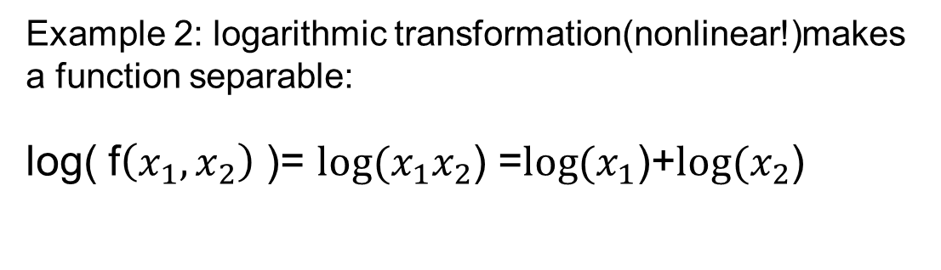
Additive Separability and Parallel Computations
Example 2: logarithmic transformation(nonlinear!)makes a function separable:
log( f$\left(x_{1},x_{2}\right)$ )= ${log⁡(x}_{1}x_{2}$) =${log⁡(x}_{1}$)+${log⁡(x}_{2}$)

Slide 49
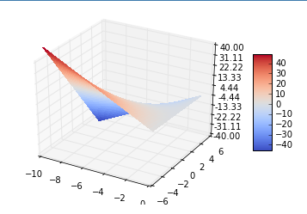
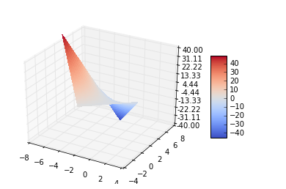

Additive Separability
and Parallel Computations
Look at the pictures:
variables ${ x}_{1}$ and ${ x}_{2}$ variables $u$ and $v$

Slide 50
Additive Separability and Parallel Computations
from mpl_toolkits.mplot3d import Axes3D
from matplotlib import cm
from matplotlib.ticker import LinearLocator, FormatStrFormatter
import matplotlib.pyplot as plt
import numpy as np
fig = plt.figure()
ax = fig.gca(projection='3d')
X = np.arange(-10, 0, 0.25)
Y = np.arange(-5, 5, 0.25)
X, Y = np.meshgrid(X, Y)
Z=X*Y

Slide 51
Additive Separability and Parallel Computations
#U=(Y+X)/2
#V=(Y-X)/2
Z = (U-V)*(U+V)
surf = ax.plot_surface(X, Y, Z, rstride=1, cstride=1, cmap=cm.coolwarm,
linewidth=0, antialiased=False)
#surf = ax.plot_surface(U,V, Z, rstride=1, cstride=1, cmap=cm.coolwarm,
# linewidth=0, antialiased=False)
ax.set_zlim(-40,40)
ax.zaxis.set_major_locator(LinearLocator(10))
ax.zaxis.set_major_formatter(FormatStrFormatter('%.02f'))
fig.colorbar(surf, shrink=0.5, aspect=5)
plt.show()

Slide 52
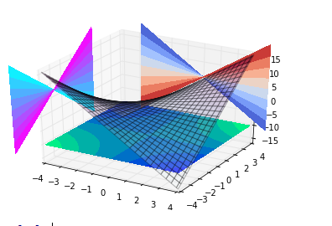
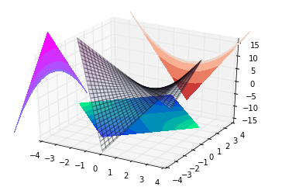

Additive Separability and Parallel Computations
Look at the pictures with contour lines:
variables ${ x}_{1}$ and ${ x}_{2}$ variables $u$ and $v$
contour lines are hyperbolas contour lines are parabolas
${ x}_{2}{ x}_{1}=const$ $u^{2}$+$v^{2}=const$

Slide 53
Additive Separability
and Parallel Computations
Let us look at the structure of transformation matrix that corrects the system of coordinate at each step of iteration procedure to make a function separable, rather than recomputes it.
Such procedure is suitable for adaptive algorithms – those that can accompodate new information at each step of the algorithm

Slide 54
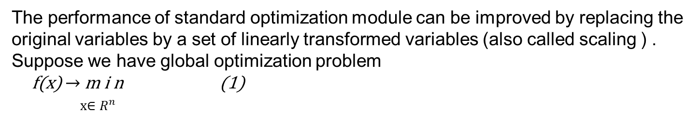
Change of Coordinates
The performance of standard optimization module can be improved by replacing the original variables by a set of linearly transformed variables (also called scaling ) .
Suppose we have global optimization problem
f(x) $→$ m i n (1)
x$∈R^{n}$
Let us assume that there exists the iterative gradient procedure which cannot be changed.(no source code available) .

Slide 55
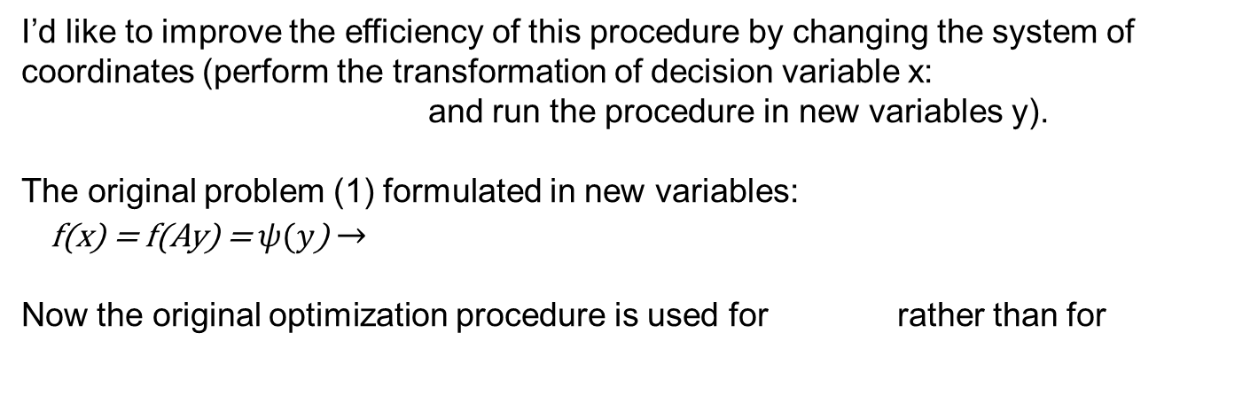
Change of Coordinates
I’d like to improve the efficiency of this procedure by changing the system of coordinates (perform the transformation of decision variable x:
and run the procedure in new variables y).
The original problem (1) formulated in new variables:
f(x) = f(Ay) = $ψ(y$) $→$
Now the original optimization procedure is used for rather than for

Slide 56
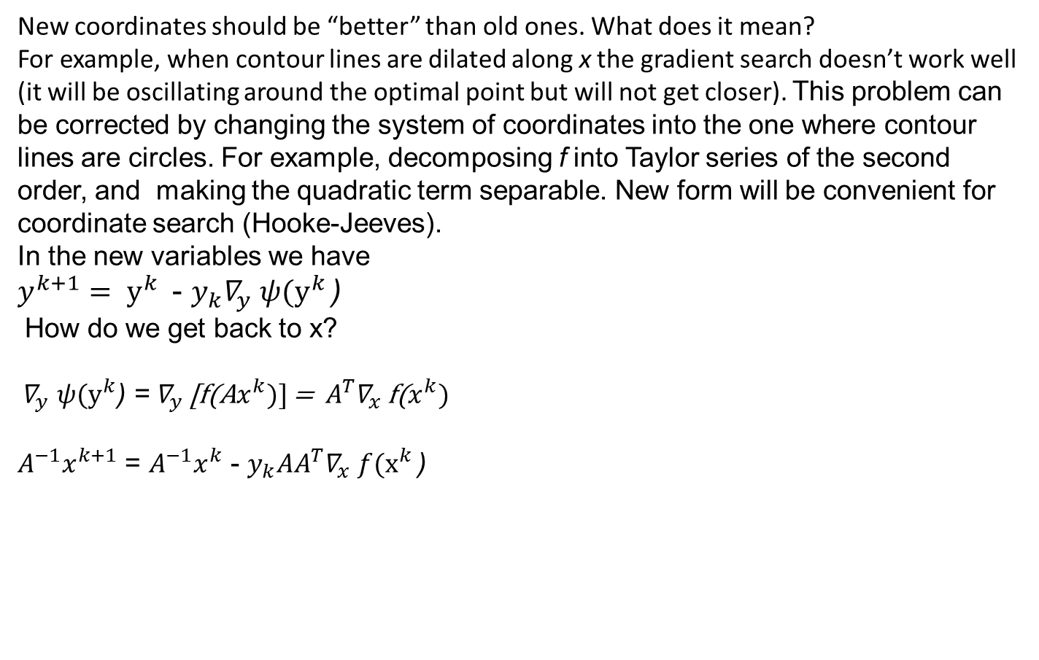
Change of Coordinates
New coordinates should be “better” than old ones. What does it mean?
For example, when contour lines are dilated along x the gradient search doesn’t work well (it will be oscillating around the optimal point but will not get closer). This problem can be corrected by changing the system of coordinates into the one where contour lines are circles. For example, decomposing f into Taylor series of the second order, and making the quadratic term separable. New form will be convenient for coordinate search (Hooke-Jeeves).
In the new variables we have
$y^{k+1}= y^{k }$ - $y_{k}∇_{y}$ $ψ(y^{k }$)
How do we get back to x?
$∇_{y}$ $ψ(y^{k}$) = $∇_{y}$ [f(A$x^{k})]$ = $A^{T}∇_{x}$f($x^{k})$
$A^{−1}x^{k+1}$ = $A^{−1}x^{k}$ - $y_{k}{AA^{T}∇}_{x}$ $f(x^{k }$)

Slide 57
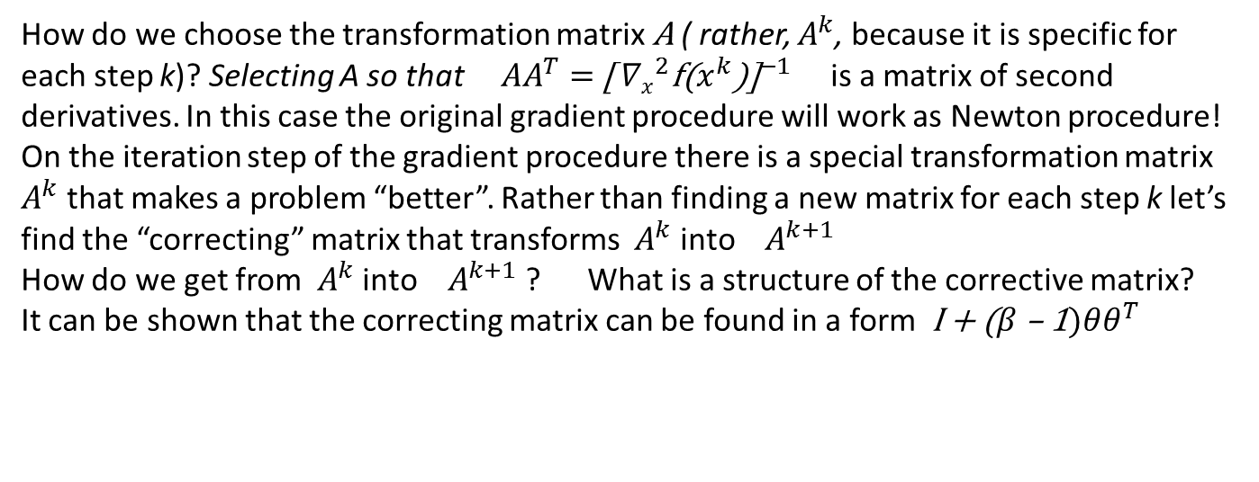
Change of Coordinates
How do we choose the transformation matrix A ( rather, $A^{k}$, because it is specific for each step k)? Selecting A so that $AA^{T}$ = ${\text{[}{ ∇x}_{}^{2}\text{f}\text{(}x^{k}\text{)]}}^{−1}$ is a matrix of second derivatives. In this case the original gradient procedure will work as Newton procedure!
On the iteration step of the gradient procedure there is a special transformation matrix $A^{k}$ that makes a problem “better”. Rather than finding a new matrix for each step k let’s find the “correcting” matrix that transforms $A^{k}$ into $A^{k+1}$
How do we get from $A^{k}$ into $A^{k+1}$ ? What is a structure of the corrective matrix?
It can be shown that the correcting matrix can be found in a form I + ($β$ – 1)$θθ^{T}$

Slide 58
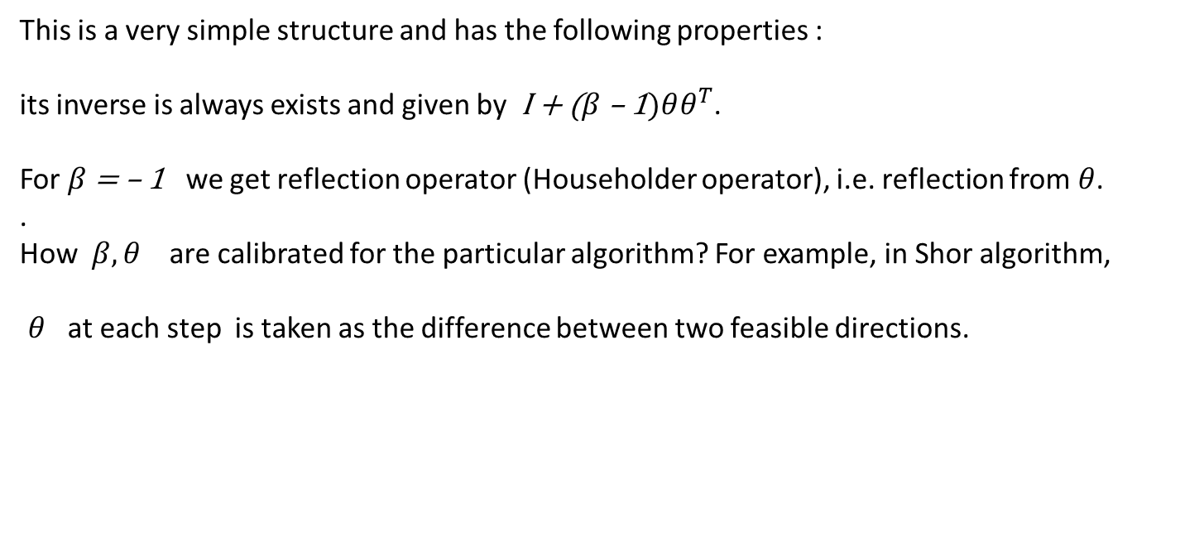
Change of Coordinates
This is a very simple structure and has the following properties :
its inverse is always exists and given by I + ($β$ – 1)$θθ^{T}$.
For $β$ = – 1 we get reflection operator (Householder operator), i.e. reflection from $θ$. .
How $β, θ$ are calibrated for the particular algorithm? For example, in Shor algorithm,
$θ$ at each step is taken as the difference between two feasible directions.

Slide 59
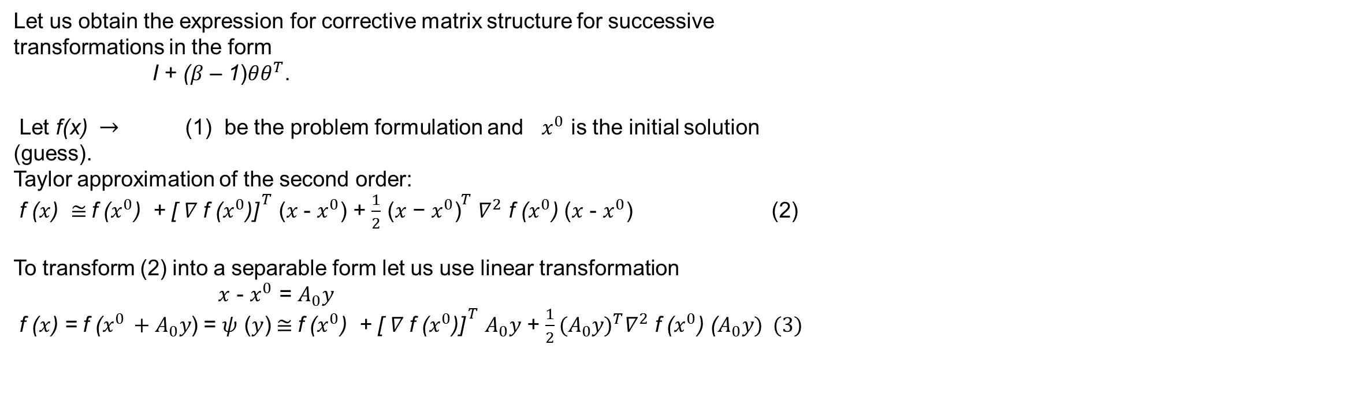
Change of Coordinates
Let us obtain the expression for corrective matrix structure for successive transformations in the form
I + ($β$ – 1)$θθ^{T}$.
Let f(x) $→$ (1) be the problem formulation and $x^{0}$ is the initial solution (guess).
Taylor approximation of the second order:
f ($x$) $≅$f ($x^{0}$) + ${\text{[ }∇ \text{f} \text{(}x^{0}\text{)]}}^{ T}$ ($x$ - $x^{0}$) + $\frac{1}{2}$ ${\text{(}x\text{ − }x^{0}\text{)}}^{T}$ $∇^{2}$ f ($x^{0}$) ($x$ - $x^{0}$) (2)
To transform (2) into a separable form let us use linear transformation
$x$ - $x^{0}$ = $A_{0}y$
f ($x$) = f ($x^{0 }+A_{0}y$) = $ψ$ ($y$)$≅$f ($x^{0}$) + ${\text{[ }∇ \text{f}\text{ (}x^{0}\text{)]}}^{ T}$ $A_{0}y$ + $\frac{1}{2}{{(A}_{0}y)}^{T}∇^{2}$ f ($x^{0}$) ($A_{0}y) (3)$

Slide 60
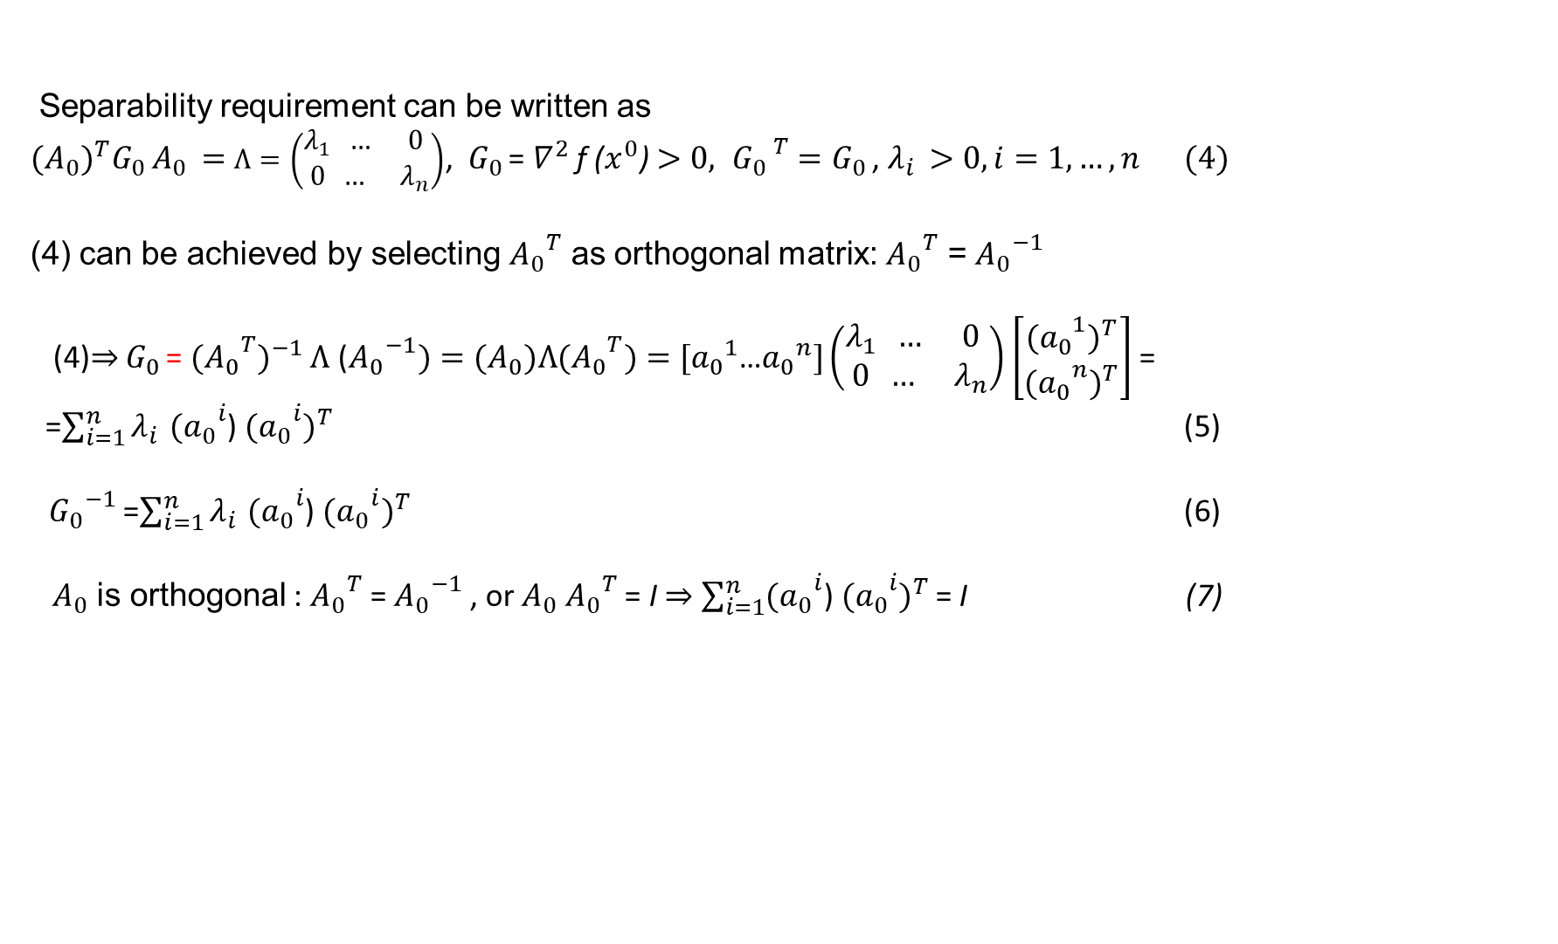
Change of Coordinates
Separability requirement can be written as
${{(A}_{0})}^{T}G_{0 }A_{0}$ $=$ $Λ=\left(\begin{matrix}λ_{1} … & 0 \\ 0 … & λ_{n}\end{matrix}\right)$, $G_{0 }$= $∇^{2}$ f ($x^{0}$) $>0, {G_{0 }}^{T}=G_{0 }$, $λ_{i }>0, i=1,…,n (4)$
(4) can be achieved by selecting ${A_{0}}^{T}$ as orthogonal matrix: ${A_{0}}^{T}$ = ${A_{0}}^{−1}$
(4)$⇒$ $G_{0 }$= ${{{(A}_{0}}^{T})}^{−1}$ $Λ$ (${A_{0}}^{−1})=(A_{0})Λ{{(A}_{0}}^{T})=[{a_{0}}^{1}$…${a_{0}}^{n}]\left(\begin{matrix}λ_{1} … & 0 \\ 0 … & λ_{n}\end{matrix}\right)$ $\left[\begin{matrix}{{{(a}_{0}}^{1})}^{T} \\ {{{(a}_{0}}^{n})}^{T}\end{matrix}\right]$ =
=$\sum_{i=1}^{n}{λ_{i }}{{(a}_{0}}^{i}$) ${{{(a}_{0}}^{i})}^{T}$ (5)
${G_{0}}^{−1}$ =$\sum_{i=1}^{n}{λ_{i }}{{(a}_{0}}^{i}$) ${{{(a}_{0}}^{i})}^{T}$ (6)
$A_{0}$ is orthogonal : ${A_{0}}^{T}$ = ${A_{0}}^{−1}$ , or $A_{0}$ ${A_{0}}^{T}$ = I $⇒$ $\sum_{i=1}^{n}{{{(a}_{0}}^{i}\text{) }{{{(a}_{0}}^{i})}^{T}}$ = I (7)
,
,

Slide 61
Change of Coordinates
We choose that , or
(8)

Slide 62
Change of Coordinates
Successive replacement (10)
shows that
the corrective matrix can be chosen as
(11)

Slide 63
Nelder and Mead Algorithm
import scipy.optimize
banana = lambda x: 100*(x[1]-x[0]**2)**2+(1-x[0])**2
xopt = scipy.optimize.fmin(func=banana, x0=[-1.2,1])
print (xopt)
Output
Optimization terminated successfully.
Current function value: 0.000000
Iterations: 85
Function evaluations: 159
[1.00002202 1.00004222]

Slide 64

Stochastic variants of Nelder and Mead
If we rely on one realization of random vector that is equal to the estimator of the mean then the above expression is rewritten as
Based on this equation we can construct the following algorithm
1. choose starting point and set . . Compute
2. on step i, obtain K realizations of random vector
3. compute , j=1,2..K and a sample mean
4. Generate the new estimate of such that by choosing he appropriate step size.
F it cannot be obtained within prespeciefied number of trials than set

Slide 65
Stochastic variants of Nelder and Mead
5. Termination criterion-sample standard deviation
Which is estimate of the derivative of F(X) along the gradient direction
Another algorithm (polytope-like) is based on the following formula
The above formula means that a new estimate for the mean of is the centroid of the polytope with vertices that depend on the previous step

Slide 66
Stochastic variants of Nelder and Mead
Algorithm2
1.initialization step:generate K separate realizations of the random vector
Set
2 on step I calculate new set of vertices
Set
Adjust step size so that
3.termination criterion

Slide 67
Previous Student Projects
Algorithmic differentiation (AD) – computing derivatives of algorithmically defined functions ( European option price is considered as an example, for which analytical derivatives are also available).
Logistic regression will be introduced in the tutorial through the simple examples. The advanced tutorial on application of logistic regression for estimating probability of default for the company is also available to the interested participants.
Optimization tools in Python – PyOpt,AlgoPy,SciPy.Optimize

Slide 68
Previous Student Projects
Application of genetic algorithms (GA) to equity trading (presented at Matlab Computational Finance conference in NY, 2014)
Tutorial on the use of Householder transformation in financial engineering
Weighted Monte Carlo simulations for exotic option pricing,
Python /AlgoPy framework for computing sensitivities of exotic options with non-differentiable payoffs,
Matlab / Machine Learning Toolbox SVM-based classification of market signals for pair trading (presented at Sigm Xi student conference in Connecticut, 2015)
Matlab / Machine Learning Toolbox SVM-based calibration of volatility surface for swaptions.

Slide 69
References
[1]Kaplinskii A.I., Propoi A.I., First-order nonlocal optimization methods that use potential theory, Automation and Remote Control , 1994, №7, pp.94-103.
[2]Kaplinskii A.I., Propoi A.I., Nonlocal optimization methods that use potential theory, Automation and Remote Control , 1993, №7, pp.55-66.
[3]Kaplinskii A.I., Propoi A.I., Second-order refinement conditions in nonlocal optimization methods that use potential theory, Automation and Remote Control , 1994, №8, pp.104-113.
[4]Prudnikov I.M., The Use of Certain Equations of Mathematical Physics in Optimization of a Function on a Set. I, Automation and Remote Control, 2002
[5] Distributed block coordinate descent for minimizing partially separable functions, Jakub Marecek, Peter Richtaric, Martin Takac , in “Recent Developments in Numerical Analysis and Optimization”, 2015
[6] An Asynchronous Parallel Stochastic Coordinate Descent Algorithm, Ji Liu, Stephen J. Wright , Journal of Machine Learning Research, 16, 2015, 285-322

